Slide 1

By: Jake Brand, Ben Brown, Brianna Corcoran, Mamadou Sall, Xiaoyue Sun

Slide 2
Colgate-Palmolive: The Consumer Goods Industry
Founded in 1806 by William Colgate in New York, Colgate
First products: Starch, Soap, and Candles
After 211 years of operating, Colgate has diversified its product line and distribution worldwide.
Colgate(Palmolive) has products focused on Oral Care, Personal Care, Home Care and Pet Nutrition in the United States and more 200 other countries.

Slide 3
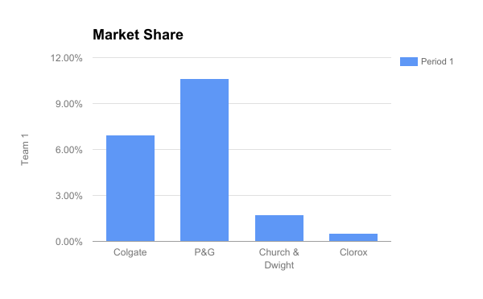
Competitors (Jake)
The Clorox Company
  Smallest Market Share
Procter & Gamble Company
  Largest Market Share
Church & Dwight Co.
  Third largest Market Share
Notes:
Church & Dwight: Arm & Hammer, Oxi Clean
P&G: Bounty, Crest, Gillette (everything, too many products to name)
Clorox: Bleach, Disinfecting wipes, etc
All are consumer products in competition, p&g is most direct competition bc they have a toothpaste/oral hygiene brand in crest

Slide 4

Porter’s Five Forces: Threat of New Entry
Threat of New Entry: Low
High Entry Barriers
Economies of Scale
Established Brand Image
Advanced Technology
High Start Up Cost
Notes:
cohesive and good status with suppliers/distributors
In 2001, technology had differentiated CP from its competitors. Leadership in promising toothpaste from solid to gel technology that delivers new brushing sensations.
n some segments within the household consumer-products industry, this may not be the case since a small manufacturer could develop a superior product, such as a detergent, and compete with Procter & Gamble. The test is whether the small manufacturer can get its products on the shelves of the same retailers as its much larger rivals. Verdict: Low threat of new entrants.

Slide 5

Porter’s Five Forces: Buyer’s Bargaining Power
Bargaining Power: High (Individual Customer and Retailer)
Price Sensitive Consumers
Consumers are Well-Educated Regarding Products
Substitutes are Available
Undifferentiated Products
Retailers are able to Negotiate
Notes:
(Xiaoyue)

Slide 6

Porter’s Five Forces: Supplier’s Bargaining Power
Bargaining Power: Low
Partnerships
Supply Chain Management
Training
Dependency
Notes:
suppliers that do a large amount of business with these companies

Slide 7
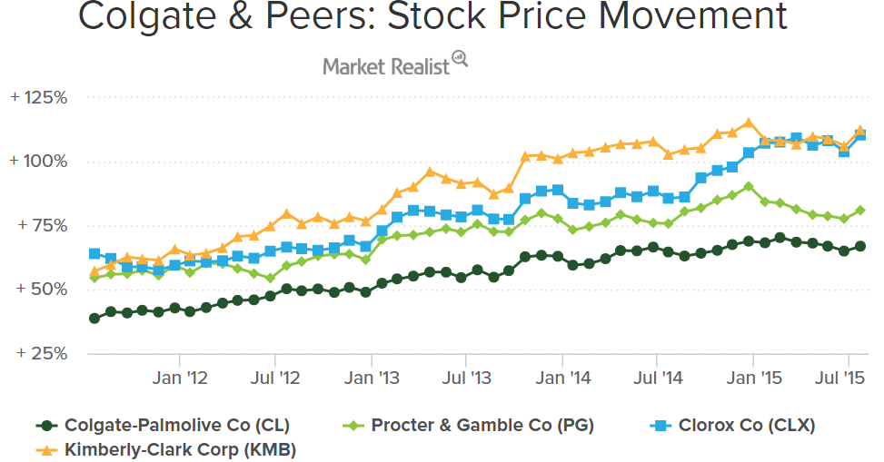
Porter’s Five Forces: Rivalry
Rivalry: Exists
Competition of Price
Low Switching Costs
Local and Global Competition

Slide 8
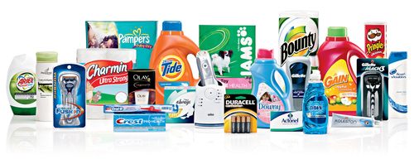
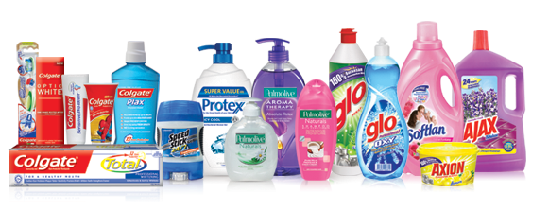
Porter’s Five Forces: Threat of Substitutes
Threat of Substitutes: High
Low Switching Cost
Buyers Impacted by Costs or Social/Political Factors
Cost Efficiency, NOT Differentiation
Substitute Store-Branded Private-Label Offerings Trend
Notes:
The threats of substitutes in which customers switch product references are primarily caused by several external and internal factors. One of the factors in which customers tend to switch their preferences is the price cost of a product. If a product raises its cost value, customers may have a second thought of sticking into as his/her preference; therefore, the tendency is that the shift and switch of preference occurred.
ome of these same store-brand private-label products are manufactured by the large consumer-products firms. The firms believe that if they can manufacture and package a lower-price alternative themselves, they would rather accept the marginal revenue from their lower-priced items than risk completely losing the sale to a private-label competitor.

Slide 9

Main Force on Industry Profitability
Rivalry:
Many Competitors in the Industry
Equal Size Operations
Undifferentiated Products
High Competition on Price
Target Market is Price Sensitive
Notes:
Consumers in this category enjoy a multitude of choices for everything from cleaning products to bath washes.

Slide 10

Overall Attractiveness of The Consumer Goods Industry
Overall Attractiveness: Low
High Barriers to Entry
Competitive Market
Many Substitutes
Heavily Impacted by Political and Economic Factors

Slide 11

General Environment
Technology
Online retailing
Customization of products (online)
Social Media Marketing
Analyze data trends to be more efficient
Notes:
General Industry trends affect the average profitability

Slide 12

General Environment cont.
Legal/Regulatory
Tax Cuts for Consumers
Trade Restrictions
Consumer Product Safety Act

Slide 13
Sources
https://www.slideshare.net/THIPPESHBABUSBsbthip/executive-summary-51857603
http://www.academia.edu/7882830/Market_segmentation_by_colgate
https://strategiccfo.com/buyer-bargaining-power-one-of-porters-five-forces/

