Slide 1
Anxiety Disorders
Chapter 5

Slide 2
Anxiety Disorders
Fear vs. anxiety

Slide 3
Anxiety Disorders
Fear vs. anxiety
Is anxiety useful? Fun??

Slide 4
Anxiety Disorders
Fear vs. anxiety
Is anxiety useful? Fun??
Anxiety disorder: too severe, too frequent, lasts too long, or too easily triggered

Slide 5
Anxiety Disorders
Fear vs. anxiety
Is anxiety useful? Fun??
Anxiety disorder: too severe, too frequent, lasts too long, or too easily triggered
Most common mental disorder: 18% prevalence, 29% lifetime prevalence. Only ~20% seek help

Slide 6
Anxiety Disorders
Fear vs. anxiety
Is anxiety useful? Fun??
Anxiety disorder: too severe, too frequent, lasts too long, or too easily triggered
Most common mental disorder: 18% incidence, 29% lifetime prevalence. Only ~20% seek help
Significant comorbidity: other anxiety disorders, depression

Slide 7
Anxiety Disorders
Fear vs. anxiety
Is anxiety useful? Fun??
Anxiety disorder: too severe, too frequent, lasts too long, or too easily triggered
Most common mental disorder: 18% incidence, 29% lifetime prevalence. Only ~20% seek help
Significant comorbidity: other anxiety disorders, depression
Most anxiety disorders more common in women than men

Slide 8
Generalized Anxiety Disorder

Slide 9
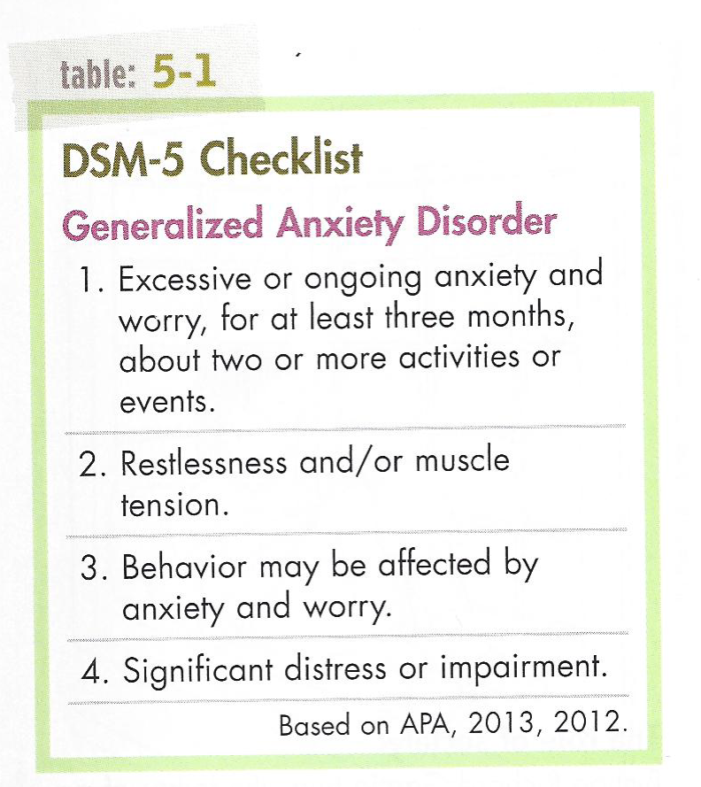
Generalized Anxiety Disorder

Slide 10
Generalized Anxiety Disorder
PsychPortal video

Slide 11
Generalized Anxiety Disorder
Etiology and treatments

Slide 12
Generalized Anxiety Disorder
Etiology and treatments
Sociocultural view: threatening environment. Treatment: Remove?

Slide 13
Generalized Anxiety Disorder
Etiology and treatments
Sociocultural view: threatening environment. Treatment: Remove?
Psychodynamic view: prevented from or punished for expressing id impulses, and/or weak defense mechanisms. Treatment: Become more comfortable with and/or control id impulses

Slide 14
Generalized Anxiety Disorder
Etiology and treatments
Sociocultural view: threatening environment. Treatment: Remove?
Psychodynamic view: prevented from or punished for expressing id impulses, and/or weak defense mechanisms. Treatment: Become more comfortable with and/or control id impulses
Humanistic view: did not receive unconditional positive regard. Treatment: Offer acceptance

Slide 15
Generalized Anxiety Disorder
Etiology and treatments
Sociocultural view: threatening environment. Treatment: Remove?
Psychodynamic view: prevented from or punished for expressing id impulses, and/or weak defense mechanisms. Treatment: Become more comfortable with and/or control id impulses
Humanistic view: did not receive unconditional positive regard. Treatment: Offer acceptance
Cognitive view: irrational assumptions. Treatment: challenge assumptions and increase rational thinking

Slide 16
Generalized Anxiety Disorder
Etiology and treatments
Sociocultural view: threatening environment. Treatment: Remove?
Psychodynamic view: prevented from or punished for expressing id impulses, and/or weak defense mechanisms. Treatment: Become more comfortable with and/or control id impulses
Humanistic view: did not receive unconditional positive regard. Treatment: Offer acceptance
Cognitive view: irrational assumptions. Treatment: challenge assumptions and increase rational thinking
Biological view: not enough GABA messages sent, and/or anxiety circuit in brain. Treatment: sedative drugs, relaxation training, biofeedback

Slide 17
Phobias

Slide 18
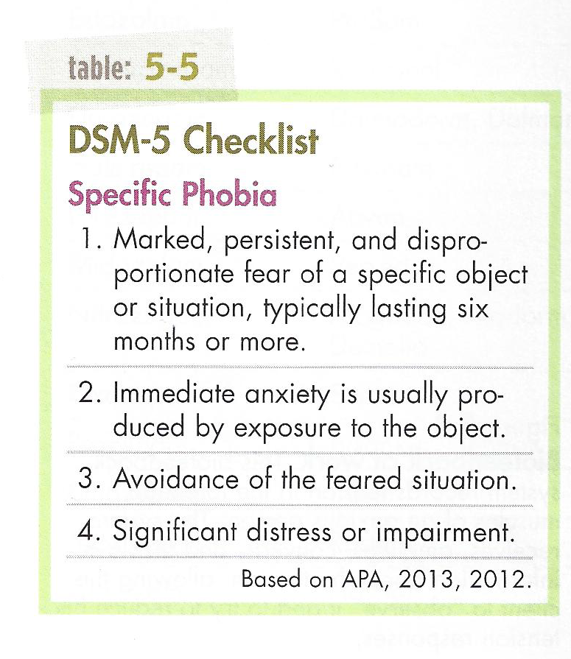
Phobias

Slide 19
Phobias
Specific phobia – etiology and treatment
Behavioral view: fears are learned through conditioning or modeling and maintained through avoidance

Slide 20
Phobias
Specific phobia – etiology and treatment
Behavioral view: fears are learned through conditioning or modeling and maintained through avoidance. Treatment: Exposure, through systematic desensitization or flooding

Slide 21
Phobias
Specific phobia – etiology and treatment
Behavioral view: fears are learned through conditioning or modeling and maintained through avoidance. Treatment: Exposure, through systematic desensitization or flooding
Agoraphobia

Slide 22
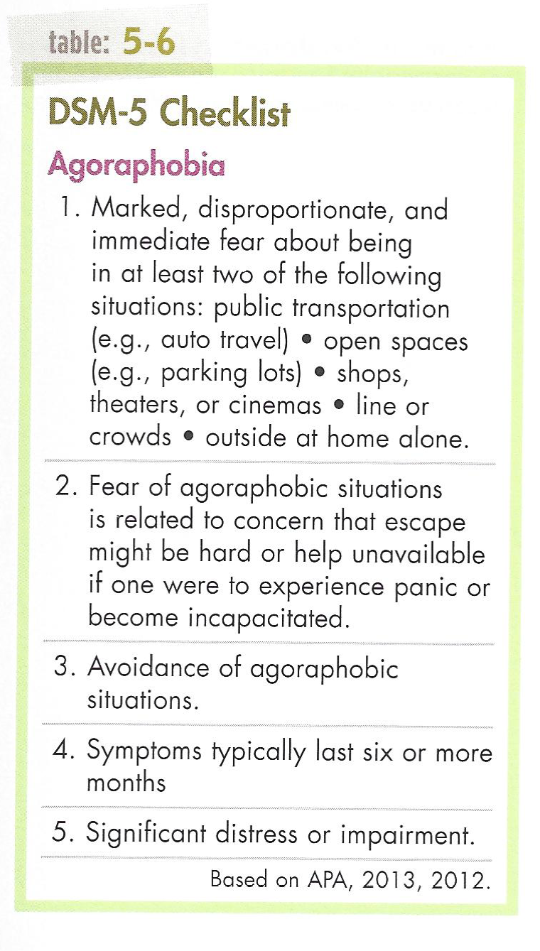
Agoraphobia

Slide 23
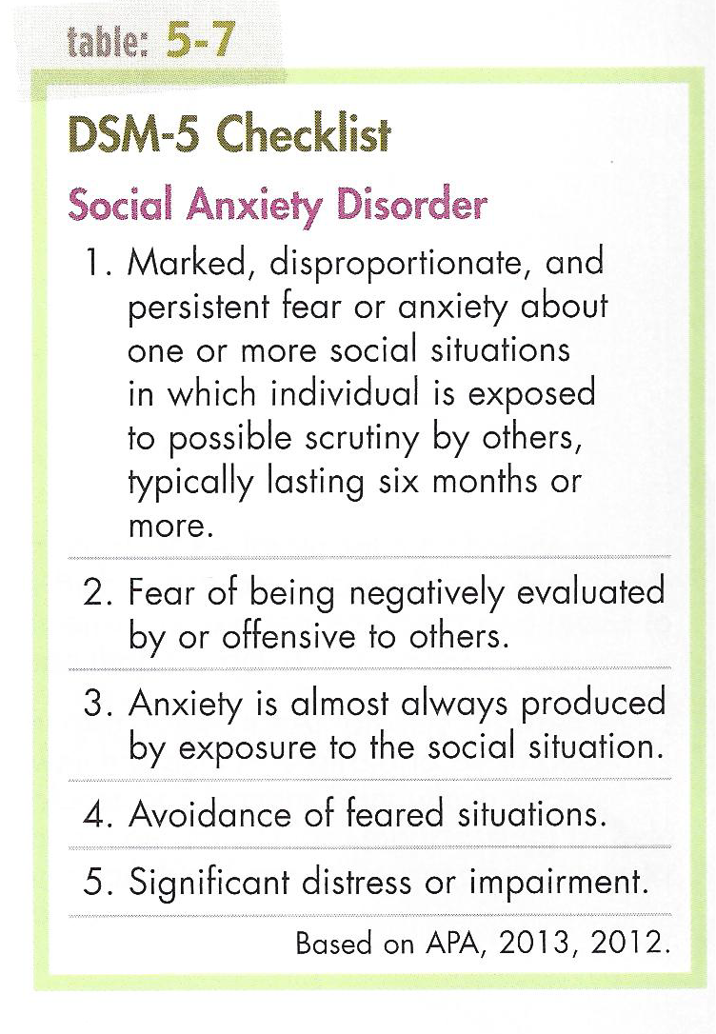
Phobias

Slide 24
Phobias
Social Anxiety Disorder – etiology and treatment
Cognitive view: unrealistic expectations, negative view of self, anticipate the worst, avoid situations

Slide 25
Phobias
Social Anxiety Disorder – etiology and treatment
Cognitive view: unrealistic expectations, negative view of self, anticipate the worst, avoid situations.
Treatment:
Biological: medications
Behavioral: exposure, social skills training
Cognitive: challenge unrealistic thoughts

Slide 26
Panic Disorder

Slide 27
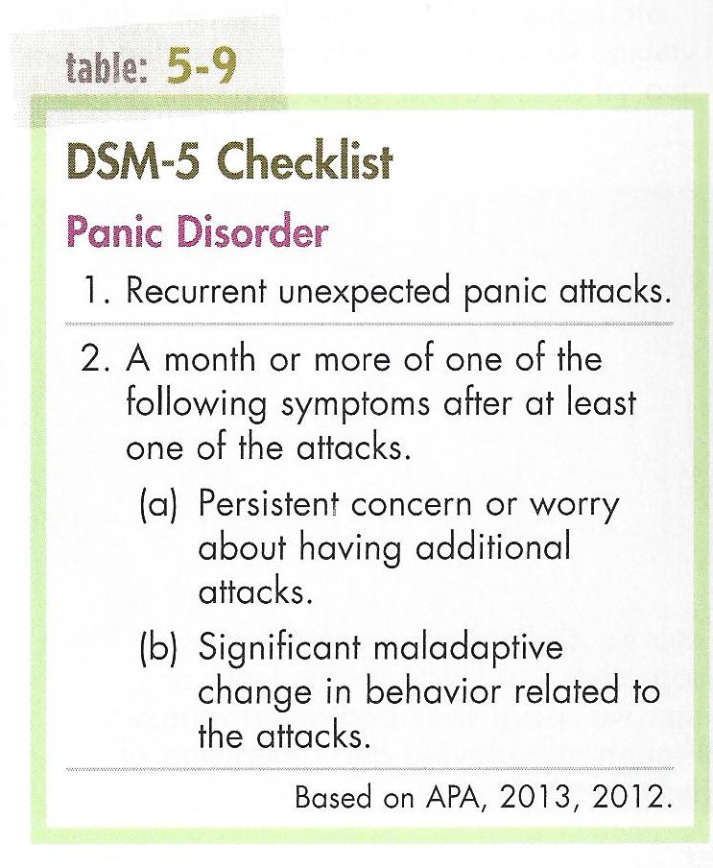
Panic Disorder

Slide 28
Panic Disorder
Etiology and treatment

Slide 29
Panic Disorder
Etiology and treatment
Biological view: inherited problems with brain function (excess norepinephrine) or structure (overreactive amygdala).

Slide 30
Panic Disorder
Etiology and treatment
Biological view: inherited problems with brain function (excess norepinephrine) or structure (overreactive amygdala). Treatment: Antianxiety or antidepressant medications

Slide 31
Panic Disorder
Etiology and treatment
Biological view: inherited problems with brain function (excess norepinephrine) or structure (overreactive amygdala). Treatment: Antianxiety or antidepressant medications
Cognitive view: misinterpretation of physical events.

Slide 32
Panic Disorder
Etiology and treatment
Biological view: inherited problems with brain function (excess norepinephrine) or structure (overreactive amygdala). Treatment: Antianxiety or antidepressant medications
Cognitive view: misinterpretation of physical events. Treatment: Educate about body, teach accurate interpretations, teach relaxation

Slide 33
Obsessive-Compulsive Disorder (OCD)

Slide 34
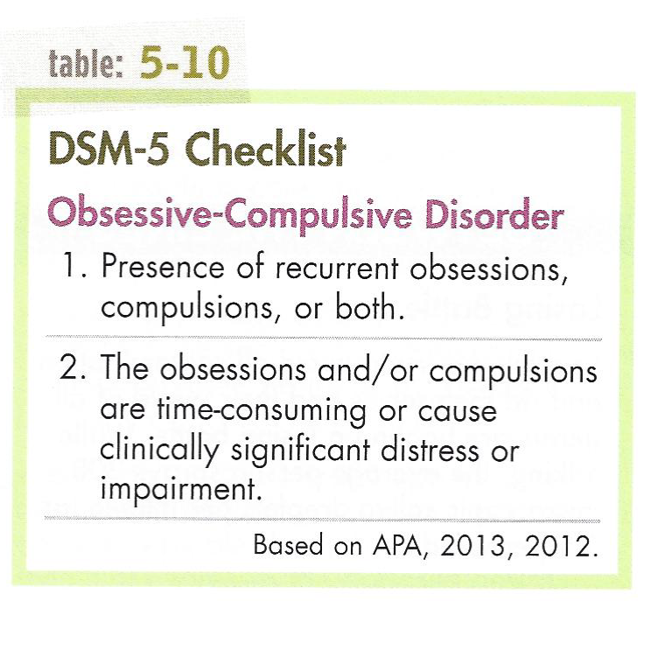
Obsessive-Compulsive Disorder (OCD)

Slide 35
Obsessive-Compulsive Disorder (OCD)
Etiology and treatment

Slide 36
Obsessive-Compulsive Disorder (OCD)
Etiology and treatment
Psychodynamic view: obsessions are the id’s impulses, and compulsions are the ego’s defense mechanisms. Treatment: Uncover and resolve early childhood fears and conflicts

Slide 37
Obsessive-Compulsive Disorder (OCD)
Etiology and treatment
Psychodynamic view: obsessions are the id’s impulses, and compulsions are the ego’s defense mechanisms. Treatment: Uncover and resolve early childhood fears and conflicts
Behavioral view: certain behaviors just happen and then get reinforced and repeated. Treatment: Exposure and response prevention (ERP)

Slide 38
Obsessive-Compulsive Disorder (OCD)
Etiology and treatment
Psychodynamic view: obsessions are the id’s impulses, and compulsions are the ego’s defense mechanisms. Treatment: Uncover and resolve early childhood fears and conflicts
Behavioral view: certain behaviors just happen and then get reinforced and repeated. Treatment: Exposure and response prevention (ERP)
Cognitive view: tendency to want to neutralize thoughts; tendencies for perfection and control. Treatment: Challenge distorted/unrealistic thinking

Slide 39
Obsessive-Compulsive Disorder (OCD)
Etiology and treatment
Psychodynamic view: obsessions are the id’s impulses, and compulsions are the ego’s defense mechanisms. Treatment: Uncover and resolve early childhood fears and conflicts
Behavioral view: certain behaviors just happen and then get reinforced and repeated. Treatment: Exposure and response prevention (ERP)
Cognitive view: tendency to want to neutralize thoughts; tendencies for perfection and control. Treatment: Challenge distorted/unrealistic thinking
Biological view: low serotonin (and others); overactive anxiety brain circuit. Treatment: antidepressant medications

Slide 40
Obsessive-Compulsive Disorder (OCD)
Other disorders in this category:
Body Dysmorphic disorder
Hoarding Disorder
Hair-Pulling Disorder (trichotillomania)
Excoriation (Skin-Picking) Disorder

Slide 41
Conclusions
Anxiety disorders are best understood through a diathesis-stress model – some biological vulnerability or predisposition combined with psychological or social factors

Slide 42
Conclusions
Anxiety disorders are best understood through a diathesis-stress model – some biological vulnerability or predisposition combined with psychological or social factors
Accordingly, a combination of treatments may work best

Slide 43
Quiz

