Slide 1
Chapter 9
Attention-Deficit/Hyperactivity Disorder

Slide 2
Attention-Deficit/Hyperactivity Disorder

Slide 3
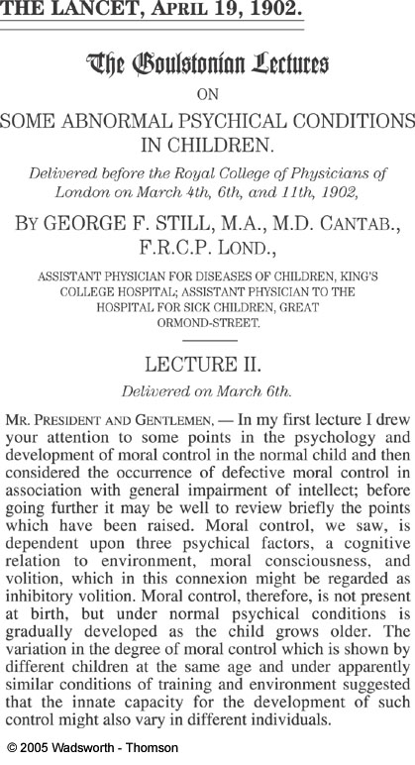

Slide 4


Diagnosis

Slide 5
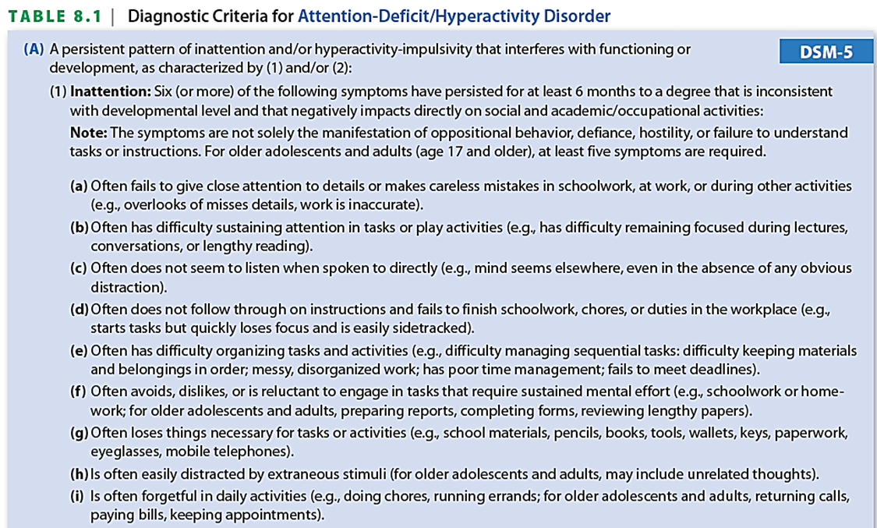

Slide 6
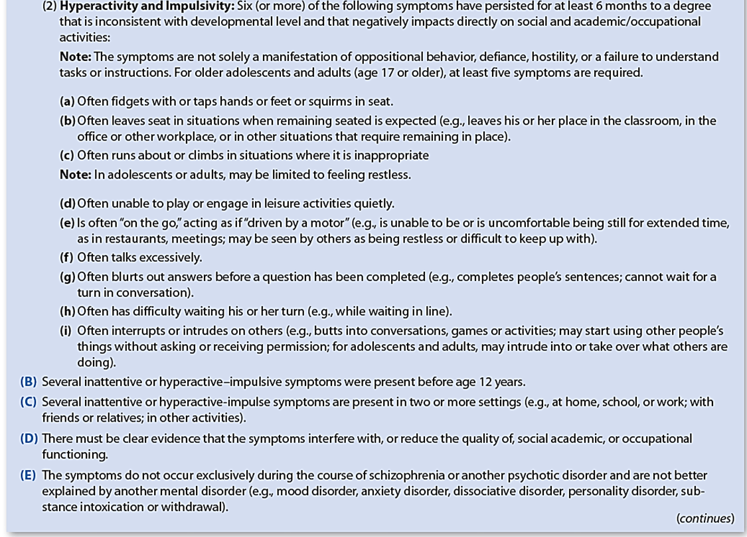

Slide 7
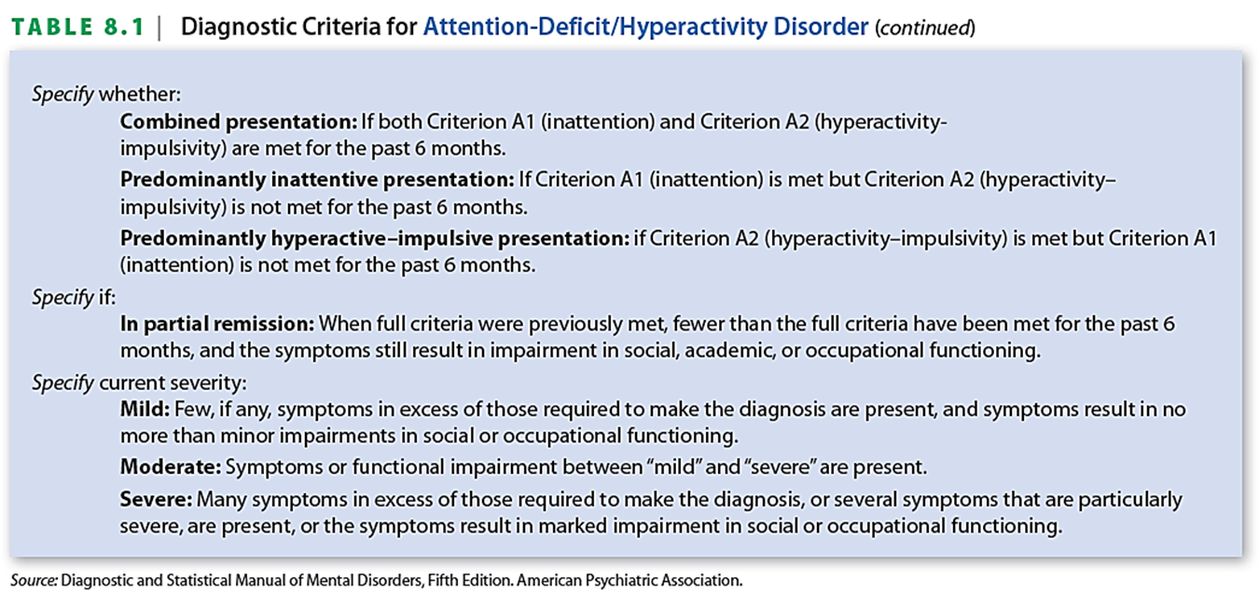

Slide 8
Other diagnostic criteria

Slide 9
Other diagnostic criteria
Symptoms present before age 12

Slide 10
Other diagnostic criteria
Symptoms present before age 12
Occur across two or more settings

Slide 11
Associated characteristics

Slide 12
Associated characteristics
Cognitive problems

Slide 13
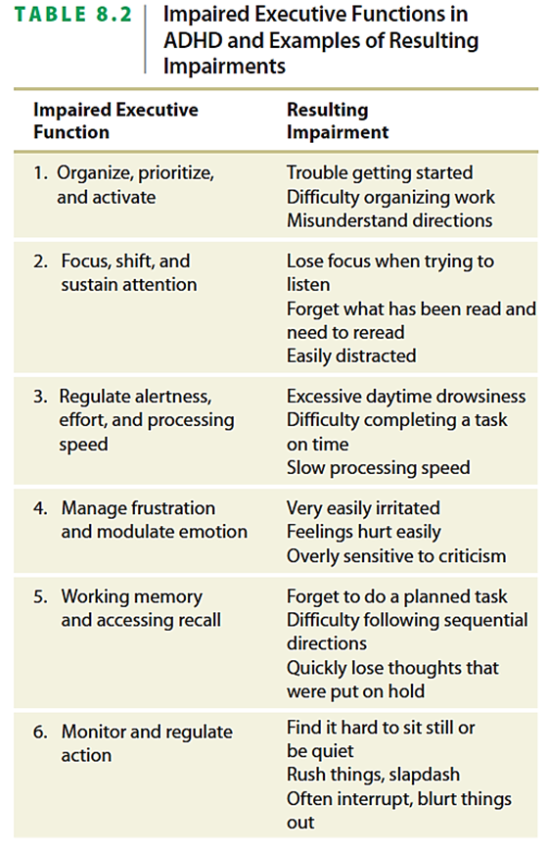

Slide 14
Associated characteristics
Cognitive problems
Speech and language problems

Slide 15
Associated characteristics
Cognitive problems
Speech and language problems
Medical and physical concerns

Slide 16
Associated characteristics
Cognitive problems
Speech and language problems
Medical and physical concerns
Social problems

Slide 17
Associated characteristics
Cognitive problems
Speech and language problems
Medical and physical concerns
Social problems
Comorbid disorders

Slide 18
Prevalence

Slide 19
Prevalence
About 5-8%

Slide 20
Prevalence
About 5-8%
More boys than girls, about 4-5:1

Slide 21
Prevalence
About 5-8%
More boys than girls, about 4-5:1
Across all SES levels, but slightly more in lower SES

Slide 22
Prevalence
About 5-8%
More boys than girls, about 4-5:1
Across all SES levels, but slightly more in lower SES
Similar rates around the world

Slide 23
Course

Slide 24
Course
Early childhood
Elementary school
Adolescence
Adulthood

Slide 25
Etiology

Slide 26
Etiology
Not enough support for several popular theories

Slide 27
Etiology
Not enough support for several popular theories
Biological issues

Slide 28
Etiology
Not enough support for several popular theories
Biological issues
  Genetic inheritance
  Prenatal influences
  Brain structure differences
  Brain function differences

Slide 29
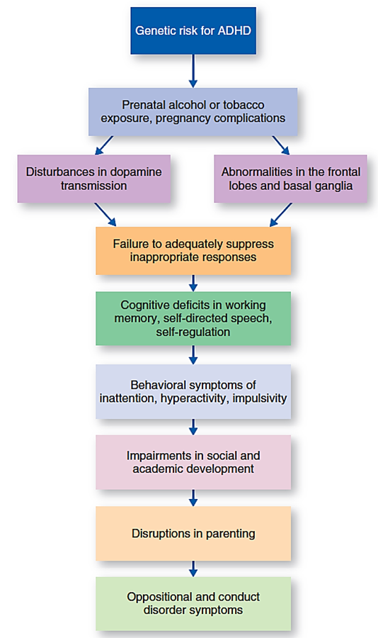

Slide 30
Etiology
Not enough support for several popular theories
Biological issues
Family issues

Slide 31
Assessment

Slide 32
Assessment
History
Observation
Rating scales
CPTs
Actigraphs
Teacher input
Rule out other disorders

Slide 33
Treatment

Slide 34
Treatment
Stimulant medication

Slide 35
Treatment
Stimulant medication
Parent management training

Slide 36
Treatment
Stimulant medication
Parent management training
Educational intervention

Slide 37
Treatment
Stimulant medication
Parent management training
Educational intervention
Intervention with child

Slide 38
Treatment
Stimulant medication
Parent management training
Educational intervention
Intervention with child
Summer treatment programs

Slide 39
Treatment
Stimulant medication
Parent management training
Educational intervention
Intervention with child
Summer treatment programs
Support groups

Slide 40
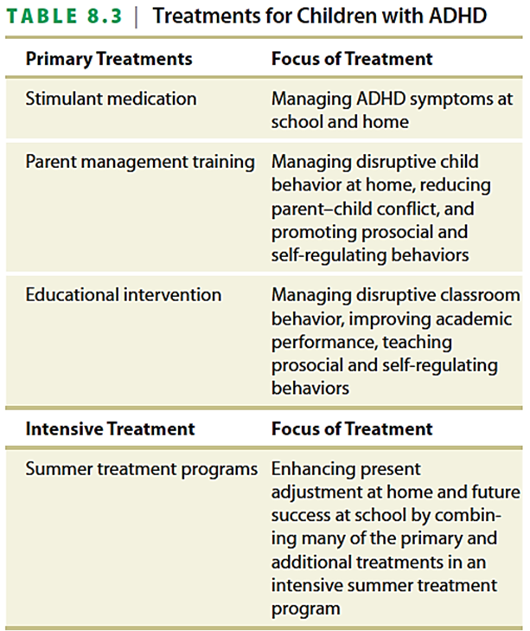
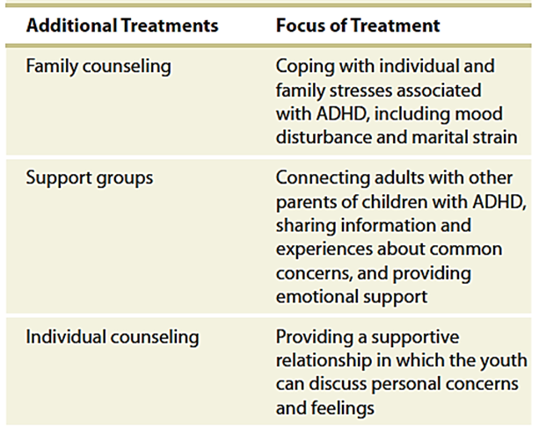

Slide 41
Resources
www.add.org – National Attention Deficit Disorder Association
www.chadd.org – Children and Adults with ADHD

Slide 42
Quiz

