Slide 1
Galbraith

Slide 2
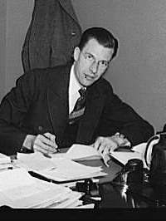
John Kenneth Galbraith 1908 - 2006
Canadian born, US naturalized citizen
Grew up on farm
Berkeley PhD – Agricultural Economics
WWII government management of prices
Later advisor to JFK
Three best known books
American Capitalism
The Affluent Society
The New Industrial State

Slide 3
Galbraith Quote
“Though a hungry man cannot be persuaded as between bread and a circus, a well-nourished man can. And he can be persuaded as between different circuses and different foods.”

Slide 4
Galbraith Themes
Large corporation planning – has replaced market as major economic force
Large capital investments for technology - drive need for planning
Desire for steady growth moderates prices
Planning requires control of demand
Purchases are now wants – enables control
Create loyal customer base
Product design, model changes, etc. - focus on loyalty
Mass media fill need for repetitive communication

