Slide 1
Polo Infrastructure

Slide 2
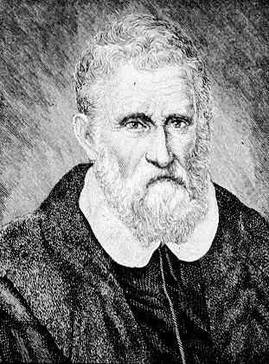
Marco Polo 1254 - 1324
Merchant from Republic of Venice
With father & uncle, journeyed thru Asia & to China
Returned after 24 years to find Venice at war
Dictated story of his travels to cellmate
Influence Columbus, others
Died free, wealthy

Slide 3
Marco Polo: The Kahn’s China
Marco Polo – The writing describes a society that is organized and quite advanced. Not unlike how we’re organized.
Describe the society
  Peaceful
  Abundance
  Had a leisure class
  Division of labor
    Doctors, Courtesans, Traders, Manufacturers
  Public financing
    Khan collects tax
    Trade barriers (3.33% for domestic, 10% for foreign)
    One kind of money
  Commerce
    Products – Silks, Salt, Sugar, Porcelain, Fruit, Wine, etc.
  Public works & Infrastructure –
    Town Squares, Bridges, Streets, Water & Sewer (sort of)

Slide 4
Infrastructure (1)
What | China | US Today
Transport | Rivers & Canals Roads & Bridges Harbor
Sanitation | Water & “Sewer”
Commerce | Warehouses & Markets
Public Finance | 1 Money System Taxes to pay for infrastructure
Power
Communications

Slide 5
Infrastructure (2)
What | China | US Today
Transport | Rivers & Canals Roads & Bridges Harbor | Same plus Rail (& facilities) Trucking (roads) Air (& facilities)
Sanitation | Water & “Sewer” | Same plus Water treatment & storage Waste treatment Trash collection & landfills
Commerce | Warehouses & Markets | Same plus Stock markets, etc
Public Finance | 1 Money System Taxes to pay for infrastructure | Same
Power |  | Electric gen & distribution Gas wells & distribution Oil wells, refine & distribution
Communications |  | Telephony (land) Cell Internet (email, etc)

