Slide 1
A Satisfactory Moral Theory

Slide 2

Daniel Quinn
“But why? Why do you need prophets to tell you how you ought to live? Why do you need anyone to tell you how you ought to live”

Slide 3
Morality Without Hubris

Slide 4
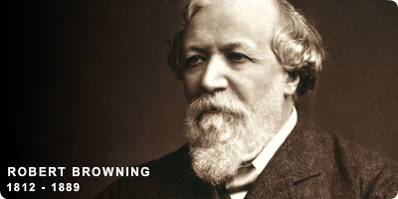
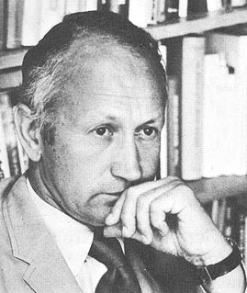
“Ah, but a man's reach should exceed his grasp, or what's a heaven for?”
“Inevitably, an individual is measured by his or her largest concerns.”

Slide 5

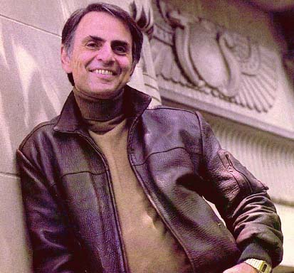
Carl Sagan

Slide 6
Sagan’s Cosmic Time Charts
January 1 Big Bang May 1 Origin of the Milky Way September 9 Origin of the Solar System September 14 Formation of the Earth September 25 Origin of life on Earth October 2 Formation of the oldest rocks known on Earth October 9 Date of oldest fossils (bacteria and blue-green algae November 1 Invention of sex (by micro-organisms) November 12 Oldest fossil photosynthetic plants November 15 Eukaryotes (first cells with nuclei) flourish
From The Dragons of Eden by Carl Sagan

Slide 7
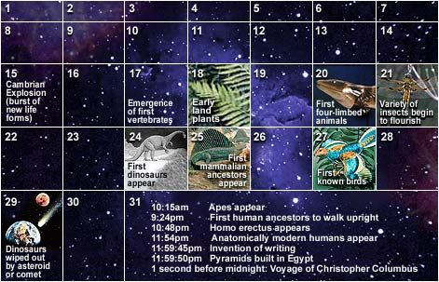
December

Slide 8
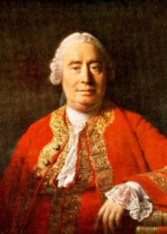
“The life of man is of no greater importance to the universe than that of an oyster.”
David Hume (1711-1776)

Slide 9
We are rational beings
We consider options
We weigh consequences
We choose to behave one way rather than another
We can articulate the reasons for our choices

Slide 10
Egoism
Ethical Egoism: prescriptive
Psychological Egoism: descriptive

Slide 11

Bunk
“Rachels says that psychological egoism is not true...we do not always act only for our own self interest.”

Slide 12
Theory
A) What reason requires: impartiality
B) What social living requires: the golden rule
C) Our natural inclination: concern for others
Suggests that morality is natural for us...

Slide 13
Treating Others as They Deserve
Remember Kant’s ‘respect for persons’
If we don’t adjust our actions to reflect our judgments of others’ actions we may be denying their status as free agents...
But...

Slide 14


Reasons to Ignore Impartiality
Our lives will go better if...we love our children, enjoy our friends, take pride in our work,
keep our
promises.....

Slide 15
Multiple-Strategies Utilitarianism
Human welfare as a moral standard...
Keep your promises (but not always)
Refrain from hurting people (but not always)
Never tell a lie (except sometimes)
Never put yourself first (except sometimes)

Slide 16
Multiple-Strategies Utilitarianism
Acting in accordance with your best plan...
Think about personalizing it:
Motives
Virtues
Decision-making strategies

Slide 17
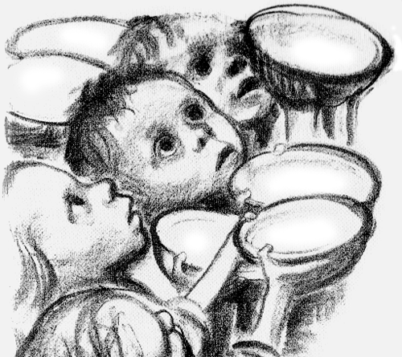
The Moral Community
Everyone and everything that can suffer
and prefers not to is part of our moral
community. Near and far.
Present and future.

Slide 18
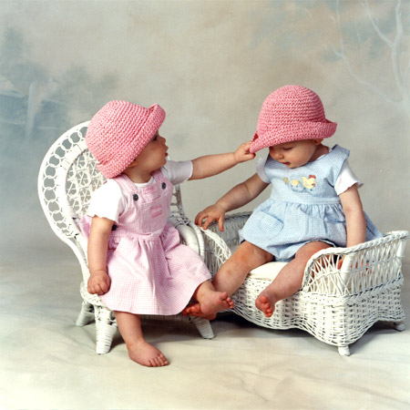
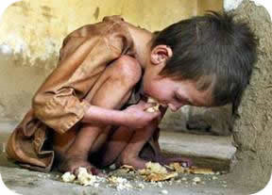
Justice and Fairness
The Natural Lottery...
Looks, brains, family status
How fair is that?

Slide 19
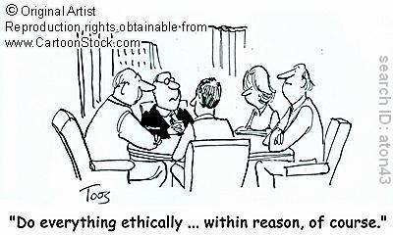
Conclusion

Slide 20
Practical Wisdom
http://www.ted.com/talks/barry_schwartz_on_our_loss_of_wisdom.html

Slide 21
The real difference between liberals and conservatives
http://www.youtube.com/watch?v=vs41JrnGaxc

Slide 22
The Entertainment Industry

Slide 23
Why are you here?

Slide 24
Is entertainment persuasive?

Slide 25

Media is Persuasive

Slide 26
Media is Persuasive
http://www.history.com/this-day-in-history/welles-scares-nation

Slide 27
Games
“People know that there's something magical about games. They don't always express that opinion positively, but even condemnations of video games acknowledge that they contain special power, power to captivate us and draw us in, power to encourage us to repeat things we've seemingly done before, power to get us to spend money on things that seem not to exist, and so forth.
While not everyone agrees that games are culture, or media, or art, everyone seems to agree that games are powerful. And that power is mysterious and wild, like black magic. You don't have to like games to want a piece of it.”
Ian Bogost

Slide 28

Film

Slide 29
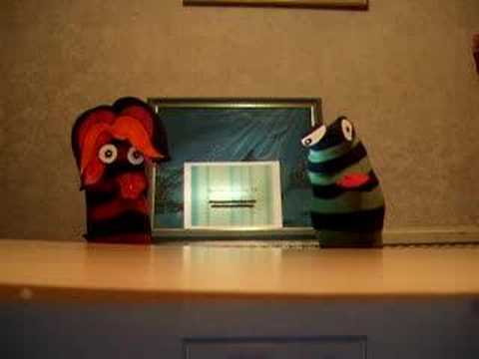
Television

Slide 30
Best Plan Paper: Friday
Best Plan Paper for peer review. Write a three page paper explaining your view of a “Satisfactory Moral Theory”. Form a clear thesis stating your view of a “Satisfactory Moral Theory”. Support this thesis with material from the text and other sources. Properly footnote references from the text, optional reading material or other sources. This paper should address which philosophies work best in making moral decisions regarding three different groups of people: People you will likely never meet but who will be affected by a moral decision you make, people you interact with casually, and people with whom you have intimate relationships- friends and family.

Slide 31
Take Home Midterm
Take home essay style midterm covering each of the theories covered in weeks 3 and 4.

