Slide 1
Feminism & the Ethics of Care

Slide 2
How many feminists?

Slide 3
Kant, Rousseau, Aristotle...

Slide 4
Kohlberg’s Stages of Moral Development
At stage 1 children think of what is right as that which authority says is right. Doing the right thing is obeying authority and avoiding punishment. At stage 2, children are no longer so impressed by any single authority; they see that there are different sides to any issue. Since everything is relative, one is free to pursue one's own interests, although it is often useful to make deals and exchange favors with others.
At stages 3 and 4, young people think as members of the conventional society with its values, norms, and expectations. At stage 3, they emphasize being a good person, which basically means having helpful motives toward people close to one At stage 4, the concern shifts toward obeying laws to maintain society as a whole.
At stages 5 and 6 people are less concerned with maintaining society for it own sake, and more concerned with the principles and values that make for a good society. At stage 5 they emphasize basic rights and the democratic processes that give everyone a say, and at stage 6 they define the principles by which agreement will be most just.

Slide 5
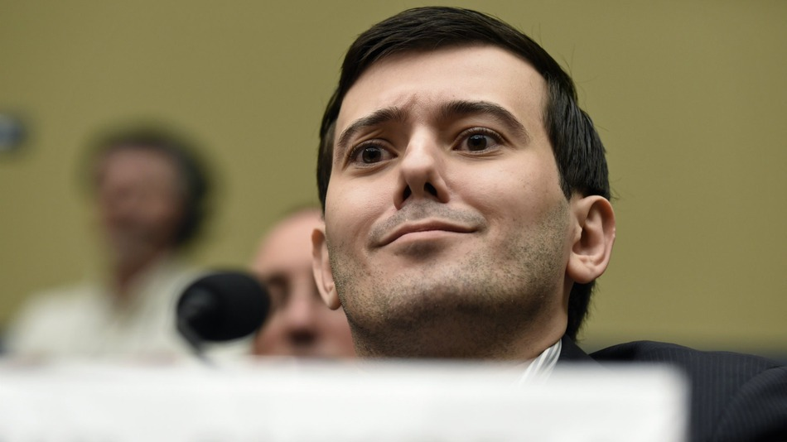
Heinz’s Dilemma

Slide 6
What does each child say?

Slide 7
What does each child say?
For one thing, a human life is worth more than money, and if the druggist only makes $1,000, he is still going to live, but if Heinz doesn't steal the drug, his wife is going to die. (Why is she worth more than money?) Because the druggist can get a thousand dollars later from rich people with cancer, but Heinz can't get his wife again. (Why not?) Because people are all different and so you couldn't get Heinz's wife again.

Slide 8
What does each child say?
Well, I don't think so. I think there might be other ways besides stealing it, like if he could borrow the money or make a loan or something, but he really shouldn't steal the drug--but his wife shouldn't die either. If he stole the drug, he might save his wife then, but if he did, he might have to go to jail, and then his wife might get sicker again, and he couldn't get more of the drug, and it might not be good. So, they should really just talk it out and find some other way to make the money.

Slide 9
Which is better?

Slide 10
What’s the flaw here?

Slide 11
Do men and women think differently about ethics?

Slide 12
Maybe, but really…?
Not that much
Consider the problem again

Slide 13
And yet, can evolution explain?

Slide 14
If there is a different ethical construct, how would it look?

Slide 15
Family
Ethics often breaks down when we talk about friends and family
Trolley problem
What explains this from a ethically dispassionate POV
The ethics of care, however...

Slide 16
Children with HIV
What does the ethics of care have to say about this?
Why?
How is this different from traditional ethical principles?

Slide 17
Children with HIV
What does the ethics of care have to say about this?
Why?
How is this different from traditional ethical principles?
Obligation.

Slide 18
Animals
Are animals things that we can care for?
What does traditional ethics have to say here?

Slide 19
Can the two be married? Are they separate?

Slide 20
Part of a greater whole: virtue ethics

Slide 21
Virtue Ethics

Slide 22
The progression of ethics
Aristotle → Saint Augustine → Kant, etc.

Slide 23
Virtue Ethics
Courage
Self-Control
Generosity
Truthfulness

Slide 24
How do we develop virtues?

Slide 25
How do we develop virtues?
By forming good habits.
What does this imply?

Slide 26
Courage
Exists between two extreme vices
Cowardice
Foolhardiness
Challenge?

Slide 27
Generosity
Exists between two extreme vices
Stinginess
Extravagance
Challenge?

Slide 28
Honesty
What is honesty, strictly speaking?
Why is this problematic?
What is an alternative way to look at honesty, then?

Slide 29
Virtues
Why are virtues important?
Individually?
Collectively?

Slide 30
Are virtues broadly applicable?

Slide 31
Are virtues broadly applicable?
Let us finally consider how naive it is altogether to say: "Man ought to be such and such!" Reality shows us an enchanting wealth of types, the abundance of a lavish play and change of forms — and some wretched loafer of a moralist comments: "No! Man ought to be different." He even knows what man should be like, this wretched bigot and prig: he paints himself on the wall and comments, "Ecce homo!"

Slide 32
And yet...
Everyone needs courage
Honesty is always a virtue
Everyone needs friends

Slide 33
Advantages
Moral motivation (rather than out of duty)
Doubts about impartiality
  In virtue ethics, some things are partial, others are impartial (loyalty)
In general, theories that emphasize a “right” action are incomplete; no character. Virtue ethics makes character a central concern.

Slide 34
Problems
Incomplete.
Why should I, for instance, be dependable?
What do I do in issues of moral conflict?
  My mullet
  Honesty and Kindness

Slide 35
Is this separate?
Or can we integrate virtue ethics into other ethical views?

Slide 36
Is this separate?
Utilitarianism
What is best for everyone?
  Which actions
  Which social policies
  Which qualities of character
  Would lead to this result?

