Slide 1
Kant - Absolute Rules and Respect for Persons

Slide 2
Are there absolute rules?

Slide 3
Are there absolute rules?
According to Divine Command?

Slide 4
Are there absolute rules?
According to Utilitarians?

Slide 5
Are there absolute rules?
According to Kant?

Slide 6
What is the one rule that all ethicists can agree on?

Slide 7
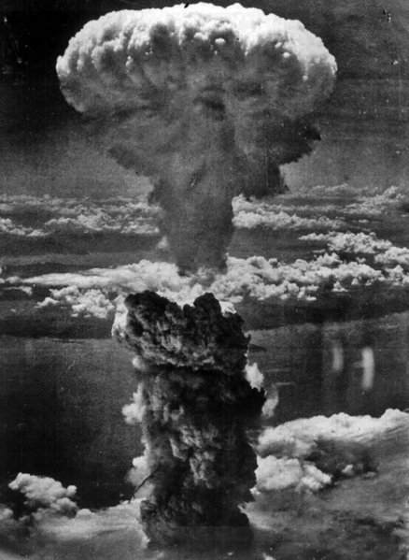
Let’s drop the big one.

Slide 8
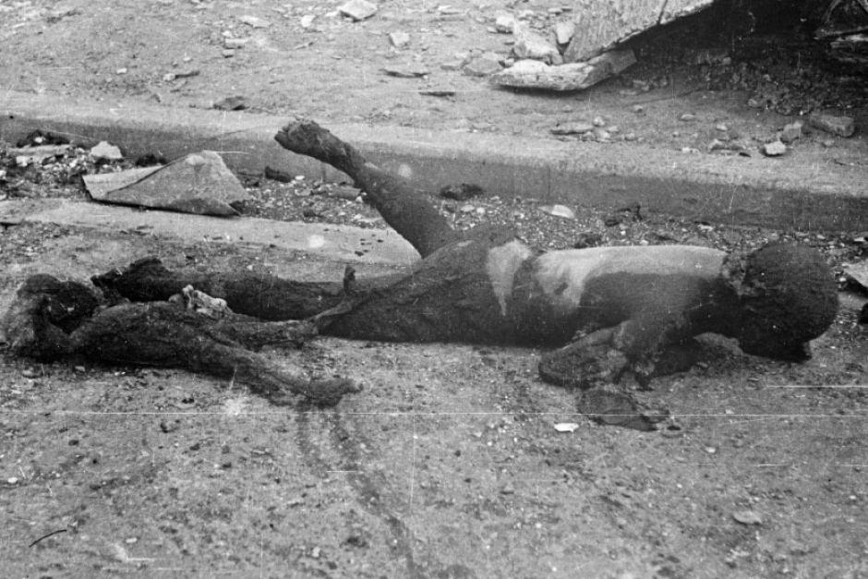
Let’s drop the big one.
150,000 - 200,000 dead

Slide 9
Let’s drop the big one.
Harry Truman: The ends justify the means
What is the justification?

Slide 10
Let’s drop the big one.
Anscombe: There are some things that you cannot do, no exceptions.
What is the justification?

Slide 11
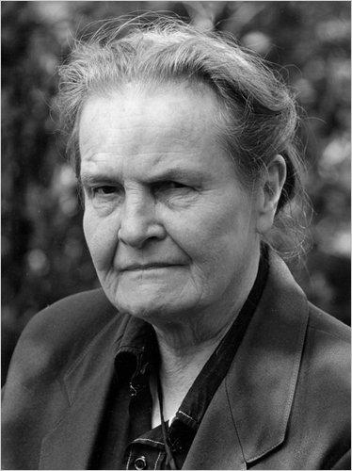
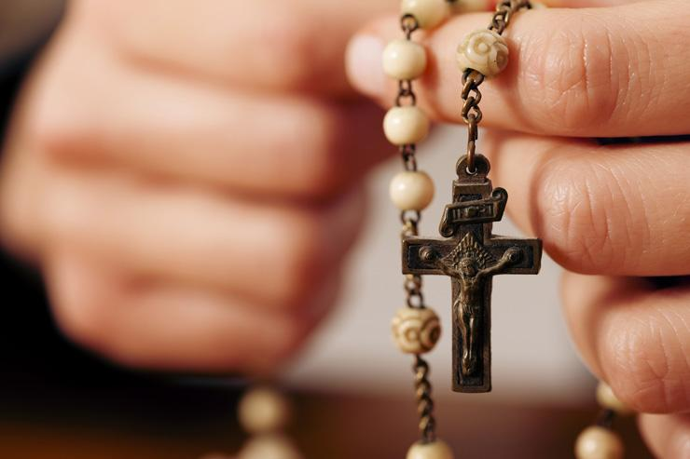
Anscombe

Slide 12
Kant
Agrees, but for different reasons
What is that reason?

Slide 13
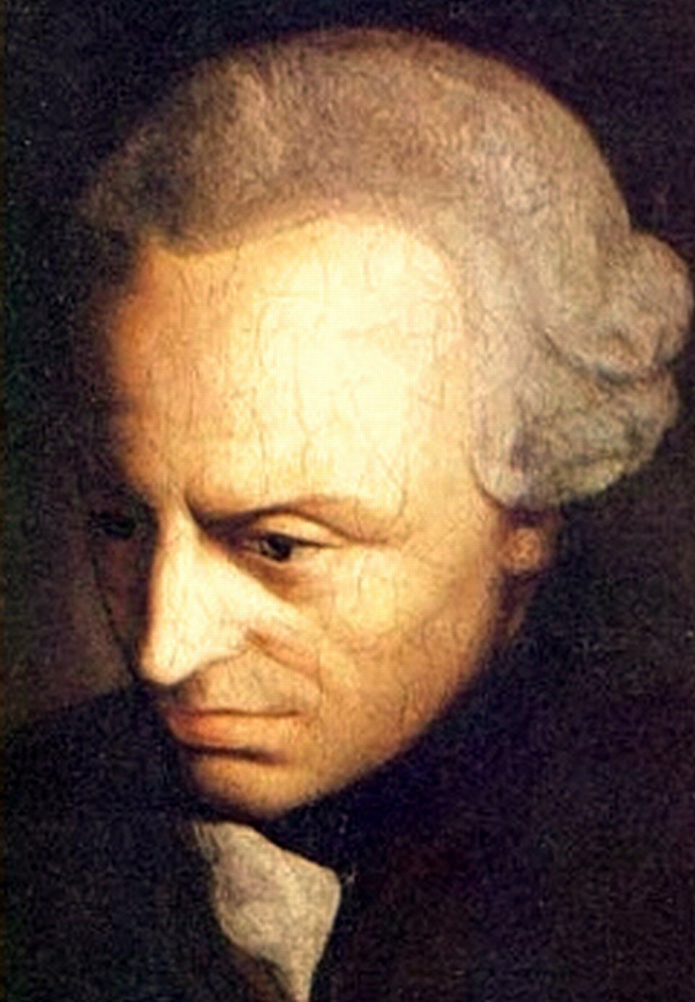
Categorical Imperatives

Slide 14
Categorical “Oughts”
Act only according to that maxim by which you can at the same time will that it should become a universal law
You ought to do this thing, period.
No exceptions.
None.
Zip.
Nada.
Zero.
Cero.

Slide 15
Categorical Imperative
Note the difference
  Utilitarianism: good vs bad
  Kantian: right vs wrong
We must ignore consequences. They tempt us from our duty.

Slide 16
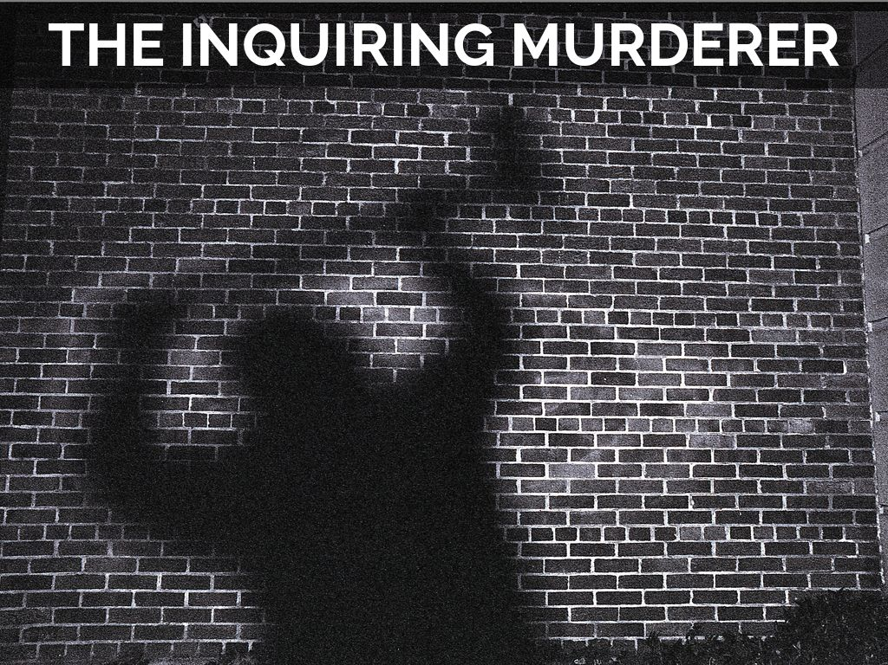
Problem: The Inquiring Murderer
A man walks past you
Minutes later, another walks past
(murderer)
“Say, which way did he go?”

Slide 17
What does Anscombe say?

Slide 18
What does Kant say?

Slide 19
Response to Kant?

Slide 20
Response to Kant?
Unreasonably pessimistic view of what we can and cannot know.

Slide 21

Response to Kant?
Unreasonably pessimistic view of what we can and cannot know.
Kant assumes that we would be morally responsible for bad consequences of lying, but what is he missing?

Slide 22
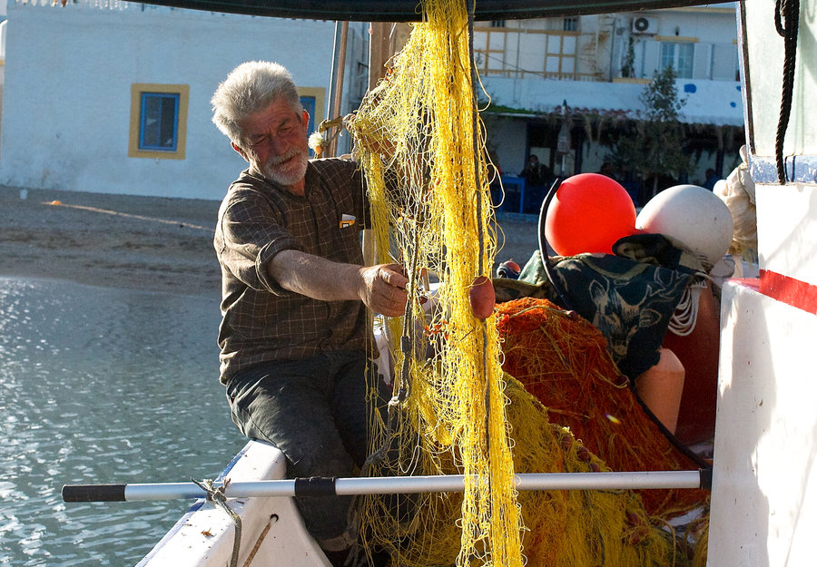
What about cases where two imperatives clash? (Dutch Fisherman)
It is wrong to lie.
It is wrong to facilitate the murder of innocent people.
Problem?

Slide 23
Let’s drop the big one.

Slide 24
Categorical Imperative
Binding on rational agents simply because they are rational; in other words, a person who rejected this principle would be guilty not merely of being immoral but also of being irrational.
You should act consistently, across the board
You are not special
There are no exceptions

Slide 25
Respect for Persons

Slide 26
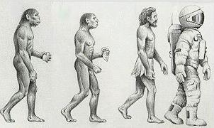
Respect for Persons
Kant: Humans are not just different, we are better
People are irreplaceable
Humans are not only valuable, but we do the valuing
Why?

Slide 27
People are rational agents. The only way for moral goodness to exist is for rational creatures to act from good will.

Slide 28
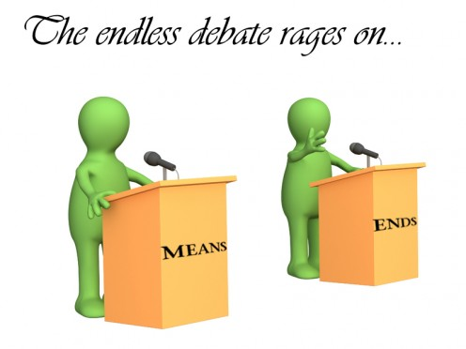
End, not Means
Because people are so valuable, morality requires us to treat them “always as an end and never as a means only.”
What does this mean?
Can I borrow money if I lie about paying it back, even if it’s for a good reason?
Can I borrow money if I tell the truth to my friend?
What’s the difference?

Slide 29
Kant on Retribution and Punishment

Slide 30
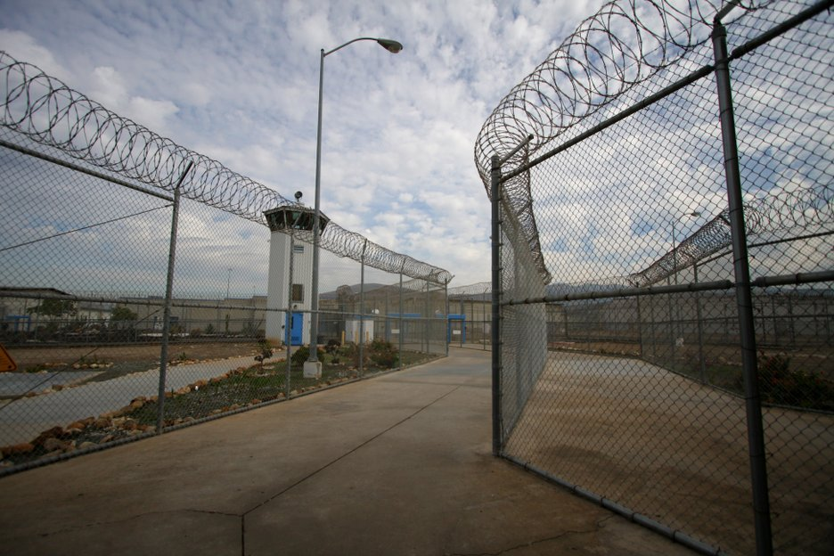
Punishment in America
In the ‘50s: correctional facilities
In the ‘70s: things begin to change
Why?

Slide 31
Punishment and Kant?
What does Kant say about punishment?

Slide 32
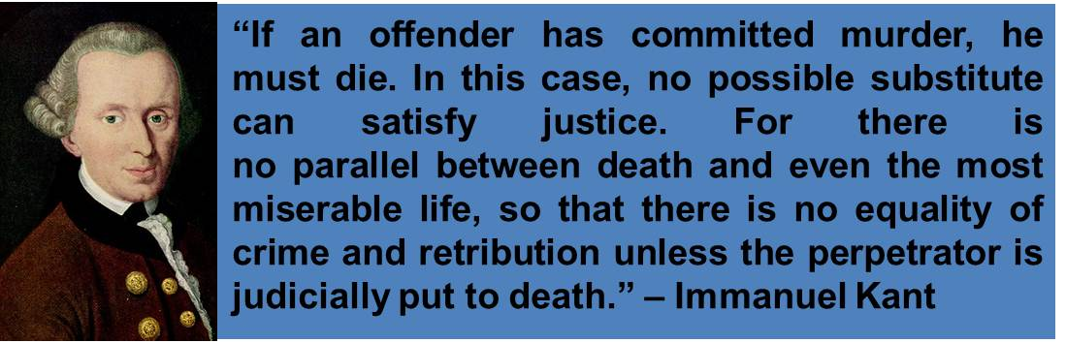
Punishment and Kant?
What does Kant say about punishment?
It may increase misery, but that’s OK. The suffering is done by those who had it coming.

Slide 33
Punishment and Kant?
What does Kant think about the Utilitarian approach to punishment?

Slide 34
Punishment and Kant?
What does Kant think about the Utilitarian approach to punishment?
This treats human beings as a means to an end
  We want them to behave better
  But what if they don’t want to?

Slide 35
Punishment and Kant?
What does Kant think about the Utilitarian approach to punishment?
This treats human beings as a means to an end
  We want them to behave better
  But what if they don’t want to?
Instead, people should be punished for their crimes
And also, punishment should be proportionate to the seriousness of the crime

Slide 36
Why?

Slide 37
Rational Beings and Punishment
Rational beings are responsible for their behavior, and so they are accountable for what they do.
Thus, in punishing people, we are holding them responsible for their actions.

Slide 38
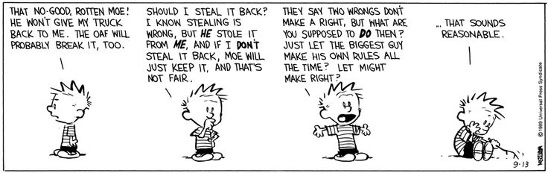

Slide 39
Rational Beings and Punishment
Furthermore, when a rational being decides to treat people in a certain way, they decree that this is the way people are to be treated. Thus, if we treat them the same way in return, we are doing nothing more than treating them as they have decided that people are to be treated.
There is, of course, a problem with this, too. What is it?

Slide 40
Rational Beings and Punishment
Why should we adopt a criminal’s principle of action, rather than our own?

Slide 41
NEXT WEEK

Slide 42
Next Week
Due week 5, but assigned next week. You can get started on the latter now!
Take-home style midterm
Paper explaining your view on a “Satisfactory Moral Theory

