Slide 1
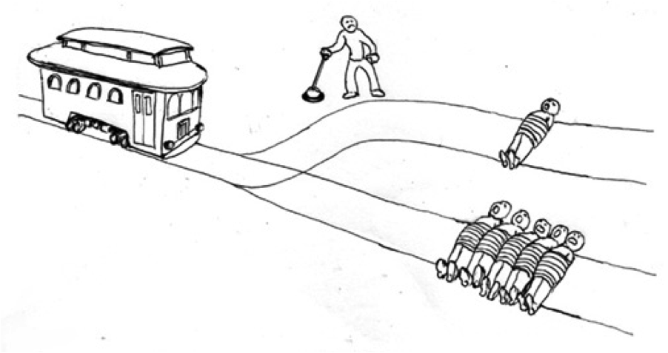
Utilitarianism
And the debate therein

Slide 2
Utilitarianism as a Radical Idea
Late 18th and early 19th Centuries
Jeremy Bentham and John Stuart Mill

Slide 3
What’s happening at the time?

Slide 4
Why is Utilitarianism a revolutionary idea?

Slide 5
Let’s examinate some problems.

Slide 6
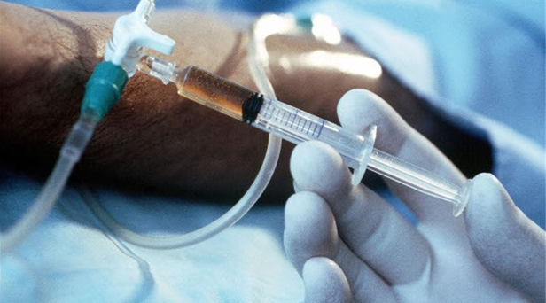
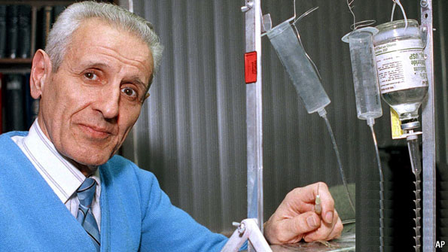
Euthanasia

Slide 7
Euthanasia
Consider: A person in extreme pain, and on their deathbed.
They ask for mercy; death.
Is it moral to help this person kill themselves?

Slide 8
What is the argument against this?

Slide 9
What is the argument against this?
It is immoral to kill, and therefore it is immoral to help someone take their life.
Where does this come from?

Slide 10
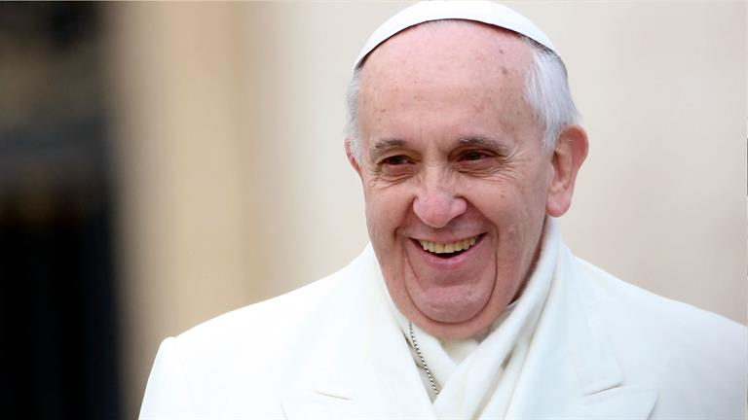
What is the argument against this?
It is immoral to kill, and therefore it is immoral to help someone take their life.
Where does this come from?
Religious doctrine. God says so.

Slide 11
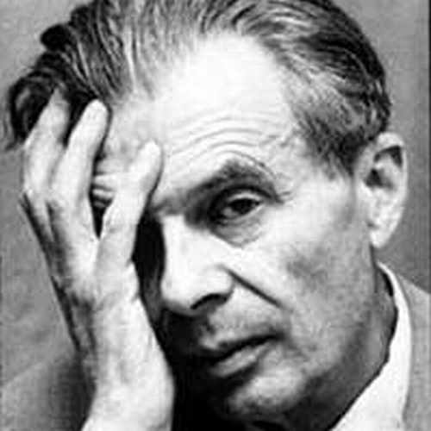
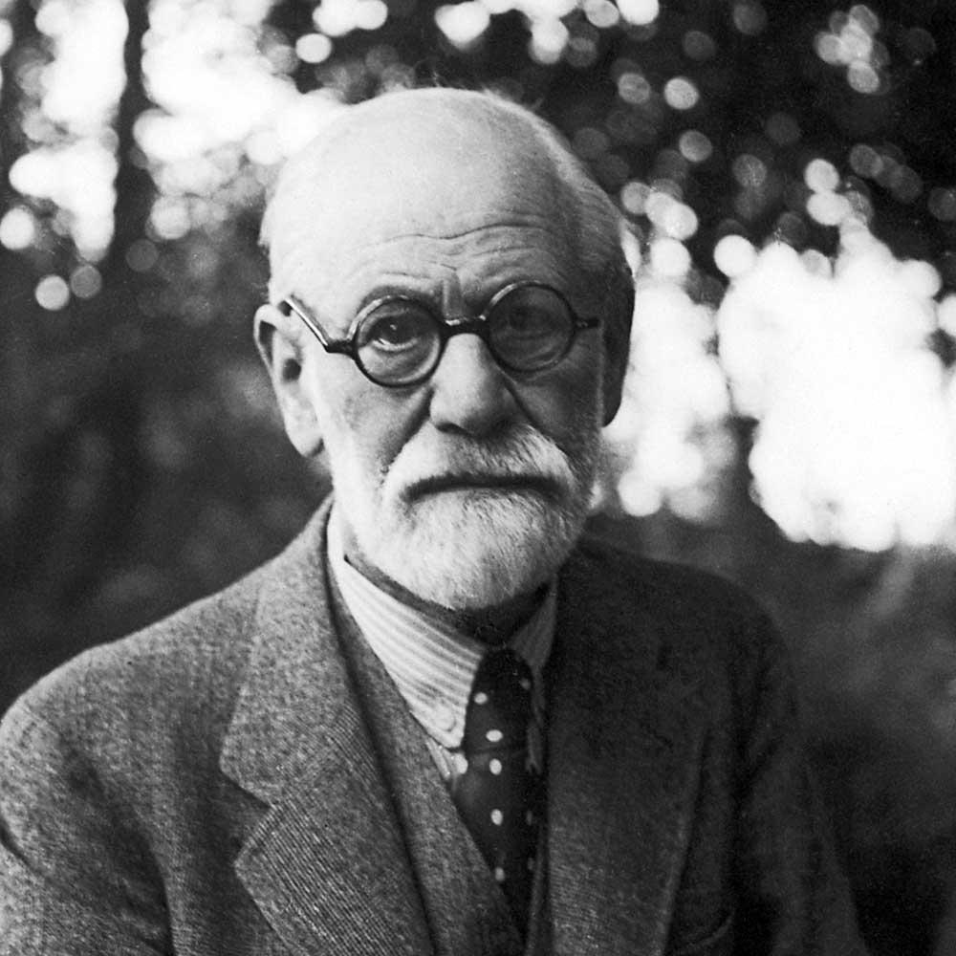
What is the argument for this?
The man is incredibly unhappy
Under Utilitarianism, what is the act that will produce the greatest balance of happiness over unhappiness?

Slide 12
Does this necessarily fly in the face of our conception of moral law and God?

Slide 13
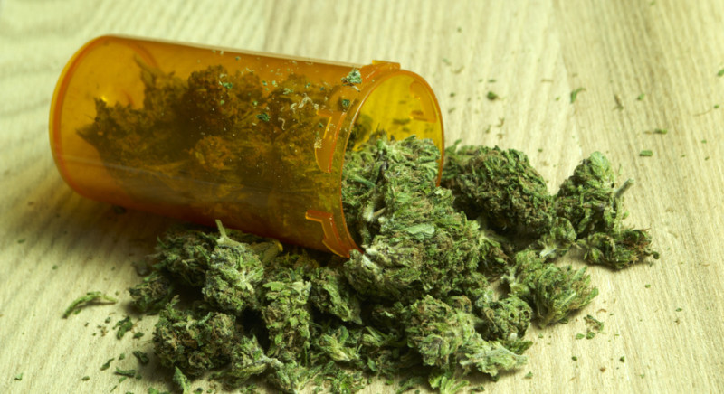
2. Marijuana

Slide 14
2. Marijuana
Consider: a younger person may deny any negative side-effects of marijuana
  An older person may think that drug use, ipso facto, is immoral
What would a Utilitarian say? Is it immoral to smoke pot?

Slide 15
What is the argument from Utilitarianism?
What is the main principle we should analyze this from?

Slide 16
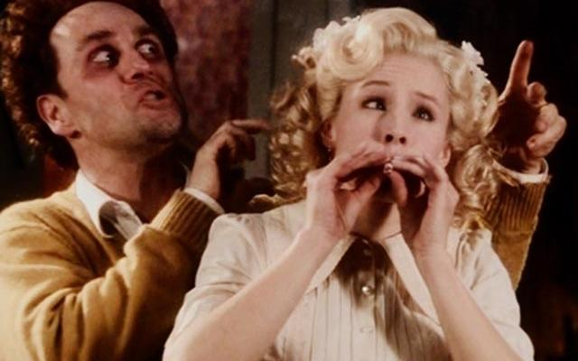
What is the argument from Utilitarianism?
What is the main principle we should analyze this from?
What happiness can pot use cause?
What unhappiness can pot use cause?

Slide 17
What about pot and the law?
Considerations?

Slide 18
What about pot and the law?
Considerations?
Immoral (society worse off):
People would be less productive
People could drive while high

Slide 19

What about pot and the law?
Considerations?
Society better off:
Pot might replace alcohol, which is even worse
Pot fuels drug wars
Lost revenue
Harm inflicted upon offenders
Ill will that drug enforcement causes

Slide 20
3. Nonhuman Animals

Slide 21
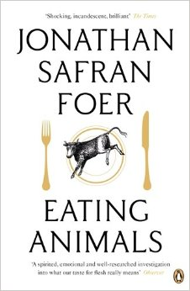
3. Nonhuman Animals
Traditional thinking: animals are for our own use
  We use them in experiments
  We eat them
  We use them for amusement
In traditional thinking, does this mean we can also torture them?

Slide 22
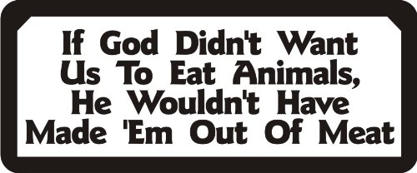
3. Nonhuman Animals
They are made for us
They are not human
They are not rational
They cannot speak

Slide 23
3. Nonhuman Animals
What about from a Utilitarian view?

Slide 24
3. Nonhuman Animals
What about from a Utilitarian view?
If an animal can experience happiness, then that’s all that matters.

Slide 25
The day may come when the rest of animal creation may acquire those rights which never could have been withholden from them but by the hand of tyranny. The French have already discovered that the blackness of the skin is no reason why a human being should be abandoned without redress to the caprice of a tormentor. It may one day come to be recognized that the number of legs, the villosity of the skin, or the termination of the os sacrum are reasons equally insufficient for abandoning a sensitive being to the same fate. What else is it that should trace the insuperable line? Is it the faculty of reason, or perhaps the faculty of discourse? But a full-grown horse or dog is beyond comparison a more rational, as well as a more conversable animal, than an infant of a day or a week or even a month old. But suppose they were otherwise, what would it avail? The question is not, Can they reason? nor Can they talk? but, Can they suffer?

Slide 26
Does this mean that animals are equals?

Slide 27
The Debate Over Utilitarianism

Slide 28
Classical Utilitarianism
The morality of an action depends solely on the consequences of the action; nothing else matters.
An action’s consequences matter only insofar as they involve the greater or lesser happiness of individuals.
In the assessment of consequences, each individual’s happiness gets equal consideration.

Slide 29
Problems?

Slide 30
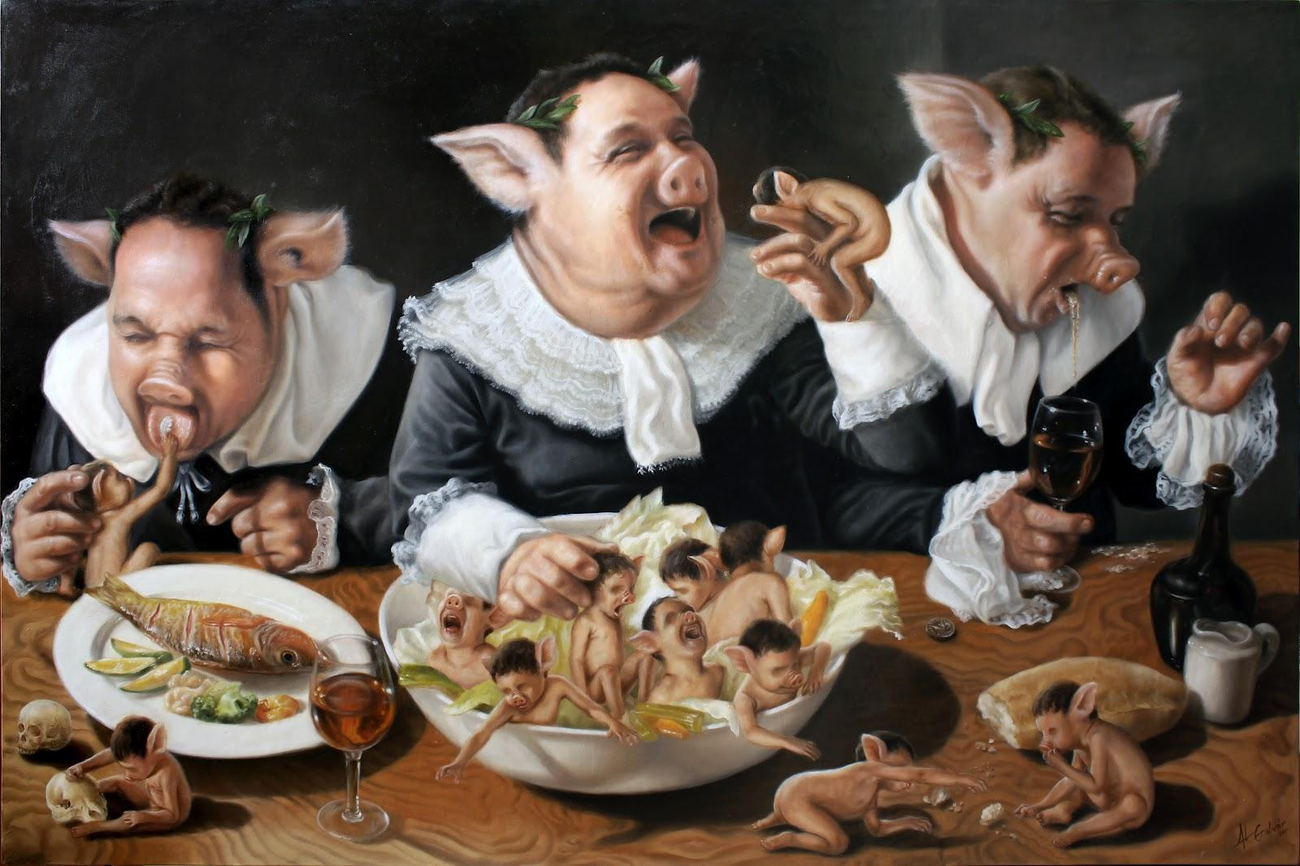
Is Pleasure all that matters?

Slide 31
Consider
A friend talking behind your back, but you never find out
  This does not technically cause you harm…
A pianist who injures her hands severely
  But could she find pleasure elsewhere?

Slide 32
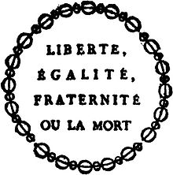
2. Are consequences all that matter?

Slide 33
Justice
Suppose a utilitarian were visiting an area in which there was racial strife, and that, during his visit, a Negro rapes a white woman, and that race riots occur as a result of the crime, white mobs, with the connivance of the police, bashing and killing Negroes, etc. Suppose too that our utilitarian is in the area of the crime when it is committed such that his testimony would bring about the conviction of a particular Negro. If he knows that a quick arrest will stop the riots and lynchings, surely, as a utilitarian, he must conclude that he has a duty to bear false witness in order to bring about the punishment of an innocent person.

Slide 34
Rights
Or a woman goes to the police after being abused, and the police take pictures as evidence.
But then the images are circulated throughout the police department…

Slide 35

Backward-Looking Reasons
You make a promise to meet someone for dinner, but then decide you’d rather stay home than go out. You can’t notify your friend, but you stay home anyway.
You are happy, your friend is mildly annoyed.

Slide 36
3. Should we be equally concerned for everyone?
You cannot buy things that you want (PlayStation, new car, etc)
We are, in reality, deeply partial to certain people.

Slide 37
Responses

Slide 38
Contesting Consequences
What are the actual consequences of lying in our situation of the false accusation?

Slide 39
Contesting Consequences
What are the actual consequences of lying in our situation of the false accusation?
This is not an excellent defense, though, because it does not apply to all situations. I.e. the white lie

Slide 40
2. Rules, Not Acts
Which set of rules is optimal from the utilitarian viewpoint?
For instance, what rules of conduct promote the most happiness in the case of our liar? “Don’t bear false witness.”
*but to do rules have exceptions?*

Slide 41
3. Common Sense Cannot be Trusted
If we consult our “common moral consciousness,” many considerations other than utility seem morally important.
“There must be still other countless errors of the same sort that no living man can yet detect, because of the fog within which our type of Western culture envelops us. Cultural influences have set up the assumptions about the mind, the body, and the universe with which we begin; pose the questions we ask; influence the facts we seek; determine the interpretations we give these facts; and direct our reaction to these interpretations and conclusions.”

