Slide 1
Complete Health History and Physical Assessment
November 29, 2015

Slide 2

Patient Information
Name: W.H.
Date: 11/09/2015
Time: 0800
Age: 65
Sex: Female
Notes:
W.H. is a 65 year old female who presented to the clinic on the morning of November 9, 2015.

Slide 3
SUBJECTIVE ASSESSMENT

Slide 4
SUBJECTIVE: CC & HPI
Chief Complaint: “I am following up on a medication change for my blood pressure.”
History of the Present Illness:
Friendly 65 year old female; currently asymptomatic
Previously diagnosed hypertension
Patient acknowledges a recent medication adjustment
She was taking Dyazide, but discontinued the medication due to a potassium abnormality
Notes:
W.H. explained her reason for visiting the clinic was to follow up on a recent medication adjustment for previously diagnosed hypertension. She was taking Dyazide, but discontinued the medication due to a potassium abnormality. On this date W.H. was asymptomatic.

Slide 5
SUBJECTIVE: Medications
Taking
Not Taking/PRN
Vitamin D 50000 IU Capsule, 1 capsule once per week for Vitamin D deficiency
Klonopin (Clonazepam) ½ tablet, once per day as needed for insomnia
Synthroid (Levothyroxine) 125mcg Tablet, 1 tablet once per day for hypothyroidism
Aspirin 81mg chewable tablet, 1 tablet once per day for preventive heart attack/stroke
Prilosec (Omeprazole) 20mg Delayed Release Capsule, 1 capsule per day for GERD
Zyrtec (Cetirizine hydrochloride) 10mg Tablet, 1 tablet once per day as needed for seasonal allergies
Pravachol (Pravastatin) 40mg Tablet, 1 tablet once per day for hyperlipidemia
Diovan (Valsartan) 320mg Tablet, 1 tablet once per day for hypertension
Omnicef (Cefdinir) 300mg Capsule, 1 tablet with food twice per day for bacterial infection
Dyazide (Triamterene-HCTZ) 75-50mg Tablet, 1 tablet in the morning once per day for hypertension
Rynex DM (brompheniramine/dextromethorphan/ phenylephrine) 2.5-1-5mg/5mL liquid, 5mL as needed every 4 hours for cough
Coreg (Carvedilol) 12.5mg Tablet, 1 tablet with food twice per day for hypertension
Diovan (Valsartan) 320mg Tablet, once per day for hypertension
Nitrolingual (Nitroglycerin) 0.4mg Sublingual Tablet, for hypertension
Discontinued
Notes:
W.H. declared she was taking several medications for vitamin D deficiency, insomina, hypothyroidism, heart attack and stroke prevention, GERD, allergies, hyperlipidemia and hypertension. Furthermore, she had taken additional medications in the past for bacterial infection and cough and several other medications for hypertension.

Slide 6
SUBJECTIVE: Past Medical History
Allergies: N.K.D.A.
Medication Intolerances: None
Chronic Illnesses/Major traumas: Vitamin D deficiency, hypothyroidism, cardiac arrhythmia, hyperlipidemia, GERD, insomnia, HTN
Hospitalizations/Surgeries:
Denies past hospitalization
Hysterectomy in 2005
Thyroid surgery in 2008
Surgery on right eye in 2011
Chronic Health Problems:
Vitamin D deficiency, unspecified (268.9)—controlled
Hypothyroidism, unspecified (E03.9)—controlled
Cardiac arrhythmia, unspecified (427.9)—controlled
Hyperlipidemia, unspecified (272.4)—controlled
GERD without esophagitis (530.81)—controlled
Insomnia, unspecified (780.52)—controlled
HTN (401.9)
Notes:
W.H. stated she had no known drug allergies and no medication intolerances. She had never been hospitalized, but had three minor surgeries between 2005-2011 with positive outcomes. Her chronic health problems (vitamin D deficiency, hypothyroidism, cardiac arrhythmia, hyperlipidemia, GERD and insomnia) were all currently controlled with medication. Her hypertension remained uncontrolled, hence her visit to the clinic.

Slide 7
SUBJECTIVE: Family & Social History
Family History
Parents deceased, both diagnosed with HTN
Younger brother, alive, diagnosed with type II diabetes and HTN
History about grandparents unknown
Social History
Married for over 40 years
Two adult children (one son and one daughter) who are alive and healthy
Homemaker while raising her children, then worked as a school secretary
Retired 10 years ago
Denies any tobacco, alcohol or drug use
Notes:
Ms. W.H’s parents are deceased and both were diagnosed with hypertension. She has one younger brother who is alive and diagnosed with type II diabetes and hypertension. No history is known about her grandparents from either side.
Ms. W.H. has been married to her husband, J.H., for over 40 years and together they have two adult children (one son and one daughter) who are alive and healthy. W.H. was a homemaker while raising her children and worked as a school secretary until retiring 10 years ago. She denied tobacco, alcohol or drug use.

Slide 8
SUBJECTIVE: Review of Systems
General: Denies fever, chills, rigors, malaise, nausea, vomiting, diarrhea, constipation, change in appetite, change in weight or change in sleep pattern
Skin: Denies rash, itching, bruising, cuts or abnormal nail/hair growth
Eyes: No corrective lenses; denies blurry vision, eye pain, redness, diplopia or flashing lights
Ears: Denies ear pain, hearing loss, ringing in ears or discharge
Nose/Mouth/Throat: Denies dryness, hoarseness, mouth or throat pain; denies use of dentures
Breast: Has not received mammogram in over 6 years “because I do my own self exams each month;” denies lumps, bumps or changes
Notes:
As previously mentioned, W.H. was asymptomatic during her visit to the clinic. Her skin, eyes, ears, nose, mouth and throat all appeared normal. She admitted to forgoing routine mammograms, but claimed to perform a monthly breast self-exam and has not noticed any lumps, bumps or changes.

Slide 9
SUBJECTIVE: Review of Systems
Heme/Lymph/Endo: Denies easy bruising, bleeding or blood clots; denies increased thirst or hunger
Cardiovascular: History of high blood pressure; denies chest pain, murmur, bruits, palpitations or edema
Respiratory: Denies cough, wheezing, hemoptysis, SOB, TB or pneumonia
Gastrointestinal: Denies abdominal pain, nausea, vomiting, diarrhea, dysphagia, dyspepsia, black or tarry stools or blood in stools
Genitourinary/Gynecological: Denies any urgency, frequency, hesitancy, nocturia, dysuria, hematuria or discharge
Musculoskeletal: Denies decreased ROM, joint swelling, stiffness or pain
Notes:
W.H. denied any problems regarding hematologic, lymphatic, endocrine, respiratory, gastrointestinal, genitourinary/gynecological or musculoskeletal systems. Her only concern related to the cardiovascular system was her high blood pressure.

Slide 10
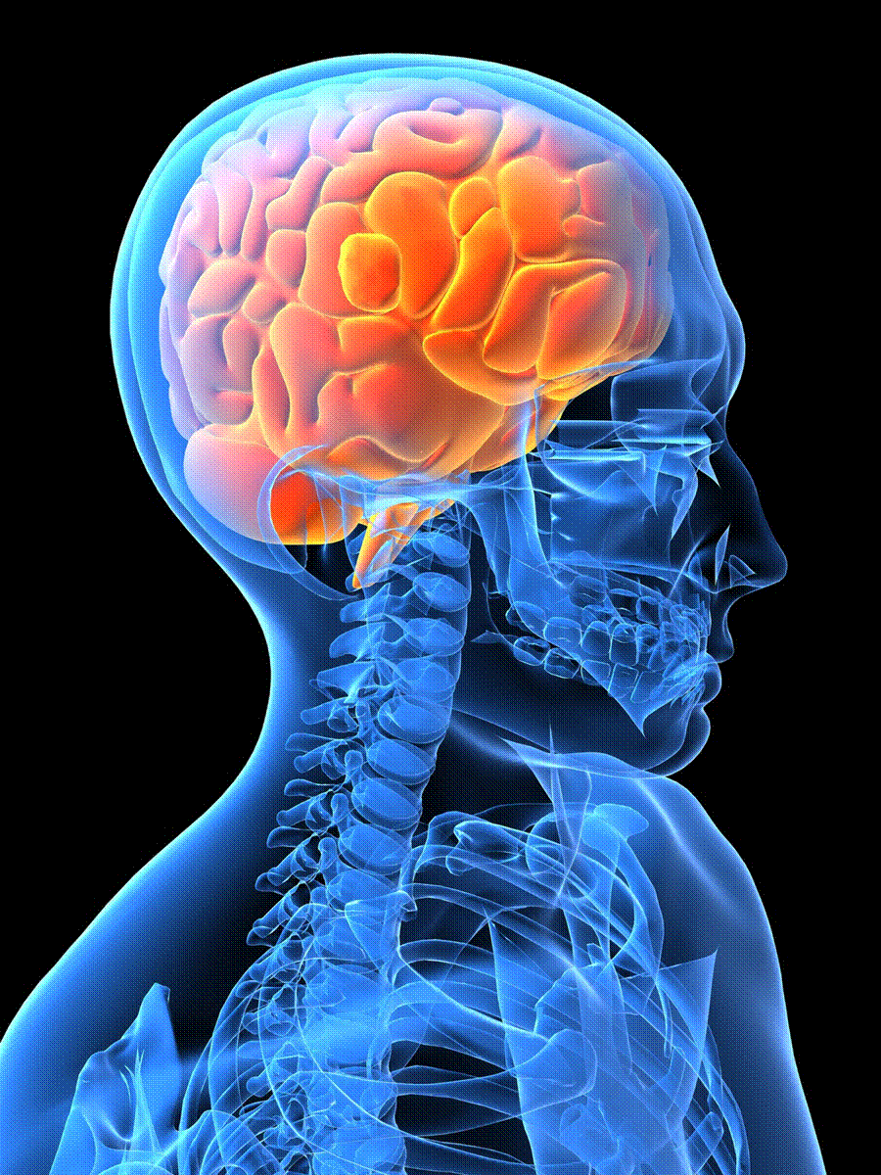
SUBJECTIVE: Review of Systems
Neurological: Denies syncope, seizures, head injuries, weakness, headaches, numbness, falls, tremor or memory loss
Psychiatric: Admits to “sometimes waking up too early, but not all the time;” denies depression, anxiety or suicidal ideation/attempts
Notes:
Despite occasional sleep problems, W.H. had no serious neurological or psychiatric issues.

Slide 11
OBJECTIVE ASSESSMENT

Slide 12
OBJECTIVE: Biometric Data
Height: 5’9”
Weight: 235 lbs
Body Mass Index: 34.7
Temperature: 98.7 F
Blood Pressure: 180/117 mmHg (left arm)
Pulse: 83 beats per minute
Respiration Rate: 20 breaths per minute
Notes:
W.H.’s temperature, pulse and respiration rate were all normal.
Her blood pressure was elevated and her BMI placed her in the category of obese.

Slide 13
OBJECTIVE: Review of Systems
General Appearance: Healthy appearing adult African American female in no acute distress; alert and oriented, answers questions appropriately, well developed, well nourished
Skin: Uniform in color, unblemished, no presence of foul odor, good skin turgor, normal temperature
Notes:
W.H. presented as a sociable, independent 65 year old African American female who appeared well nourished and in no acute distress.
Her skin was intact, warm and dry with no bruising, lesions or rashes.

Slide 14
OBJECTIVE: Review of Systems
Eyes
Bulbar Conjunctiva: Transparent with capillaries slightly visible
Palpebral Conjunctiva: Shiny, smooth, pink
Sclera: appears white
Lacrimal gland, Lacrimal sac, Nasolacrimal duct
No edema or tenderness over the lacrimal gland and no tearing
Cornea Clarity and Texture: Transparent, smooth and shiny upon inspection by the use of a penlight
Corneal sensitivity: Blinks when the cornea is touched through a cotton wisp from the back
Pupils: Black, equal in size with consensual and direct reaction, pupils equally rounded and reactive to light and accommodation, pupils constrict when looking at near objects, dilates at far objects, converge when object is moved toward the nose at four inches distance and by using penlight
Visual Fields: Can see objects at the periphery
when looking straight ahead
Visual Acuity: Can read newsprint at a distance of 8”
Notes:
W.H.’s eyes appeared healthy as evidenced by the conjunctiva, cornea, pupils, visual fields and visual acuity.

Slide 15
OBJECTIVE: Review of Systems
Ears
Auricles: Color of auricles is same as facial skin, symmetrical, auricle is aligned with the outer canthus of the eye, mobile, firm, non-tender, and pinna recoils after it is being folded
External Ear Canal: No impacted cerumen
Hearing Acuity Test: Voice sound audible
Watch Tick Test: Can hear ticking in both ears at a distance of 1”
Cardiovascular: No visible pulsations on aortic and pulmonic areas, no presence of heaves or lifts
Respiratory
Normal breath sounds without dyspnea, lungs clear, chest wall intact with no tenderness/masses
Full and symmetric expansion, thumbs separate 2-3 cm during deep inspiration
Quiet, rhythmic and effortless respirations
Notes:
W.H.’s ears looked healthy as demonstrated by the auricles, external ear canal, hearing acuity test and watch tick test.
Her cardiovascular and respiratory systems were also in good shape.

Slide 16
OBJECTIVE: Review of Systems
Nose/Mouth/Throat
Nasal Cavity Mucosa: pink, no lesions, nasal septum intact and in middle with no tenderness
Mouth and Oropharynx: symmetrical, pale lips, brown gums, able to purse lips
Teeth: dental caries and decayed lower molars
Tongue and Floor of Mouth: central position, pink with whitish coating, veins prominent in the floor of the mouth
Tongue movement: moves without difficulty and without tenderness upon palpation
Uvula: positioned midline of soft palate
Gag Reflex: present when elicited through the use of a tongue depressor
Notes:
W.H.’s nose, mouth and throat appeared satisfactory as substantiated by nasal cavity mucosa, lips, gums, teeth, tongue, uvula and gag reflex.

Slide 17
OBJECTIVE: Review of Systems
Gastrointestinal
Unblemished skin, uniform in color, symmetric contour, not distended
Abdominal movements: symmetrical movements caused by respirations
Auscultation of bowel sounds: audible sounds of 22 bowel sounds/minute
Abdomen:
Unblemished skin, uniform in color, symmetric contour
Symmetric movements associated with respiration
Jugular veins not visible
Blanch Test: nails returned to usual color in fewer than 4 seconds
Notes:
W.H.’s gastrointestinal system looked healthy as proven by abdomen appearance, abdominal movements, bowel sounds and Blanch Test (capillary nail refill test).

Slide 18
OBJECTIVE: Review of Systems
Breast
No masses detected, denies pain, no nipple discharge, no discoloration or change in the quality of the skin, no redness noted
Genitourinary/Gynecological
No bladder distension, no vaginal or urethral discharge, denies costovertebral angle tenderness or genitourinary pain
No history of bladder infection or kidney stones
Menopause at age 50
Musculoskeletal
Muscles: equal in size both sides of the body, smooth coordinated movements, 100% of normal full movement against gravity and full resistance
Bones and Joints: no deformities or swelling, joints move smoothly
Upper Extremities: both extremities without scars and lesions
Lower Extremities: minimal scars on lower extremities
Notes:
W.H.’s breasts, genitourinary/gynecological and musculoskeletal systems appeared normal as verified by a physical exam and demonstration of full range of motion.

Slide 19
OBJECTIVE: Review of Systems
Neurological/Psychiatric
Oriented to place, date and time
Attention Span: able to concentrate as evidence by answering questions appropriately; clear speech
Level of Consciousness : complete orientation and alertness
Walking Gait: upright posture and steady gait with opposing arm swing unaided and maintaining balance
Heel Toe Walking: maintains a heel toe walking along a straight line, able to walk several steps in toes/heels
Finger to Nose Test: can repeatedly and rhythmically touch nose
Alternating Supination and Pronation of Hands on Knees: can perform at rapid pace
Finger to Nose and to the Nurse’s Finger: can perform with coordination and rapidity
Fingers to Fingers: can perform with accuracy and rapidity
Fingers to Thumb: can rapidly touch each finger to thumb with each hand
Notes:
W.H.’s neurological/psychiatric assessment was acceptable based on her attention span, level of consciousness, walking gait and tests of the fingers/thumbs.

Slide 20

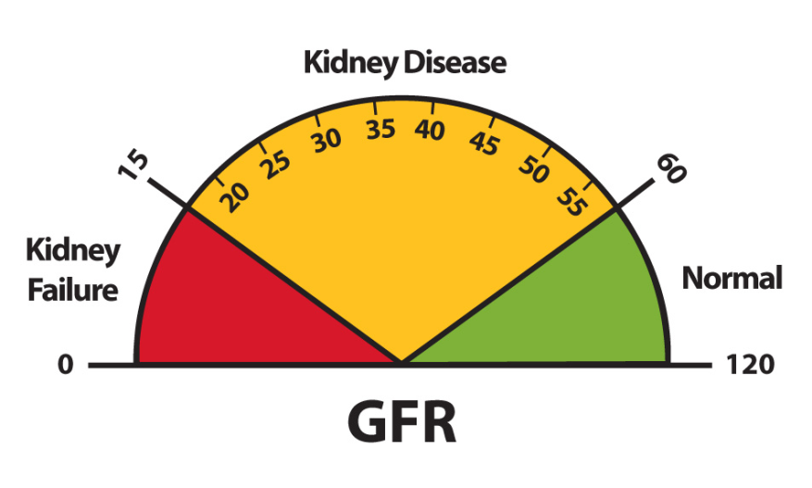
OBJECTIVE: Pending Lab Tests
Comprehensive Metabolic Panel (CMP)
Glomerular Filtration Rate (GFR)
Notes:
Laboratory tests performed during this visit included a comprehensive metabolic panel (to measure blood levels of albumin, calcium, sodium, potassium, blood urea nitrogen, carbon dioxide, chloride, creatinine, glucose, liver enzymes and total bilirubin and protein) and a glomerular filtration rate test (to establish how well the kidneys are working).

Slide 21
PLAN

Slide 22

PLAN: Diagnosis & Medication
Diagnosis
Essential (Primary) Hypertension (I10)
Medication
Microzide (Hydrochlorothiazide) 12.5mg tablet, 1 tablet, Orally, Once a day, 90 days (1 refill)
Diovan (Valsartan) 320mg tablet, 1 tablet, Orally, Once a day, 90 days (1 refill)
Notes:
W.H. was given a diagnosis of essential (primary) hypertension, which is ICD-10 Code I10.
She was given two handwritten prescriptions for Microzide (a thiazide diuretic) and Diovan (an angiotensin II receptor antagonist) to lower her blood pressure.

Slide 23

PLAN: Education/Non-Medication Treatments
Education
Significance of medication adherence
Common side effects of the prescribed medications
Check BP using an automatic monitor at home
Importance of achieving and maintaining a healthy weight
Non-Medication Treatments
Dietary Approaches to Stop Hypertension (DASH) diet
Regular exercise (daily walking)
Notes:
W.H. was educated on the significance of medication adherence, side effects she may encounter, how and when to self-monitor her blood pressure at home, and the importance of achieving and maintaining a healthy weight through diet and exercise. Moreover, the DASH diet and daily walking were recommended as non-medication treatments.

Slide 24
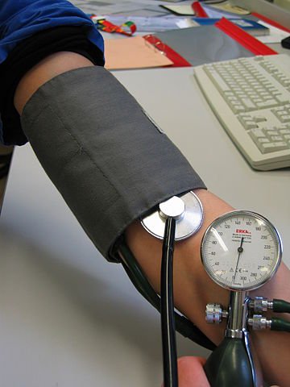
PLAN: Return to Clinic
Return to clinic in 2 weeks to recheck BP
Continue to have BP checked every 2-4 weeks until controlled
Visit NP at least every 6 months for surveillance of BP (more often if complications)
Notes:
W.H. was asked to return to the clinic in 2 weeks for a blood pressure check and to discuss the medication changes. She should continue to have her blood pressure checked at the clinic every 2-4 weeks until it is under control. Lastly, W.H. was advised to visit the clinic at least every 6 months for blood pressure surveillance and to stop in more often if complications occurred.

Slide 25
EVALUATION

Slide 26

EVALUATION: Patient Encounter
First patient of the practicum experience
Patient pleasant and amicable
Exam straightforward and prompt
Weaknesses: Distracted by SOAP notes—inattentive?
Strengths: HTN management & education
Preparing to Progress as a NP: Confidence through experience
Notes:
Overall, this was my first patient of the practicum experience. Ms. W.H. was friendly and a pleasure to work with and the exam was quite straightforward.
My weaknesses as I interviewed and assessed this patient were that I was trying to make sure I recorded all the necessary information for the SOAP notes and in turn was not as amicable or attentive as I have been in the past with patients. On the other hand, my strengths were that I am very familiar with the diagnosis, treatment and prevention of hypertension and was able to offer Ms. W.H. advice and recommendations.
As I progress and grow as a Nurse Practitioner, I will prepare differently by better knowing what information is required in the SOAP notes and gaining more confidence as I interview and assess additional patients.

