Slide 1
Advertising THROUGH SOCIAL MEDIA

Slide 2
Introduction
The introduction of social media has changed the manner people handle activities while at work
LinkedIn, Facebook, Google+, Pinterest, Tumblr, Wikipedia, YouTube, Twitter forms social media.
It has changed the manner people communicate and transact business.
Social media has been useful in managing talent
The article discusses the applications of media at workplace.
Blog an Microblogs have been used to make social media a collaborative tool.

Slide 3
Advantages
Most advertisers rely on limited set of options that are presented to them by the traditional marketing.
The common set of arts that have been adopted by both traditional and facebook marketing include age, gender and location.
there is limited use of other options such as College University among others.
Advertisers can take advantage of the uncommonly used words in their marketing.
Workplace offers plenty of opportunities to all sets of people

Slide 4
Cont’d
Workplace balances between relationships and education that allows direct entry of company name.
Individuals should be careful while feeling the workplace ads considering small spelling error could limit the reach of the add
One should take a glance at facebook stream to confirm an entry over facebook’s traffic estimate.
Low means one has to double check and company name they have entered (Jon, 2016).

Slide 5
Recruiting
In the past recruiters and managers had to post vacancies on job boards that hosted expensive job affairs. Most of the companies are now hiring through social media.
Used for informal networking-mining and posting of talents and post openings.
Challenging technical questions could be posted by employers and contact respondents that provide best answers (Jon, 2016).
Building of track relations that could be useful for future openings.
Conducting of online searches with online applications in smartphones and provide better exchange of information.
It provides room the creation of specialty recruiting sites for specific industries.
It carries legal risks that are found unique to the social media environment (Jon, 2016).

Slide 6
Employee engagement
Employees are productive if they feel informed and if they know their opinions are heard.
Acts a channel to spread information on employee comments.
Source of communication for new programs.
It provides a site through which employees can instantly react to announcements.
The video and blog capability enables for sharing of minutes of the meeting to employees in different parts of the world.
It is an effective tool for communicating new program policies to employees and presents a plat form for disseminating of information on the organization of state and employees that feel involved.
Through social media employees get to know that they are being appreciated.

Slide 7
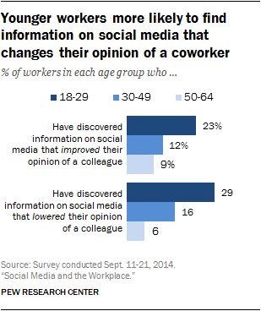
Graphical representation

Slide 8
Learning application
It is changing the manner learning happens.
Allows employers to allow the younger generations to learn turning the workplace environment to being friendly.
Allows before and after sessions with employees
Organizations need to rethink their learning programs.
It promotes harmonious learning process (Jon, 2016).
It does not allow the military type of leadership where instructions are directed down to employees.
Great amount of knowledge is shared among the media (Jon, 2016).

Slide 9
Micro blogging and micro sharing
There is real time sharing of small information.
Micro blogging tools have been secured by most company’s in their computer firewalls which is always online internal.
They use it to post comments on their proposals, presentations or preparations.
Micro sharing programs are part of daily workflow.
Social texts provides a section that one comment while going through a document instantly.
Managers can use it to communicate and address budgetary challenges (Jon, 2016).

Slide 10
Human Resources
Are at time tempted to ignore the issue of social matter allowing IT to solve their issues.
Issues involving the use of social media need lots of privacy, confidentiality and proper communication styles which entirely are in the HR.
HR structures policies to minimize the risks to the employer’s security and reputation
HR enforces policies that guide employees while at work place in a means to provide organizational benefit.
HR provides training guidelines on the use of social media both at work and at home.
Provides lessons on social media etiquette
Provides employer expectation upon the use of social media at workplace

Slide 11
References
Jon, H. (2016). Your Employees are using social media at work: Deal with it. Workforce.

