Slide 1
Management of Financial Resources
Foodservice Organizations
Gregoire
Chapter 13

Slide 2
The Purpose of Budgeting
Budget
An estimate of the income and expenditures during a given period of time based on the mission, goals, and objectives of an organization.
In other words, an organization’s business plan expressed in financial terms.

Slide 3
The Purpose of Budgeting
Budget helps to set the parameters for activities to be done during the budget period
Acts as a control device for regulating spending in the organization
Provides an objective set of criteria against which a manager’s performance can be measured

Slide 4
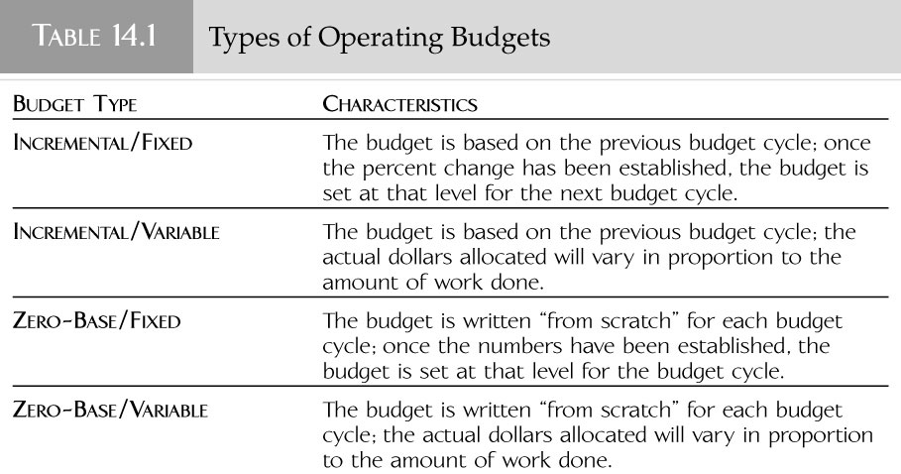
Operating Budgets

Slide 5
Operating Budgets
Time period for operating budget
Fiscal Year - A 12-month period for which an organization plans the use of its funds.
It can begin on any date and end 365 days later (366 in leap years).
Calendar Year - A 12-month period that begins January 1 and ends December 31.

Slide 6
Operating Budgets
Manner budget is divided for accounting purposes
Accounting Period - The time period designated by an organization for purposes of financial reporting.
Does not carry over from one year the next

Slide 7
Operating Budgets
Incremental Budgets
A type of operating budget that is based on the previous year’s budget and a predetermined increment.
This increment may depend on a number of factors such as inflation rate, labor contracts, profitability, operating losses, restructuring, reengineering, and so on.

Slide 8
Operating Budgets – Incremental Budgets
3 options for handling incremental budgets:
Each budget item is increased by predetermined amount
Manager is allocated total sum which has already been incrementally increased, and is allowed to distribute it among budget items
Manager is allocated total sum unchanged, and must request additional funds

Slide 9
Operating Budgets – Incremental Budgets
Advantages:
Easy to prepare
Usually precise (if based on accurate records)
Disadvantages:
Unresponsive to change
Discourage innovation
Support status quo, and therefore existing inefficient practices

Slide 10
Operating Budgets
Zero-Base Budgets
A type of operating budget that is based on estimated need for the coming year, without relying on last year’s budget as a starting point.
It requires managers to write budgets from scratch and to justify every dollar of proposed spending.

Slide 11
Operating Budgets – Zero-Base Budgets
Goal is for manager to:
Delineate functions within span of control
Assign an annual cost to each function
Situations where zero-base budgets work well:
During restructuring, rapid change
For start-up or high-tech companies
Disadvantages:
Difficult and costly to prepare
Vulnerable to politics, manager's bias

Slide 12
Operating Budgets
Fixed Budgets
Budget plans for which funds are allocated for the entire fiscal year.
It is also known as a static budget and can be applied to either the zero-base budget or to the incremental budget.
Provide manager with measurable goals, but...
Are inflexible and unresponsive to volume changes

Slide 13
Operating Budgets
Variable Budgets
Budget plans for which expenses will vary in response to actual production, volume, or revenues.
It is also referred to as a flexible budget and can be used in conjunction with either the zero-base budget or the incremental budget.
Account for variations in costs with volume fluctuations

Slide 14
Operating Budgets
Variable Budgets
Drawbacks:
More reactive than predictive
Many organizations cannot respond quickly to volume changes

Slide 15
Preparing the Operating Budget
Typical procedure:
Project revenues
Estimate labor needs and costs
Estimate non-labor expenses
Combine parts of the budget to project profit or loss

Slide 16
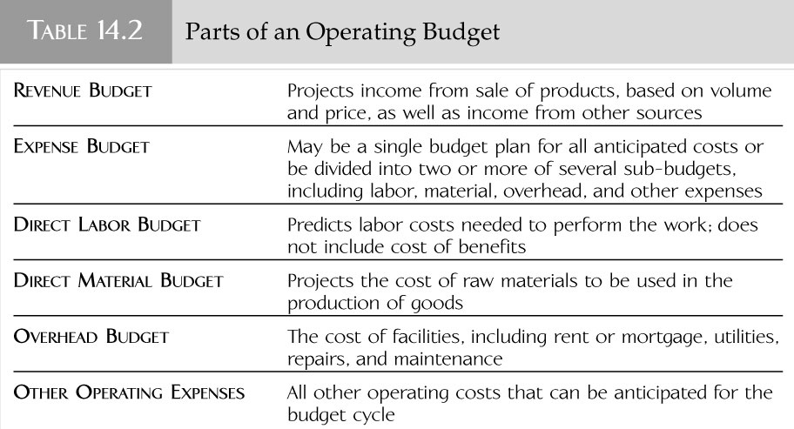
Preparing the Operating Budget

Slide 17
Preparing the Operating Budget
Cost Center
Any unit within an organization that has expenses.
Some cost centers, like foodservices and pharmacy, also generate revenues.
Others, like payroll, human resources, and materials management, are not expected to generate a profit or to break even.

Slide 18
Preparing the Operating Budget
Revenue Center
Any department within an organization that generates an income.
Profit Center
Any department within an organization with an income that exceeds operating costs.

Slide 19
Preparing the Operating Budget
Revenues
Revenue Budget - The projection of the income of an organization or a department based on the sale of products (part of operating budge).
Considerations:
Prices and sales volume (and their relationship)
Money from non-sales sources
Bad debts

Slide 20
Preparing the Operating Budget
Expenses
Expense Budget - Component of the operating budget that deals with all anticipated costs, which can be further divided into a number of sub-budgets.

Slide 21
Preparing the Operating Budget - Expenses
Labor
Labor - A prediction of the labor costs needed to get work done; does not always include the cost of benefits.
It can be written as part of the expense budget or as a separate part of the operating budget.
Direct Labor Costs - Labor costs that are related to the actual performance of work.
ex: base pay, overtime, pay in lieu of benefits
These are the projections that get written into the labor budget.

Slide 22
Preparing the Operating Budget - Expenses
Labor
Indirect Labor Costs - Labor costs over which managers have little control.
ex: benefits like insurance, taxes, and paid time off
Material
Direct Material Budget - The estimate of cost for raw materials to be used in the production of goods.
This part of the operating budget is computed for departments that produce a tangible product.

Slide 23
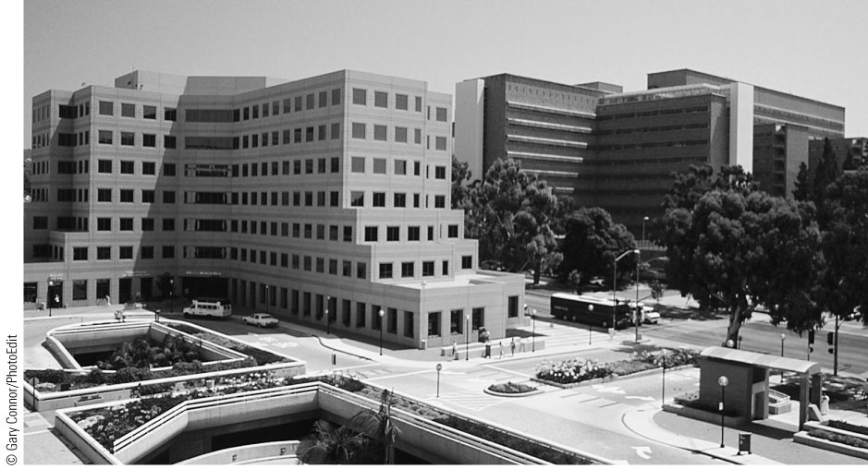
Preparing the Operating Budget - Expenses
Overhead - The general expenses associated with the operation of a facility that include rent, taxes, utilities, repairs, and maintenance.

Slide 24
Preparing the Operating Budget - Expenses
Other Operating Expenses - Subdivision of the operating budget that encompasses all other anticipated costs of operation.
ex: telephone bills, copying charges, printing, office supplies, books, travel, journals, postage, fees and licenses
Organizations that do not use sub-budgets would also include the costs of labor, overhead, and material under this heading.

Slide 25
Cash Handling
Cash Handling
The management of cash transactions.
Includes the receiving, storing, counting, recording, withdrawing, and depositing of cash.

Slide 26
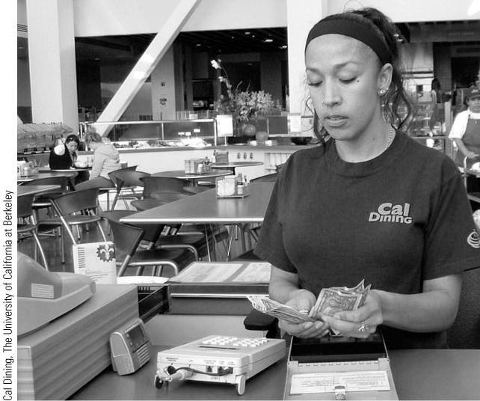
Cash Handling
Checks and balances
Cashier verifies bank amount at beginning of shift
Cashier counts amount in drawer at end of shift

Slide 27
Cash Handling – Checks and Balances
Bank - The amount of money that the cash register drawer contains at the start of a shift.
Cash Receipts - The amount of money that is present in the cash register drawer at the end of the day minus the starting bank.

Slide 28
Cash Handling – Checks and Balances
Cash Register - A machine that records and displays the details of a sales transaction (such as the quantity and price of items purchased), as well as acting as a storage unit for the cash involved in these transactions.
Cash receipts and cash register data are reconciled periodically

Slide 29
Cash Handling
Security
Cash must be secured when not being handled, when counted, and when transported
Safe - A place or container used to secure valuables from theft.
Armored Transport - Transport of money between retail facilities and commercial banks by licensed and bonded companies.

Slide 30
Cash Handling
Petty cash
Money that is kept on hand for making emergency purchases or for minor expenditures that cannot be made through regular vendors in a timely manner.
Should be used appropriately, not to avoid following procedures
Is preferable over using money from cash receipts for emergency purchases

Slide 31
Cash Handling
Petty cash
1 month's supply of funds should be kept on hand
When low, receipts are exchanged for more petty cash
Some organizations use company credit cards instead

Slide 32
Controlling Costs
Material management
Negotiating good prices
Specifications
Using a prime vendor
Group purchases
Just-in-time delivery
Keeping up-to-date records of inventory
Use of POS system
Secure receiving, storage and work areas

Slide 33
Controlling Costs
Workflow
Smooth forward workflow
Economies of scale
Quality control
The workforce
Measuring and improving productivity
Monitoring work hours and avoiding overtime
Scheduling employees for appropriate tasks

Slide 34
Controlling Costs
Facilities maintenance
Investing in preventing maintenance avoids larger replacement costs and disruption of workflow

Slide 35
Controlling Costs
Management of utilities
Gas equipment is generally cheaper than electric
Idle equipment not in use
Insulation for thermal equipment, windows
Automatic lights
Water-conserving fixtures/equipment
Recycling, composting

Slide 36
Financial Reports
Operating Statement
A document prepared by the accounting department of an organization at the end of an accounting period that compares actual fiscal performance to the budget.
A.K.A. a performance report.
Should be generated promptly so that results can be used to make adjustments
ex: increased membership revenues for health club = more customers, more staff needed to maintain level of service

Slide 37
Excerpt from an operating statement

Slide 38
Financial Reports
Variance Analysis
A statement prepared by managers to account for any deviation from the budget.
Budget Variance - Any deviation from the budget.
Managers should identify variances on the operating statement, and investigate the causes
Some managers must submit formal variance analyses routinely
Managers are responsible for identifying the cause and stopping it if necessary

Slide 39
Financial Reports
Profit and loss statements
Profit and Loss Statement (P&L) - A document generated by the accounting department of an organization that lists all the actual data accumulated for the accounting period, including both controllable as well as uncontrollable revenues and expenses, as well as net profits or losses.

Slide 40
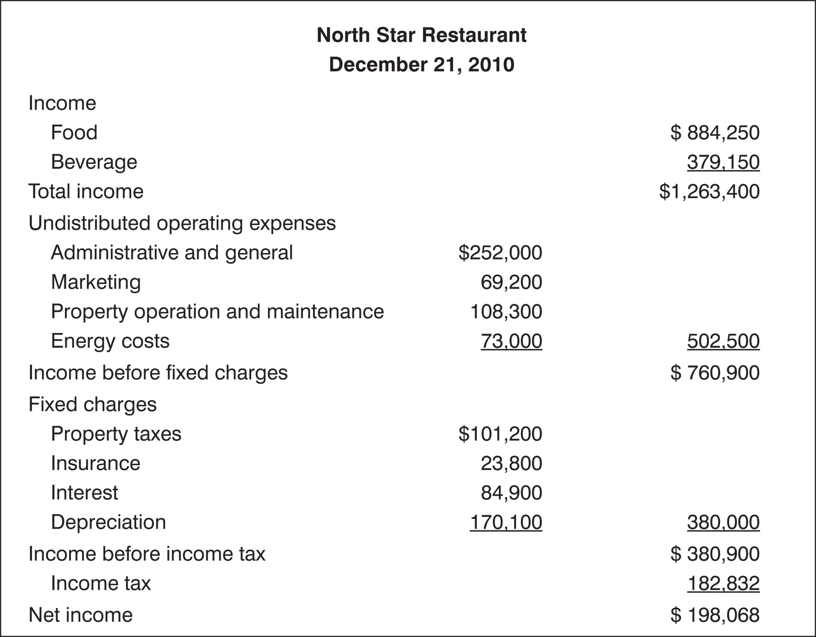
Income Statement
Notes:
The income statement is the financial report that presents the net income or profit of an organization for the accounting period.
It provides information about the revenues and expenses that resulted in the net income or loss.
The income statement is considered a flow or dynamic statement because operating results over time are presented.
The income statement (also known as the statement of income or the profit-and-loss statement) is a primary managerial tool reporting the revenues, expenses, and profit or loss as a result of operations for a period of time.
Sales or revenues include the cash receipts or the funds allocated to the operation for the period.
In a foodservice establishment, the cost of sales section of the income statement reflects the cost of products sold that generated the revenue.
Gross profit or income is determined by subtracting cost of goods sold from sales or revenue.
Net profit or loss is determined by subtracting expenses from gross profit.

Slide 41
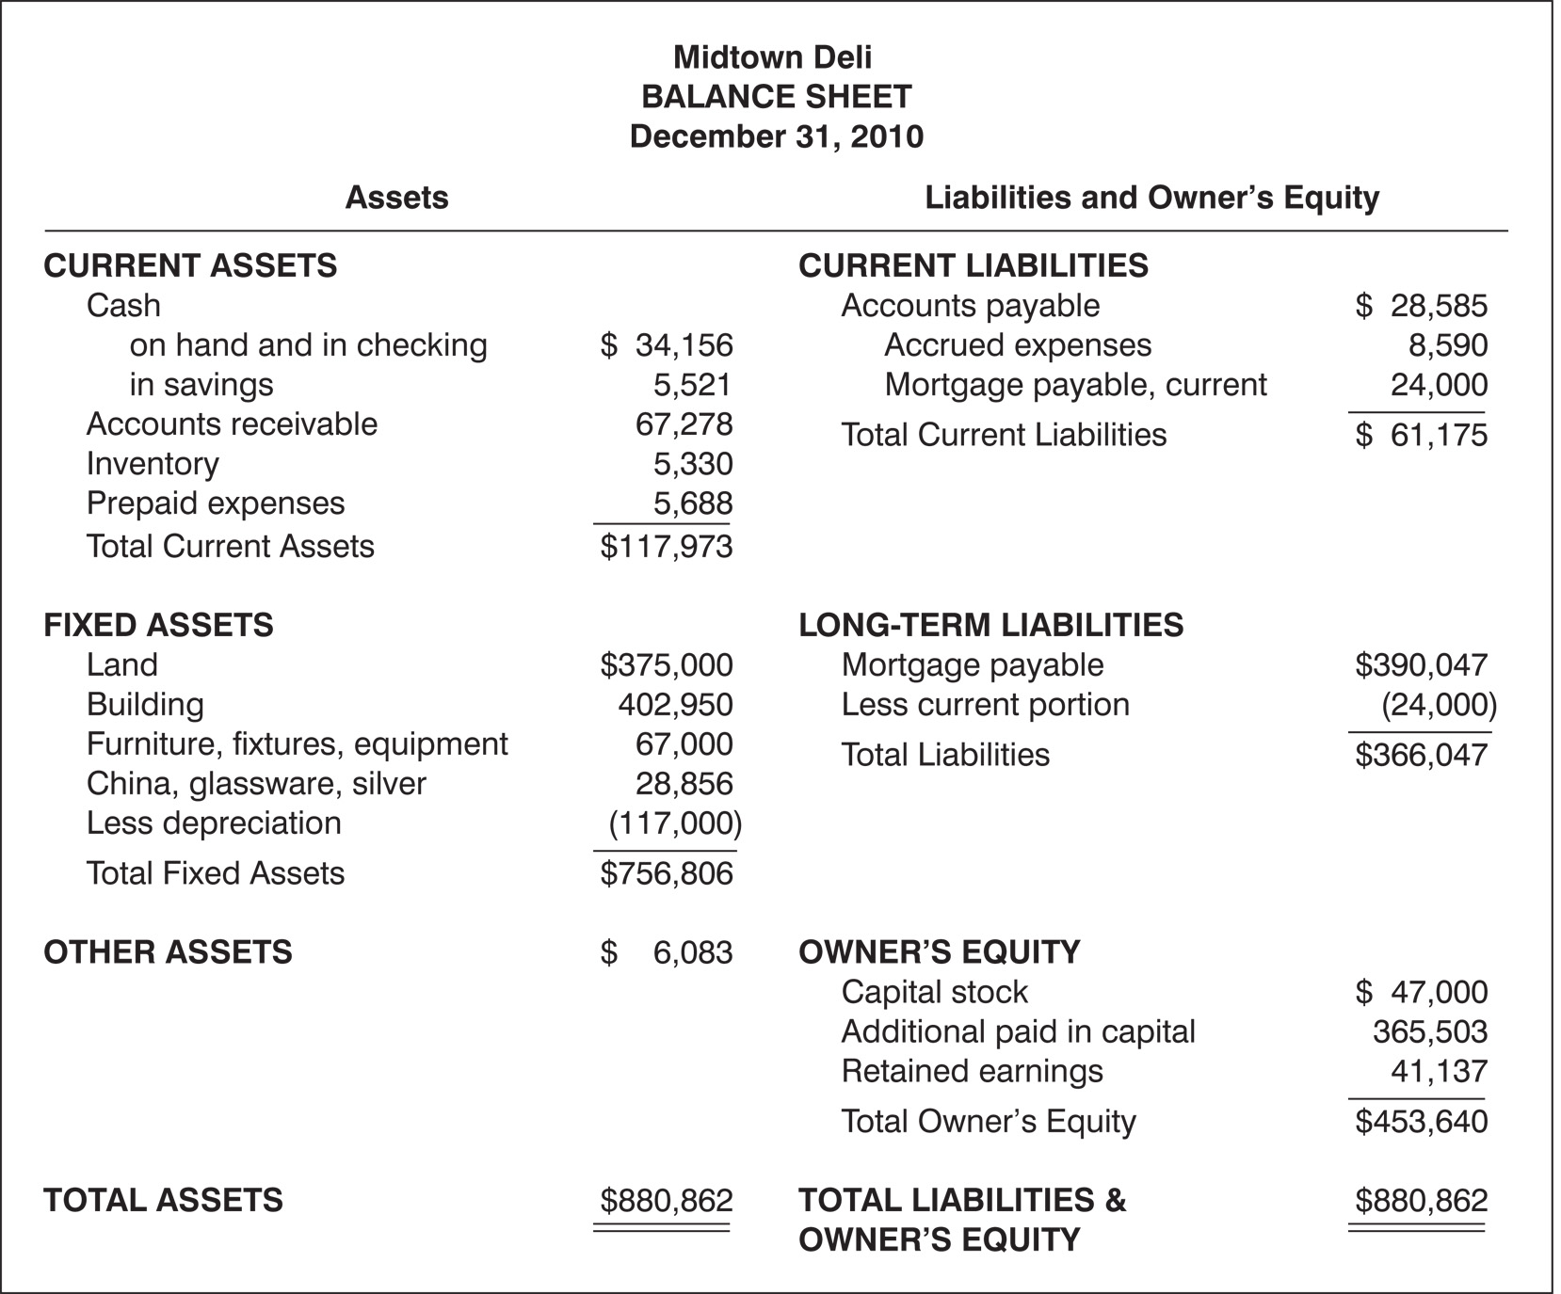
Balance Sheet
Notes:
The balance sheet is a statement of assets, liabilities or debts, and capital or owner’s equity at a given time or at the end of the accounting period.
The balance sheet is considered a static statement because it presents the financial position at a specific date or time.
The balance sheet, or statement of financial condition, is a list of assets, liabilities, and owner’s equity of a business entity at a specific date, usually at the close of the last day of a month, quarter, or year.
This statement is designated a balance sheet because it is based on a fundamental equation that shows that assets equal liabilities plus owner’s equity.
Assets. The first section of the balance sheet is a list of assets, which are generally categorized as current or fixed.
Current assets include cash and all assets that will be converted into cash in a short period of time, generally 1 year.
The cash accounts are cash on hand and in checking accounts and cash in savings.
Other current assets include accounts receivable, inventory, prepaid expenses, and entrance fees receivable.
Any marketable securities held would also be included as a current asset.
Fixed, or long-term, assets are those of a permanent nature, most of which are acquired to generate revenues for the business.
Fixed assets are not intended for sale and include land, buildings, furniture, fixtures, and equipment, in addition to small equipment such as china, glassware, and silver.
Because fixed assets generally lose value over their expected life, their initial cost is reduced by a monetary amount each year called accumulated depreciation.
Liabilities. Liabilities are categorized as current and long term.
Current liabilities represent those that must be paid within a period of 1 year, including such items as accounts payable for merchandise, accrued expenses, and annual mortgage payment.
Accrued expenses are due but not paid at the end of the accounting period, such as salaries, wages, and interest.
Fixed, or long-term, liabilities, in contrast, are obligations that will not be paid within the current year.
Owner’s Equity. The owner’s equity or capital section of the balance sheet represents that portion of the business that is the ownership interest, along with earnings retained in the business from operations.
In profit-oriented enterprises, the ownership may be one of three kinds:
A proprietorship, a business owned by a single individual.
A partnership, a business owned by two or more people.
A corporation, a business incorporated under the laws of the state with ownership held by stockholders.
In a not-for-profit corporation, the members may be the owners.

Slide 42
ASSIGNMENT#3
You have just been hired as a Food Service Director at St. Agastine Hospital. As you enter the workforce you realize that the food service budget is operating in the red. Using the management principles, what are some of the steps you would take to try and reap a profit or make it self- sustaining?
Use about 10 varied management concepts and highlight the management jargon as you explain your course of actions

