Slide 1
Interesting Question
How can we account for long-term social issues when managing corporate social responsibility?
What does the economic perspective of CSR (Friedman) offer in contrast to the social systems perspective of CSP (Wood)?

Slide 2
Competing Pressures in Social Responsibility
Pressures to mitigate potential negative consequences/long-term harm from a product or service vs. potential to hinder the viability of a legal product or service (NFL & safety, NHL & headshots, JinLin and hotels in Hainan; Four Loko and caffeine, guarana & taurine)
Pursuing a vital short-term business threat or opportunity vs. navigating the long term public opinion challenges that could result from this pursuit (Pittsburgh Pirates owners, Vermont Teddy Bear and “Crazy For You” Bear, Royal Caribbean and Haiti’s ports, Citigroup layoff, Wal-Mart and the Battle of the Wilderness landmark)
Pressure to address a serious negative social aspect of a product/service vs. trying to mitigate the likely impact of this negative incident on reputation or brand image (Goodell and Roethlisberger; Phil Knight and Tiger Woods; Taco Bell and 35% beef)
Pressure to meaningfully address high profile media coverage of a company scandal or incident vs. mitigating the possibilty of generating grounds for liability/lawsuits (Rockstar and fatal shooting attributed to GTA; Ford Pinto; Colgate and Tricolosan; PG&E and Hexavalent Chromium CR-6)
Desire to make a substantial commitment to address an important social concern vs. the need to control costs associated with this social effort (Starbucks and its sustainability commitment; Jamie Oliver and nutrition in Huntington, WV, BP and the Gulf; Pepsi forgoes a Super Bowl Ad and donates the money to “Refresh Everything”

Slide 3
Economics vs. Social Systems
Milton Friedman
Donna Wood
Corporate Social Responsibility:
Evaluating a business actor’s action or decision with respect to
- Profitability: Is the action a Profitable/reasonable business activity?
- Legality: Does the action follow relevant laws and legal concerns?
- Ethical Custom: Is the action consistent with ethical custom (public opinion)
Corporate Social Performance:
A business actor’s long term commitment to managing a social issue or concern:
- Principles: What factors (law, public opinion, organizational mission statement, individual employee beliefs) influence the business actor’s involvement with the issue?
- Processes: What specific things is the business actor doing with respect to the social issue?
- Outcomes: What are the business outcomes and social impacts of the business actor’s involvement with the issue?

Slide 4
Corporate Social Performance
Donna Wood, 1991: “Corporate Social Performance Revisited.” AMR.
Principles:
  Institutional
  Organizational
  Individual
Processes:
  Environmental Assessment
  Stakeholder Management
  Issues Management
Outcomes:
  Social Impacts
  Social Programs
  Social Policies

Slide 5
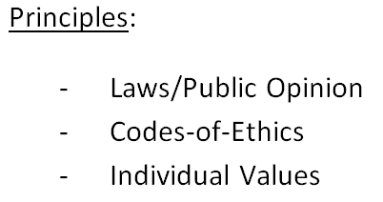
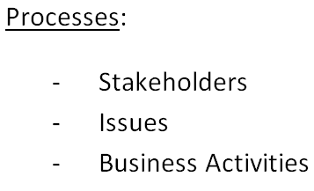
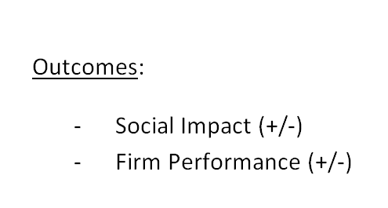
Donna Wood –
Firm’s Long-Term Management of a Social Issue
Novelty
Value
Social
Network

Slide 6
Principles
Institutional:
  Laws (Letter vs. Spirit)
  Public Opinion
Organizational:
  Organizational Values
  Codes of Ethics
Individual:
  Managerial Discretion (person using the resources of their organizational role)

Slide 7
Processes
Environmental Scanning – pay attention to the external environment in order to understand how a firm affects/is affected by an issue
Stakeholder Management – pay attention to social actors who affect/are affected by the issue
Issues Management – address the agendas of different stakeholders and attempt to reconcile these with the firm’s agenda

Slide 8
Outcomes
Social Impact: Have a clear sense of how the firm’s principles and processes affect the needs and interests of stakeholders and the public policy issue (+ and -)
Firm/Organizational Impact: Have a clear sense of how the firm’s involvement in the issue affects its performance (+ and -)

Slide 9
“Pros” of Managing
Corporate Social Responsibility
Friedman’s economic perspective provides three fairly tangible standards for assessing social responsibility
Wood’s social systems perspective requires that an organization/firm make a long-term commitment to addressing a social issue, which means constantly questioning changes to principles, processes and outcomes.
Both the economic and social systems approaches demands an attention to competing pressures, which allows us to consider business-social trade-offs (and how they can be balanced)

Slide 10
“Cons” of Managing
Corporate Social Responsibility
Friedman’s economic model places such a high value on profitability and legal compliance that it is almost impossible to justify making a long term investment in a social concern or taking any kind of risk to address an important social cause.
Wood’s social systems model is heavily-based on the assumption that business should be responsible to societal demands, and places less of an emphasis on business/organizational performance.
While both perspectives are balanced, a strict adherence to either perspective would probably lead a manager to make “passive compromises” (for profitability in Friedman and for social betterment in Wood)

Slide 11
Takeaway
These alternate approaches to managing corporate social responsibility provides a more systematic way to consider why a firm should address a social issue, how a firm can address a social issue and what impacts occur from this involvement.
Managers must take care to incorporate business and organizational issues into this analysis, and must commit to a comprehensive long-term approach to the issue.

