Slide 1
SAVINGS AND INVESTMENT

Slide 2
Benefits of Stocks
Firstly, stocks yield huge gains.
Secondly, it is an ideal investment.
Thirdly, legal liabilities to the investor are limited.
Fourthly, they are easy to trade.
Lastly, it offers two types of benefits. Stocks can earn from capital gains or dividends
Notes:
The liquidity of stocks allows the trader to buy and sell at their own convenience. Lastly, it offers two types of benefits. Stocks can earn from capital gains or dividends. Capital gains are acquired when the value of the stock appreciates and the investor receives a cut from the company. Dividends are gained when the company decides to distribute the excess money it gets from covering growth and maintenance.

Slide 3
Risks of stock investment
Firstly, they are high risk investments.
Secondly, stocks give the investor less control on the investment. Thirdly, a stock investor is the last one to get paid.
Notes:
Firstly, they are high-risk investments. Stock prices are very volatile and fluctuate erratically which means investor risk losing a lot of money if falls in prices cause them to panic and hence sell their stocks they end up losing money. In addition, if the company goes bankrupt, your investment disappears too. Secondly, stocks give the investor less control on the investment. The success and failure of the stocks depend on the practices and strategies that the company puts in place. The investor cannot impose his will on the company and hence is subject to the decisions that the business puts in place. Thirdly, a stock investor is the last one to get paid. The investor gets paid last, after taxes, employees, creditors, and suppliers and hence in the case of liquidation, the highest ranking, members get paid before the investor.

Slide 4
Benefits of Bonds
Firstly, bonds are a relatively safe investment.
Secondly, their returns are predictable.
Thirdly, bonds are a worthwhile investment compared to banking.
Notes:
Investing bonds in the government are relatively risk-free, albeit low returns. Secondly, their returns are predictable. Unlike stock that can make huge losses annually, bond income is more steady in that one’s capital will remain consistent even if there are little returns. Thirdly, bonds are a worthwhile investment compared to banking. Unlike saving in a bank, bonds have the potential to generate interest at relatively low risk of losing the money.

Slide 5
Risk of Bonds
Firstly, credit risk is a major risk for bonds.
Secondly, event risk is another threat to bonds.
Thirdly, bonds lack diversification.
Finally, bonds have no global exposure.
Notes:
Event risk is another threat to bonds. A company might face unforeseen circumstances that would undermine its ability to generate funds. Lack of cash flow determines the ability of the firm to repay the investor’s interest and principle.
Bonds lack diversification. Individual bonds are exposed to concentrated position risk which means that there are no additional compensations for the investor. Finally, bonds have no global exposure. Bonds lack diversified global exposure meaning that they do not benefit from global fixed income which is a source of diversification and a big investable asset class.

Slide 6
Bond Valuation techniques
This is the process of determining the fair value of a bond. It involves calculating the present value of a bond’s future interest payments and the value of the bond upon maturity. The valuation process involves the following steps; firstly, the expected cash flow is estimated. Secondly, the appropriate interest rates are determined to be used to discount the cash flow. And thirdly, the present value of the expected cash flow is calculated using the interest rates that were determined in step two.
Notes:
Investors would like to know the price offered for the bone in order to determine the reasonableness of investing in it. Bond value is the economic value of the value. The economic value of the bond is the present value of the future cash flows that are expected to be received or paid. The economic value directs the investor on the amount he is willing to pay while considering the risk and nature of future cash flows. Another important feature of a bond is the actual price the investor has to pay for the bond. If the economic value of the bond is less than the market value, then the bond is overvalued to the investors perspective. If the economic value of the bond is greater than the market value, then, to the investor, it is undervalued.

Slide 7
Step by step explanation
A bond XYZ shall mature in 5 years at a coupon rate of 7 percent and the maturity value of $1000. The discount rate is 5 percent per annum.
The cash flow for each year is as follows:
1st year = $70
2nd year = $70
3rd year = $70
4th year = $70
5th year = $1070
Notes:
The first thing when computing the value of a bond is finding the present value of the bond’s cash flows in the future. The present value is the amount that the investor would have to pay in order to make a certain amount of future cash flow.It depends on the interest rate used and the maturation period of the bond.To find out the value, the present value of each cash flow has to be found. The bond’s price is the calculated by adding this figures together.
PV at time T=expected cash flows in period T/(1+I) to the Nth power
After calculating the expected cash flows, the individual cash flows are added together
Value=present value @ T1+presnet value @ T2+present value @Tn
As the rate decrease or increase, the discount rate also changes.

Slide 8
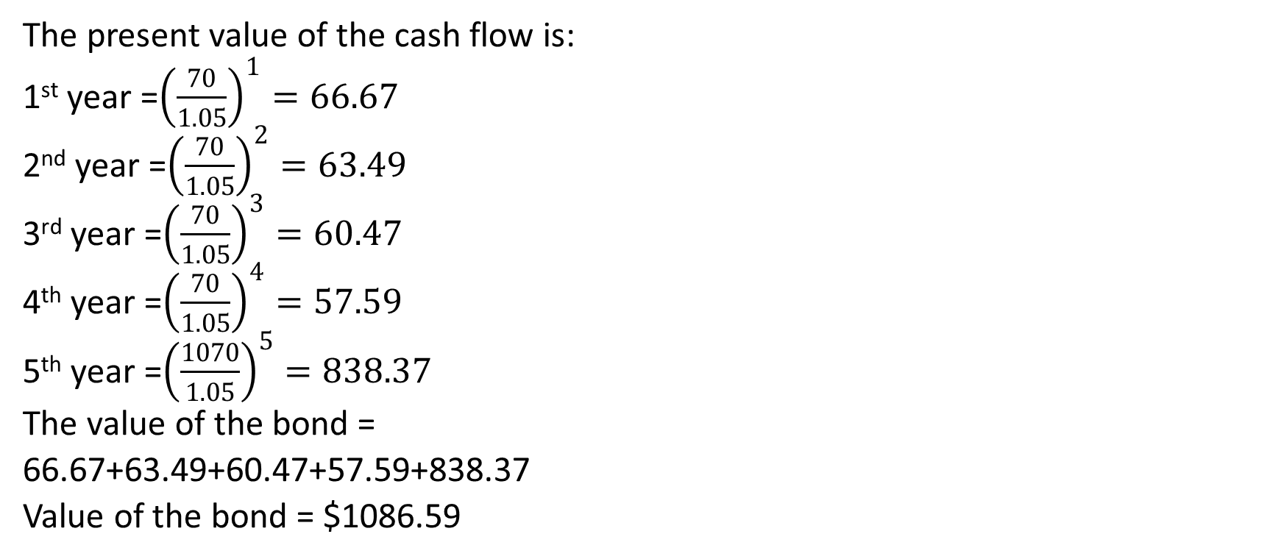
Continuation..
The present value of the cash flow is:
1st year =${\left(\frac{70}{1.05}\right)}^{1}=66.67$
2nd year =${\left(\frac{70}{1.05}\right)}^{2}=63.49$
3rd year =${\left(\frac{70}{1.05}\right)}^{3}=60.47$
4th year =${\left(\frac{70}{1.05}\right)}^{4}=57.59$
5th year =${\left(\frac{1070}{1.05}\right)}^{5}=838.37$
The value of the bond =
66.67+63.49+60.47+57.59+838.37
Value of the bond = $1086.59
Notes:
As an investor, it is crucial to determine a favorable entry point for the stock market. A good entry point is determined by the valuation of the stocks. The valuation of a stock is determined by several valuation ratios. Some important ratios to understand are. Price-to-earnings ratio, this ratio is important because it helps to compare a firm’s valuation versus its peers and valuations from a historical standpoint. Another ratio to understand is the price-to-earnings growth ratio. This helps to determine the growth of the estimated growth of the company. Furthermore, it is important to understand the cash flow ratio. This helps the investor to know the ability of a company to provide cash flow per share. This ratio and others such as dividend yield and book value ratio help the investor to spot a potential deal in order to risk their capital.

Slide 9
Valuation technique explained
The first thing when computing the value of a bond is finding the present value of the bond’s cash flows in the future. The present value is the amount that the investor would have to pay in order to make a certain amount of future cash flow. It depends on the interest rate used and the maturation period of the bond. To find out the value, the present value of each cash flow has to be found. The bond’s price is the calculated by adding this figures together.
PV at time T=expected cash flows in period T/(1+I) to the Tth power
After calculating the expected cash flows, the individual cash flows are added together
Value=present value @ T1+presnet value @ T2+present value @Tn
As the rate decrease or increase, the discount rate also changes.
Notes:
The first thing when computing the value of a bond is finding the present value of the bond’s cash flows in the future. The present value is the amount that the investor would have to pay in order to make a certain amount of future cash flow.It depends on the interest rate used and the maturation period of the bond.To find out the value, the present value of each cash flow has to be found. The bond’s price is the calculated by adding this figures together.
PV at time T=expected cash flows in period T/(1+I) to the Tth power
After calculating the expected cash flows, the individual cash flows are added together
Value=present value @ T1+presnet value @ T2+present value @Tn
As the rate decrease or increase, the discount rate also changes.

Slide 10
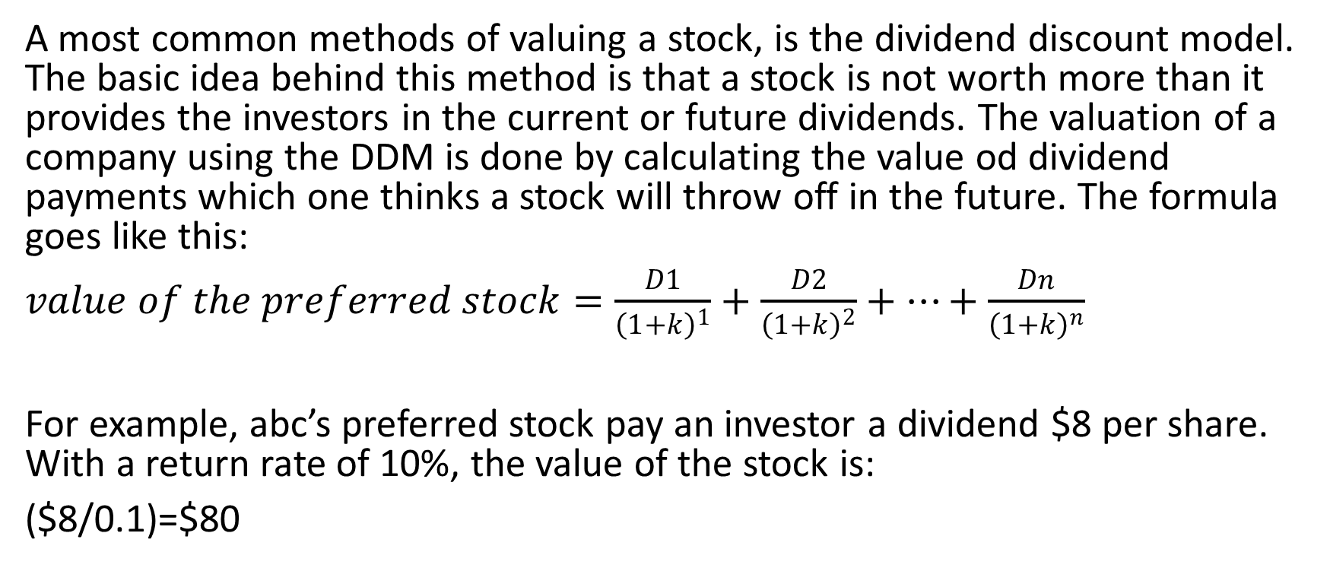
Step by step valuation of the stock
A most common methods of valuing a stock, is the dividend discount model. The basic idea behind this method is that a stock is not worth more than it provides the investors in the current or future dividends. The valuation of a company using the DDM is done by calculating the value od dividend payments which one thinks a stock will throw off in the future. The formula goes like this:
$value of the preferred stock=\frac{D1}{{\left(1+k\right)}^{1}}+\frac{D2}{{\left(1+k\right)}^{2}}+…+\frac{Dn}{{\left(1+k\right)}^{n}}$
For example, abc’s preferred stock pay an investor a dividend $8 per share. With a return rate of 10%, the value of the stock is:
($8/0.1)=$80
Notes:
There are two categories of valuation techniques, relative and absolute models. Absolute models try to find the true value of an investment based only on fundamentals. Fundamentals focus on things such as cash flows, dividends and a company’s growth rate. Techniques in this category include discounted cash flow model, dividend discount models, asset based models and residual income. On the other hand, relative valuation models compare the company to other similar companies. They involve calculating ratios such as the price-to-earnings ratio and compare it to the ratios of other companies. This method is quicker and easier and hence analysts and investors start analyzing with this method.

Slide 11
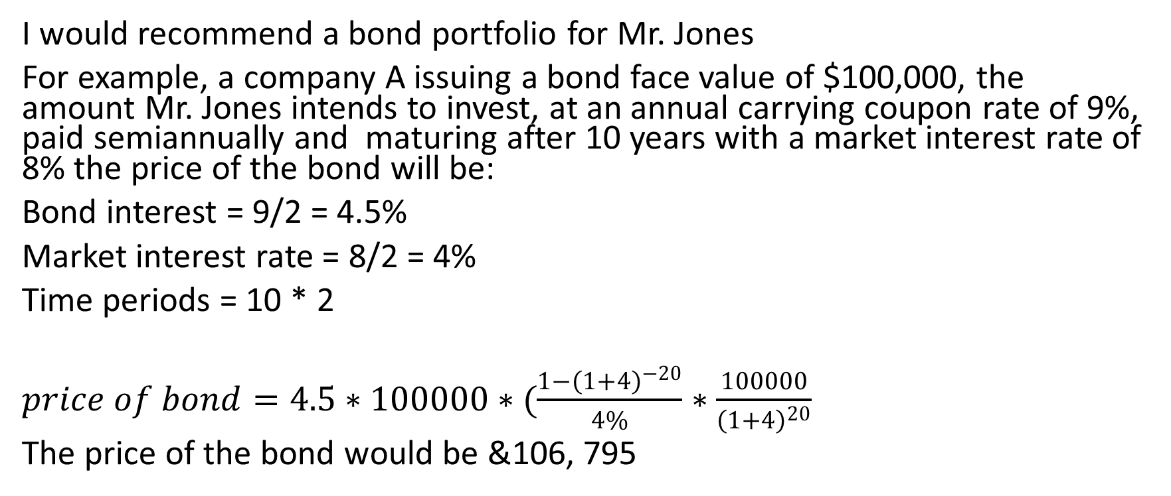
Recommendation
I would recommend a bond portfolio for Mr. Jones
For example, a company A issuing a bond face value of $100,000, the amount Mr. Jones intends to invest, at an annual carrying coupon rate of 9%, paid semiannually and maturing after 10 years with a market interest rate of 8% the price of the bond will be:
Bond interest = 9/2 = 4.5%
Market interest rate = 8/2 = 4%
Time periods = 10 * 2
$price of bond=4.5∗100000∗(\frac{1−{\left(1+4\right)}^{−20}}{4\%}∗\frac{100000}{{\left(1+4\right)}^{20}}$
The price of the bond would be &106, 795
Notes:
Mr. Jones intends to invest $100000 for a long period and hence investing in bonds is a good alternative.
References
Morris, K. & Morris, V. (2004). The Wall Street journal guide to understanding money & investing (1st ed.). New York: Lightbulb Press.

