Slide 1
Time Value For Money

Slide 2
The concept of time value of money is based on the idea that cash available presently is a lot more worth than a similar amount in the future. This is because between now and the future, the present sum has the potential to earn more money, interest, (Peterson Drake & Fabozzi, 2009). Furthermore, the future is risky; inflation and default risk are two probable risks. Default risk occurs when a borrowed amount is not returned to the lender. Inflation refers to the increase in the prices of goods. Time value of money is also known as present discounted value (Peterson Drake & Fabozzi, 2009).

Slide 3

Present Value Calculation
The present value formula for is given by;
$PV=FV∗\left[\frac{1}{{\left(1+I\right)}^{n}}\right]$
Where PV = Present Value
FV = Future Value
n = time
i = interest
for example, to receive $100 at the end of two years then the present value of money at a compound interest of 8% annually is given by:
PV = FV * [1 / (1 +i ) ^ n]
PV = 100 * [1 / (1 + 0.08) ^ 2]
PV = 100 * [1 / 1.664 ]
PV = 100 * 0.8573388
PV = $85.73

Slide 4
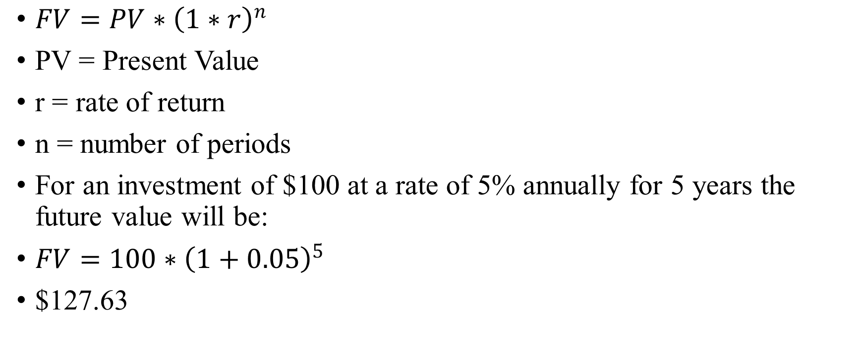
Future Value Calculation
$FV=PV∗{\left(1∗r\right)}^{n}$
PV = Present Value
r = rate of return
n = number of periods
For an investment of $100 at a rate of 5% annually for 5 years the future value will be:
$FV=100∗{\left(1+0.05\right)}^{5}$
$127.63

Slide 5

Effects of Compounding
PV = $1000
Interest (annually)– 5%
Time (years) – 3
$Interest first year=1000∗0.05$ = $50
Principal second year = 1000 + 50 = $1050
$Interest Second year=1050∗0.05$ = $52.5
Principal third year = 1050 + 52.5 = $1102.5
$Interest third year=1102.5∗0.05$ = $55.125
Total after 3 years = 1000 + 50 + 52.5 + 55.13
FV = $1157.63

Slide 6
Time Value Concepts Summary
A dollar in the pocket today is worth more than a dollar in the future.
Money available currently has the capacity to collect interest
Value is compromised by inflation and default risk

