Slide 1
SAVINGS AND INVESTMENT

Slide 2
Benefits of Stocks
Firstly, stocks yield huge gains.
Secondly, it is an ideal investment.
Thirdly, legal liabilities to the investor are limited.
Fourthly, they are easy to trade.
Lastly, it offers two types of benefits. Stocks can earn from capital gains or dividends

Slide 3
Risks of stock investment
Firstly, they are high risk investments.
Secondly, stocks give the investor less control on the investment. Thirdly, a stock investor is the last one to get paid.

Slide 4
Benefits of Bonds
Firstly, bonds are a relatively safe investment.
Secondly, their returns are predictable.
Thirdly, bonds are a worthwhile investment compared to banking.

Slide 5
Risk of Bonds
Firstly, credit risk is a major risk for bonds.
Secondly, event risk is another threat to bonds.
Thirdly, bonds lack diversification.
Finally, bonds have no global exposure.

Slide 6
Bond Valuation techniques
This is the process of determining the fair value of a bond. It involves calculating the present value of a bond’s future interest payments and the value of the bond upon maturity. The valuation process involves the following steps; firstly, the expected cash flow is estimated. Secondly, the appropriate interest rates are determined to be used to discount the cash flow. And thirdly, the present value of the expected cash flow is calculated using the interest rates that were determined in step two.

Slide 7
Step by step explanation
A bond XYZ shall mature in 5 years at a coupon rate of 7 percent and the maturity value of $1000. The discount rate is 5 percent per annum.
The cash flow for each year is as follows:
1st year = $70
2nd year = $70
3rd year = $70
4th year = $70
5th year = $1070

Slide 8
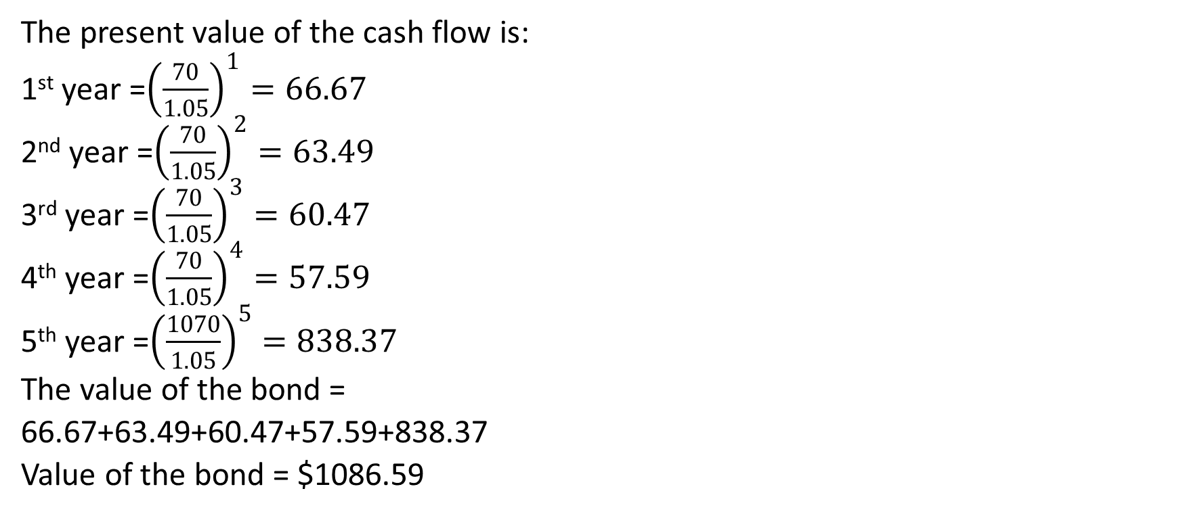
Continuation..
The present value of the cash flow is:
1st year =${\left(\frac{70}{1.05}\right)}^{1}=66.67$
2nd year =${\left(\frac{70}{1.05}\right)}^{2}=63.49$
3rd year =${\left(\frac{70}{1.05}\right)}^{3}=60.47$
4th year =${\left(\frac{70}{1.05}\right)}^{4}=57.59$
5th year =${\left(\frac{1070}{1.05}\right)}^{5}=838.37$
The value of the bond =
66.67+63.49+60.47+57.59+838.37
Value of the bond = $1086.59

Slide 9
Valuation technique explained
The first thing when computing the value of a bond is finding the present value of the bond’s cash flows in the future. The present value is the amount that the investor would have to pay in order to make a certain amount of future cash flow. It depends on the interest rate used and the maturation period of the bond. To find out the value, the present value of each cash flow has to be found. The bond’s price is the calculated by adding this figures together.
PV at time T=expected cash flows in period T/(1+I) to the Tth power
After calculating the expected cash flows, the individual cash flows are added together
Value=present value @ T1+presnet value @ T2+present value @Tn
As the rate decrease or increase, the discount rate also changes.

Slide 10
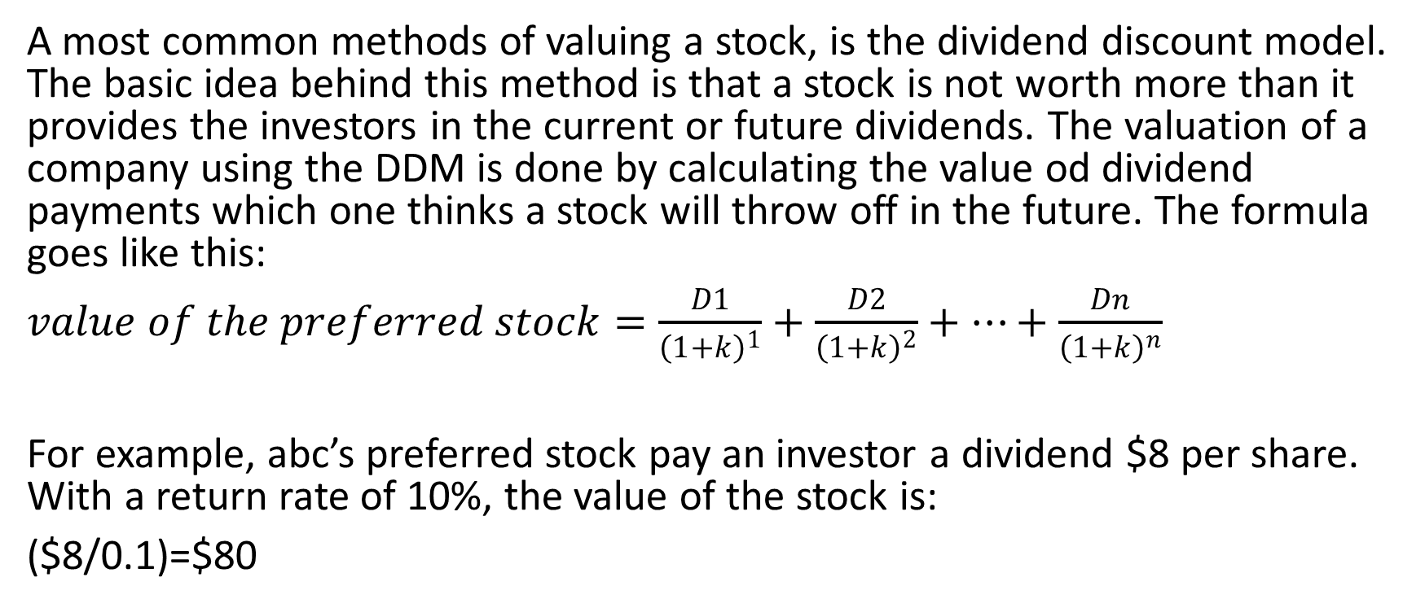
Step by step valuation of the stock
A most common methods of valuing a stock, is the dividend discount model. The basic idea behind this method is that a stock is not worth more than it provides the investors in the current or future dividends. The valuation of a company using the DDM is done by calculating the value od dividend payments which one thinks a stock will throw off in the future. The formula goes like this:
$value of the preferred stock=\frac{D1}{{\left(1+k\right)}^{1}}+\frac{D2}{{\left(1+k\right)}^{2}}+…+\frac{Dn}{{\left(1+k\right)}^{n}}$
For example, abc’s preferred stock pay an investor a dividend $8 per share. With a return rate of 10%, the value of the stock is:
($8/0.1)=$80

Slide 11
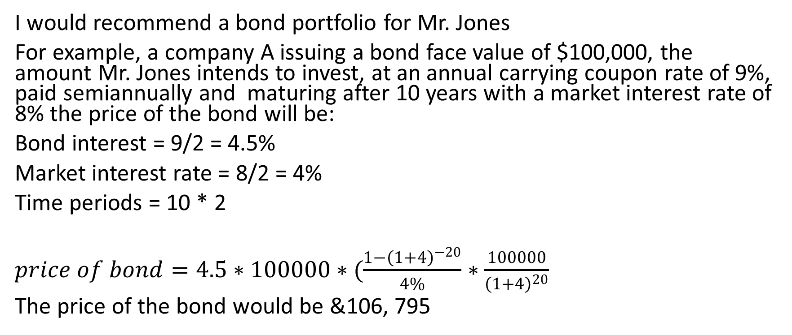
Recommendation
I would recommend a bond portfolio for Mr. Jones
For example, a company A issuing a bond face value of $100,000, the amount Mr. Jones intends to invest, at an annual carrying coupon rate of 9%, paid semiannually and maturing after 10 years with a market interest rate of 8% the price of the bond will be:
Bond interest = 9/2 = 4.5%
Market interest rate = 8/2 = 4%
Time periods = 10 * 2
$price of bond=4.5∗100000∗(\frac{1−{\left(1+4\right)}^{−20}}{4\%}∗\frac{100000}{{\left(1+4\right)}^{20}}$
The price of the bond would be &106, 795

