Slide 1
Presentation Requirements
Dr. Robin Switzer

Slide 2
Contents
Requirements similar to paper expectations
Requirements different than paper expectations
Writing
Design
Notes:
This presentation is designed to help clarify expectations and requirements for a Power Point Presentation.

Slide 3
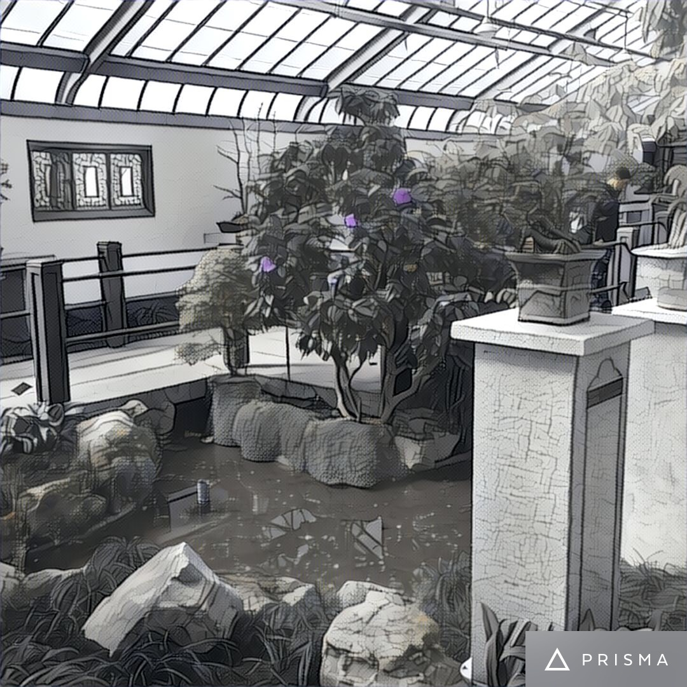
Expectations Similar to Papers
Notes:
In this sections, the requirements and expectations that are the same as requirements for papers will be explored.

Slide 4
Similar
Do not use contractions
Do not use I (you, we, me, us, our etc)
Write in Past tense
Introduction
Notes:
Just as in papers, the author should refrain from using contractions and spell both words; do not instead of don’t.
Do not use I statements as “skilled writers never use the phrases ‘I feel’, ‘I think’ or ‘I believe” (Mitchell, Jolley & O’Shea, 2013 pp.9). The exception of course is when quoting a personal interview.
Write in the ”past tense to express an action or condition that occurred at a specific, definite time in the past” (APA, 2010 pp.78). Research, case examples, interviews occurred in the past from the presentation, so remain in past tense.
Every presentation should have a Introduction. This slide should foreshadow the presentation by introducing the topic (Mitchell, Jolley, & O’Shea, 2013).

Slide 5
Similar continued
Citations
Sources
Reference
Notes:
In each presentation multiple academic sources must be used. Academic sources include textbooks and peer-reviewed journal articles. Such sources are available to students at the UOPx library. Each presentation should have a minimum of five sources. When a presentation calls for services from the community, web pages or informational material from the community agency may be used (cited and referenced)
To support points made in the presentation “quote, paraphrase, or summarize material” (Mitchell, Jolley & O’Shea, 2013 pp.3). Material needs to be cited either in the slide (small terms or phrases) or in the speaker’s notes for longer material.
Every presentation should have a Reference slide and ”all sources cited in the (presentation) … should appear on the list” (Mitchell, Jolley & O’Shea, 2013 pp.43). For presentation that include an interview, quotes or summaries of the interview are cited in the speaker’s notes with (personal communication, year) and not included on the reference list.

Slide 6

Expectations that differ from papers
Notes:
In this sections, expectations that differ from papers will be explored.

Slide 7
Different
Format
  Margins
  Font/typeface
  Line spacing
  Page numbers, running header
Speaker’s notes
Notes:
Although certain aspects of APA such as refraining from I or contractions must be observed. The majority of format rules do not apply. Margins, font/typeface, line spacing etc do not need to be observed. All choices in this are should be based on readability and design.
In presentation use speaker’s notes to expand on points and place the majority of cited expanded material. Do not place paragraphs in slides (Wax, n.d.), reserve longer pieces of writing for the speaker’s notes.

Slide 8

Writing
Notes:
Writing style, although similar to papers needs to be placed differently in presentations.

Slide 9
Writing
Clear
Concise
Simple
Professional
Notes:
Just as in papers, the writing should be clear and concise. “Do not use fancy words or fancy phrases to impress” but “do not banish technical terms” (Mitchell, Jolley & O’Shea, 2013 pp.10).
Incorporate professional language, and write as if the presentation audience is a potential employer.
Simply list or highlight major points in the slide, then expand within the speaker’s notes including citations. “Slides are the illustrations” (Wax, n.d.pp.1), of the material but not the bulk.
Reserve the majority of writing for the speaker’s notes.

Slide 10

Design
Notes:
Guidelines and tips for a colorful yet effective presentation.

Slide 11
Design
Color scheme
Placement
Images
Notes:
For an effective presentation use easy to read font. Make sure the font in the slide is immediately easy to read and works within the design. Headings at the top should be larger than points in the body. The font in the speaker’s notes should be no smaller than 12 or larger than twenty.
Pick a color scheme that is dark text on a light background, this is easiest for people to differentiate text from background. If the design does not work, and a dark background is desired, make sure the text is light enough to contrast and be able to read.
Align materials left or right. Centering can make it difficult to read.
(Wax, n.d.)
If images are used, make sure that the images do not overpower the slide or interfere with text. Do not use copyrighted materials such as memes, cartoons or videos posted to the Internet. If the image contains a C alone or in a circle it is copyrighted. Only use images that are freely allowed use such as clip art or images created by the author of the presentation. Citing a copyrighted cartoon, meme or video is not enough, it is considered copyright infringement.
The images used in this presentation are photographs taken by the author altered by a lens application. The images are owned by the author.

Slide 12
Reference
American Psychological Association (APA), (2010). Publication manual of the american psychological association. (6th ed.) Washington DC: American Psychological Association.
Mitchell, M.L., Jolley, J.M., & O’Shea, R.P. (2013). Writing for psychology. (4th ed.) Belmont, CA: Wadsworth, Cengage Learning.
Wax, Dustin (n.d.) Ten tips for more effective power point presentations. Life Hacks. Retrieved from www.lifehack.org
Notes:
Every presentation must have a reference slide.

