Slide 1
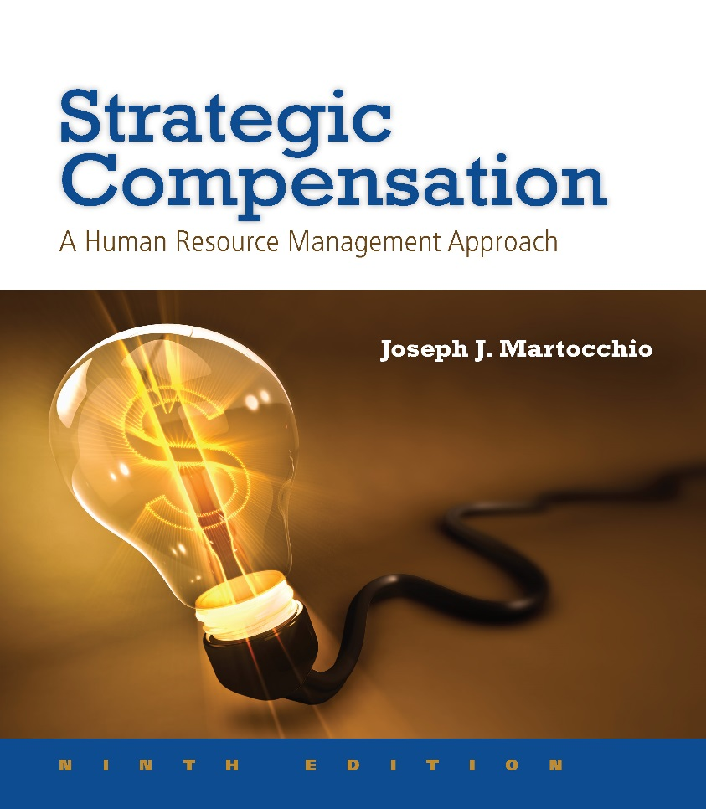
Chapter 1:
Strategic Compensation: A Component of Human Resource Systems

Slide 2
Learning Objectives
1-1. Define strategic compensation.
1-2. Summarize the role of compensation as a
strategic business partner.
1-3. Explain strategic compensation decisions.
1-4. Identify and discuss the building blocks
and structural elements of strategic
compensation systems.

Slide 3
Learning Objectives
1-5. Describe the fit of the compensation
function in organizations.
1-6. Identify the stakeholders of the
compensation function and summarize their stakes in the work compensation
professionals perform.

Slide 4
What Is Compensation?
LO 1-1
Compensation represents the rewards employees receive for performing their jobs. These rewards are either:
Intrinsic: intrinsic compensation represents employees’ critical psychological states that result from performing their jobs
Extrinsic: extrinsic compensation includes both monetary and nonmonetary rewards

Slide 5
What Is Strategic Compensation?
LO 1-1
Strategic Compensation refers to the design and implementation of compensation systems to reinforce the objectives of both HR strategies and competitive business strategies.

Slide 6
Competitive Business Strategy
LO 1-1
The planned use of company resources
Financial capital
Equipment capital
Human capital
Multiple years of time span
Competitive strategy choices
Lowest cost strategy
Differentiation strategy

Slide 7
Human Resource Strategies
LO 1-1
The use of multiple HR practices to reinforce competitive business strategy, for example:
We (Eli Lilly) are a global healthcare leader headquartered in Indianapolis, IN. Our 39,000 employees around the world work to discover and bring life-changing medicines to those who need them, and improve the understanding and management of disease.

Slide 8
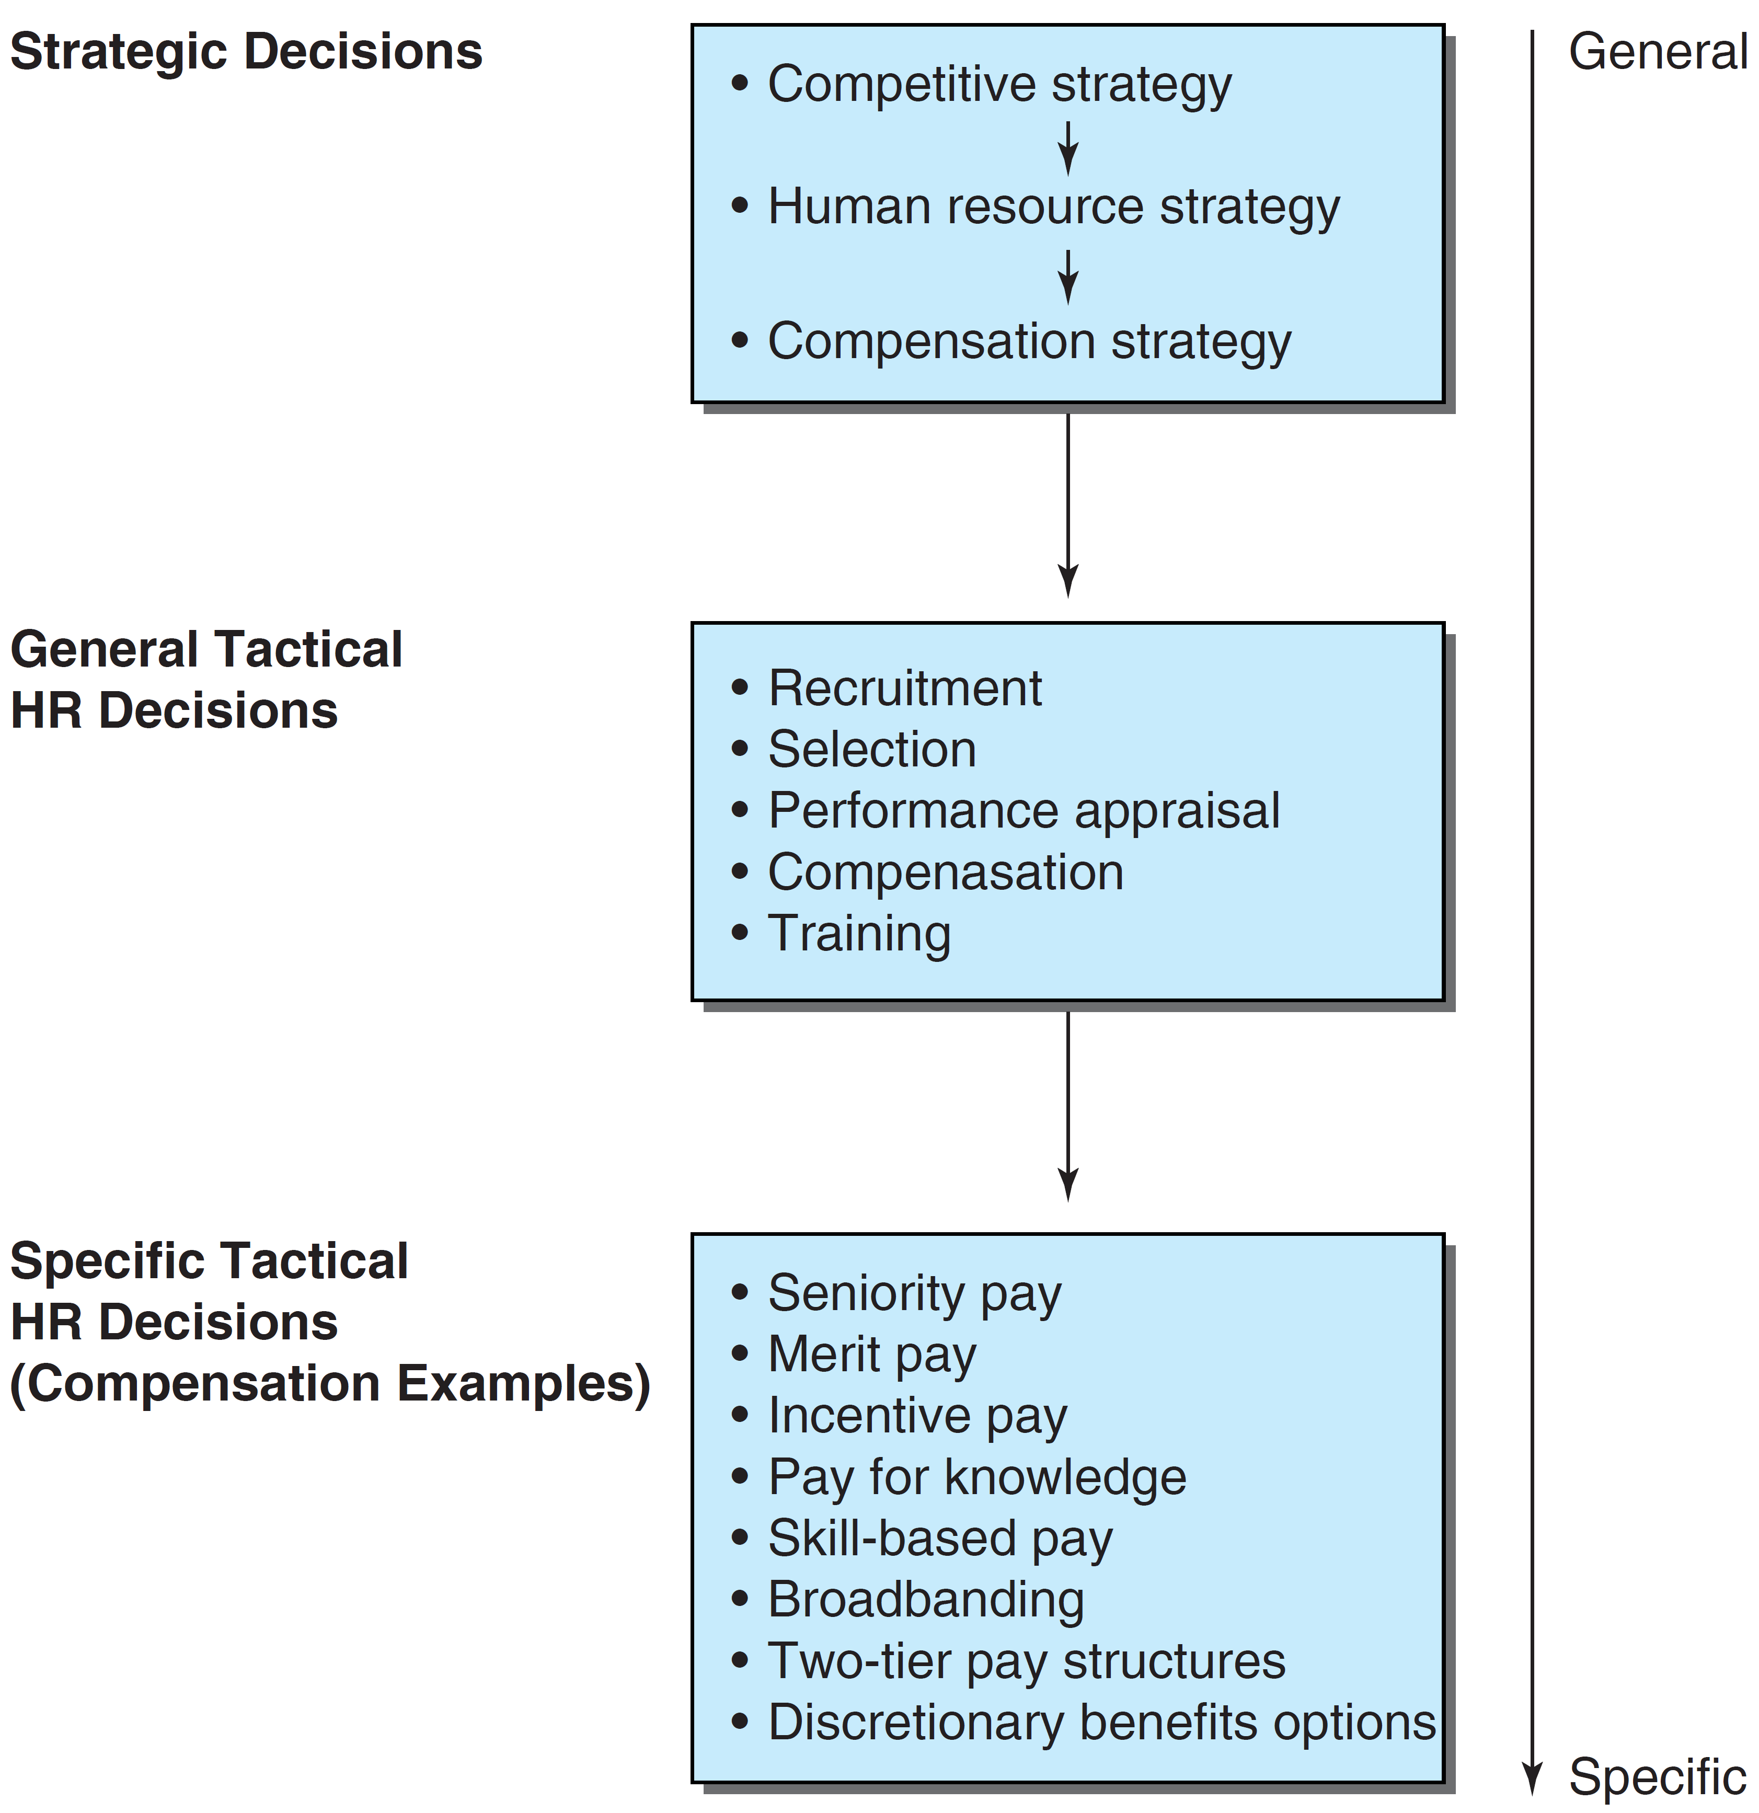
Relationship Between Strategic Decisions and Compensation Practices
LO 1-1

Slide 9
Compensation as a Strategic Business Partner
LO 1-2
HR and compensation professionals need to think like the chief executive officer (CEO)
These individuals can give the CEO and chief financial officer (CFO) an understanding of how employees combine with business processes to expand or shrink shareholder value

Slide 10
Compensation as a Strategic Business Partner
LO 1-2
Think about the role of capital for value creation
Capital refers to the factors that enable companies to generate income, higher stock prices, economic value, and reputation
Human capital refers to sets of collective skills, knowledge, and abilities that employees can apply to create value for their employers

Slide 11
Compensation as a Strategic Business Partner
LO 1-2
Compensation professions can leverage the value of human capital in a variety of ways:
Well-designed merit pay and incentive programs, which reinforce excellent job performance
Incentive programs which reduce employee entitlement
Person-focused pay which is based on extensive employer-sponsored training that enables employees to work in changing environments

Slide 12
Strategic Compensation Decisions
LO 1-3
Compensation professionals provide a strategic contribution when they can answer yes to 3 questions:
What are the competitive business strategy options and does compensation strategy fit well with the objectives of company competitive business and HR strategies?
Does the choice and design of compensation practices fit well to support compensation strategy? (continued on next page)

Slide 13
Strategic Compensation Decisions
LO 1-3
Does the implementation of compensation practices effectively direct employee behavior to enhance job performance that supports the choice of compensation practices?

Slide 14
Competitive Business Strategy Choices
LO 1-3
Lowest cost strategy: focus on being lowest cost producer/seller of goods or services
Differentiation strategy: focus on offering unique goods or services to the public

Slide 15
Lowest Cost Strategy
LO 1-3
Effective when jobs:
Include predictable behaviors
Have a short-term focus
Require autonomous activity
Focus on quantity of output
Ex: Ryanair (reduced operations costs).

Slide 16
Differentiation Strategy
LO 1-3
Effective when jobs:
Require highly creative behaviors
Have a long-term focus
Demand cooperation and independence
Involve risk-taking
Ex: Apple Computer relies on this strategy to build market demand and loyalty and strives to establish leading-edge electronic devices.

Slide 17
Building Blocks and Structures of Strategic Compensation Systems
LO 1-4
The main building blocks are extrinsic compensation and intrinsic compensation
Our focus is on extrinsic compensation:
Core compensation
Adjustments to core compensation
Legally required employee benefits
Discretionary employee benefits

Slide 18
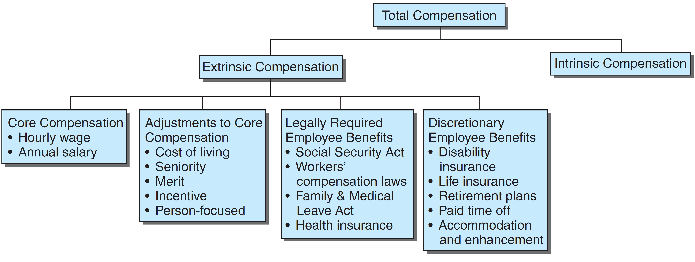
Building Blocks and Structures of Strategic Compensation System
LO 1-4

Slide 19
Base Pay
LO 1-4
Base pay
Hourly wage
Annual salary
Compensable factors
An employee’s skill level
An employee’s effort
An employee’s level of responsibility
The severity of the working conditions

Slide 20
Elements of Core Compensation (base pay adjustments described on forthcoming slides)
LO 1-4

Slide 21
Base Pay Adjustments
LO 1-4
COLAs: COLAs represent periodic base pay increases that are founded on changes in prices as indexed by the consumer price index (CPI)
Seniority pay: seniority pay systems reward employees with periodic additions to base pay according to employees’ length of service in performing their jobs
Merit pay: merit pay programs assume that employees’ compensation over time should be determined, at least in part, by differences in job performance

Slide 22
Base Pay Adjustments
LO 1-4
Incentive pay: incentive pay (or variable pay) rewards employees for partially or completely attaining a predetermined work objective
Pay-for-knowledge plans: pay-for-knowledge plans reward managerial, service, or professional workers, for successfully learning specific curricula
Skill-based pay: skill-based pay is used mostly for employees who perform physical work and increases these workers‘pay as they master new skills

Slide 23
Employee Benefits
LO 1-4
Discretionary benefits
Legally required benefits

Slide 24
Discretionary Benefits
LO 1-4
Three broad categories
Protection programs: provide family benefits, promote health, and guard against income loss caused by such catastrophic factors as unemployment, disability, or serious illness
Paid time-off: provides employees with pay for time when they are not working
Services: provides such enhancements as tuition reimbursement and day care assistance to employees and their families

Slide 25
Legally Required Benefits
LO 1-4
Federal legislation designed to:
Promote worker safety and health
Maintain family income
Assist families in crisis
Provide assistance in case of
Disability
Unemployment

Slide 26
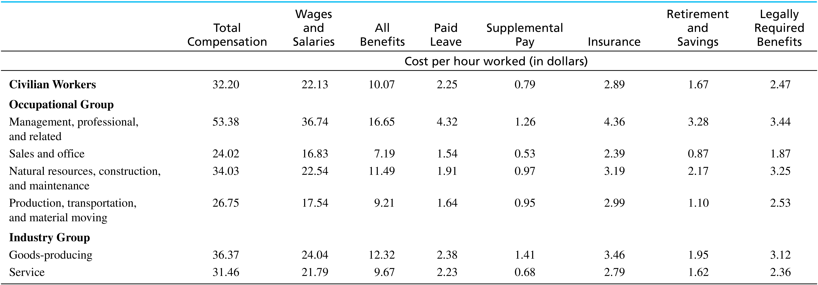
Employer Costs for Compensation
LO 1-4

Slide 27
Fundamental Compensation System Design Elements
LO 1-4
Compensation professionals promote effective compensation systems by meeting three important goals:
Internal consistency
Market competitiveness
Recognition of employee contributions

Slide 28
Internal Consistency
LO 1-4
Achieved when the value of each job is clearly defined
Represents
Job structure
Hierarchy
Achieved using
Job analysis
Job evaluation

Slide 29
Market Competitiveness
LO 1-4
Compensation policies that fit with business objectives
Vital in attracting and retaining employees
Based on:
Strategic analyses
Compensation surveys

Slide 30
Individual Contributions
LO 1-4
Pay structures: determined by employees’ credentials, job knowledge, and job performance
Pay grades: based on compensable factors
Pay ranges: built on grades, uses midpoint, minimum, and maximum pay rates

Slide 31
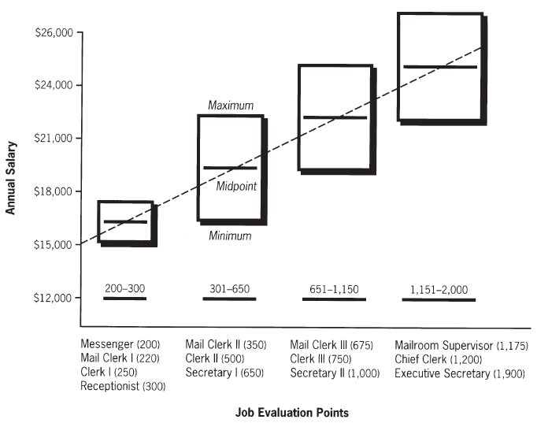
Pay Grades and Ranges
LO 1-4

Slide 32
Alternative Pay Structure Configurations
LO 1-4
Alternative pay structure configurations to be explored in this book:
Merit plans
Sales compensation plans
Broadband structures
Two-tier wage structures
Executive compensation
Contingent worker compensation
Expatriate compensation
Compensation structures in countries other than the United States

Slide 33
Fitting the Compensation Function in an Organization’s Structure
LO 1-5
How HR professionals fit into the corporate hierarchy
Line employees: directly involved in producing companies’ goods or delivering their services such as manufacturing leaders
Staff employees: support the line functions, human resource professionals and accountants are examples of staff employees

Slide 34
HR’s Role
LO 1-5
Jay Hannah of BancFirst Corporation:
“The HR department is the source and keeper of critical information, which is key in today’s workplace. With the information they provide, we in turn can build and design strategies to hire and retain the best workforce possible. And this may sound cliché, but it’s very true—the real competitive advantage is our company’s human resources.”

Slide 35
Fitting the Compensation Function in an Organization’s Structure
LO 1-5
Compensation profession roles:
Executives: report directly to the corporation’s CEO or head of a major division, perhaps responsible for the entire compensation program
Generalists: perform tasks in a variety of HR-related areas such as involvement in most or all of the compensation functions such as building job structures, market competitive pay systems, and merit pay structures

Slide 36
Fitting the Compensation Function in an Organization’s Structure
LO 1-5
Compensation profession roles:
Specialists: work within only one of the areas of compensation practice such as compensation survey development

Slide 37
HR Practices
LO 1-5
HR professionals design and implement practices:
Recruitment
Selection
Performance appraisal
Training
Career development
Labor-management relations
Employment termination
Managing HR within the context of legislation

Slide 38
Stakeholders
LO 1-6
Individuals or entities directly affected by compensation practices:
Employees
Line managers
Executives
Unions
U.S. Government

Slide 39
Stakeholders
LO 1-6
Employees rely on compensation professionals to:
Develop and implement systematic training programs
Inform them of training and pay links
Offer discretionary benefits that provide:
Income protection
Paid time off
Services
.

Slide 40
Stakeholders
LO 1-6
Line managers rely on compensation professionals to:
Ensure knowledge of relevant laws to help them make sound compensation judgments
Advise for establishing pay differentials
Train them how to properly evaluate jobs

Slide 41
Stakeholders
LO 1-6
Executives rely on compensation professionals to:
Develop and manage sound compensation systems
Insure the company’s practices are:
Legally consistent
Sufficiently attractive to recruit and retain
Cost effective

Slide 42
Stakeholders
LO 1-6
Unions rely on compensation professionals to:
Abide by their collective bargaining agreements
Ensure they get their COLA adjustments and seniority pay

Slide 43
Stakeholders
LO 1-6
The U.S. government requires compensation professionals to:
Keep updated and comply with all employment legislation
Demonstrate that alleged discriminatory pay practices are not in fact discriminatory; or, are a business necessity

Slide 44

All rights reserved. No part of this publication may be reproduced, stored in a retrieval system, or transmitted, in any form or by any means, electronic, mechanical, photocopying, recording, or otherwise, without the prior written permission of the publisher. Printed in the United States of America.

