Slide 1
VIRTUE ETHICS 2:
PRINCIPLES
NANCY HARDING

Slide 2
Overview of the final five weeks
7/11 Framework – what is virtue ethics all about? ✔
14/11 Principles – delving into this ‘all about’? ⬅
21/11 Practice – how to act virtuously.
28/12 Exam preparation
5/12 Drop-in tutorials.

Slide 3
Reminder: The virtues
Are the characteristics the individual should develop in order to achieve not only personal eudaimonia but also societal/organizational eudaimonia;
That is, society (including ‘the organization’) and individuals flourish if every member of that society works towards becoming more virtuous; individuals flourish through being part of that community.

Slide 4
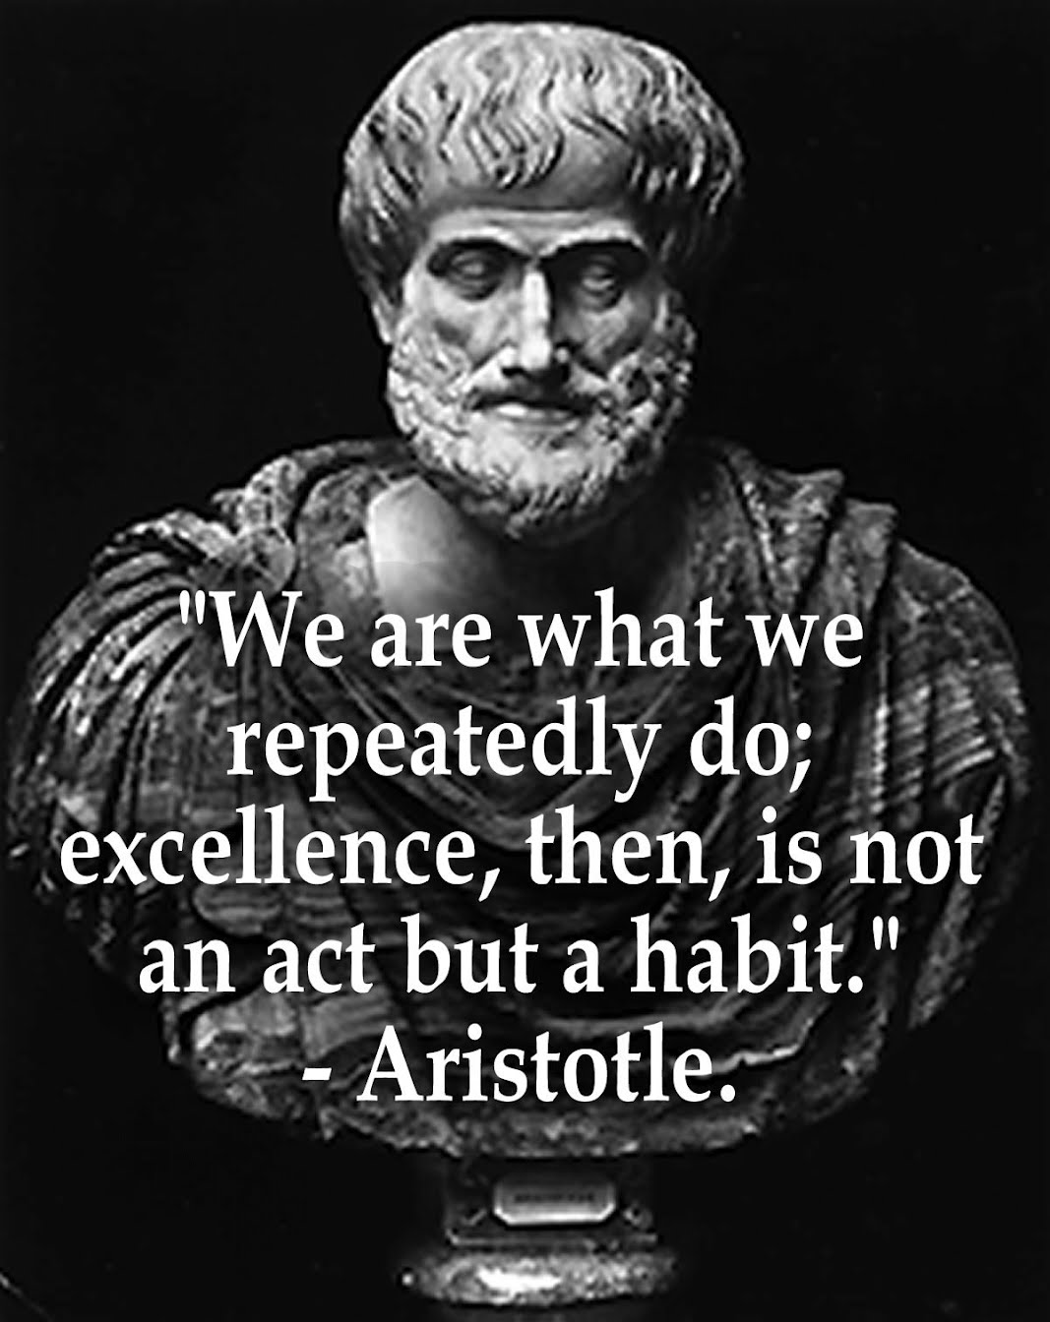
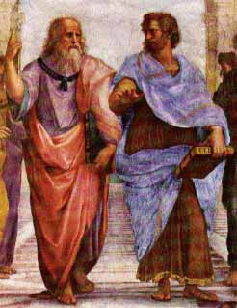
Aristotle (and his teacher, Plato)

Slide 5
The virtuous, or golden, mean
There are long lists of virtues – we need different virtues in different situations;
Virtue, for Aristotle, meant avoiding extremes, so to understand virtue we must firstly stop thinking in opposites (virtue is not the opposite of vice, for example);
Instead of pairs, we must think in triads: that is, when we think of a virtue, we must think of its opposite AND also of what happens if we take it to excess.
The virtuous person avoids both extremes and finds the mean point between them.

Slide 6
The virtue | Its opposite | Its excess | The mean
Generosity | Stinginess. | Profligacy | Giving the right amount in the right time so that all flourish
Wisdom | Ignorance | Know-it-all | Good judgement based on accumulated knowledge and continued interest in learning more.
Pride | Excess humility | Vanity | Quiet self-confidence in one’s abilities and achievements
Courage | Cowardice | Fool-hardiness | Displaying the right amount in the right time to achieve flourishing

Slide 7
As Aristotle put it, one must act:
‘at the right times, with reference to the right objects, towards the right people, with the right motive, and in the right way, is what is both intermediate and best, and this is what is characteristic of virtue’ (c. 323 BCE, cited in Fryer, 2015, p. 179).

Slide 8
Are we born virtuous or do we become virtuous?
Aristotle’s answer to this question is that we are not born virtuous but we can become virtuous. We should develop phronesis, or practical wisdom, something we develop over time.
But in the short-term, we can practice becoming more virtuous:
i. try to err on the side of the excess rather than the opposite of the virtue. We will learn more about the virtue of bravery from being rash than from being a coward;
ii. Identify those extremes to which we are habitually inclined and avoid those we find most pleasurable;

Slide 9
But also we should focus on achieving our purpose as human beings
Fryer points out the difficulty of deciding what is the purpose of human beings in general but writes about the purpose of businesses;
But what about if we thought about the purpose of ourselves as members of a community – ‘I was put on this earth to ….’. And this ‘….’ happens in relation to the community: our individual purpose cannot be separated from the contribution we make to society;
E.g. if ‘I was put on this earth to bake wonderful cakes’ then through cake-making we help our community flourish, but we also flourish because our cakes are admired (and eaten).

Slide 10
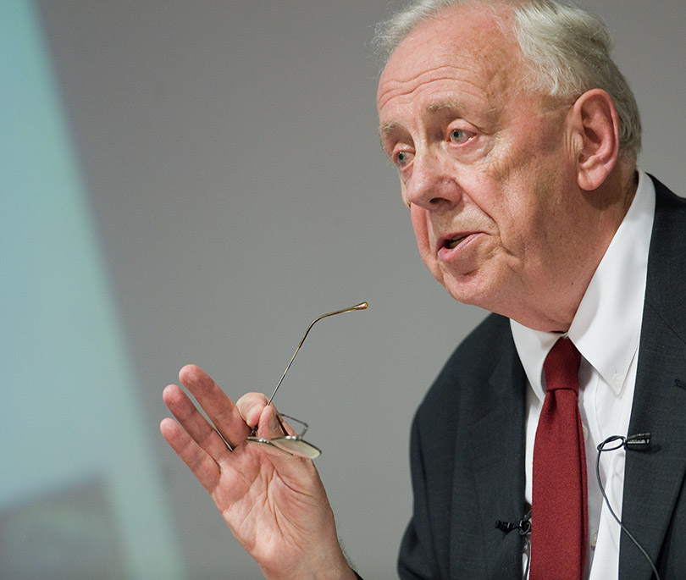
Flash forward 2300 years:
Alasdair MacIntyre (born 12/1/29)

Slide 11
‘After Virtue’ (1981)
Is critical of Kant (and deontology) and advocates a return to Aristotle;
Highlights the importance of internal as well as external goods to human flourishing;
External goods include money, success, etc – they come from ‘outside’ us, and the total amounts available are limited;
Internal goods include enjoyment, sense of achievement, etc. that we get from what we do, and the knowledge, skills and capabilities we develop through doing them – they are unlimited and can be shared.
(note the two meanings of ‘goods’ – goods are products, but in this context we can also understand them as ‘good non-material things such as feeling good).

Slide 12
The importance of practices
A practice is ‘any coherent and complex form of socially established, cooperative human activity’ (quoted in Fryer, 2015, p. 194) – thus working and studying are practices.
We derive both external and internal goods from practices;
But if we are unable to develop excellence in our practices, if we fail to do them well, we become frustrated, despondent, etc.

Slide 13
But what is ‘excellence’?
MacIntyre does not mean that we have to be outstanding at what we do – we only need to be making progress or to be gaining some success in what we are doing;
But this means that there are external standards by which we can measure our progress;
And these are set by the communities in which those practices take place – they were developed by members of those communities in the past, and will evolve as new practitioners join, develop themselves, and so on.

Slide 14
Where are the virtues in all this?
Virtues, for MacIntyre, are those ‘acquired human qualities’ that enable us to achieve those internal goods we derive from our practices.
So different virtues will be called into play in different practices;
But the virtues of courage, justice and honesty are common to most practices.

Slide 15
Summary
Internal goods
Achieved through excellence, that is through the virtues;
Virtues are essential to the achievement of internal goods;
They are dispersed throughout practitioner communities, and are endless;
External goods
May be achieved through a variety of means, not always virtuous ones;
These goods are in short supply and may benefit the few rather than the many;
There is nothing wrong in wanting, say, money and success – but it would be wrong to prioritize such desires over the more virtuous ones.

Slide 16
Knowledge warning: what Fryer does not say
In After Virtue MacIntyre identifies three characters in modern societies he particularly despises – the aesthete, the therapist and the manager.
These three all trade in ‘moral fictions’ but the manager is the worst, because the manager has to claim to be morally neutral in the pursuit of efficiency, profit, etc., but in pursuit of those ends the manager must ‘manipulate …. human beings into compliant patterns of behaviour, and it is by appeal to his[her] own effectiveness in this respect that the manager claims authority …’ (MacIntyre, 1981, p. 74).

Slide 17
SUMMARY OF VIRTUE ETHICS
https://www.youtube.com/watch?v=cpE6qllLheU

