Slide 1
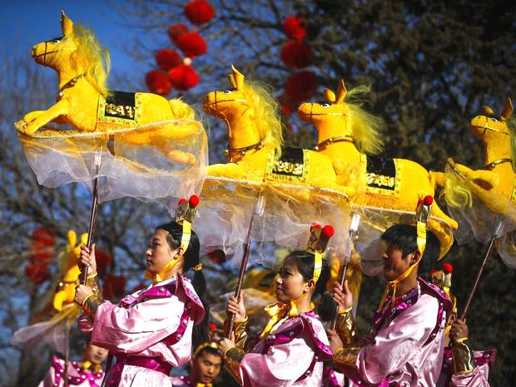
Managing Festivals, Events and Creative Performances and Managing Museums and Cultural Heritage Sites
Revise and review
4/5/2017
MGT 6121

Slide 2
Introduction……..
Now, it’s festivals, festivals everywhere. Big ones, small ones, wild ones, silly ones, dutiful ones, pretentious ones, phony ones. Many have lost purpose and direction, not to mention individual profile. Place a potted palm near the box office, double the ticket prices and – whoopee – we have a festival!" (Bernheimer, 2003, Financial Times, W21)

Slide 3
Festivals necessary
Not just different from day to day work life
Also necessary to help us cope with the stresses in our lives as human beings – remind us what it is to be human in the company of other humans mediators of social change?
‘This can include anything from the readjustments required through pivotal points in the life cycle, to the shock of migration, environmental disaster, or revolution’.(Picard 2015, 2)
How?

Slide 4
Festivals as Rupture
‘Building on Erwin Goffman… (1974) Festive frames…describe a kind of socially constructed ‘recipe’ for people to deal with the smaller and larger life crises they face in their daily lives, both by giving these meaning and by leading people through an embodied process that eventually allows them to go on with their lives’. (Picard, 2015, 2)

Slide 5
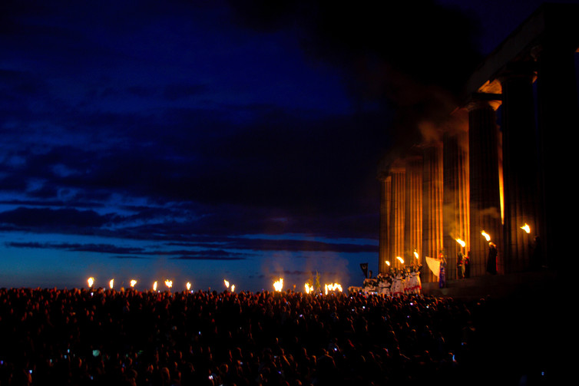
Beltane, Edinburgh

Slide 6
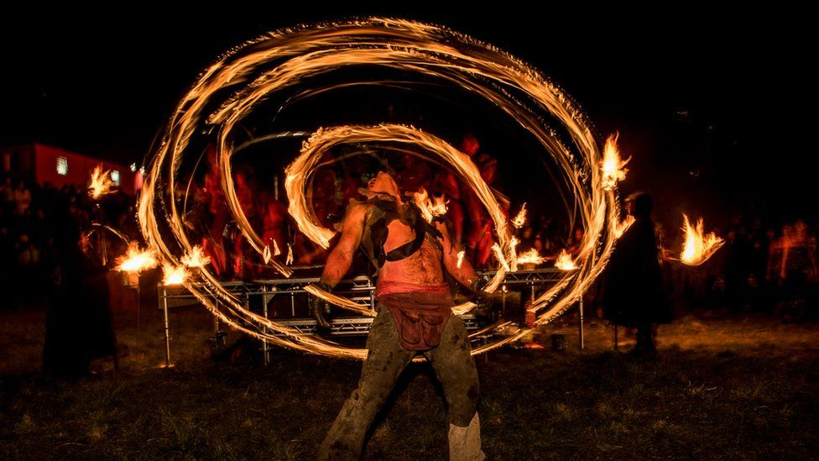

Slide 7
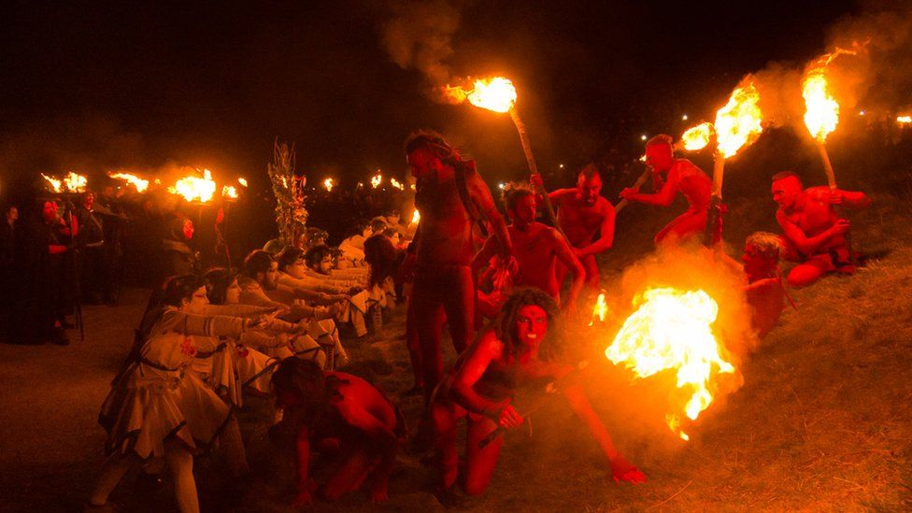

Slide 8
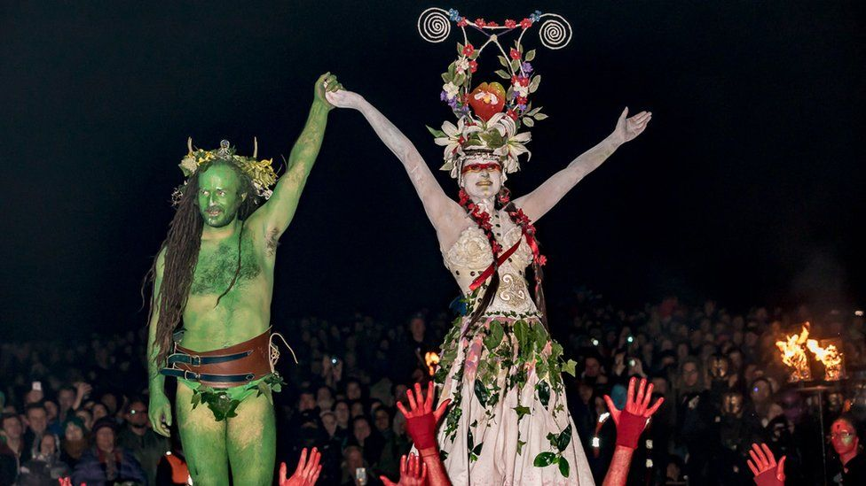

Slide 9

When festivals go bad!

Slide 10
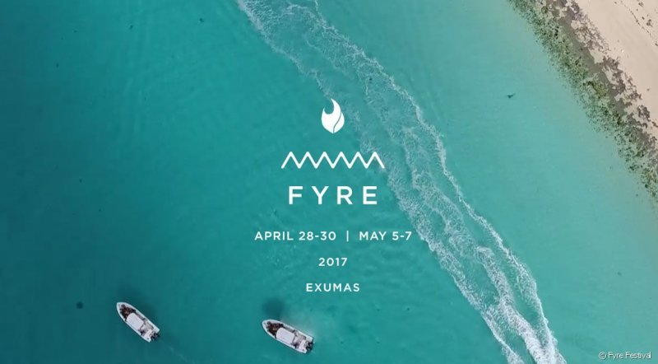
Fyre Festival
The organisers of a luxury music festival in the Bahamas have apologised after the event descended into chaos, drawing comparisons to The Hunger Games and The Lord of The Flies.
Fyre Festival, on the private Great Exumas island, had been billed as a “cultural moment” for monied millennials, with tickets costing up to $12,780 for a four-person package. It was heavily promoted on Instagram as an opportunity to mingle with models and “influencers”, including Kendall Jenner, Bella Hadid and Emily Ratajkowski.

Slide 11
Fyre festival
http://nymag.com/thecut/2017/04/fyre-festival-exumas-bahamas-disaster.html?mid=twitter_nymag
Ja Rule 'heartbroken' after Fyre Festival descends into disaster Fyre Festival, billed as an ultra-luxury destination music experience, was cancelled before it even started.
https://www.theguardian.com/world/2017/apr/29/ja-rule-heartbroken-after-fyre-festival-descends-into-disaster

Slide 12
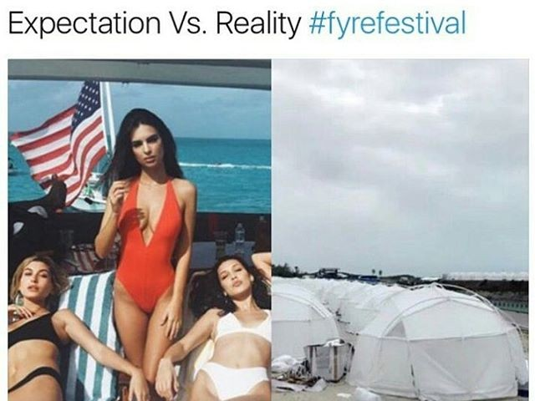

Slide 13
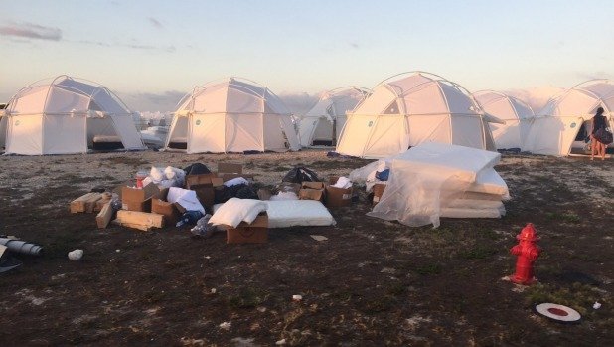

Slide 14
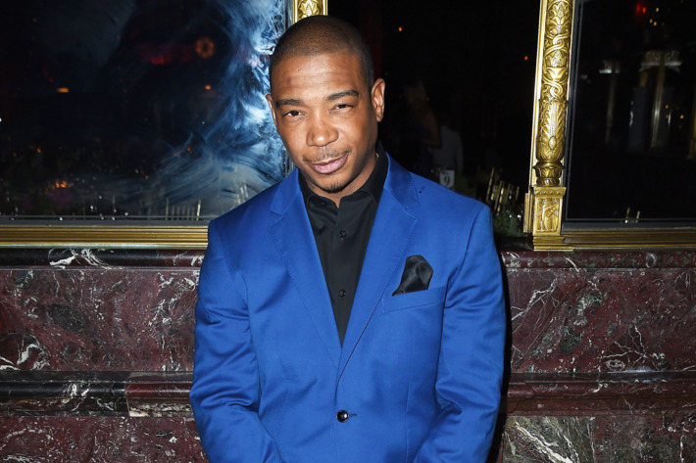
Ja Rule says sorry
The festival has since been postponed and Ja Rule posted an apology on Twitter that reads, “I truly apologize as this is NOT MY FAULT.”

Slide 15
So…. This module aims to provide you with the ability to:
To develop a critical understanding of the emergence, scale, scope and structure of Creative and Cultural Industries related art fairs, festivals and exhibitions and artistic performances
To critically examine the key management issues, trends and impacts of digital developments on art fairs, festivals exhibitions and artistic performances at local, national and international levels.
To critically evaluate art fairs, festivals exhibitions and artistic performances as tools for audience development, cultural regeneration and cultural tourism.

Slide 16
Why Festivals and Events
Social habitus (Bourdieu)
Time out of daily life
Tribalism (gatherings of like minded people - music festival, opera)
Signals a cultured people- city spaces
Art is a currency in society
Art spaces have high social standing.

Slide 17
At end of module you should be able to:
Critically analyse the political, economic, socio-cultural and environmental impacts of art fairs, festivals exhibitions and artistic performances within a range of different global contexts.
Demonstrate a critical understanding of the management issues and impacts of festivals and cultural events.
Understand the significance of visitor demand and behaviour in influencing the `marketplace’.

Slide 18
Festival and Events definitions
Hallmark, mega, major, local, community
What do organisations, places aspire to?
What the social purpose of the event
Economic purpose
Tourism
Unity/community
Showcase cultures- Mela/ carnival
Movement of peoples, ideas, events?

Slide 19
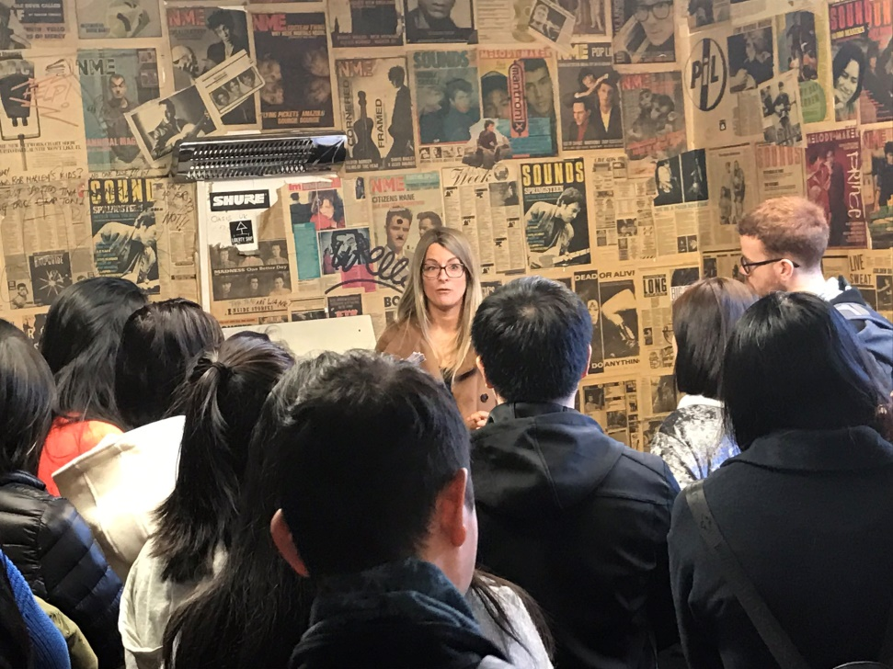
Theory into practice
We visited local and national spaces – backstage/frontstage
Tramlines
Hull – Freedom Festival, Kardomah
Exhibition venues – Millennium Galleries
National Theatre – London
BFI
Looked at how festivals, events and creative performances are linked to tourism, localities, international strategies, we were concerned with audiences and development strategies

Slide 20
Assessment
A 3000 word individual summative assessment which will cover learning outcomes 1-3

Slide 21
Essay topic
Critically appraise the development, organisation and success of one MEGA or MAJOR recurring event. (Examples of suitable events might
be the Venice Biennale, Edinburgh Festival or major sporting event such as Olympics)

Slide 22
Structure reminder
C250 words introduction
C1500 words of literature
C1000 words of case study
C250 words conclusion

Slide 23
What can you do question
You chose a festival
Look for literature which will help you define it
What kind of event is it?
What can be said about it drawing on literature – is has grown? It has developed its programme? It has developed new audiences
New ways of working in localities
What are the impacts issues of the specific event against those argued in literature?

