Slide 1
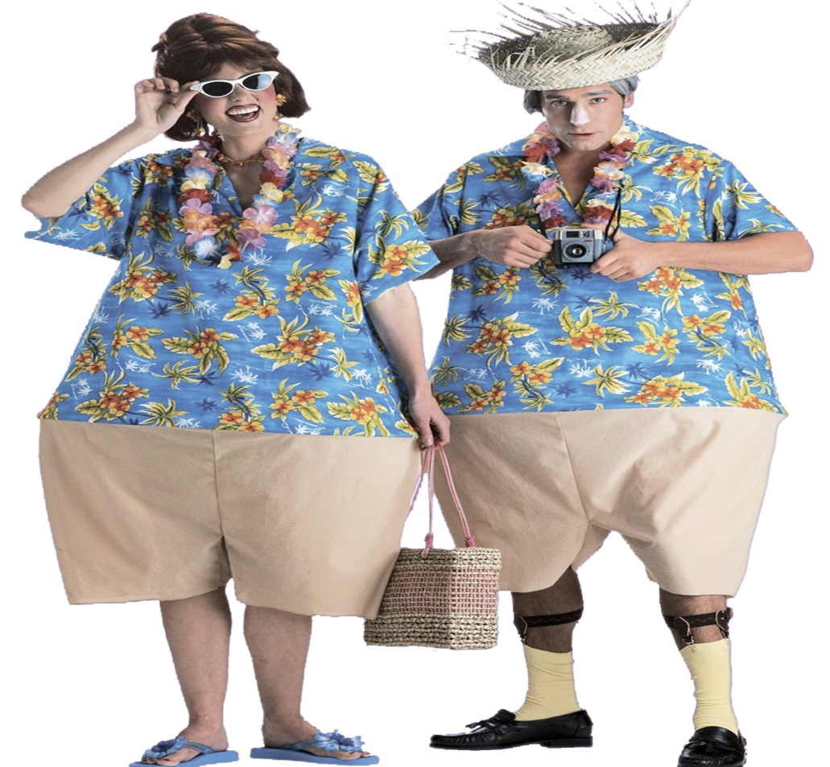
Mega Events and tourism
24/2/2016

Slide 2
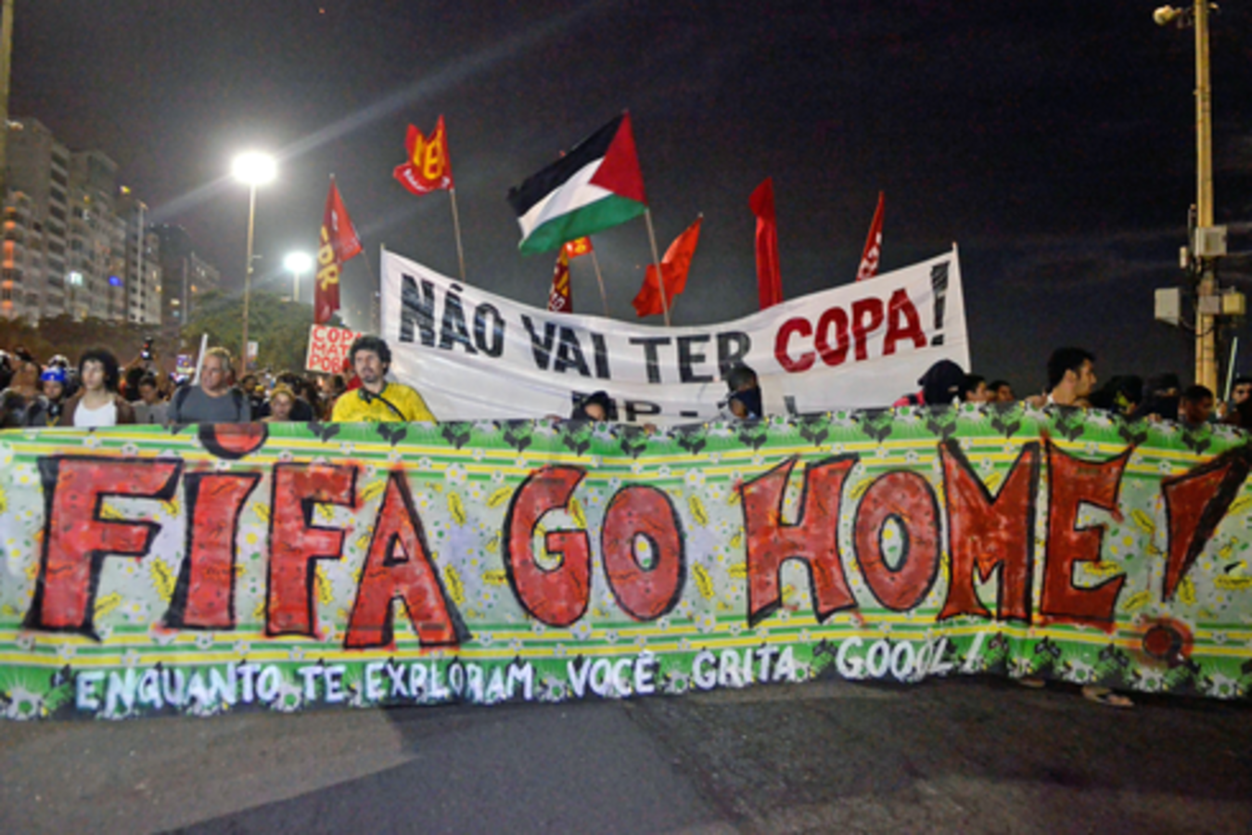
Lecture Plan
Special events perspective
Tourism and tourist types
Tourism and mega events
Impacts and issues
Tourism and
Future concerns

Slide 3
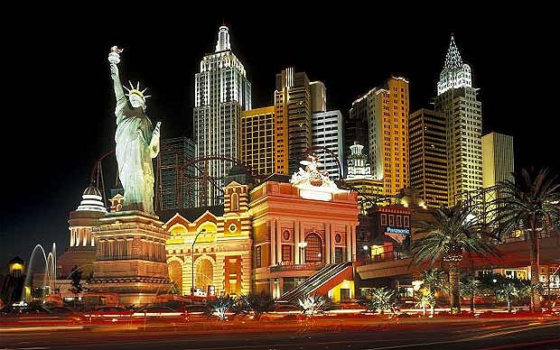
World a playground for tourists

Slide 4
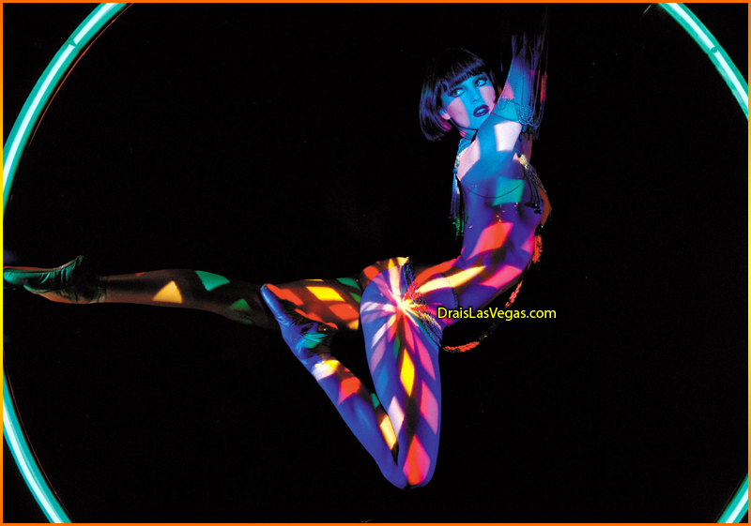
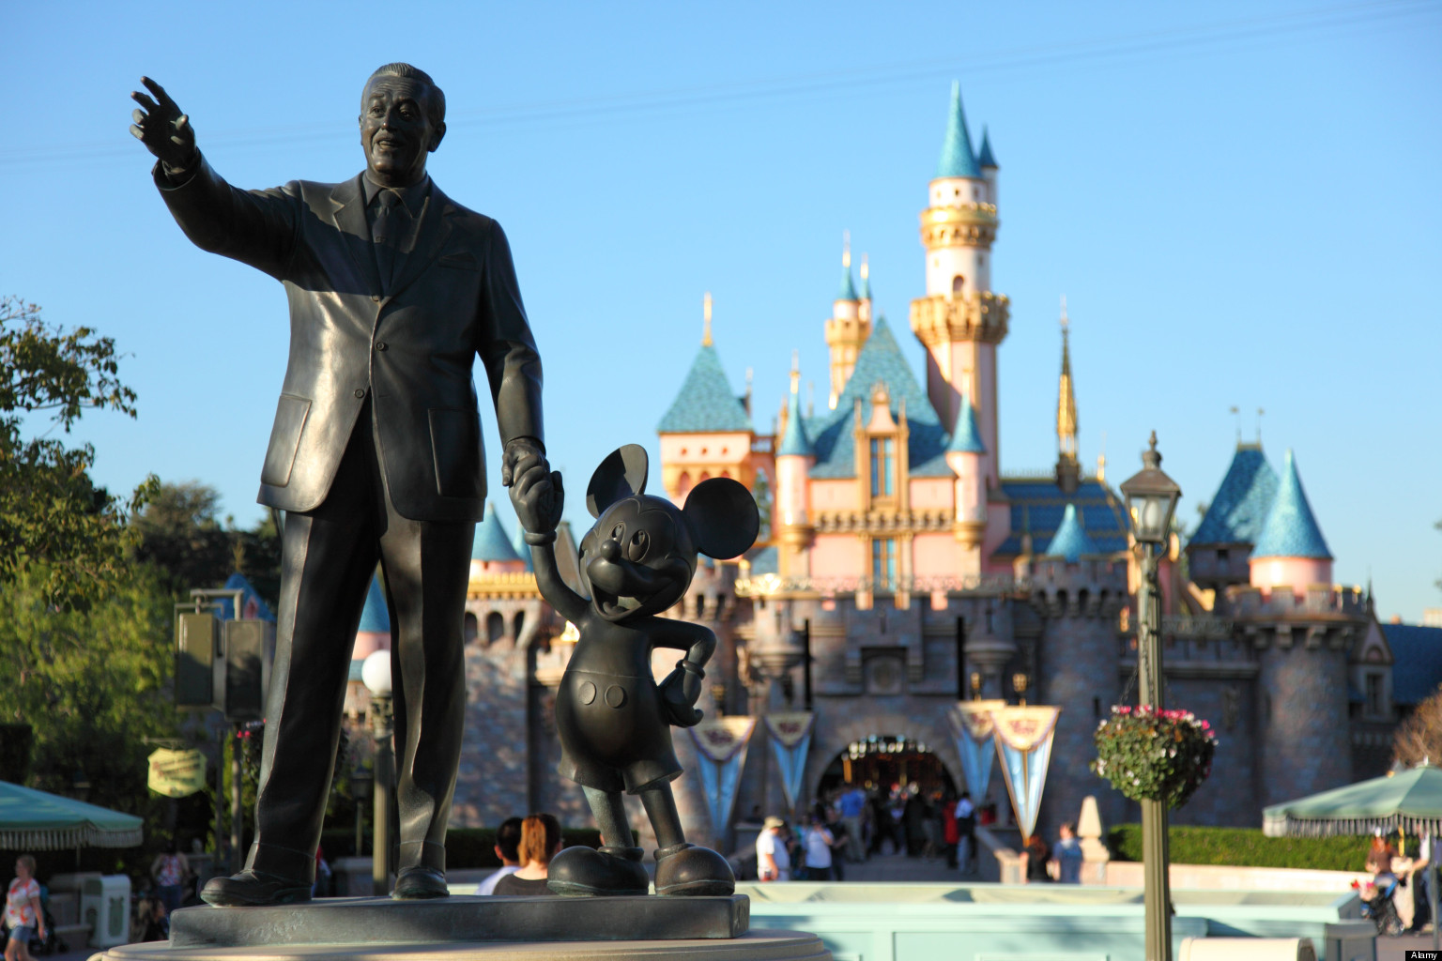
Entering other worlds

Slide 5
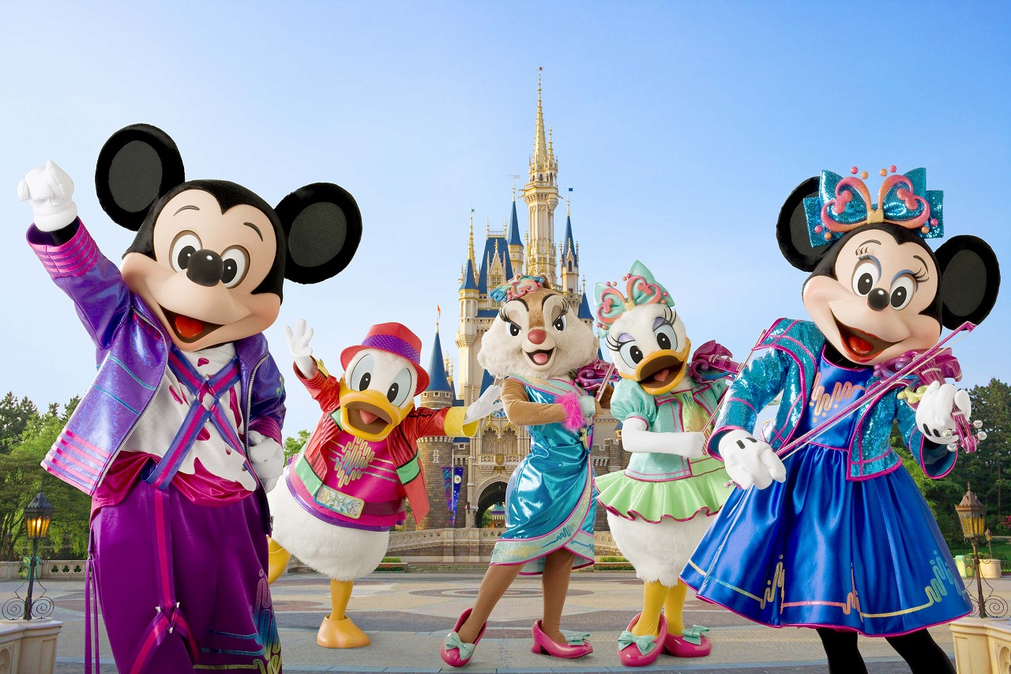

Slide 6
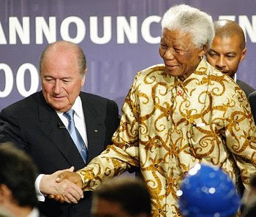
No other sporting event captures the world's imagination like the FIFA World Cup™.
Today, the FIFA World Cup holds the entire global public under its spell. An accumulated audience of over 37 billion people watched the France 98 tournament, including approximately 1.3 billion for the final alone, while over 2.7 million people flocked to watch the 64 matches in the French stadia.

Slide 7
The Special Event Perspectives
Events
Tangible Products
(The Events Façade)
Visitor
Experience
Organizers
Community Development

Slide 8
Impacts of tourism

Slide 9
TOURISM STRATEGIES FOR URBAN REGENERATION (adapted from Swarbrooke, 2000)
Urban regeneration
Event led strategies
Attraction led strategies
Business Led strategies
Culture strategies
Leisure based strategies

Slide 10
Product Life-cycle challenge
Diag 1:
REVENUE AND PROFITS
Maturity
Growth
Intro
95
96
97
98
99
00
01
02
03
TIME
(Adapted from M.Payne, EICC, April 29, 2002)

Slide 11
Impact Type | Potential Positive | Potential Negative
Economic (often linked with political) | Jobs (for local people) Increased incomes (directly generated by tourism businesses) Spin off benefit for other industries (multiplier effect or indirect effect) Increase in GDP | Fewer job opportunities (displacement effect) Low skill level Financial leakage (importation of goods and labour) One dimensional & unstable economy Uneven development Inflationary effect (especially on land, housing)

Slide 12
Impact Type | Potential Positive | Potential Negative
Cultural (often linked with social) | restoration of national identity or pride Revival of ‘dying’ customs Cultural interchange | Exploitation and devaluation of culture Commodification of culture Demonstration effect Staged authenticity

Slide 13
Impact Type | Potential Positive | Potential Negative
Environmental | Preservation of natural and built environment | Environment destroyed or deteriorating

Slide 14
Impact Type | Potential Positive | Potential Negative
Social | Improvements in facilities for locals | Doxey’s Irridex Model, 1976) Sex tourism Crime Health (HIV AIDS)

Slide 15
Impact Type | Potential Positive | Potential Negative
Political | May improve political understanding between countries | Tourism used to legitimise dictatorial regimes (e.g. during the Marcos era in the Philippines)

Slide 16
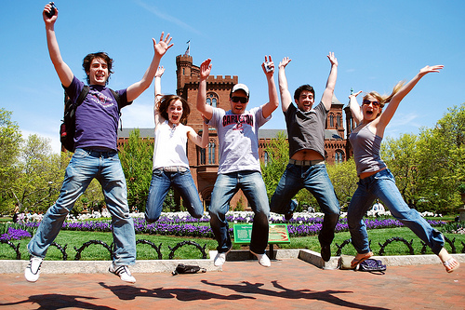
Doxey’s Irridex Model (1976) (1)
Sought to measure the extent of irritation created due to the contact between tourists (guests) and locals (hosts). Devised Five stages:
Euphoria – initial phase of tourism development. Tourism is a novelty and locals are excited and welcome visitors. Little planning or control of tourism
Apathy – tourism development seen as a money making venture and tourists taken for granted as a source of income

Slide 17

Doxey’s Irridex Model (1976) (2)
Irritation – tourism reaches saturation. Policy is to increase infrastructure rather to limit growth. Hosts feel overwhelmed
Antagonism – tourism is seen largely as having negative impacts and locals become openly antagonistic. Tourists are exploited
Final level – Increased levels of antagonism will lead tourists to move on to other destinations

Slide 18
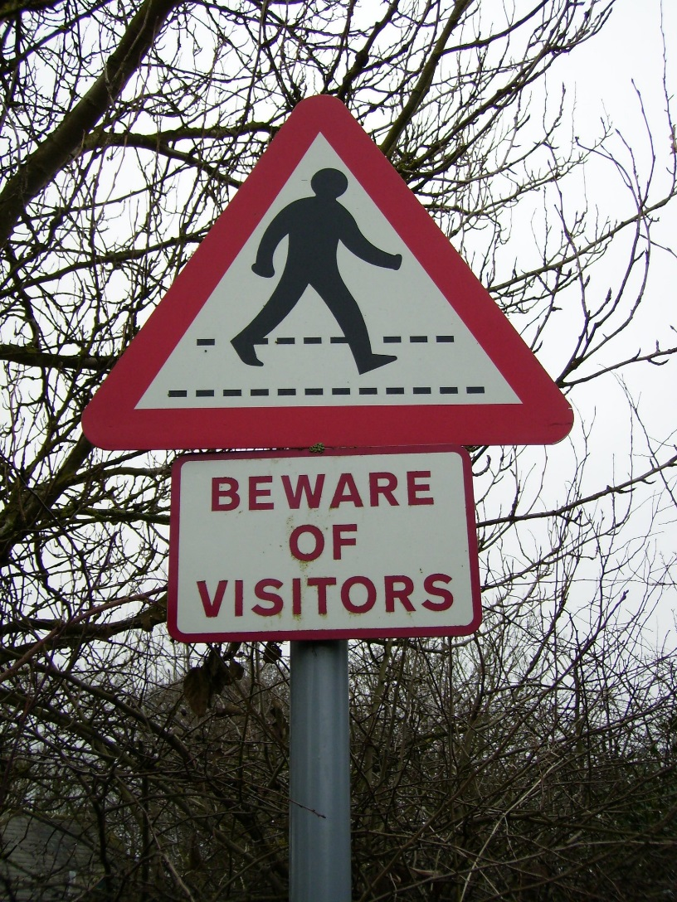
Stakeholder Dynamics
In most instances there will be conflicts within and between different stakeholder groupings in terms of their expectations
Important to understand the objectives of each stakeholder/stakeholder grouping
Some stakeholders have several roles – difficult to determine their objectives
Stakeholder groupings will change depending on the project.

Slide 19
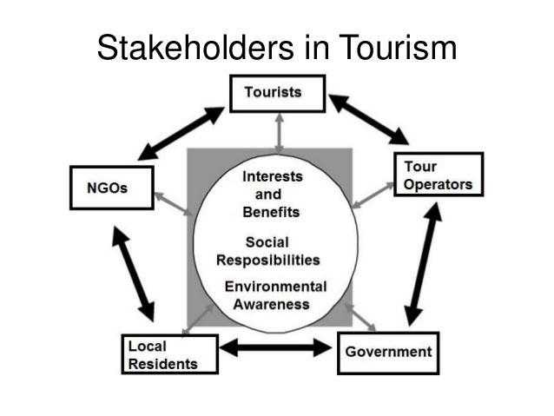

Slide 20
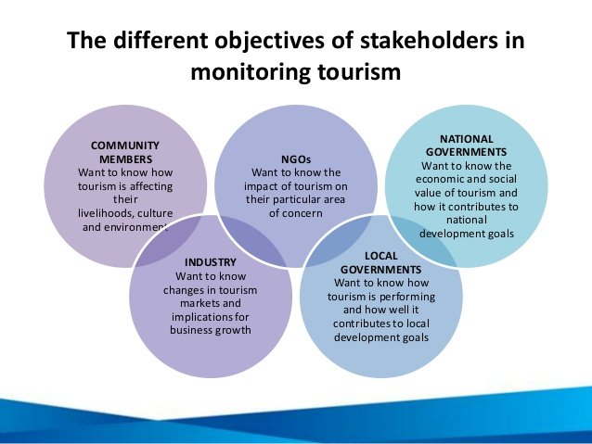

Slide 21
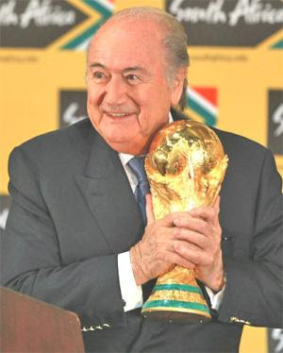
Stakeholder Collaboration 1
Why is there a need for collaboration between stakeholder groupings?
Reduces the likelihood of conflict
Ensures that plans are sustainable
Develops a sense of ownership
Develops trust
Improves quality of development (draws upon different perspectives, abilities and expertise)

Slide 22
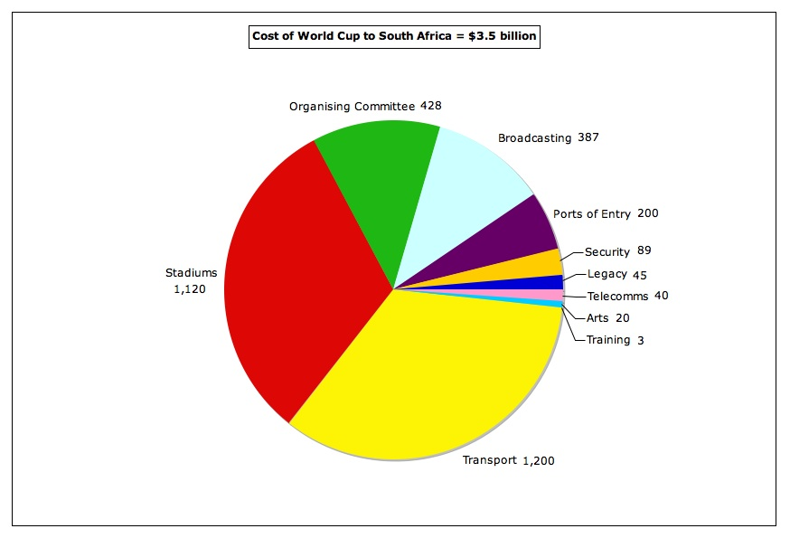

Slide 23
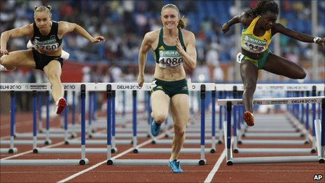
Stakeholder Collaboration 2
Jamal & Getz (1995) propose 6 important conditions which should be fulfilled in order to ensure successful collaboration between and amongst stakeholder groupings:
Stakeholders must believe in their mutual interdependency
Stakeholders must believe that they will benefit from collaboration
They must believe that any decisions made will be implemented

Slide 24
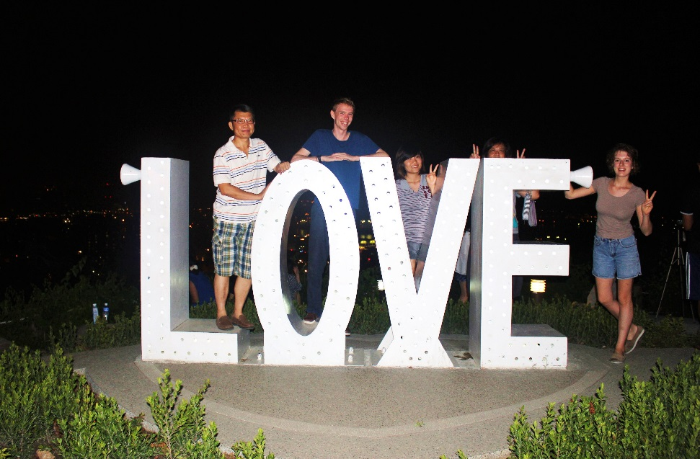
Stakeholder Collaboration 3
Key stakeholder groupings (e.g. government, residents, special interest groups) must be involved in the collaborative effort
The convener must be legitimate with the necessary expertise, resources and authority
The process of collaboration must work effectively and efficiently

Slide 25
Working with all involved parties in a democratic way can help develop sustainable tourism
Stakeholders are a key influence in the development of tourism projects
The level of stakeholder influence is dependent on the level of interest and power that each stakeholder has.
A power/interest matrix can be used to map stakeholders in order to determine levels of interest and power
Stakeholders might also be mapped in terms of their potential to threaten and their potential to cooperate with a particular tourism project
There are differences within and between stakeholders/groupings which can lead to conflict
Collaboration between stakeholders is vital to the successful development of tourism projects.

Slide 26
Revitalises communities
Mega Events
‘..are large scale cultural or sporting events designed to attract tourist and media attention’ (Roche, M)
Hallmark events
‘…a recurring event that possesses such significance…that the event provides the host venue, community, or destination with a competitive advantage’(Goldplatt, J)
Need to understand motivations, expectations & needs

Slide 27
Marketing mix for events and festivals
‘marketing events is the process of employing the marketing mix to attain organizational goals though creating value for clients and customers. The organization must adopt a marketing orientation that stresses the building of mutually beneficial relationships and the importance of competitive advantages.’ (Getz, 1997)

Slide 28

Cultural pursuits- career ladder
For such tourists cultural pursuits are a form of identity creation- career ladder (Prentice 2003)
Many of those attending (arts festivals)are involved in some form of cultural profession and leisure extension of that. (Stebbins (1994)

Slide 29
The New Tourist (1)
It has been argued that consumers are changing in tastes and preferences and that this requires a new approach to tourism product development
The chief proponent of the concept of the ‘new’ tourist is Poon (1993)
According to Poon, the ‘new’ tourist has certain characteristics including…

Slide 30
The New Tourist (2)
Risk taking
Multiple holidays per year
Sun plus
Interaction with local cultures
Independent traveller
More environmentally aware
More knowledgeable about destinations

Slide 31
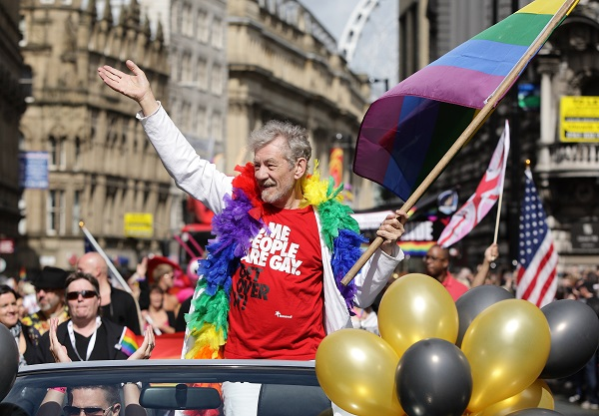
The New Tourism
This has arguably led to the emergence of a plethora of specialist or ‘niche’ tour operators who have designed their products to suit the new consumer
Festivals and events part of the new tourism

Slide 32

The aims of the Cultural Olympiad
encourage and welcome involvement from communities across the UK, including London;
leave a lasting legacy that improves cultural life;
showcase excellence in the performing arts and creative industries as well as sport;
introduce young people to the UK’s many artistic communities and those from around the world;

Slide 33
Aims of Cultural Olympiad cont.
promote London as a major cultural capital;
heighten economic regeneration and encourage tourism in the UK through the work of the creative industries;
incorporate the Olympic values of ‘excellence, respect and friendship’ and the Paralympic vision to ‘empower, achieve, inspire’.
LITERATURE POPULAR ART MUSIC PERFORMING ARTS VISUAL ARTS
Brazil 2016

Slide 34
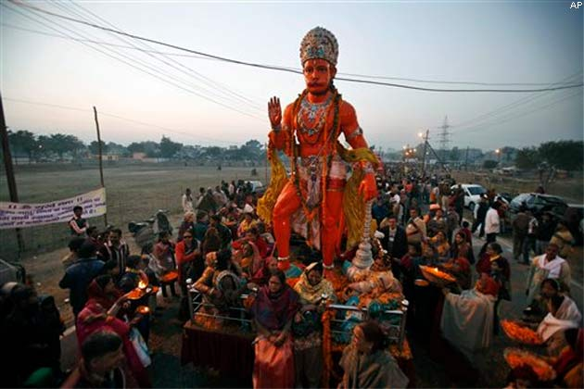
Kumbh Mela 2013
http://www.youtube.com/watch?v=cQNoimABjMQ

Slide 35
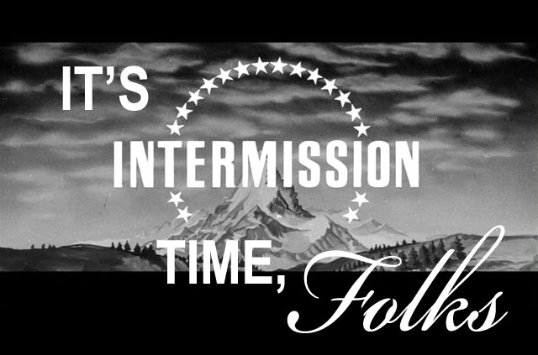

Slide 36
Environmental role special events play in generating pride etc.
POSITIVES
Showcase environment.
Raise awareness of environment
Improve infrastructure
Improve transport and communications.
_{Adapted from Hall 1989}
NEGATIVES
Environmental damage
Pollution
Destruction of heritage
Noise disturbance
Traffic congestion

Slide 37
Reputation Management
The history of the modern Olympics “shows numerous instances where inadequate planning, poor stadium design, the withdrawal of sponsors, political boycotts, heavycost overruns on facilities, the forced eviction of residents living in areas wanted for Olympic facilities, and subsequent unwanted stadia leave a legacy that tarnishes rather than enhances the
reputation of the host city” (Gold and Gold 2008, 301).
Furthermore, bribery and inequity in thebidding process, poor fiscal forecasting, deficiencies in infrastructure development, over
optimistic predictions and games boycotts have damaged the reputation of all stakeholders’ party
to the Olympic ‘dream’. (Kanderee, 2014- see MOLE)

Slide 38
Impacts of mega events
Psychological impacts
How residents and businesses feel about their locations before, during and after the event
Prestige and hospitality
Political/administrative impacts
Political aims of mega-events
Strenghtening of ideologies
Promotion of individual interests
Processes and structures
Businesses
Cities
Regions
Nations

Slide 39
Tourism impacts
Visitor expenditure
Publicity, leading to heightened awareness and more positive image
Image is affected not only by the event period but since the bidding process
Tourist volumes
Infrastructural developments
Organisational developments

Slide 40
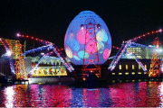
National
Political stability
EU membership and need for affirmation
Funds from EU development programs available
Need for an economic boost
Move from industrial to service economy
Enhance ‘proud’ and confidence levels

Slide 41
Local
Poor infrastructure
Major areas with declined industrial structure
Concentration of the service sector in the city centre
Inbalance between east and west
Erosion of the relationship between the city and the river
Decrease in quality of life
Desertification of many old neighbourwoods
Young middle class leaving the city
Lisbon lost 1/3 of its population since 1970 due to sub-urbanisation

Slide 42
Negative affects on communities
Can alienate community
Manipulation of community
Can create negative or false community image
Bad behaviour
Substance abuse
Loss of or restricted access to amenities for host community (adapted from Hall 1989)

Slide 43
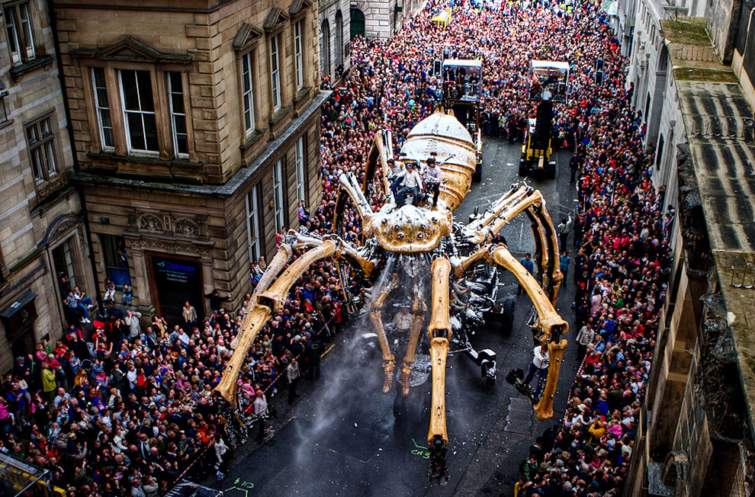

Slide 44
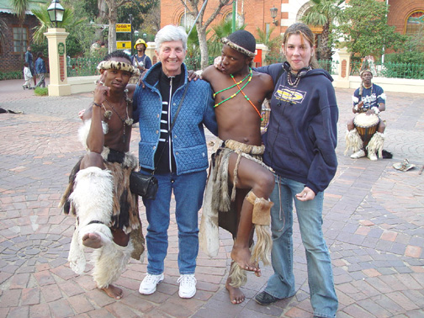
Festivals as Cultural Performance
Festivals are cultural performances…
entrepreneurs often take local festivals
They become more profitable
Restrict tourist access to off limits
Major growth since the 1950’s and boom of mass tourism (Kirshenblatt-Gimblett 1998)

Slide 45
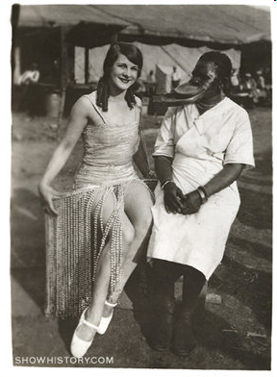
Exoticised ‘other’
‘all but extinct cultures are exoticised and felt to contain people with ‘ancient’ or ‘original’ sacred knowledge that can be taught transferred and experienced.’ (Schechner (1993)

Slide 46
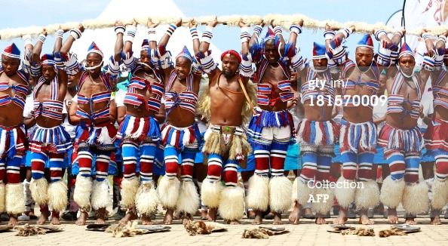
Performing cultures
Tourism gives tribalism and colonialism a second life by bringing them back as representations of themselves and circulating them within an economy of performance. Bruner and (Kirshenblatt-Gimblett 1994)

Slide 47
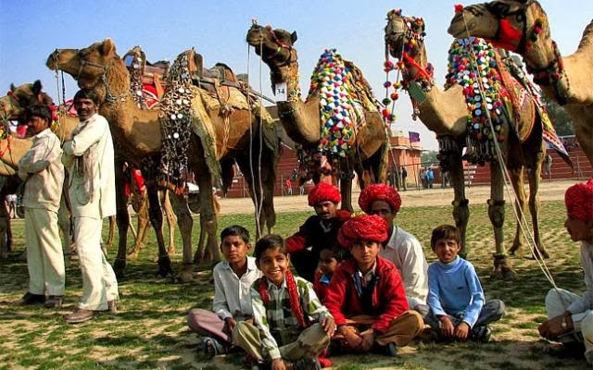
Cultural festivals and the touristic experience
Defined as ‘transient consumption of aesthetic difference in the search for the sincere and authentic’ (McCannell, Urry)
Authentic if you think it is as you create in your mind? (Chhabra et all 2003)

Slide 48
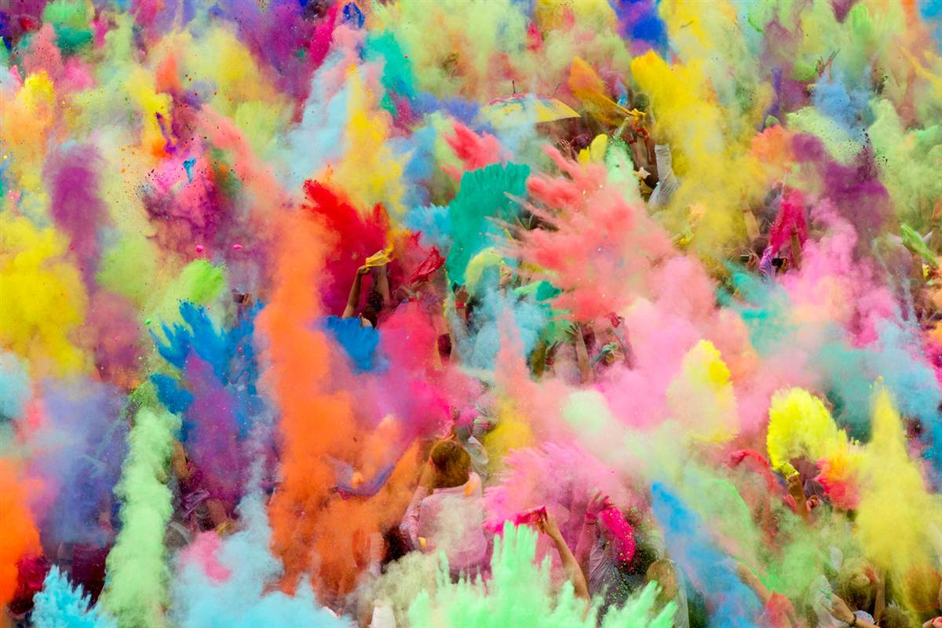
Visitor Experience Products
Spectacle
Belonging/ sharing
Authenticity
Community
Culturally genuine goods and entertainment
Realistically recreate historical/ cultural event
Do not exploit visitors
Ritual
Games
Targeted Benefits

Slide 49
Lecture : Marketing and Promoting Events
Indicative Reading
Bowdin, G et al (2001) Events Management Butterworth-Heinemann: chp 6
Goldplatt, JJ (1990) Special Events Van Nostrand Reinhold
Hall, CM (1992) Hallmark Tourism Events: impacts, management & planning Belhaven Press: Chp 8
Murray, M (1995) When will the balloon burst? Hospitality Feb/March 1995
Roche, M (1992) Mega-Events and micro-modernization: on the sociology of the new urban tourism British Journal of Sociology, Vol 43 (4) December 1992: p563-599
Watt, DC (1998) Event Tourism in Leisuure and Tourism Addison Lesley Longmann: Chp 5

