Slide 1
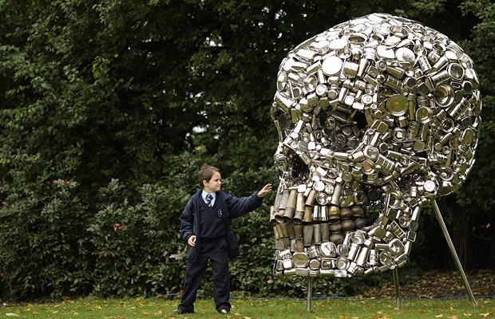
Arts fairs/historic re-enactment

Slide 2
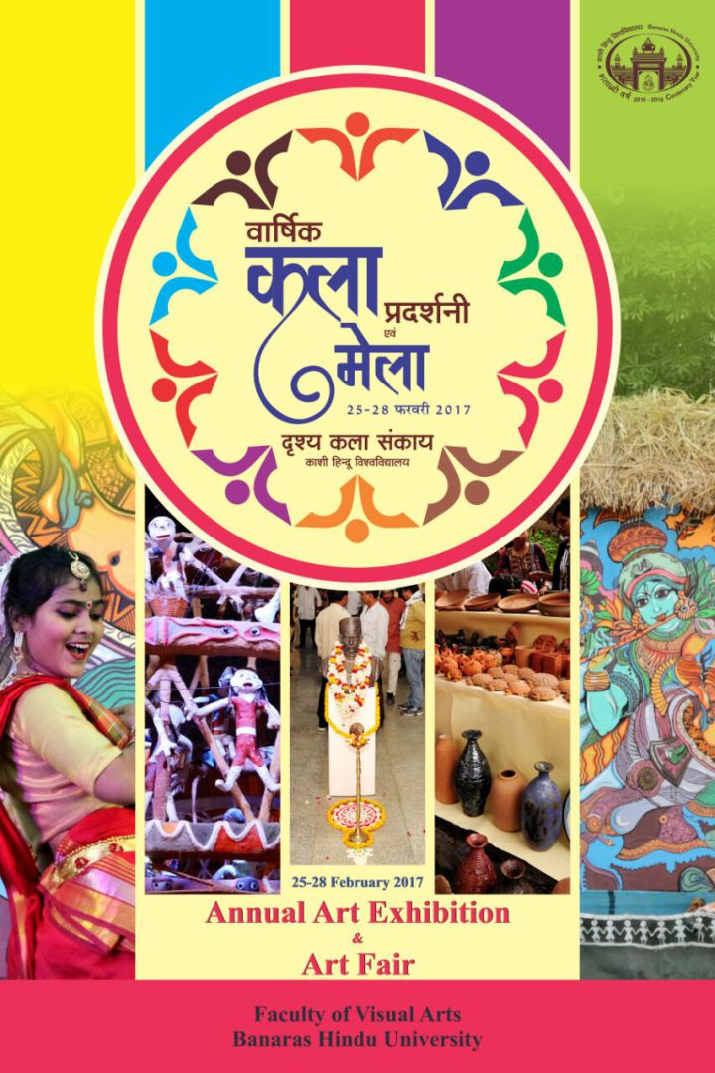
Art Fairs

Slide 3
Why Festivals and Events(recap)
Social habitus (Bourdieu)
Time out of daily life
Tribalism (gatherings of like minded people - music festival, opera)
Signals a cultured people- city spaces
Art is a currency in society
Art spaces have high social standing.

Slide 4
Why art fairs?
Develop and showcase cultural offerings
To be seen to be player on the global ‘art’ stage
Valuable market in cultural and financial terms
Cultural one-upmanship – some art fairs very exclusive
To support emerging markets – Bucharest biennale for example
To show support for countries in the political sense
Art and politics co-inside in the way that civil rights are evident within cultural spaces in terms of how they determine cultures and cultural value

Slide 5
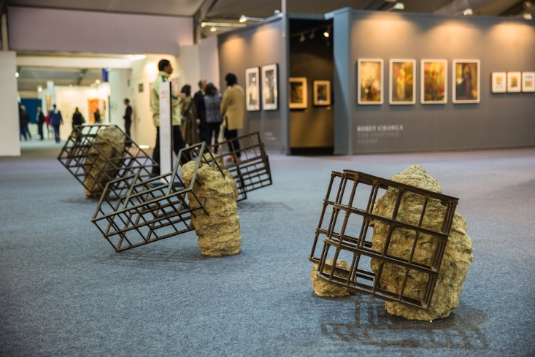
Evidenced by emerging markets entering art fair world
India Art Fair is South Asia’s leading platform for modern and contemporary art and portal to the region’s cultural landscape. Founded in 2008, India Art Fair has become the bedrock of a now booming cultural community with connections to every level of the market.

Slide 6
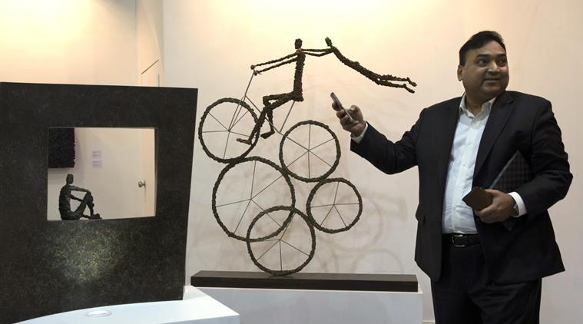
Based on Venice model
India's first art biennale, its largest ever gathering of contemporary artists, has opened in the southern city of Kochi. The exhibition, modelled on similar ones across the world, particularly in Venice, features more than 80 artists.
Not selling - showcase
Old warehouses used in the days of the spice trade more than two centuries ago, works of art in themselves with their high ceilings and wooden beam structures, have been transformed into venues.

Slide 7
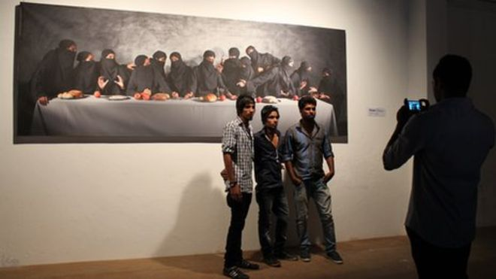
Seen as too outward looking?
Anti-biennale groups have put up posters in the town and, according to reports, even burned brochures to protest against what they say is a corporate-driven occasion which does not promote enough local artists.
"From a curatorial point of view, when you choose 80 artists from all over the world, it is tough," says Mr Komu, adding that 23 of the 82 artists showing are from Kerala.
"It's not like it's an excluding exercise, perhaps some of the artists who weren't shown should have organised a fringe biennale."

Slide 8
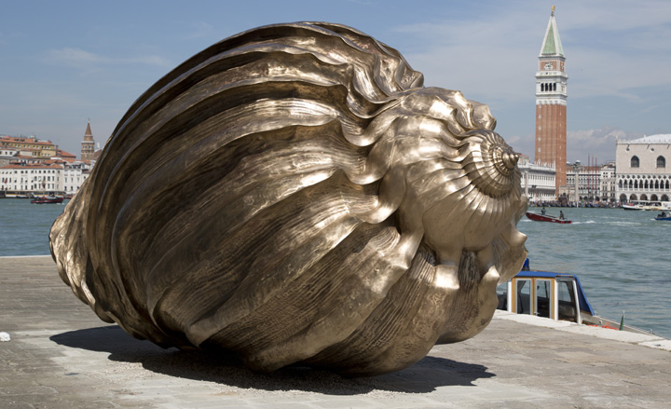
Art fairs
‘artists endlessly crossing continents to exhibit at art biennales, attempting to please the same group of jet setting-carbon-footprint-heavy international curators or NEW York based dealers now operating out of Beijing or Shanghai?’
(Harris, J (2011:3) Globalisation and Contemporary Art)

Slide 9
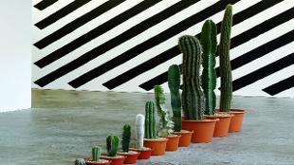
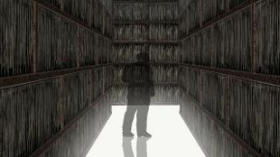
Art markets
Arts markets tend to form round the centre (established galleries, exhibition Biennales)
‘centre is where demand is concentrated, reputations are built, and the density of social networks is highest – enhances visibility, reputation and therefore price level.’( Velthuis 2005:107)

Slide 10
Beijing International Art Biennale
Cultural significances of the Biennial:
Building a grand path and bridge for international cultural exchanges;
Opening the showcase for presentation of native contemporary arts;
Incubating new concepts of arts and shortening the regeneration cycle of arts for activating innovation;
Rationally identifying excellent arts around the world and promoting exquisite arts;
Closely combining arts with international trends and national interests, developing the resource advantages in serving the society and human beings.

Slide 11
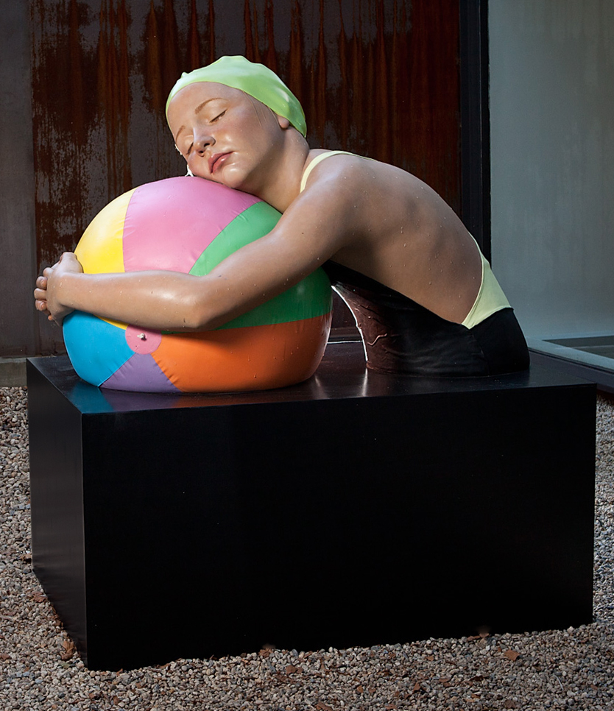
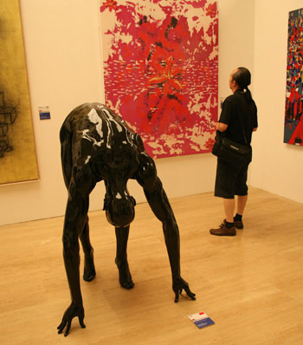
Beijing International Art Biennale

Slide 12
Social Functions of the Bienniale:
Protecting the rich and diversified cultures of the world and promoting the normalized supplementation of advanced concepts and works through multidirectional international transmission;
Creating an obstacle-free path for the convergence of pioneering thoughts of different nations and countries via the exchanges of visual arts that are less restricted by language barriers;
Maintaining and promoting the peace of human being through worldwide feeling gathering;
Making use of the geological convenience of the hosting country, highlighting the local culture and national art, winning the initiative rights of voices in the cultural circles of the world, thus developing the cultural vision of local residents;
Expanding the celebrity of the hosting city, enhancing its cultural content, promoting the economic development by accelerating the local tourism;
Performing the basic duties, which should be undertaken by big cultural powers to the international society.

Slide 13
Bucharest Biennale
‘the shifting nature of economics, politics and culture, are artistic practices whose agency lies in investigative or indirect approaches that possess their own kind of power.’ Bucharest Biennale
http://www.youtube.com/watch?v=L-X8hKYgASc
'The field of art has become-in short-a field of possibilities, of exchange and comparative analysis. It has become a field for alternatives, proposals and models, and can, crucially, act as a cross field, an intermediary between different fields, modes of perception, and thinking, as well as between very different positions and subjectivities’
Simon Sheikh, 'SPACES FOR THINKING: Perspectives on the Art Academy,‘ Texte Zur Kunst 62

Slide 14
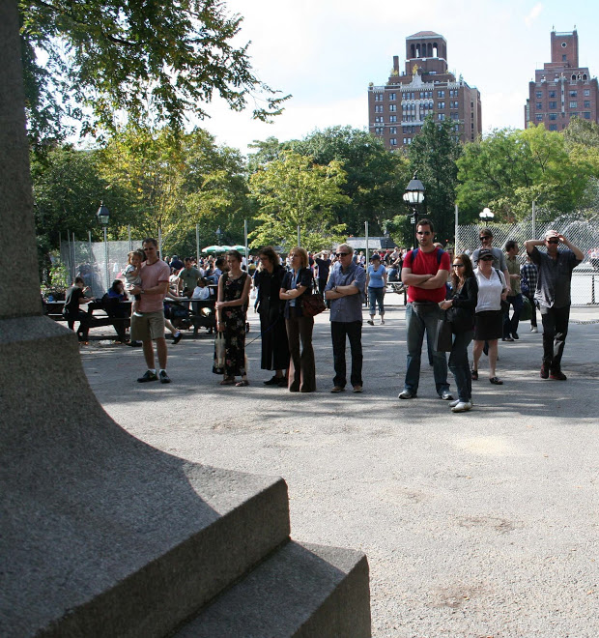
New York Biennale: fighting systems
‘New York is considered the international capital of contemporary art. New York still doesn't have an event that marks its supremacy in the field of contemporary art.
The NYBA is committed to fill this gap and call back to New York every two years the best of the international artistic production, the avantgards, and all those who tries to overpass the boundaries of and between the arts, in particular the new artist generations.
The dominant system only looks at turnover.
Money, money, money.’
http://www.nybiennaleart.org/2012-2013/

Slide 15
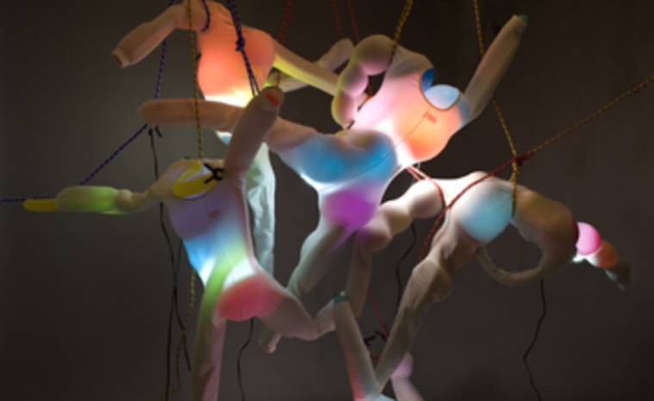
Mission cont…
They think just the present day
Tomorrow is not interested
In their hands the artistic product has become a financial product.
After preparing real estate bubble and financial bubble are also preparing one of contemporary art.
I can not wait to see it!
I will arrange a big party and we'll begin a new era,
Not Damien Hirst and his fucking dog fish, not Jeff Kons and his fucking sweet hearts.
Next Biennale will continue to beat the path of research, quality, innovation
We have to change.
We can change.

Slide 16
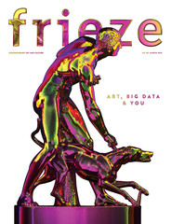
frieze art fair
Frieze Foundation is a non-profit organisation established in 2003 and is responsible for the curated programme at Frieze London, comprising artist commissions, talks, films, music and education.

Slide 17
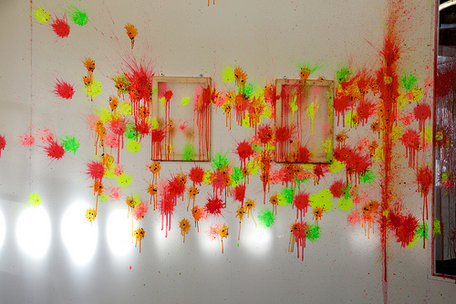
Art establishment showcase

Slide 18
Frieze 2016
https://frieze.com/media/frieze-projects-2016
Discover the world’s most exciting artists, from the emerging to the iconic
https://frieze.com/fairs/frieze-london/programme
Frieze London features more than 160 of the world’s leading galleries. View and buy art from over 1,000 of today’s leading artists, and experience the fair’s critically acclaimed Frieze Projects and Talks programmes

Slide 19
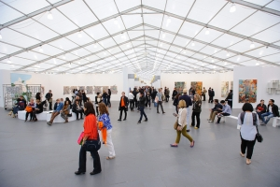
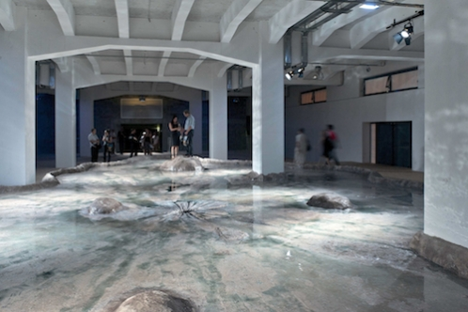
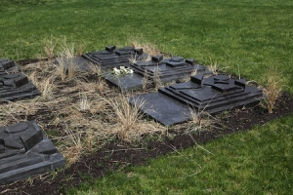
Frieze New York
featuring over 190 of the world's leading contemporary galleries.

Slide 20
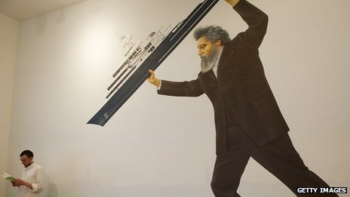
Outsider art

Slide 21
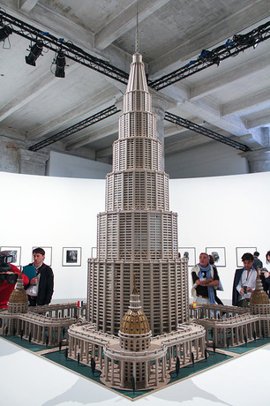
Outsider art
‘Work that has been produced by unknown artists operating outside the established market and institutions with little or no formal training is being lauded by collector's dealers and curators here, as art that has a refreshing honesty and directness.
It is, I suspect, a reaction against the increasing commodification of art, the result of a blooming market fuelled by the new ultra wealthy, profiting from economies new emerging from around the world. Will Gompertz Arts editor
http://www.bbc.co.uk/news/entertainment-arts-22719103

Slide 22
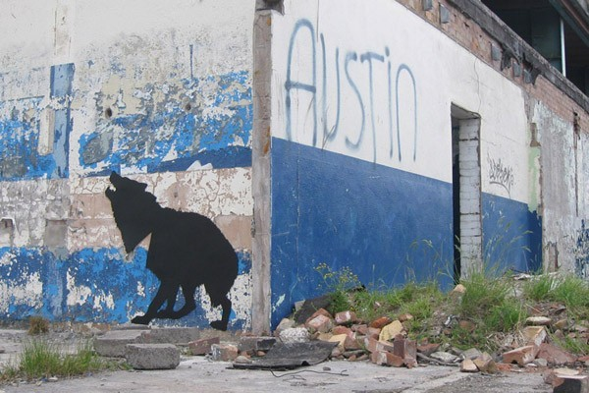
Liverpool Biennial The UK Biennial of Contemporary Art
Every two years the city of Liverpool is host to an extraordinary range of artworks, projects and a dynamic programme of events. It is the largest international contemporary art festival in the UK.
Liverpool Biennial unfolds through a programme of exhibitions and projects that lead to a rediscovery of the city. Newly commissioned and existing artworks and projects are presented in diverse locations, including unusual and unexpected public spaces as well as the city’s galleries, museums and cultural venues
Carlos Amorales Why Wolves

Slide 23
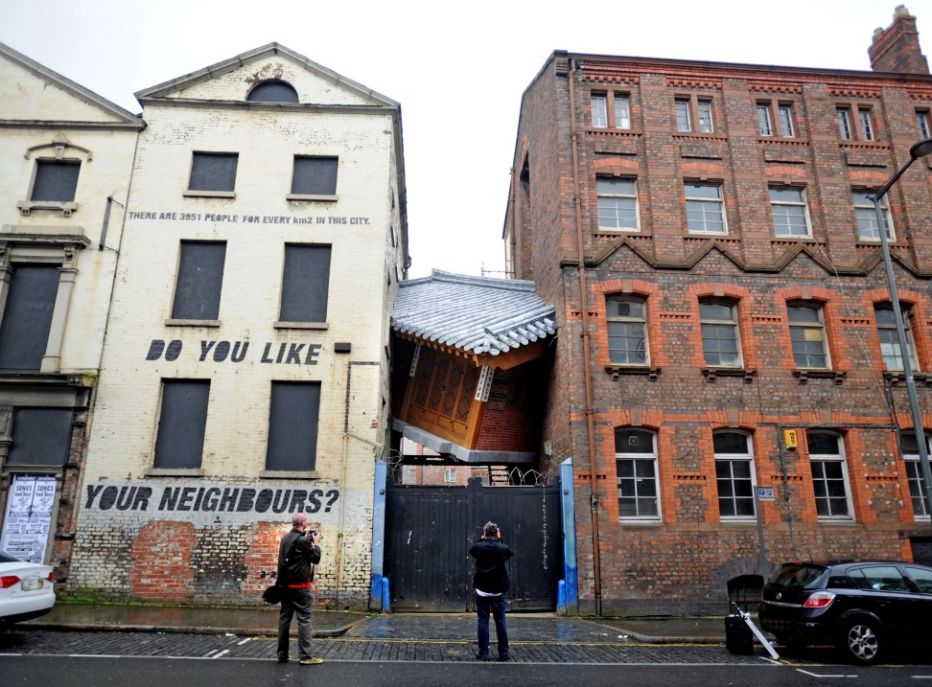
Commissioning new art
Since its launch in 1999, Liverpool Biennial has commissioned over 200 new artworks (Liverpool was City of Culture in 2008) Liverpool Biennial attracts over 600,000 visitors over 10 weeks In 2010 visitors to the Biennial spent £27millon

Slide 24
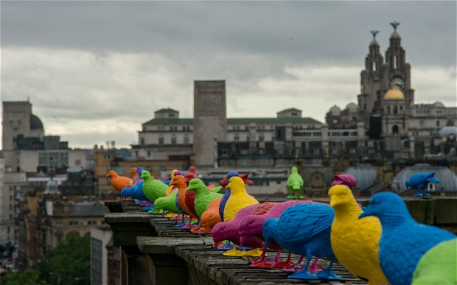
Uses the city

Slide 25
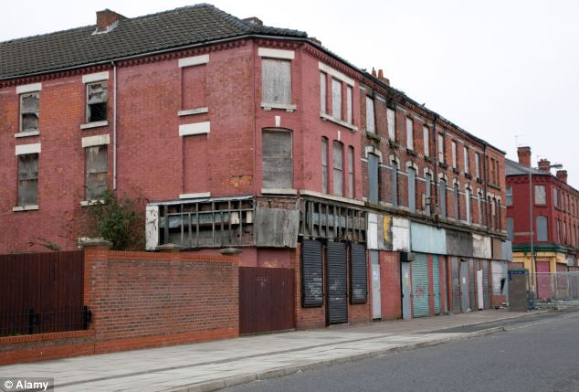
Liverpool Life
Liverpool has five of the most deprived areas in the country as report claims England is one of most unequal countries in Western world
Liverpool is the most deprived area

Slide 26
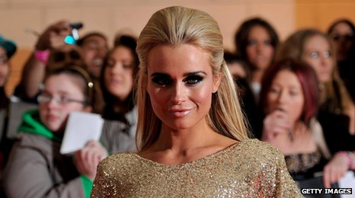
Liverpool: the best dressed city in Britain
"liverpool? Fashionable? Don't they all wear shell suits, brandish guns and have Barry Grant haircuts? Isn't it the poorest city in Britain?" People laughed when I told them I was going to Liverpool to write about the most fashionable city in Britain. (Independent 1995)
The city is now a credible fashion hotspot "Liverpool people naturally wear more fashion than the inhabitants of any other city. The girls there are wonderful, they all wear high heels.“ (Telegraph, 2008)

Slide 27
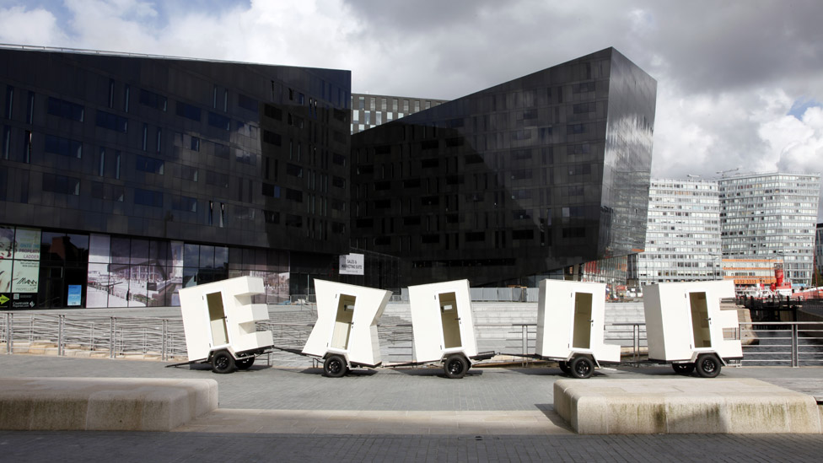
Sharing issues common to a poor city
Jose Angel Vincench's work takes the form of five mobile home trailers spelling the word Exile to represent the transient existence of people who have left their homes for political reasons.

Slide 28
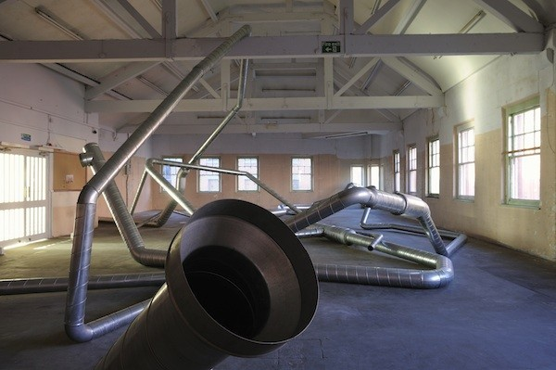
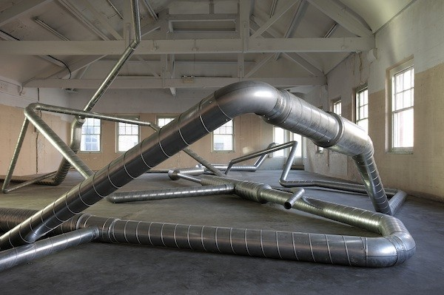
Rosa Barba: Sounds of the City
Free Post Mersey Tunnels, 2010 Pipes, sound, ventilator Courtesy Carlier | Gebauer, Berlin and Galleria Giò Marconi, Milan New commission for Liverpool Biennial 2010, Touched Photo Credit: Thierry Bal

Slide 29
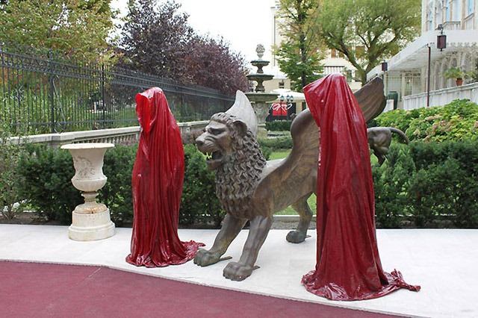
Merging of art forms

Slide 30
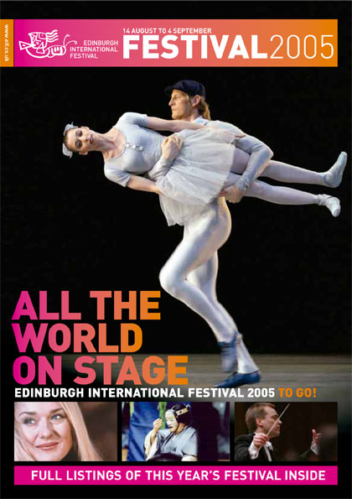
Cultural festivals as Serious leisure
Serious consumption (Stebbins) of high cultural forms i.e. Edinburgh Festival
93% being ABC1 (The Audience Business), c58% in 2004 came from outside of Edinburgh and Lothians

Slide 31
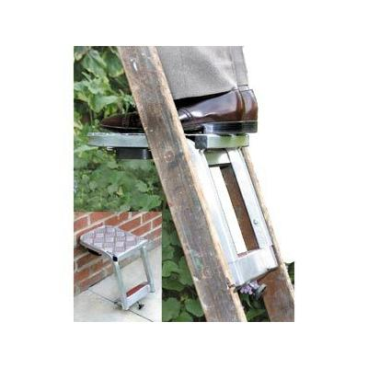
Cultural pursuits- career ladder
For such tourists cultural pursuits are a form of identity creation- career ladder (Prentice 2003)
Many of those attending are involved in some form of cultural profession and leisure extension of that. (Stebbins (1994)

Slide 32
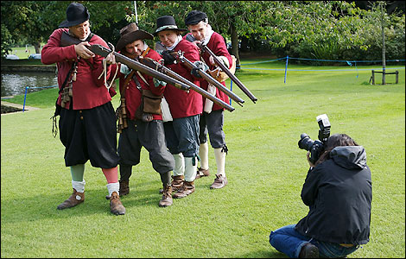
Part 2: Time travelling? Living history and re-enactment events

Slide 33
From living history to symbolic pageantry?
Living History- staging the past
Authenticity and ‘reputation management’ (Magellsen 2007)
Re-enactment societies
Lifestyle groups
War and staging battles
Interpretation at historic spaces
Festivals and one off or recurring events
Peaceful activities – food and cooking
Events that blend 2000 years of history in pageantry
‘The power of performance for articulating lived experiences of communities whose voices were often overpowered or suppressed by ‘official’ commentators’
‘Emotionally comfortable’ for visitors (Tyson, 2006)
‘living history interpretations are illusions...they allow us to explore our relationship with the past through human contact’. Goodacre and Baldwin (2002)

Slide 34
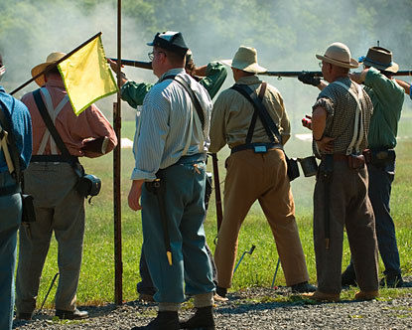
Virginia Civil War Re-enactment

Slide 35
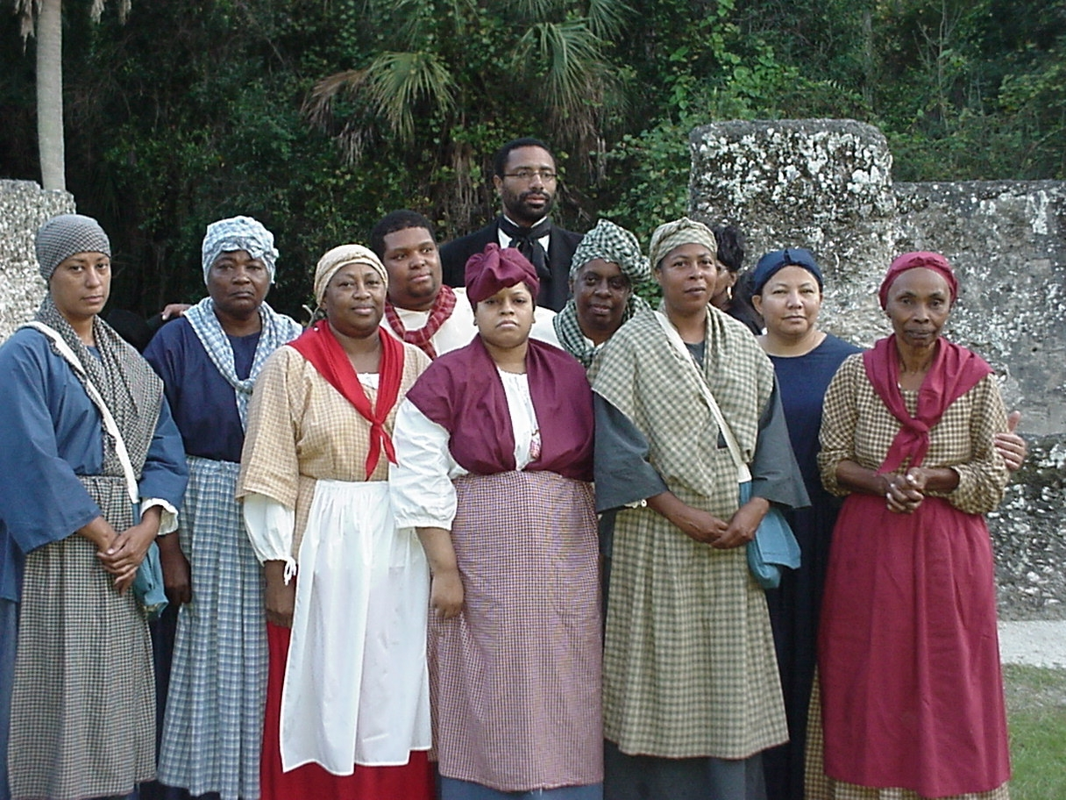

Slide 36
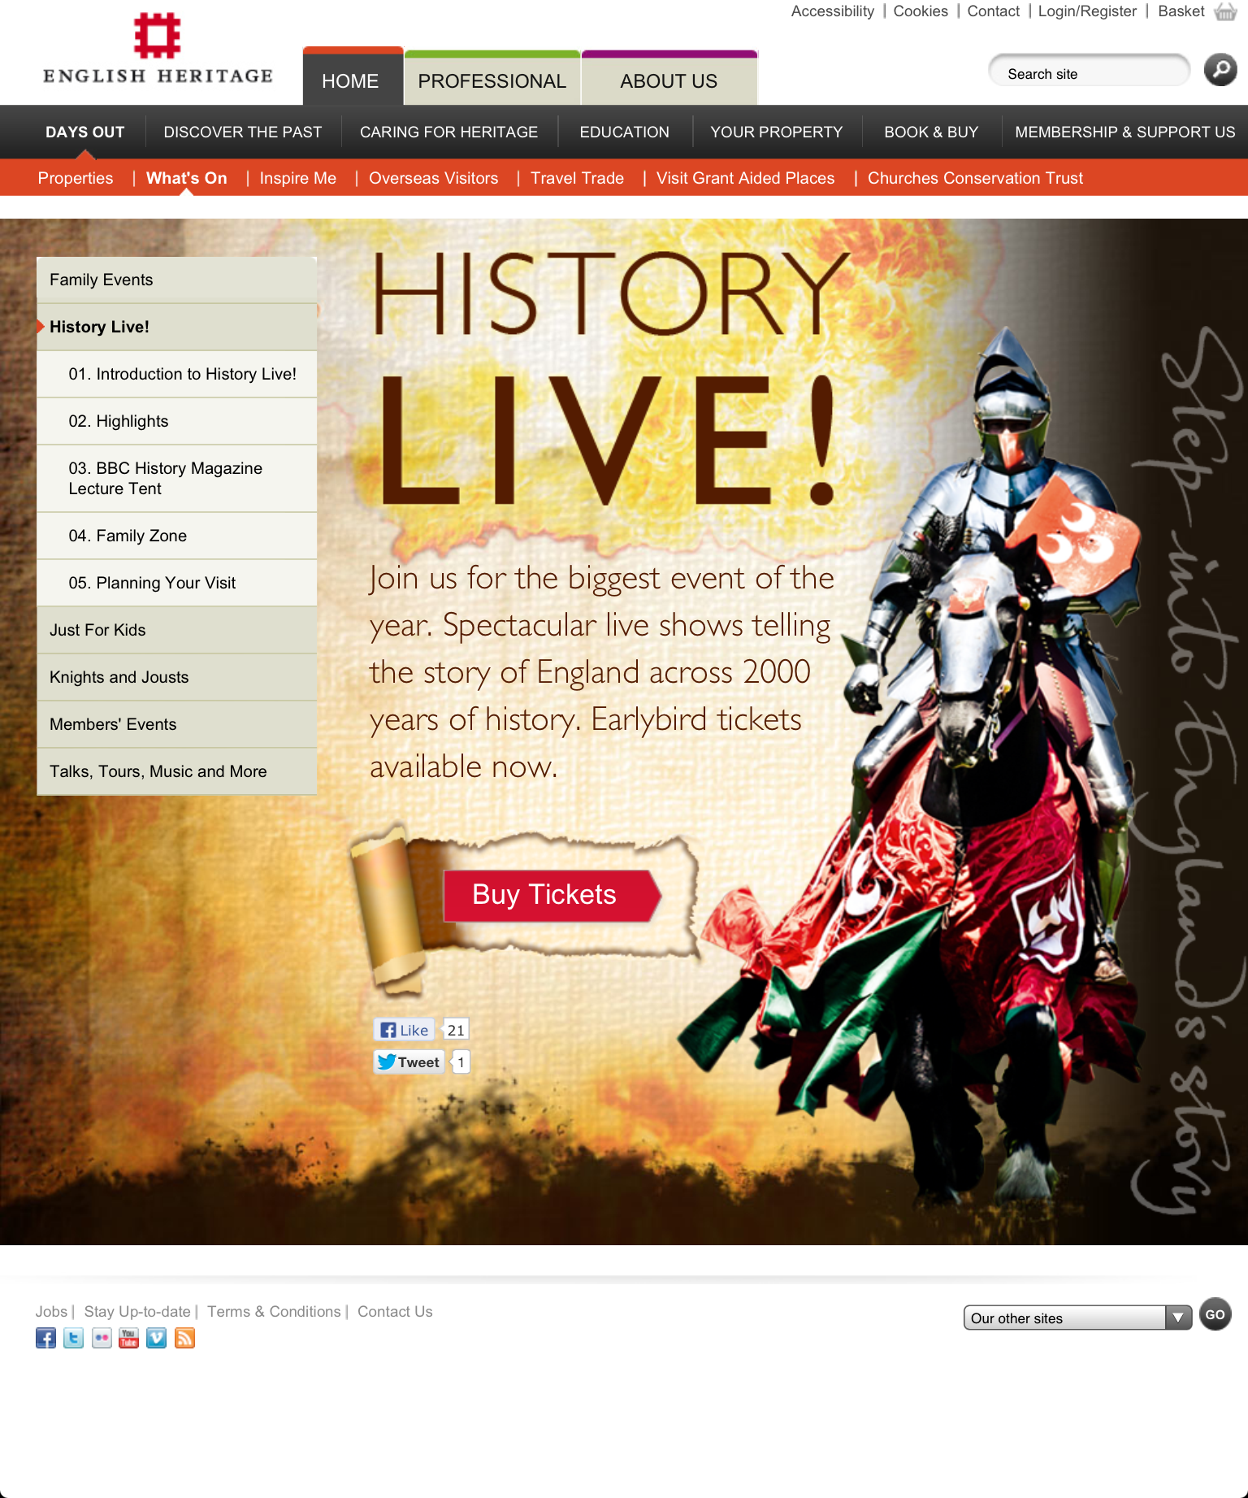

Slide 37
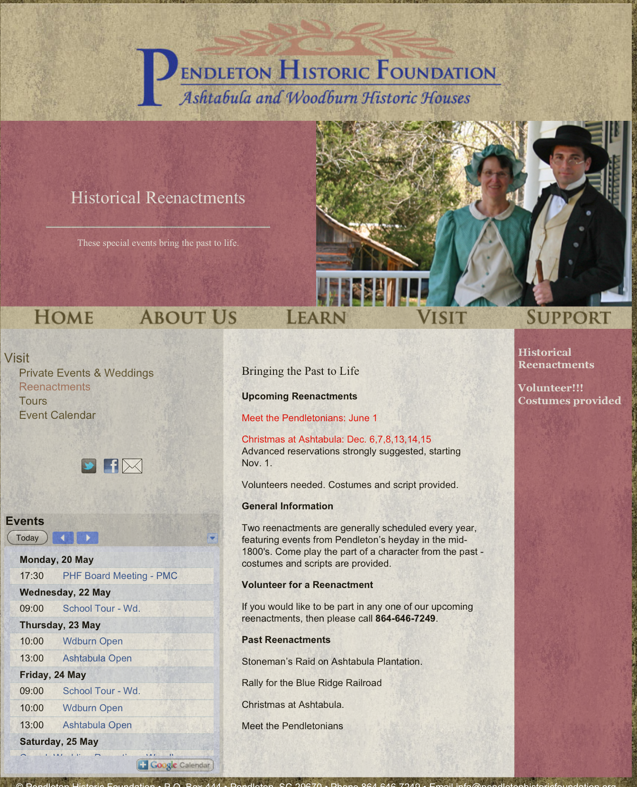

Slide 38
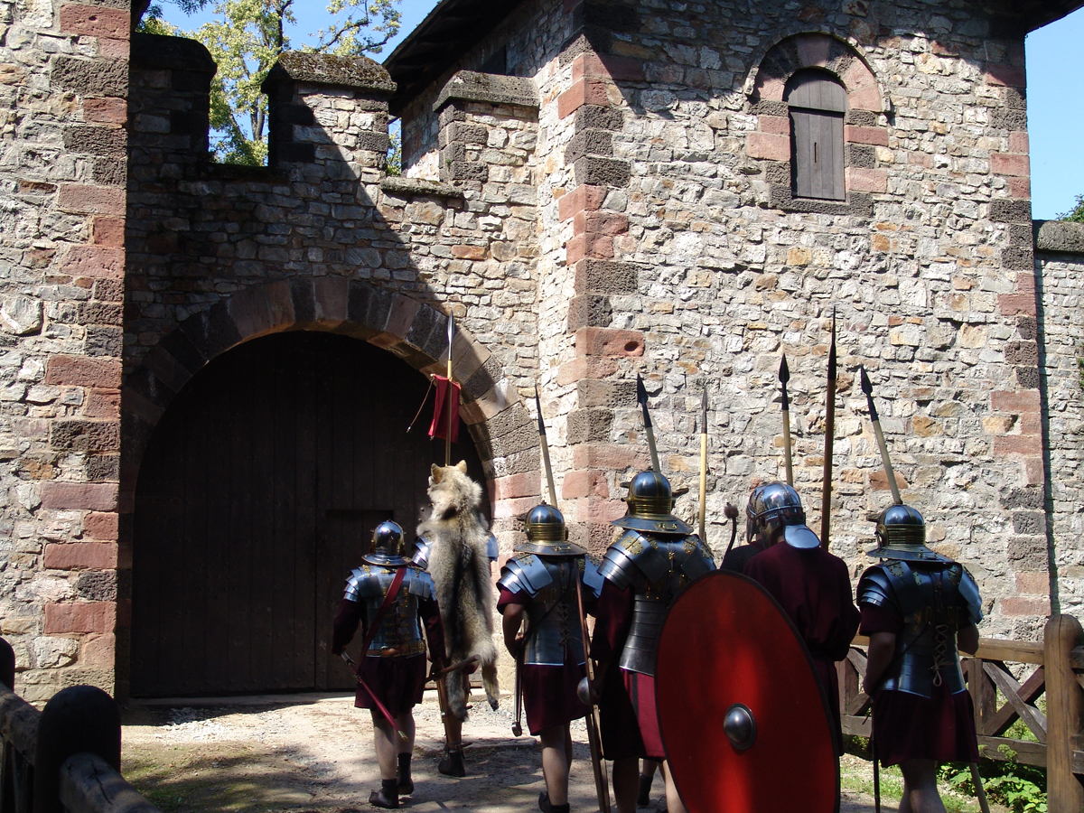
Storming the battlements- playing with place

Slide 39
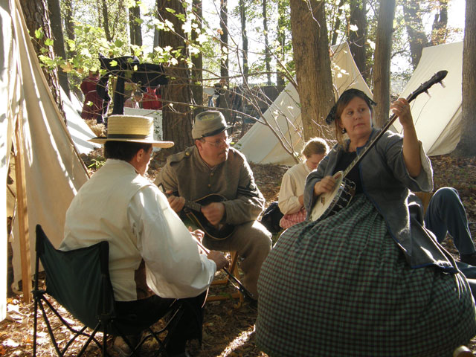
Playing with senses

Slide 40
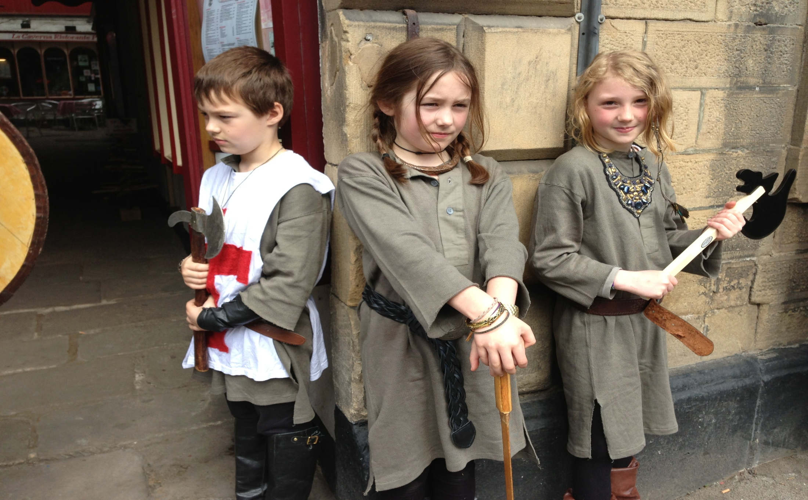
Lifestyle choices: Family fun

Slide 41
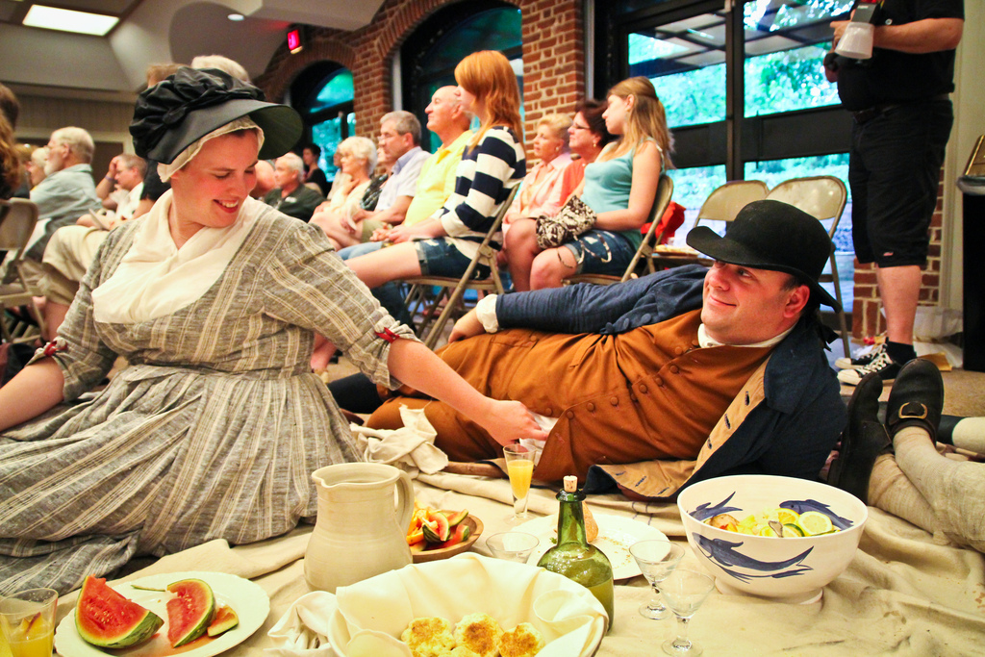
Peaceful activities

Slide 42
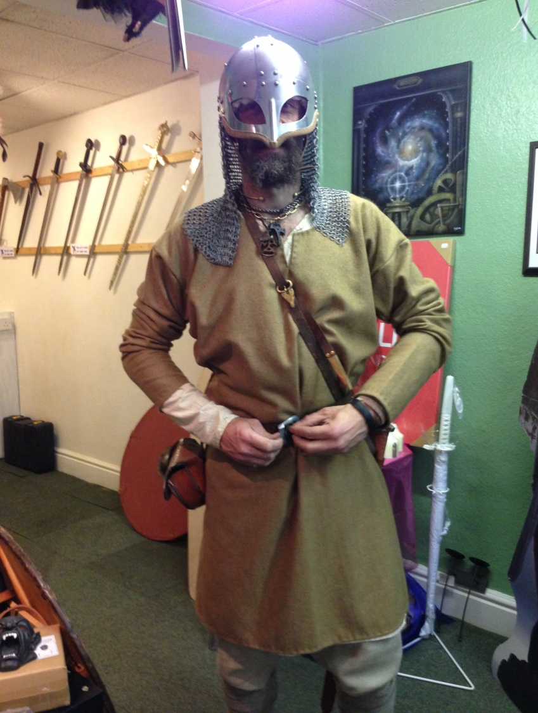
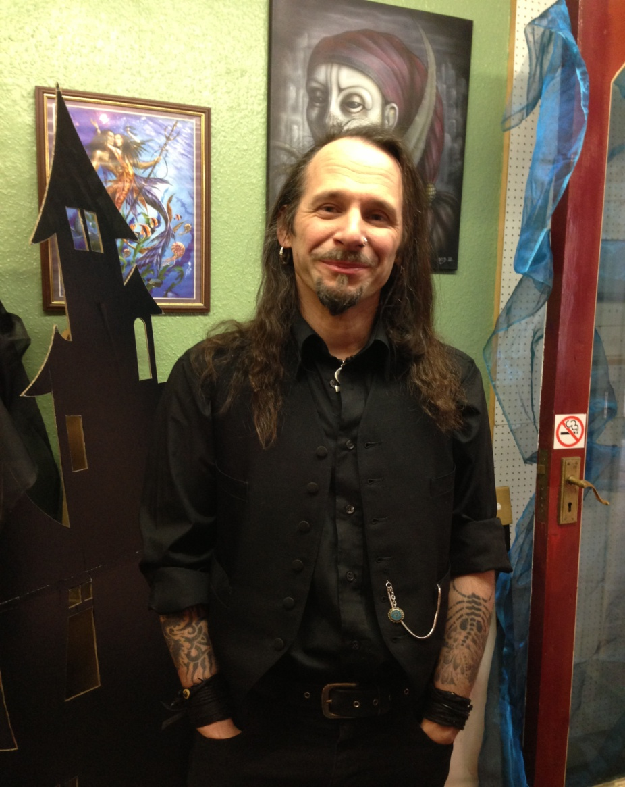
Living the dream(s)

Slide 43
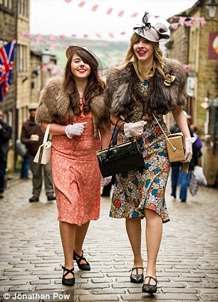
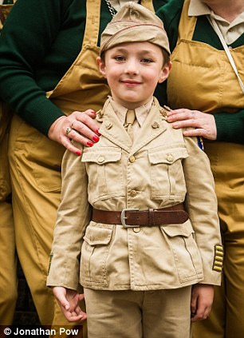
Howarth, West Yorkshire, May, 2013

Slide 44
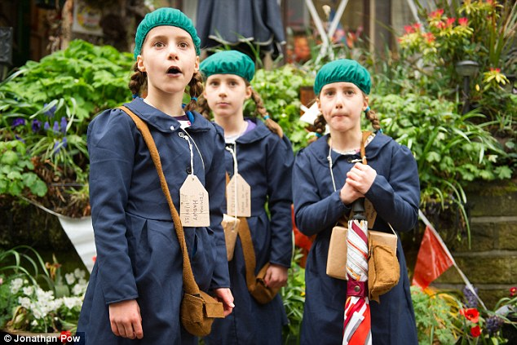
Evacuated Children

Slide 45
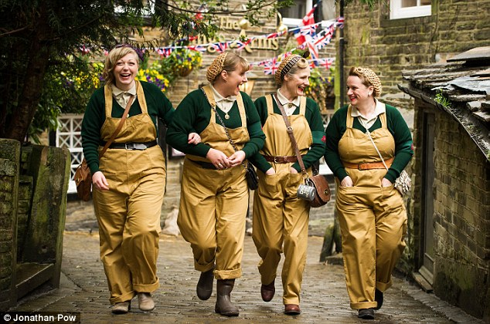
Land Girls: playing with tropes?

Slide 46
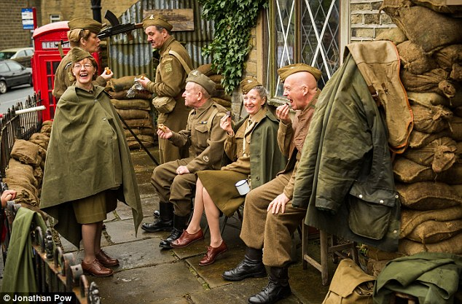
The right side?

Slide 47
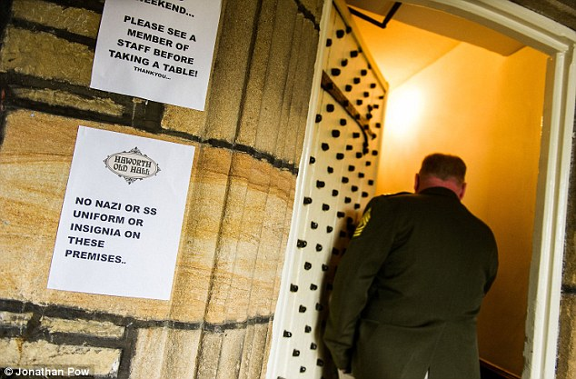
The NIMBY’s

Slide 48
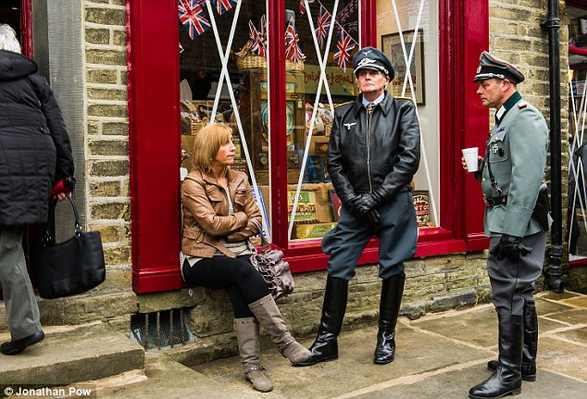
The wrong visitors?

Slide 49
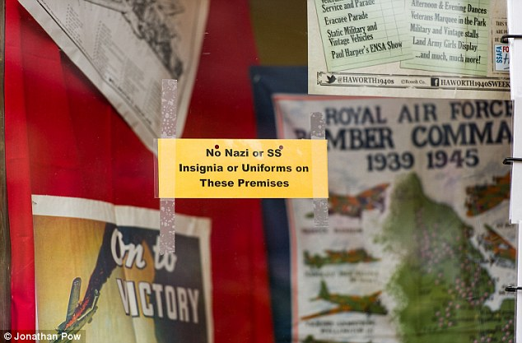
‘Dambusters celebration 'hijacked by Nazis': Outrage as visitors to WWII remembrance event defy ban on SS uniforms’ Daily Mail 19/5/2013

Slide 50
Problems of partisanship in Re-enactment events
‘To deny the re-enactment of these units is much like denying that the Holocaust happened. People need to see this, they need to see that such horror can be dressed in a smart uniform and strut around. These people are just as important as the Battle of Britain Flights or the Cenotaph... They serve a purpose they continue to remind us that not all Germans were SS but all SS were Nazi...’Blog post (May 2013)

Slide 51
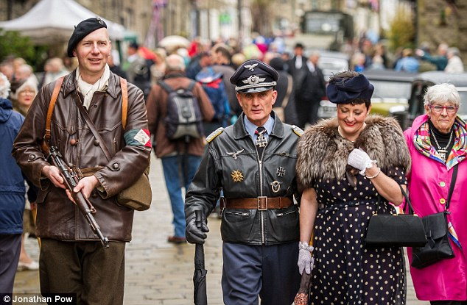
Playing with time and place?

Slide 52


I’m usually a Viking...

Slide 53


Ye Olde Merchandise

Slide 54


Slide 55


Slide 56
A necessary embellishment?
I was a by-stander in a re-enactment of the Warsaw uprising, accompanied by a 73-year-old friend who was a boy scout at the time keeping watch on German troop movements. What struck me was the way in which the event was being presented for 21st century audiences in ways which not only sanitised the event, but which dramatised it unrealistically. I don’t imagine, for example, that the Polish resisters actually stood on the top of the barricade declaiming, though this is what we saw. (Bornat,personal statement, 28 August 2004)

Slide 57

Playing with gender roles?

Slide 58


Slide 59

Liberation Day, Jersey 2007

Slide 60


Manor Lodge: ruin bought to life

Slide 61


Edutainment versus lifestyle choice

Slide 62


The Battle of Orgreave: Miner’s strike

Slide 63



King Richard's head to go on tour

Slide 64

So….
Re-enactment events offer interactivity
Add value to visits – played out in historic space
Can be partisan, racist, ‘inaccurate’/educational?
Offers family engagement

