Slide 1

International Business Essay - Internationalization Of Business
Objectives
Ability To Comprehend The Nature Of International Process Of Business
Perform An International Business Analysis
Need To Understand International Business Theories
Assist In Learning & Applying KEY IB Theories From The Course To ‘Real-Life’ MNCs

Slide 2
International Business Essay – Structure Of Your Essay
Key Question
What Is The Internationalization Process Of The Company …… In (Industry & Country)?

Slide 3

Step 1
Select A MNC From The List Of 2015 Fortune’s Global 500 MNCs
(http://fortune.com/global500/)

Slide 4


Step 1
You Are Encourage To Select A MNC From An EMERGING COUNTRY. Examples!
Brazil
UAE
Russia
India
Vietnam
China
Indonesia
Malaysia
South Africa
South Korea
AEC - ASEAN Economic Community
Mercosur Countries - Argentina, Brazil, Paraguay, Uruguay & Venezuela

Slide 5




Step 2
Select ONE Country Where The MNC Has Invested In (In Any FDI Forms)
Analyze The Internationalization Of The MNC

Slide 6
Step 2 – Cont’d
You Need To Follow These Instructions:
1. The ANALYSIS Of Your MNC:
Present & Analyze Key Data Supporting The Status As A MNC
Use Key Academic Sources To Illustrate & Explain The Concept Of A MNC

Slide 7
Step 2
2. HOST Country Analysis:
Focus On ONE Factor (i.e. Political Economy & Socio Cultural Factors) From The HOST Country That Influences The Internationalization Process of The Firm
Answer The Following Questions
What Is The Key Factor From The Host Country That Promotes Internationalization Process Of Your MNC? WHY?

Slide 8
Step 2
2. HOST Country Analysis: (Cont’d)
Answer The Following Question
Use ONE Theory To Support Your Argument(s). Examples:
Uppsala Internationalization Theory
Dunning Eclectic Paradigm
Porter’s Diamond Theory

Slide 9
Step 2
3. Foreign Entry Strategies:
Answer These Questions
Explain Entry Strategy/Strategies Performed By The Company
Use Academic Resources (i.e. Journal Articles) To Explain The Concept Of The Company’s Entry Strategy & Its Benefits

Slide 10
Step 2
3. Foreign Entry Strategies: (cont’d)
Answer These Questions – Cont’d
Identify Some Constraints Of The Selected Entry Strategy.
Important To Combined Points From Academic Sources (i.e. Academic Journal Articles) & Information From The MNC To Analyze Potential Constraints Of The Entry Strategy

Slide 11

Step 2
4. International Business Impacts & Contributions:
What Are The Major Contributions Of Your MNC To The HOST Country
From The UN Global Compact Principles, Which Area That Your MNC Will Need To Focus In Their Current & Future Business? WHY?

Slide 12

TIPs
This Assignment Is To Assess Your Level Of Mastery Of the Subject Matters & Your Analytical Skills In Relation To Foreign Market Entry Strategies
1. Important You Can Integrate Key International Business Theories From The Course To Your Analysis Of An MNC
2. DO NOT PERFORM - PESTLE; SWOT; Porters 5 Forces
3. This Is An International Business Essay. AVOID Marketing & General Management Points/Analyses

Slide 13
Other Requirements
A Minimum Of 6 (SIX) Academic Journal Articles Must Be Read & Cited
The Assignment Must Be Well-Structured & Well-Presented
Clarity Of Expressions Together With Appropriate Use Of Grammar, Spelling, & Punctuations
Any Use Of Comments, Information, Data Or Quotations From Others (Books, Journals, Newspapers, Web, etc.) Must Be Cited Using Harvard Referencing Style.

Slide 14
Headings (For Essay/Report Format) - Definitions
1. Executive Summary – An Overview Of The Essay/Report & The Intended Objectives
2. Introduction – Introduce The Concepts/Theories Of Internationalization, Entry Modes, etc.
3. Conclusion – Summarize The Strategic Considerations Behind Internationalization & The Eventual Recommendations

Slide 15
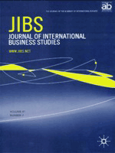
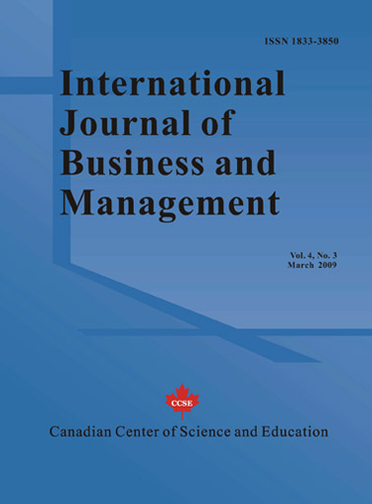
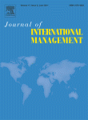
A Minimum Of Six (6) Academic Journal Article Must Be Read & Cited
Examples – Academic Journals

Slide 16
Examples - Peer Reviewed Academic Journal Articles
Gabrielsson, M. Et Al “Born Globals: Propositions To Help Advance Theory”, International Business Review 17 (2008), Pp. 385-401
Chetty, S, “Explosive International Growth & Problems Of Success Among Small & Medium Sized Firms”, International Business Journal, Feb 2003, Pp. 5-28
O’rourke, K.L. & Williamson, J.G. (2002) “When Did Globalization Begin”, European Review Of Economic History 6, Pp. 23-50
Li, J,; K.C.K.; Karakowsky, L. & Qian, G. “Firm Resource & First Mover Advantages. A Case Of Foreign Direct Investment (FDI) In China”, International Business Review 12 (2003), Pp.625-645
Anand, J. & Kogut, B (1997) “Technological Capabilities Of Countries, Firm Rivalry, & Foreign Direct Investment”, Journal Of International Business Studies Pp. 445-465
London, T & Hart, S (2004) “Reinventing Strategies For Emerging Markets: Beyond The Transnational Model”, Journal Of International Business Studies 35, 5, Pp. 350-363

Slide 17
Examples - Peer Reviewed Academic Journal Articles
7. Ghemawat, P (2002) “Semi-Globalization & International Business Strategy”, Journal Of Business Studies 34 (2), Pp. 138-152
8. Wang, P.; Chow Hou, W & Hiong Koh, P. (1998) “Control Mechanisms, Key Personnel Appointment, Control & Performance Of Sino-Singaporean Joint Ventures,”, International Business Review 7, Pp. 351-375
9. Williams, C & S Van Triest (2009) “The Impact Of Corporate & National Cultures On Decentralization In Multinational Companies”, International Business Review 18, 2, Pp.156-167
10. Tihanyi, L., Griffith, D And Russell, C (2005) “The Effect Of Cultural Distance On Entry Mode Choice, International Diversification, & MNE Performance: A Meta-Analysis”. Journal Of International Business Studies 36 (3), Pp. 270-283
11. Arino, A. (2003) “Measures Of Strategic Alliance Performance”, Journal Of International Business Studies 34, Pp. 66-79
12. Teegen, H (2000) “Examining Strategic & Economic Development Implications Of Globalizing Through Franchising”, International Business Review 9, Pp. 497-521

Slide 18











Examples: Non-Academic Literature – Periodicals, Newsprint, Magazines

Slide 19

Any Use Of Comments, Information, Data Or Quotations From Any Sources (Books, Journals, Newspapers, Web, etc.) Must Be Cited Using Harvard Referencing Style.

