Slide 1

ASSIGNMENT 2
RECAP & GUIDANCE

Slide 2
Critically discuss the cultural implications for multinational corporations of different approaches to employee voice and support your discussion with empirical illustrations.
Submission Date : 22nd April 2016

Slide 3
For Assessment Two you will need to:
Define key terms:
Culture
MNC
Employee Voice
Explain how they are interlinked

Slide 4
YOU WILL NEED TO DEFINE WHAT CULTURE IS:
“Culture is the characteristic way of behaving and believing that a group of people in a country or region (or firm) have evolved over time and share “ (Briscoe and Schuler, 2004:116)
There are many cultural influences, including national and organisational culture

Slide 5
YOU WILL NEED TO DEFINE WHAT CULTURE IS:
National Culture: Given that we operate within 'learned frameworks’ (Torrington, 1994) we have a ‘world view’, which is ‘normal’ to us, which we treat it as ‘standard’
Organisational Culture: “the collective programming of the mind which distinguishes the members of one organisation from another” (Hofstede, 1991)

Slide 6
YOU WILL NEED TO DEFINE WHAT AN MNC IS:
“MNCs are enterprises which in more than one country own or control productions or service facilities and activities that add value” (Leat, 1999)
It is the dimension of ownership & control and of value-adding activity that sets MNCs apart from organisations that simply trade internationally or enter into strategic international alliances or partnerships (Leat, 2001, p.83)
CULTURAL DIFFERENCE

Slide 7
YOU WILL ALSO NEED TO DEFINE WHAT ‘EMPLOYEE VOICE IS:
“A whole variety of processes and structures which enable, and at times empower, employees, directly and indirectly, to contribute to decision-making in the firm” (Boxall & Purcell, 2003, p162)
Voice’ is the ability for employees to ‘have a say’, to a lesser or greater extent, in organisational activities.
DIFFERENT CULTURAL ATTITIDES

Slide 8


Employee Voice
Direct
Indirect
Based on Unitarianism
Based on Pluralism

Slide 9




Direct Voice
“forms of voice involving direct two-way communication between workers and management” (Bryson, 2004 p213).
E.g. Team briefings, Quality circles, appraisals, ‘Open Door’ policies

Slide 10

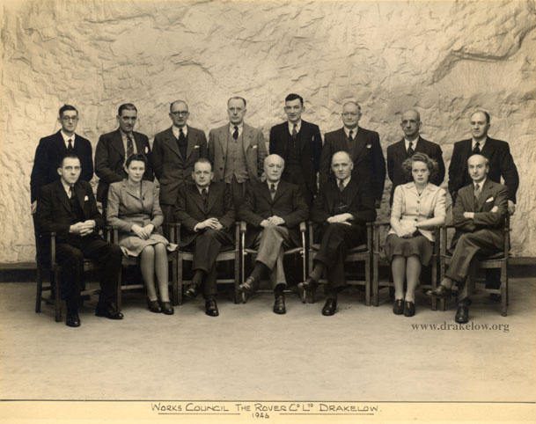

Indirect (Representative) Voice
“where the views and concerns of a body of employees are communicated to management by one or more employees selected to represent or act in an agency function for the larger group” (Taras & Kaufman, 2006 p515).
E.g. Trade union; European Works Councils, staff committee

Slide 11
How Effective is Employee Voice?
Voice can Strong or Weak, depending on:
Level of involvement in decision-making:
Provision of Information?
Joint consultation?
Collective bargaining?
Joint Decision Making?
Whether issues covered are operational/ trivial or strategic/substantive?
Some studies suggest the benefits of Direct forms of Voice disproportionately accrue to management

Slide 12
What are the implications for MNCs of culture upon employee Voice?
There are different traditions in different countries as to whether employees:
have a voice in the workplace
what form that voice takes
how effective it is
So there are cultural implications in respect of Employee Voice. The Voice system of the ‘home’ country may sit uncomfortably in the ‘host’ nation.
In many Western economies, ‘High Commitment’ HRM ideals are embraced and it is usual to give employees a Voice in the belief this improves organisational performance.
But that voice can vary considerably in form and effectiveness
And it is not the norm to give employees a Voice in all countries

Slide 13
For Assessment Two you should:
Find examples of how different countries view the need to give employees a Voice
Find examples of different countries attitudes to Direct Voice and Indirect Voice (including Trade Unions and EWCs)
Why do different viewpoints exist regarding Unions?
Could this be something to do with CULTURE?
Are there any models you could apply?
Consider their strengths and weaknesses.

Slide 14
Hofstede’s Cultural Dimensions
Power Distance: extent to which people accept inequality between members of society/ organisations.
Collectivism/Individualism: extent to which people see themselves as being part of a group or as individuals.
Masculinity/Femininity: extent to which the assertive acquisition of money & power or quality of life and good relationships is valued.
Uncertainty Avoidance: extent to which people are willing to accept change and work in uncertain circumstances.
Long-term Orientation: extent to which societies maintain links with the past whilst dealing with the challenges of the present.
Indulgence/ Restraint: extent to which gratification is allowed or suppressed.
http://geert-hofstede.com/countries.html
https://www.youtube.com/watch?v=LBv1wLuY3Ko

Slide 15
Trompenaars Cultural Dimensions
Universalism v Particularism
Individualism v Collectivism
Neutral v Affective
Specific v Diffuse
Achievement v Ascription
Inner Directed v Outer Directed
Sequential v Synchronic time orientation
https://youtu.be/hmyfjKjcbm0

Slide 16
Different ‘Voices’ Around the World
The challenge for MNCs is to create a system that operates effectively in multiple countries
They face a ‘balancing act’ between then need for Global standardization & Local responsiveness…

Slide 17
DIFFERENT VOICES AROUND THE WORLd
Global Standardisation is about achieving consistency, transparency & alignment of a geographically fragmented workforce around common goals.
It is a market-based approach aimed at gaining efficiencies
It fosters a feeling of equal treatment and clear expectations

Slide 18
DIFFERENT VOICES AROUND THE WORLd
Local responsiveness is about respecting local cultural values, traditions, legislation & government policy regarding employment practices
It aims to maintain employee commitment

Slide 19
For Assessment Two you should:
Find examples of different approaches MNCs have taken to Employee Voice systems.
Do they impose the country of origin’s way of doing things?
Do they adopt the host nation’s cultural traditions?
Do they develop a new ‘hybrid’ system?
Are there any models you can apply?

Slide 20
Perlmutter’s (1969) Model
Ethnocentric The values, culture and strategic decisions are determined by the parent company.
Polycentric Each overseas subsidiary is treated as an autonomous unit, controlled and managed locally.
Regiocentric Staff and decisions controlled within a geographic space but presided over by top managers at the centre.
Geocentric A mix of home country and parent country managers run the overseas subsidiaries.

Slide 21
Bartlett and Ghoshal’s (1989) Model
Global Centralised with parent HQ taking a strong role in determining policy for subsidiaries.
Multidomestic A strong local presence, decentralised, local autonomy. Sometimes called ‘multinational’
International Federal type structure whereby the centre coordinates rather than instructs.
Transnational Flexible arrangements, shared knowledge, direction & coordination between local and centre levels.

Slide 22
SOURCES OF ILLUSTRATIVE EXAMPLES
You can find some case studies in the recommended text books & journal papers to be found on Blackboard
You can also draw on the case studies we have looked at in class
Your own literature searches
Your own observations & research

