Slide 1
ORGANIZATIONAL DEVELOPMENT PROGRAM AND PROCESS
DIVERSITY TRAINING

Slide 2
INTRODUCTION
Organisational development refers to a set of change techniques that attempt to enhance organizational value and the wellbeing of the staff.
Organisation development incorporates a set of planned-changed mediations established on humanistic democratic worth whose mandate is to enhance organizational value and employee well-being
The organization under examination is Rhino Foods in Vermont, USA.

Slide 3
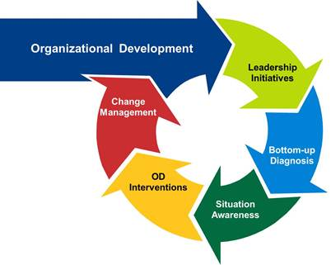
Process of Organizational Development
Problem identification and diagnosis
Planning strategy for change (Balzac, 2011)
Intervening in the system
Evaluation
Notes:
Problem identification and diagnosis: The identified problem is improvement of diversity training for the employees within the organization
Planning strategy for change: Integration of training programs and processes that can lead to the desired results
Intervening in the system: The intervention process will involve the actual process of engaging employees in diversity training
Evaluation: Testing and examining the employees performance and interactions to find out whether they mastered concepts of the training or not. Is the intervention used able to attract minorities and women in the organization?

Slide 4
Managing the OD Process
Components of OD program:
Diagnosis - unrelenting collection of data concerning the system, its subunits, processes, and its culture (Lewis, Passmore, & Cantore, 2016)
Action – processes and interventions initiated to enhance the organization’s operation
Program Management – activities designed to facilitate program success
Notes:
Diagnosis: Identification of the main issues that causes conflicts and lack of cooperation within the organization and thus, affect performance and discourage minorities and women from applying for jobs at Rhino Foods.
Action: Once the diagnosis is well defined through assessment of available data and issues that lead to conflicts among employees, the training will be organized to address them. In other words, the action to be taken is the training that will empower employees on the need to understand and embrace diversity to avoid conflicts and work together in teams.
Program Management: For the action to be successful, the entire program will be managed systematically by funding it and providing all the necessary resources to make it happen.

Slide 5
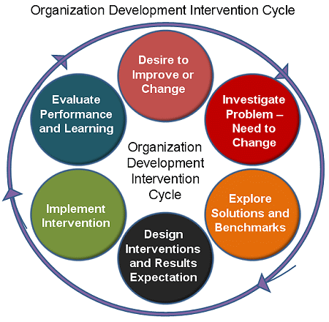
Process of OD Intervention
Sensitive training
Team building
Survey feedback
Behaviour modification
Grid organization development (Lewis, Passmore, & Cantore, 2016)
Career planning
Job expectation technique
Organizational renewal process
Notes:
Sensitive training: Create awareness about personal biases and prejudice
Team building: Work towards cohesion and unity among employees to facility teamwork
Survey feedback: Details of the reactions, responses, failures, and achievements of the training
Behaviour modification: Training process that focus on understanding and correcting behaviours of the employees
Grid organization development: Focusing on general development of groups, individuals, and the corporation as a whole
Career planning: Exploration of personal interests and abilities, systematic plan of personal career goals, and establishing learning and action plans
Job expectation technique: Analysis of the requirements of the job and comparing them to the current achievements to check whether the goals are met or not
Organizational renewal process: building novelty and adaptation into the company (Rhino Foods)

Slide 6
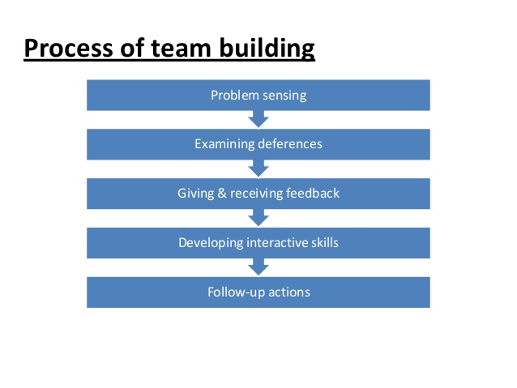
Sensitive Training and Team Building
Procedure for Sensitive Training
Process of Team Building
It is a type of training that makes individuals more aware of their preconceptions and more sensitive to others
It is done through (Noumair, 2016;
  Unfreezing the old values
  Developing new values
  Refreezing the new ones
Notes:
Unfreezing of Old values: to make employees aware of the inefficiencies of the old values
Develop new values: Trainees evaluate their interpersonal behaviours and give each other feedback with the help of a trainer
Refreezing the new values: Examines the scope of opportunities the trainees have to practice their newly acquired values and behaviours
After Such an understanding and awareness, the trainer can proceed to empower them on team building by taking them through the mentioned processes.

Slide 7
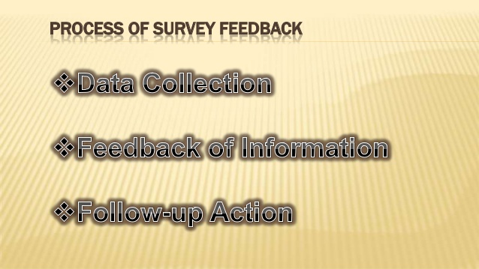
Survey Feedback
Survey Feedback refers to the application of questionnaires to identify discrepancies among members. It examines their views, discussion follows, and solutions are proposed
Process of Survey Feedback
  Data Collection
  Feedback and Information
  Follow-up action
Notes:
Data Collection: Issuance of questionnaires for the trainees to respond to the questions asked
Feedback and Information: Identification of disagreements and issues raised by trainees to address them effectively
Follow-up Action: Engagement in discussion with the trainees to understand their reactions and propose practical remedies

Slide 8
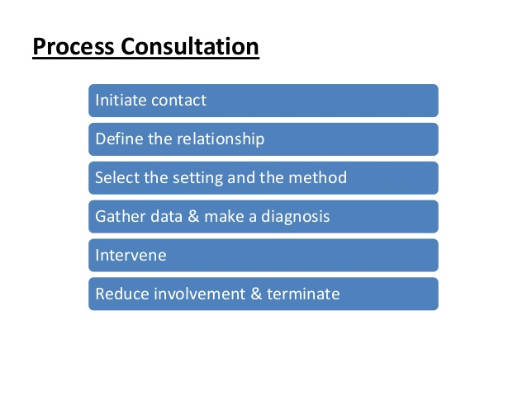
Process Consultation
Process consultation emphasizes on the aspect of the consultant working with persons and groups in the organization to learn about human and social processes and find solutions to problems that originate from process events (Noumair, 2016).
During diversity training at Rhino Foods, the trainer will act as the consultant
He will work with employees individually and in groups to help them understand the need of interpersonal relations
Notes:
The trainer will emphasize on interpersonal trust among the workers
Consultation will improve the level of satisfaction and commitment among the workers
Consultations in groups will help manage conflicts
The overall achievement will be enhanced corporation problem-solving experience and ability

Slide 9
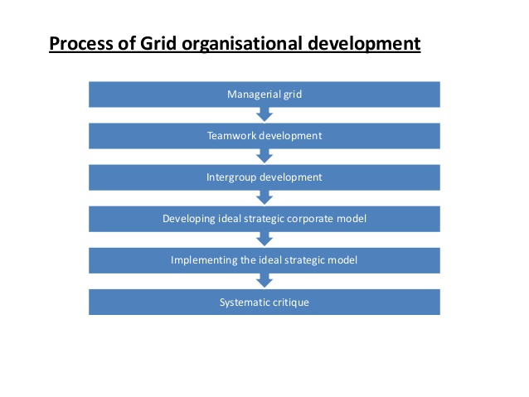
Grid Organizational Development
Refers to a detailed and systematic OD program that focuses on individuals, groups and the organization at large.
Notes:
Grid organizational development utilizes a sensible number of instruments that enables people and groups to evaluate their strengths and weaknesses.
Managerial grid: Emphasizes on discovering managerial styles, communication skills, and teamwork that prevails with the company
Teamwork development: Focus on teamwork by assessing the cultural and traditions that exist at Rhino Foods. It also looks at objective-setting skills, planning skills, and problem solving skills
Intergroup development: looks at ways to maintain cordial intergroup associations
Developing Ideal Strategic Corporate Model: Examines the skills required to excel the organization
Implementing the Ideal Strategic Model: Building the organization based on aspects of the previous phase
Systematic critique: Evaluation of Rhino Foods’ development program based on efforts made and the setbacks experienced while running the program.

Slide 10
Conclusion
OD effort is a planned change that integrates the entire system managed with complete acceptance and determination by the top management to improve the effectiveness of the organization
Rhino Foods’ application of the OD plan examined will lead to the desired outcomes
The issue of conflicts, poor relations, poor communications, and poor performance will be no more
The diversity training through the processes of OD Intervention will enable Rhino Foods to increase performance and maximize returns

Slide 11
References
Noumair, D. A. (2016). Research in organizational change and development. Place of publication not identified: Emerald Group Publishing.
Lewis, S., Passmore, J., & Cantore, S. (2016). Appreciative inquiry for change management: Using AI to facilitate organizational development. London: Kogan Page.
Balzac, S. (2011). The McGraw-Hill 36-hour course Organizational development. New York: McGraw-Hill.

