Slide 2
LO1 Understand why every company needs a distinctive strategy to compete successfully, manage its business operations, and strengthen its prospects for long-term success.
LO2 Learn why it is important for a company to have a viable business model that outlines the company’s customer value proposition and its profit formula.
LO3 Develop an awareness of the five most dependable strategic approaches for setting a company apart from rivals and winning a sustainable competitive advantage.
LO4 Understand that a company’s strategy tends to evolve over time because of changing circumstances and ongoing management efforts to improve the company’s strategy.
LO5 Learn the three tests of a winning strategy.

Slide 3
Why Strategy Matters?
Strategy is about choosing how to compete:
How to create products or services that attract and please customers.
How to position the company in the industry.
How to develop and deploy resources to build valuable competitive capabilities.
How each functional piece of the business (R&D, supply chain activities, production, sales and marketing, distribution, finance, and human resources) will be operated.
How to achieve the firm’s performance targets

Slide 4
A company’s strategy explains why the company matters in the marketplace by specifying an approach to creating superior value for customers and determining how capabilities and resources will be utilized to deliver the desired value to customers.

Slide 5
The Importance of Strategic Uniqueness
A Company’s Strategy
is the distinctive set of creative strategic choices made by its managers that sets it apart from its rivals and produces its competitive edge.
must tightly fit its own particular situation to achieve competitive advantage.
defines how it intends to do what rival firms do not do or, better yet, what rival firms cannot do.

Slide 6
Strategy and a Company’s Business Model
Business Model
Management’s blueprint for delivering a valuable product or service to customers in a manner that will yield an attractive profit.
Elements of the Business Model
Customer value proposition defines how the firm will satisfy buyer wants and needs at a price customers consider a good value.
Profit formula describes the firm’s approach to determining a cost structure that will allow for acceptable profits given the pricing tied to its customer value proposition.

Slide 7
A company’s business model sets forth how its strategy and operating approaches will create value for customers, while at the same time generate ample revenues to cover costs and realize a profit. The two elements of a company’s business model are its (1) customer value proposition and (2) its profit formula.

Slide 8
PANDORA, SIRIUS XM, AND OVER-THE-AIR BROADCAST RADIO: THREE CONTRASTING BUSINESS MODELS
Concepts & Connections 1.1
 | Pandora | Sirius XM | Over-the-Air Radio Broadcasters
Customer value proposition | Internet radio service that allows PC, tablet computer, and smartphone users to create up to 100 personalized music and comedy stations. | Satellite-based music, news, sports, national and regional weather, traffic reports in limited areas, and talk radio programming provided for a monthly subscription fee. | Free-of-charge music, national and local news, local traffic reports, national and local weather, and talk radio programming.
Profit formula | Revenue generation: Display, audio, and video ads sold to local and national advertisers. | Revenue generation: Monthly subscription fees, sales of satellite radio equipment, and advertising revenues. | Revenue generation: Advertising sales to national and local businesses.
 | Cost structure: Fixed costs associated with developing software for computers, smartphones, and tablet computer. Fixed and variable costs related to operating data centers to support streaming network, content royalties, marketing, and support activities. | Cost structure: Fixed costs associated with operating a satellite-based music delivery service and streaming Internet service. Fixed and variable costs related to programming and content royalties, marketing, and support activities. | Cost structure: Fixed costs associated with terrestrial broadcasting operations. Fixed and variable costs related to local news reporting, advertising sales operations, network affiliate fees, programming and content royalties, commercial production activities, and support activities.
 | Profit margin: Profitability was dependent on generating sufficient advertising revenues and subscription revenues to cover its costs and provide attractive profits. | Profit margin: Profitability was dependent on attracting a sufficiently large number of subscribers to cover its costs and provide attractive profits. | Profit margin: Profitability was dependent on generating sufficient advertising revenues to cover costs and provide attractive profits.

Slide 9




Strategy and the Quest for Sustainable Competitive Advantage: Choosing a Strategic Approach
low-cost provider
broad differentiation
focused low-cost
focused differentiation
best-cost provider

Slide 10
Strategic approaches to gaining a sustainable competitive advantage
A low-cost provider strategy—achieving a cost-based advantage over rivals.
A broad differentiation strategy—seeking to differentiate products or services from rivals’ in ways that will appeal to a broad spectrum of buyers.
A focused low-cost strategy—concentrating on a narrow buyer segment (or market niche) and outcompeting rivals by having lower costs than rivals and thus being able to serve niche members at a lower price.
A focused differentiation strategy—concentrating on a narrow buyer segment (or market niche) and outcompeting rivals by offering niche members customized attributes that meet their tastes and requirements better than rivals’ products.
A best-cost provider strategy—giving customers more value for the money by satisfying buyers’ expectations on key quality/features/ performance/service attributes, while beating their price expectations.

Slide 11
A company achieves sustainable competitive advantage when an attractively large number of buyers develop a durable preference for its products or services over the offerings of competitors, despite the efforts of competitors to overcome or erode its advantage.

Slide 12
The Importance of Capabilities in Building and Sustaining Competitive Advantage
Competitively Valuable Capabilities
cannot be easily bested, matched, or imitated by rivals.
represent superior know-how and specialized abilities that require time to fully develop and perfect.
result in a sustainable competitive advantage over rivals.

Slide 13
STARBUCKS’ STRATEGY IN THE SPECIALTY COFFEE MARKET
Concepts & Connections 1.2
Emphasis on store ambience and elevating the customer experience at Starbucks stores.
Purchase and roast only top-quality coffee beans.
Commitment to corporate responsibility.
Continue the drive to make Starbucks a global brand.
Expansion of the number of Starbucks stores domestically and internationally.
Broaden and periodically refresh in-store product offerings.
Fully exploit the growing power of the Starbucks name and brand image with out-of-store sales.

Slide 14
Why Strategy Evolves Over Time
A strategy changes over time due to:
Unexpected moves of competitors
Shifts in the needs and preferences of buyers
Emerging market opportunities
New ideas by managers to improve the strategy
Mounting evidence the strategy is not working well
A strategy evolves:
Incrementally or dramatically
Proactively and adaptively

Slide 15
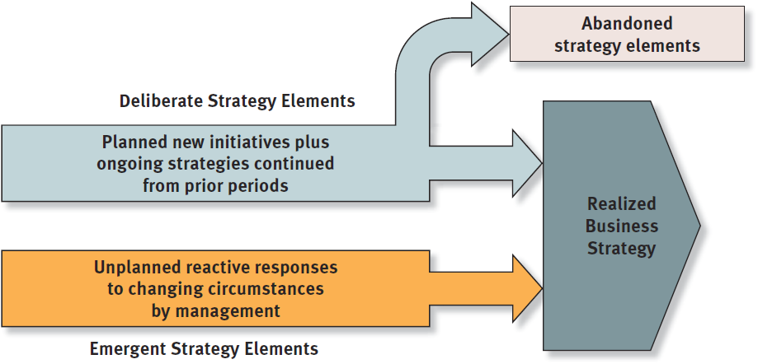
FIGURE 1.1
A Company’s Strategy Is a Blend of Planned Initiatives and Unplanned Reactive Adjustments

Slide 16
A company’s realized strategy is a combination deliberate planned elements and unplanned emergent elements. Some components of a company’s deliberate strategy will fail in the marketplace and become abandoned strategy elements.

Slide 17
The Three Tests of a Winning Strategy
Strategic Fit
How well does the strategy fit the company’s situation?
Competitive Advantage
Is the strategy helping achieve a sustainable competitive advantage?
Performance
Is the strategy producing good company performance?

Slide 18
Why Crafting and Executing Strategy Are Important Tasks
Good strategy and good strategy execution are the most telling signs of good management
How well a company performs is directly attributable to the caliber of its strategy and the proficiency with which the strategy is executed.

Slide 19
The Road Ahead
Strategy is about asking and answering a most important question:
What must managers do, and do well, to make a company a winner in the marketplace?
The answer is that doing a good job of managing inherently requires good strategic thinking and good management of the strategy-making, strategy-executing process.
Best wishes for your success in the class!!

