Slide 2
LO1 Grasp why it is critical for company managers to have a clear strategic vision of where a company needs to head and why.
LO2 Understand the importance of setting both strategic and financial objectives.
LO3 Understand why the strategic initiatives taken at various organizational levels must be tightly coordinated to achieve companywide performance targets.
LO4 Learn what a company must do to achieve operating excellence and to execute its strategy proficiently.
LO5 Become aware of the role and responsibility of a company’s board of directors in overseeing the strategic management process.

Slide 3
What Does the Strategy-Making, Strategy-Executing Process Entail?
Developing a strategic vision
Setting objectives
Crafting a strategy
Implementing and executing the chosen strategy
Monitoring developments, evaluating performance, and initiating corrective adjustments

Slide 4
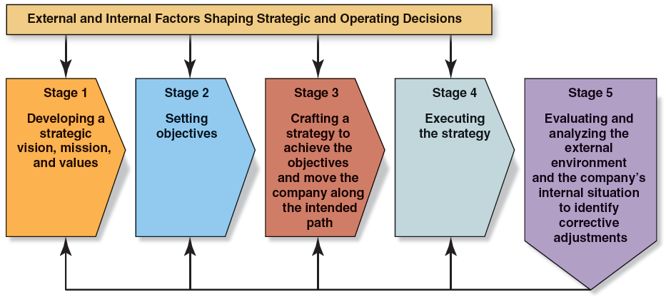
FIGURE 2.1
The Strategy Formulation, Strategy Execution Process

Slide 5
TABLE 2.1
Factors Shaping Decisions in the Strategy Formulation, Strategy Execution Process
External Considerations | Internal Considerations
Does sticking with the company’s present strategic course present attractive opportunities for growth and profitability? | Does the company have an appealing customer value proposition?
What kind of competitive forces are industry members facing and are they acting to enhance or weaken the company’s prospects for growth and profitability? | What are the company’s competitively important resources and capabilities and are they potent enough to produce a sustainable competitive advantage?
What factors are driving industry change and what impact on the company’s prospects will they have? | Does the company have sufficient business and competitive strength to seize market opportunities and nullify external threats?
How are industry rivals positioned and what strategic moves are they likely to make next? | Are the company’s costs competitive with those of key rivals?
What are the key factors of future competitive success and does the industry offer good prospects for attractive profits for companies possessing those capabilities? | Is the company competitively stronger or weaker than key rivals?

Slide 6
A company’s strategic plan lays out its future direction, performance targets, and strategy.
A strategic inflection point occurs when significant changes in an industry require that management must evaluate the risks of changing the company’s future direction rather than staying on its established course.

Slide 7
Stage 1: Developing a Strategic Vision, a Mission, And Core Values
Strategic Vision
Is top management’s view of “where we are going”— the firm’s direction and its future product-market-customer-technology focus to stakeholders.
Is distinctive and specific to a particular organization.
Avoids use of generic, innocuous, and uninspiring language that could apply to most any firm.
Definitively states how the company’s leaders intend to position the firm beyond where it is today.

Slide 8
A strategic vision describes “where we are going”—the course and direction management has charted and the company’s future product- customer-market-technology focus.

Slide 9
TABLE 2.2
Characteristics of Effectively Worded Vision Statements
Graphic | Paints a picture of the kind of company that management is trying to create and the market position(s) the company is striving to stake out.
Directional | Is forward looking; describes the strategic course that management has charted and the kinds of product-market-customer-technology changes that will help the company prepare for the future.
Focused | Is specific enough to provide managers with guidance in making decisions and allocating resources.
Flexible | Is not so focused that it makes it difficult for management to adjust to changing circumstances in markets, customer preferences, or technology.
Feasible | Is within the realm of what the company can reasonably expect to achieve.
Desirable | Indicates why the directional path makes good business sense.
Easy to communicate | Is explainable in 5 to 10 minutes and, ideally, can be reduced to a simple, memorable “slogan”

Slide 10
TABLE 2.3
Common Shortcomings in Company Vision Statements
Vague or incomplete | Short on specifics about where the company is headed or what the company is doing to prepare for the future.
Not forward looking | Doesn’t indicate whether or how management intends to alter the company’s current product-market-customer-technology focus.
Too broad | So all-inclusive that the company could head in most any direction, pursue most any opportunity, or enter most any business.
Bland or uninspiring | Lacks the power to motivate company personnel or inspire shareholder confidence about the company’s direction.
Not distinctive | Provides no unique company identity; could apply to firms in any of several industries (including rivals operating in the same market arena).
Too reliant on superlatives | Doesn’t say anything specific about the company’s strategic course beyond the pursuit of such distinctions as being a recognized leader, a global or worldwide leader, or the first choice of customers.

Slide 11
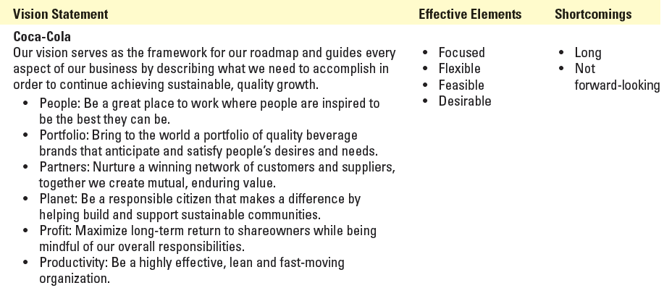
EXAMPLES OF STRATEGIC VISIONS—HOW WELL DO THEY MEASURE UP?
Concepts & Connections 2.1

Slide 12
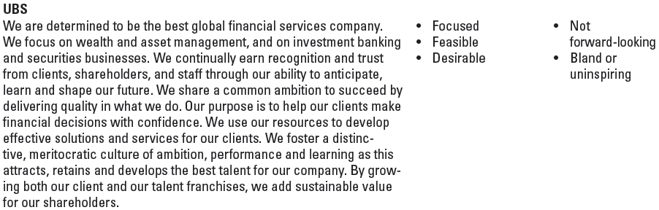
EXAMPLES OF STRATEGIC VISIONS—HOW WELL DO THEY MEASURE UP?
Concepts & Connections 2.1

Slide 13
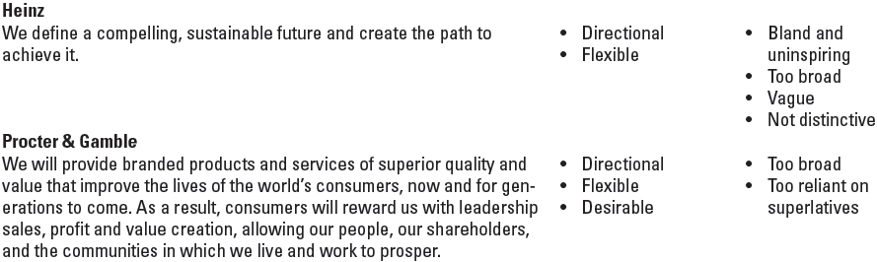
EXAMPLES OF STRATEGIC VISIONS—HOW WELL DO THEY MEASURE UP?
Concepts & Connections 2.1

Slide 14
The Importance of Communicating the Strategic Vision
An engaging, inspirational vision
Provides direction and energizes employees
Makes the organization’s case for “where we are going and why”
Evokes positive support and excitement
Enlists the commitment of company personnel to engage in actions that move the company in its intended direction

Slide 15
Expressing the Essence of the Vision in a Slogan
Nike
To bring innovation and inspiration to every athlete in the world.
The Mayo Clinic
The best care to every patient every day
Greenpeace
To halt environmental abuse and promote environmental solutions.

Slide 16
Why a Sound, Well-Communicated Strategic Vision Matters
It crystallizes senior executives’ own views about the firm’s long-term direction.
It reduces the risk of rudderless decision making by management at all levels.
It is a tool for winning the support of employees to help make the vision a reality.
It provides a beacon for lower-level managers in forming departmental missions.
It helps an organization prepare for the future.

Slide 17
Strategic Vision versus Mission Statement
A strategic vision concerns a firm’s future business path—“where we are going”
Markets to be pursued
Future product/ market/customer/ technology focus
The mission statement of a firm focuses on its present business purpose—“who we are and what we do”
Current product and service offerings
Customer needs being served

Slide 18
Developing a Company Mission Statement
Ideally, a company mission statement is sufficiently descriptive to:
Identify the company’s products or services.
Specify the buyer needs it seeks to satisfy.
Specify the customer groups or markets it is endeavoring to serve.
Specify its approach to pleasing customers.
Give the company its own identity.

Slide 19
A well-conceived mission statement conveys a company’s purpose in language specific enough to give the company its own identity.

Slide 20

Example of a Mission Statement
The mission of Trader Joe’s is to give our customers the best food and beverage values that they can find anywhere and to provide them with the information required for informed buying decisions. We provide these with a dedication to the highest quality of customer satisfaction delivered with a sense of warmth, friendliness, fun, individual pride, and company spirit.

Slide 21



Examples of Mission Statements
“to assure the safety and health of America’s workers by setting and enforcing standards; providing training, outreach, and education; establishing partnerships; and encouraging continual improvement in workplace safety and health.”
To help people and businesses throughout the world realize their full potential.
To organize the world’s information and make it universally accessible and useful.

Slide 22
Strategic Mission, Vision and Profit
Occasionally, companies state that their mission is to simply earn a profit.
Profit is more correctly an objective and a result of what a firm does.
Profit is the obvious intent of every commercial enterprise.
Profit is not “who we are and what we do.”

Slide 23
Linking the Strategic Vision and Mission with Company Values
Values
Provide guidance for desired actions and behaviors of employees as they conduct the company’s business:
fair treatment
honor and integrity
ethical behavior
innovativeness
teamwork
a passion for excellence
social responsibility
community citizenship

Slide 24
A company’s values are the beliefs, traits, and behavioral norms that company personnel are expected to display in conducting the company’s business and pursuing its strategic vision and mission.

Slide 25
ZAPPOS MISSION AND CORE VALUES
Concepts & Connections 2.2
Deliver Wow through Service
Embrace and Drive Change
Create Fun and a Little Weirdness
Be Adventurous, Creative, and Open Minded
Pursue Growth and Learning
Build Open and Honest Relationships with
Communication
Build a Positive Team and Family Spirit
Do More with Less
Be Passionate and Determined
Be Humble

Slide 26
Stage 2: Setting Objectives
Managerial Purpose in Setting Objectives
To convert the strategic vision into specific performance targets
To create yardsticks to track progress and measure performance
Managerially Valuable Objectives
Are well-stated (clearly worded).
Are challenging, yet achievable such that they stretch the organization to perform at its full potential.
Are quantifiable (measurable).
Contain a specific deadline for achievement.

Slide 27
Stage 2: Setting Objectives (cont’d)
What Kinds of Objectives to Set
Financial objectives
Communicate management’s targets for financial performance.
Are lagging indicators that reflect the results of past decisions and organizational activities.
Relate to revenue growth, profitability, and return on investment.

Slide 28
Stage 2: Setting Objectives (cont’d)
What Kinds of Objectives to Set
Strategic objectives
Are related to a firm’s marketing standing and competitive vitality.
Are leading indicators of a firm’s future financial performance and business prospects.
If achieved, indicate that a firm’s future financial performance will be better than its current or past performance.

Slide 29
Objectives are an organization’s performance targets—the results management wants to achieve.
Financial objectives relate to the financial performance targets management has established for the organization to achieve.
Strategic objectives relate to target outcomes that indicate a company is strengthening its market standing, competitive vitality, and future business prospects.

Slide 30
The balanced scorecard is a widely used method for combining the use of both strategic and financial objectives, tracking their achievement, and giving management a more complete and balanced view of how well an organization is performing.

Slide 31
TABLE 2.4
The Balanced Scorecard Approach to Performance Measurement
Financial Objectives | Strategic Objectives
An x percent increase in annual revenues Annual increases in earnings per share of x percent An x percent return on capital employed (ROCE) or shareholder investment (ROE) Bond and credit ratings of x Internal cash flows of x to fund new capital investment | Win an x percent market share Achieve customer satisfaction rates of x percent Achieve a customer retention rate of x percent Acquire x number of new customers Introduce x number of new products in the next three years Reduce product development times to x months | Increase percentage of sales coming from new products to x percent Improve information systems capabilities to give frontline managers defect information in x minutes Improve teamwork by increasing the number of projects involving more than one business unit to x

Slide 32
Examples of Financial Objectives
X % increase in annual revenues
X % increase annually in after-tax profits
Profit margins of X %
X % return on capital employed (ROCE)
Sufficient internal cash flows to fund 100% of new capital investment

Slide 33
Examples of Strategic Objectives
Win an X % market share
Achieve a customer retention rate of X %
Acquire X number of new customers
Reduce product defects to X %
Introduce of X number of new products in the next three years
Increase employee training to X hours/year
Reduce turnover to X % per year

Slide 34
EXAMPLES OF COMPANY OBJECTIVES
Concepts & Connections 2.3
PEPSICO
Accelerate top-line growth; build and expand our better-for-your snacks and beverages and nutrition businesses; improve our water use efficiency by 20 percent per unit of production by 2015; improve our electricity use efficiency by 20 percent per unit of production by 2015; maintain appropriate financial flexibility with ready access to global capital and credit markets at favorable interest rates.
WALGREENS
Increase revenues from $72 billion in 2012 to more than $130 billion in 2016; increase operating income from $3.5 billion in 2012 to $8.5 billion to $9.0 billion by 2016; increase operating cash flow from $4.4 billion in 2012 to approximately $8 billion in 2016; generate $1 billion in cost savings from combined pharmacy and general merchandise purchasing synergies by 2016.
YUM! BRANDS (KFC, PIZZA HUT, TACO BELL, LONG JOHN SILVER’S)
Increase operating profit derived from operations in emerging markets from 48 percent in 2010 to 57 percent in 2015; increase number of KFC units in Africa from 655 in 2010 to 2,100 in 2020; increase KFC revenues in Africa from $865 million in 2010 to $1.94 billion in 2014; increase number of KFC units in India from 101 in 2010 to 1,250 in 2020; increase number of KFC units in Vietnam from 87 in 2010 to 500 in 2020; increase number of KFC units in Russia from 150 in 2010 to 500 in 2020; open 100 + new Taco Bell units in international markets in 2015; increase annual cash flows from operations from $1.5 billion in 2010 to $2 + billion in 2015.

Slide 35
Short-Term and Long-Term Objectives
Short-term Objectives
Are targets to be achieved soon.
Represent milestones or stair steps for reaching long-range performance.
Long-term Objectives
Are targets to be achieved within 3 to 5 years

Slide 36
The Need for Objectives at All Organizational Levels
Objectives Are Needed at All Levels
To set business-level objectives
To set establish functional-area objectives
To set operating-level objectives
Long-term objectives take precedence over short-term objectives

Slide 37
Stage 3: Crafting a Strategy
Crafting a strategy means asking:
how to attract and please customers
how to compete against rivals
how to position the firm in the marketplace and capitalize on attractive opportunities to grow the business
how best to respond to changing economic and market conditions
how to manage each functional piece of the business
how to achieve the firm’s performance targets

Slide 38
Strategy Formulation Involves Managers at All Organizational Levels
In most firms, crafting strategy is a collaborative team effort that includes managers in various positions and at various organizational levels. Crafting strategy is rarely something only high-level executives do.

Slide 39

A Company’s Strategy-Making Hierarchy
A firm’s strategy is a collection of initiatives undertaken by managers at all levels in the organizational hierarchy.
Crafting strategy is a collaborative effort that:
Involves managers from various levels of the organization.
Is rarely something only high- level executives engage in.
Requires choosing among the various strategic alternatives.

Slide 40
Corporate strategy establishes an overall game plan for managing a set of businesses in a diversified, multibusiness company.
Business strategy is primarily concerned with strengthening the company’s market position and building competitive advantage in a single business company or a single business unit of a diversified multibusiness corporation.

Slide 41
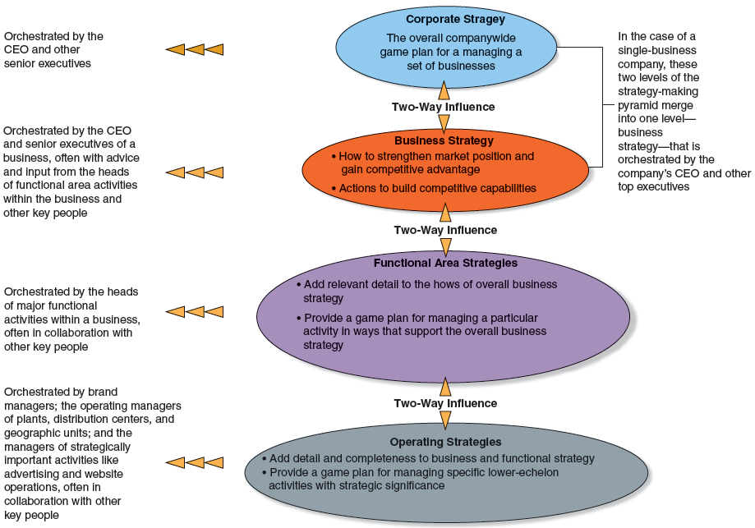
FIGURE 2.2
A Company’s Strategy-Making Hierarchy

Slide 42
The Strategy-Making Hierarchy
Corporate strategy | Is orchestrated by the CEO and other senior executives and establishes an overall game plan for managing a set of businesses in a diversified, multibusiness company. Addresses the questions of how to capture cross-business synergies, what businesses to hold or divest, which new markets to enter, and how to best enter new markets—by acquisition, creation of a strategic alliance, or through internal development.
Business strategy | Is primarily concerned with building competitive advantage in a single business unit of a diversified company or strengthening the market position of a nondiversified single business company.
Functional-area strategies | Are concerned with actions related to particular functions or processes within a business (marketing strategy, production strategy, finance strategy, customer service strategy, product development strategy, and human resources strategy).
Operating strategies | Are relatively narrow strategic initiatives and approaches for managing key operating units (plants, distribution centers, geographic units) and specific operating activities such as materials purchasing or Internet sales.

Slide 43
Stage 4: Implementing and Executing the Chosen Strategy
Managing the strategy execution process involves:
Staffing the organization to provide needed skills and expertise.
Allocating ample resources to activities critical to good strategy execution.
Ensuring that policies and procedures facilitate rather than impede effective execution.
Installing information and operating systems that enable personnel to perform essential activities.

Slide 44
Stage 4: Implementing and Executing the Chosen Strategy (cont’d)
Managing the strategy execution process involves:
Pushing for continuous improvement in how value chain activities are performed.
Tying rewards and incentives directly to the achievement of performance objectives.
Creating a company culture and work climate conducive to successful strategy execution.
Exerting the internal leadership needed to propel implementation forward.

Slide 45
Stage 5: Evaluating Performance and Initiating Corrective Adjustments
Deciding if there is a need for change:
Monitoring for disruptive developments
Evaluating the firm’s recent performance
Making corrective adjustments to strategy
Strategy execution is an ongoing and uneven process of organizational learning
A firm’s vision, objectives, strategy, and approach to strategy execution are never final.

Slide 46
Corporate Governance: The Role of the Board Of Directors
The Role of the Board Of Directors in the Strategy-Formulation, Strategy-Execution Process:
Oversee the firm’s financial accounting and reporting practices.
Diligently critique and oversee the company’s direction, strategy, and business approaches.
Evaluate the caliber of senior executives’ strategy-making and strategy-executing skills.
Institute a compensation plan for top executives that rewards them for actions and results that serve shareholder interests.

Slide 47
Strong Boards Lead to Good Corporate Governance
A Strong, Independent Board of Directors:
Is well informed about the company’s performance.
Guides and judges the CEO and other top executives.
Has the courage to curb management actions it believes are inappropriate or unduly risky.
Certifies to shareholders that the CEO is doing what the board expects.
Provides insight and advice to management.
Is intensely involved in debating the pros and cons of key decisions and actions.

