Slide 1


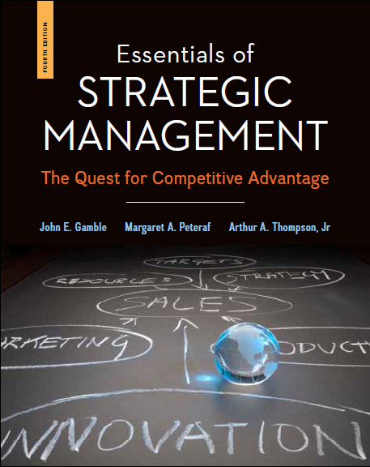

chapter
3
Evaluating a
Company’s External
Environment
PowerPoint Presentation by Charlie Cook
© 2015 by McGraw-Hill Education. This is proprietary material solely for authorized instructor use. Not authorized for sale or distribution in any manner. This document may not be copied, scanned, duplicated, forwarded, distributed, or posted on a website, in whole or part.

Slide 2
LO1 Identify factors in a company’s broad macro-environment that may have strategic significance.
LO2 Become adept at recognizing the factors that cause competition in an industry to be fierce, more or less normal, or relatively weak.
LO3 Become adept at mapping the market positions of key groups of industry rivals.
LO4 Learn how to determine whether an industry’s outlook presents a company with sufficiently attractive opportunities for growth and profitability.

Slide 3
The First Test of a Winning Strategy:
“How well does the strategy fit the company’s situation?”
Two facets of the company’s situation
  The industry and competitive environments in which the company operates—its external environment
  The company’s resources and organizational capabilities—its internal environment

Slide 4
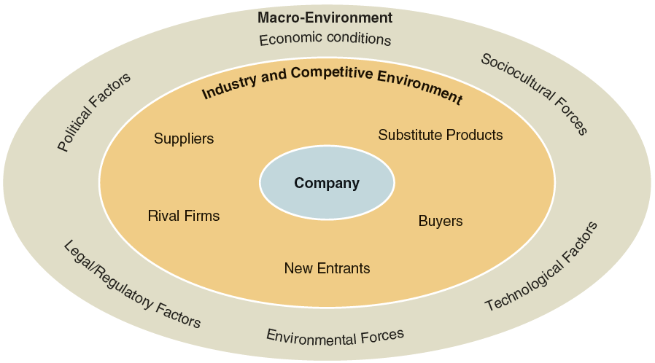
FIGURE 3.1
The Components of a Company’s External Environment

Slide 5
Evaluating the Strategically Relevant
Components of a Company’s
Macro-Environment
Relevant Factors
  Play a significant role in shaping management’s decisions regarding the company’s long-term direction, objectives, strategy, and business model.
  Are on the immediate inner ring industry and competitive environment of the company—competitive pressures, the actions of rivals firms, buyer behavior, supplier-related considerations, and so on.

Slide 6
The macro-environment encompasses the broad environmental context in which a firm is situated and is comprised of six principal components: political factors, economic conditions, sociocultural forces, technological factors, environmental factors, and legal/regulatory conditions.
PESTEL analysis can be used to assess the strategic relevance of the six principal components of the macro-environment: political, economic, social, technological, environmental, and legal forces.

Slide 7



TABLE 3.1
The Six Components of the Macro-Environment Included in a PESTEL Analysis
Political
factors
Sociocultural factors
PESTAL Analysis:
Macro-Environmental Components
Economic conditions
Environmental forces
Technological factors
Legal and regulatory factors

Slide 8
Assessing the Company’s Industry and Competitive Environment
Do the dominant economic characteristics of the industry offer sellers opportunities for growth and attractive profits?
What kinds of competitive forces are industry members facing, and how strong is each force?
What forces are driving industry change, and what impact will these changes have on competitive intensity and industry profitability?

Slide 9
Assessing the Company’s Industry and Competitive Environment (cont’d)
What market positions do industry rivals occupy—who is strongly positioned and who is not?
What strategic moves are rivals likely to make next?
What are the key factors of competitive success?
Does the industry outlook offer good prospects for profitability?

Slide 10
Question 1: What Are the Industry’s Dominant Economic Characteristics?
Market size and growth rate
Number of rivals
Scope of competitive rivalry
Pace of technological change
Degree of vertical integration
Need for economies of scale
Learning and experience curve effects

Slide 11
TABLE 3.2
What to Consider in Identifying an Industry’s Dominant Economic Features
ECONOMIC CHARACTERISTIC | QUESTIONS TO ANSWER
Market size and growth rate | How big is the industry and how fast is it growing? What does the industry’s position in the life cycle (early development, rapid growth and takeoff, early maturity and slowing growth, saturation and stagnation, decline) reveal about the industry’s growth prospects?
Scope of competitive rivalry | Is the geographic area over which most companies compete local, regional, national, multinational, or global?
Demand-supply conditions | Is a surplus of capacity pushing prices and profit margins down? Is the industry overcrowded with too many competitors?
Market segmentation | Is the industry characterized by various product characteristics or customer wants, needs, or preferences that divide the market into distinct segments?
Pace of technological change | What role does advancing technology play in this industry? Do most industry members have or need strong technological capabilities? Why?

Slide 12
Question 2: How Strong Are the Industry’s Competitive Forces?
State of Competition: Where are we now?
  The dynamics of competition are not the same from on industry to another.
The Five-forces Model Of Competition
  Is the most powerful and widely used tool for assessing the strength of the competitive forces that affect an industry’s attractiveness.

Slide 13
The Five Competitive Forces
Affecting Industry Attractiveness
Competitive pressures stemming from buyer bargaining power.
Competitive pressures coming from firms in other industries to win buyers over to substitute products.
Competitive pressures stemming from supplier bargaining power.
Competitive pressures associated with the threat of new entrants into the market.
Competitive pressures associated with rivalry among competing sellers to attract customers.

Slide 14
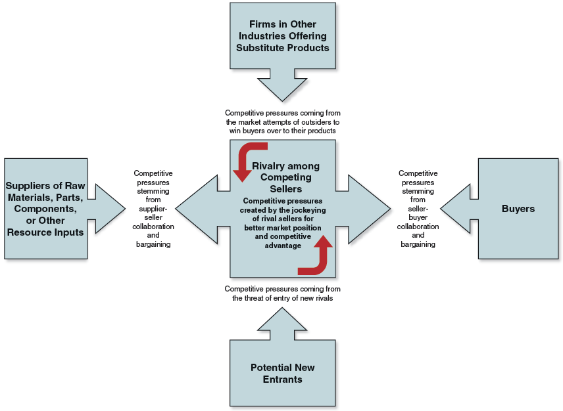
FIGURE 3.2
The Five-Forces Model of Competition

Slide 15
The Competitive Force of
Buyer Bargaining Power
Whether seller-buyer relationships represent a minor or significant competitive force in limiting industry profitability depends on:
  Whether some or many buyers have sufficient bargaining leverage to obtain price concessions and other favorable terms
  The extent to which buyers are price sensitive.

Slide 16
When Is the Bargaining
Power of Buyers Stronger?
Buyers gain bargaining leverage when:
  Their large size allows them to demand concessions.
  Their costs of switching to competing brands or substitutes are relatively low.
  They are few in number, control market access or, if
  a buyer-customer is particularly important to a seller.
  Weak buyer demand creates a “buyers’ market.”
  Buyers are well informed about sellers’ products, prices, and costs.
  Buyers pose a credible threat of integrating backward into the business of sellers.

Slide 17
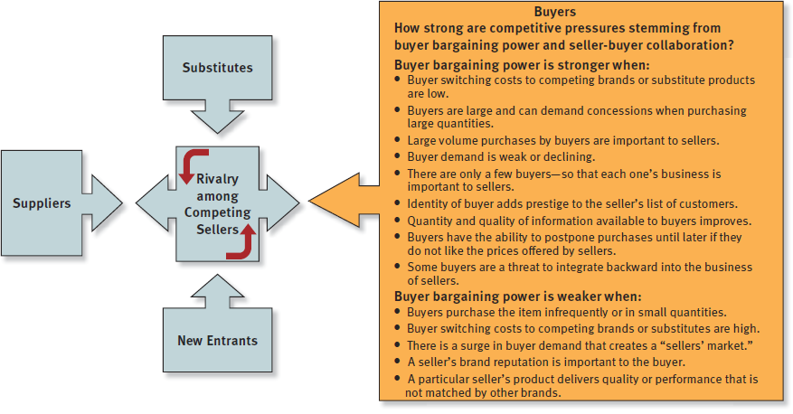
FIGURE 3.3
Factors Affecting the Strength of Buyer Bargaining Power

Slide 18
The Competitive Force of Substitute Products
The strength of competitive pressures from the sellers of substitute products depends on three factors:
  Whether substitutes are readily available and attractively priced.
  Whether buyers view the substitutes as comparable or better in terms of quality, performance, and other relevant attributes.
  Whether the costs that buyers incur in switching to the substitutes are high or low.

Slide 19
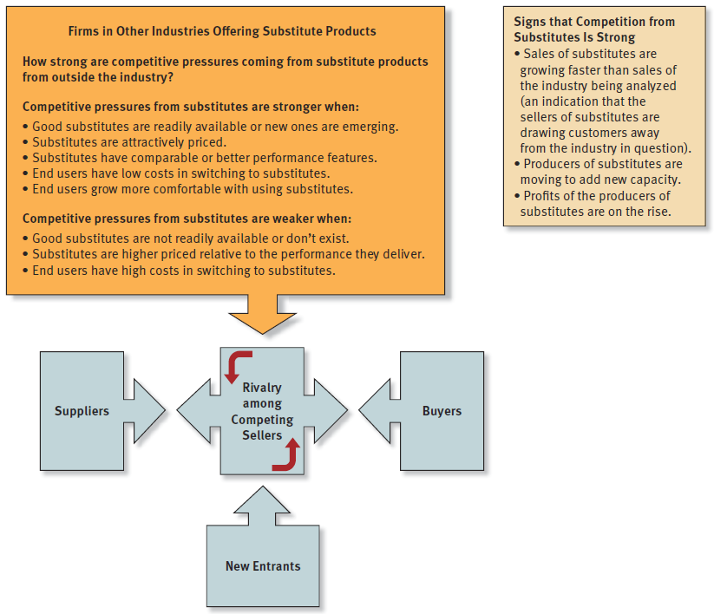
FIGURE 3.4
Factors Affecting Competition from Substitute Products

Slide 20
The Competitive Force of Supplier Bargaining Power
Industry suppliers can exert substantial bargaining power or leverage:
  If the item being supplied is not a commodity readily available from many suppliers.
  If industry members cannot switch their purchases to another supplier or switch to attractive substitutes.
  If certain inputs are in short supply.
  If certain suppliers provide a differentiated input that enhances the performance, quality, or image of the industry’s product.

Slide 21
The Competitive Force of Supplier Bargaining Power (cont’d)
Industry suppliers can exert substantial bargaining power or leverage:
  If they provide specialized equipment or services that yield cost savings to industry members in conducting their operations.
  If a large fraction of the costs of the buyer industry’s product is accounted by the cost of a particular input.
  If industry members are not major or large customers of suppliers.
  If it does not make good economic sense for industry members to vertically integrate backward.

Slide 22
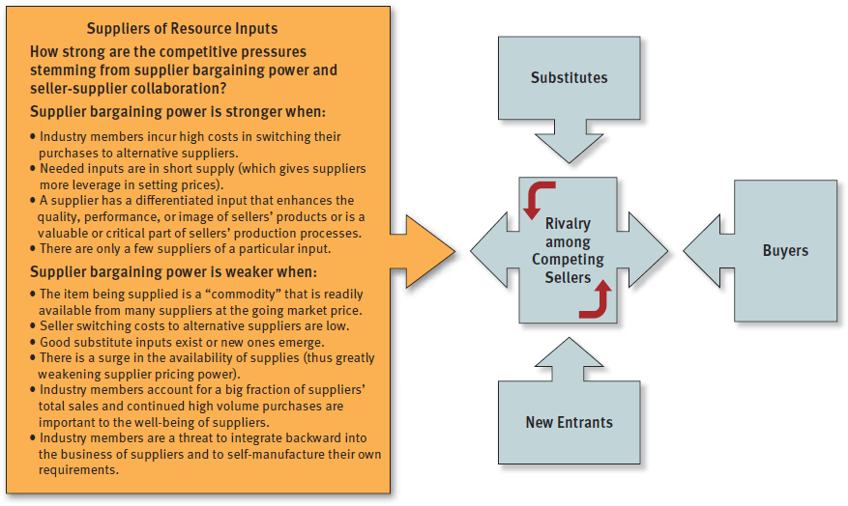
FIGURE 3.5
Factors Affecting the Strength of Supplier Bargaining Power

Slide 23
The Competitive Force of
Potential New Entrants
The threat of entrants into the marketplace presents significant competitive pressure when:
  There is a sizable pool of likely entry candidates.
  Potential entrants have ample entry resources at their command.
  Current industry participants are looking beyond their current markets for growth opportunities.
  When the industry is growing, offers attractive profit opportunities, and its barriers to entry are low.

Slide 24
What Are the Barriers to Entry?
The presence of sizable economies of scale in production or other areas of operation
Cost and resource disadvantages not related to scale of operation
Strong brand preferences and high degrees of customer loyalty
High capital requirements
Restrictive regulatory policies
The difficulties of building a network of distributors-retailers and securing adequate space on retailers’ shelves
Tariffs and international trade restrictions
The ability and willingness of industry incumbents to launch vigorous initiatives to block a newcomer’s successful entry

Slide 25
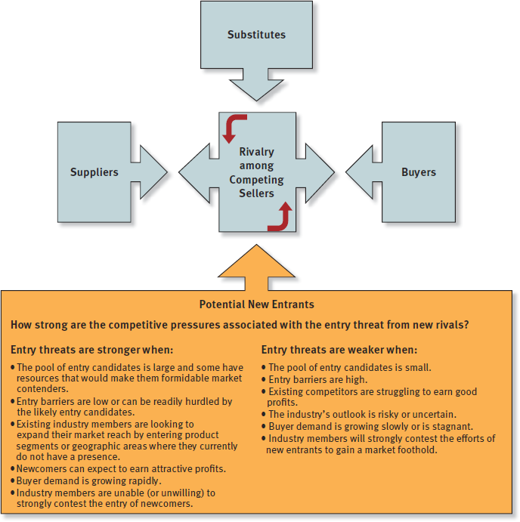
TABLE 3.6
Factors Affecting the Threat of Entry

Slide 26
The Competitive Force of Rivalry among Competing Sellers
The rivalry is most intense in markets where:
  Rivals can launch actions to boost their market standing and performance.
  Competitors are equal in size and capability.
  Markets are slow-growing or are declining and demand is off, resulting in no growth opportunities, excess capacity and inventory.
  It has become less costly for buyers to switch brands.
  The products of rival sellers have become more standardized.
  Industry conditions tempt competitors to use price cuts or other competitive weapons to boost unit volume.
  Competitors have become dissatisfied with their market position.
  Strong outside firms acquire weak firms in the industry and launch aggressive, well-funded moves to build market share.

Slide 27
The Competitive Force of Rivalry among Competing Sellers (cont’d)
The rivalry among industry competitors is usually weaker in industries where:
  The products of industry rivals become more differentiated.
  Markets or market segments are expanding and fast-growing.
  Markets are comprised of vast numbers of small rivals; likewise, it is often weak when there are fewer than five competitors.

Slide 28
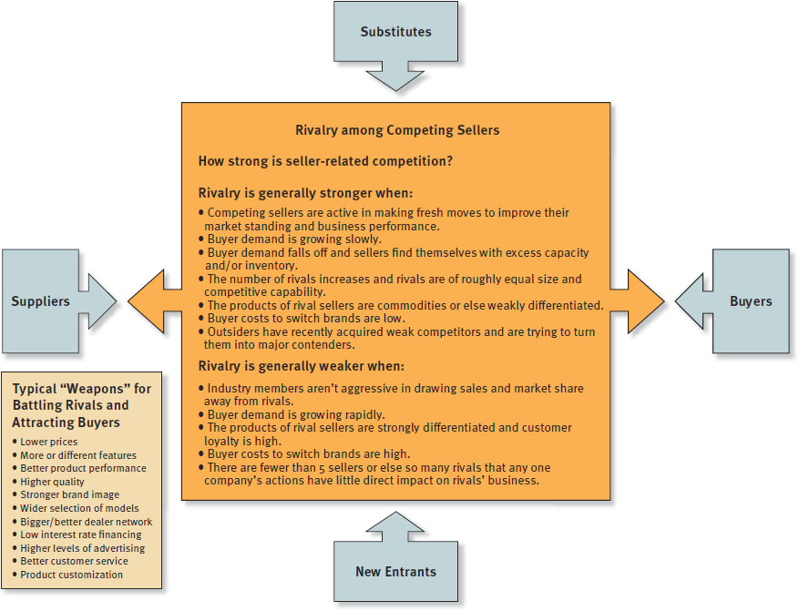
FIGURE 3.7
Factors Affecting the Strength of Competitive Rivalry

Slide 29
Industry Rivalry
Cutthroat
(Brutal)
Competitors engage in protracted price wars or habitually employ other aggressive tactics that are mutually destructive to profitability.
Fierce
(Strong)
The battle for market share is so vigorous that the profit margins of most industry members are squeezed to bare-bones levels.
Moderate
(Normal)
The maneuvering among industry members, while lively and healthy, still allows most industry members to earn acceptable profits.
Weak
Most industry members are satisfied with their sales growth and market share and rarely undertake offensives against their competitors.

Slide 30
The Collective Strengths of the Five Competitive Forces and Industry Profitability
As a rule, the stronger the collective impact of the five competitive forces, the lower the combined profitability of industry participants.
The stronger the forces of competition, the much harder it becomes for industry members to earn attractive profits.

Slide 31
When Do the Five Competitive Forces Result in Attractive industry Conditions?
The ideal competitive environment for earning superior profits is when:
  Suppliers and customers are in weak bargaining positions
  There are no good substitutes
  High entry barriers deter entry of new competitors
  Internal rivalry is producing only moderate competitive pressure

Slide 32
When Do the Five Competitive Forces
Result in Unattractive Industry Conditions?
An industry is competitively unattractive when all five forces are producing strong competitive pressures:
  Internal rivalry among competitors is strong.
  Low entry barriers result in entry of new competitors.
  Competition from substitutes is intense.
  Suppliers and customers are in strong bargaining positions.

Slide 33
Driving forces are the major underlying causes of change in industry and competitive conditions.
Some driving forces originate in the outer ring of the company’s macro-environment but most originate in the company’s more immediate industry and competitive environment.

Slide 34
Question 3: What Are the Industry’s Driving Forces of Change and
What Impact Will They Have?
Driving forces analysis has three steps:
  Identifying the present driving forces, as only 3–4 factors qualify as real drivers of change
  Assessing how strongly the forces are, individually or collectively, impacting industry attractiveness by affecting demand, competition, and profitability.
  Determining what strategy changes are needed to prepare for the impact of the driving forces.

Slide 35
TABLE 3.2
Common Driving Forces
Changes in the long-term industry growth rate. Increasing globalization. Emerging new Internet capabilities and applications. Changes in who buys the product and how they use it. Product innovation. Technological change and manufacturing process innovation. Marketing innovation. Entry or exit of major firms. Diffusion of technical know-how across more companies and more countries. Changes in cost and efficiency. Growing buyer preferences for differentiated products instead of a standardized commodity product (or for a more standardized product instead of strongly differentiated products). Regulatory influences and government policy changes. Changing societal concerns, attitudes, and lifestyles.

Slide 36
Question 4: How Are Industry Rivals Positioned?
Strategic Group Mapping
  Is a technique for graphically displaying the different market or competitive positions that rival firms occupy in the industry.
A Strategic Group
  Is a cluster of industry rivals that have similar competitive approaches and market positions.

Slide 37
Strategic group mapping is a technique for displaying the different market or competitive positions that rival firms occupy in the industry.
A strategic group is a cluster of industry rivals that have similar competitive approaches and market positions.

Slide 38
Constructing a Strategic Group Map
Identify the competitive characteristics that delineate strategic approaches used in the industry.
  Typical variables: the price/quality range (high, medium, low), geographic coverage (local, regional, national, global), degree of vertical integration (none, partial, full), product-line breadth (wide, narrow), choice of distribution channels (retail, wholesale, Internet, multiple channels), and degree of service offered (no-frills, limited, full).
Plot firms on a two-variable map based upon their strategic approaches.
Assign firms occupying the same map location to a common strategic group.
Draw circles around each strategic group, making the circles proportional to the size of the group’s share of total industry sales revenues.

Slide 39
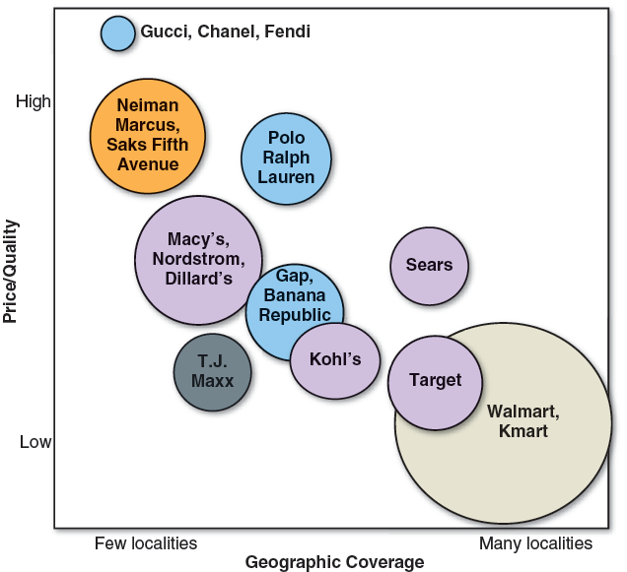
COMPARATIVE MARKET POSITIONS OF SELECTED RETAIL CHAINS: A STRATEGIC GROUP MAP APPLICATION
Concepts & Connections 3.1

Slide 40
What Can Be Learned from
Strategic Group Maps?
Industry driving forces may favor the growth of some strategic groups and hurt the prospects of others.
External competitive pressures and intragroup competitive rivalries may cause the profit potential of different strategic groups to vary.

Slide 41
Question 5: What Strategic Moves
Are Rivals Likely to Make Next?
Considerations in predicting what strategic moves rivals are likely to make next include the following:
  What executives are saying about where the industry is headed, the firm’s situation, and their past actions and leadership styles.
  Identifying trends in the timing of product launches or new marketing promotions.
  Determining which rivals badly need to increase unit sales and market share.
  Considering which rivals have a strong incentive, along with the resources, to make major strategic changes.
  Knowing which rivals are likely to enter new geographic markets.
  Deciding which rivals are strong candidates to expand their product offerings and enter new product segments.

Slide 42
Predicting the Next Strategic Moves Rivals Are Likely to Make
Profiling key rivals involves gathering competitive intelligence about:
  Thinking and leadership styles of top executives
  Identifying trends in the timing of new product launches and marketing promotions
  Considering which rivals have the motivation and capability to make major strategy changes

Slide 43
Business Ethics And Competitive Intelligence
Concepts & Connections 3.2
Those who gather competitive intelligence on rivals can sometimes cross the fine line between honest inquiry and unethical or even illegal behavior. For example, calling rivals to get information about prices, the dates of new-product introductions, or wage and salary levels is legal, but misrepresenting one’s company affiliation during such calls is unethical. Pumping rivals’ representatives at trade shows is ethical only if one wears a name tag with accurate company affiliation indicated.
Avon Products at one point secured information about its biggest rival, Mary Kay Cosmetics (MKC), by having its personnel search through the garbage bins outside MKC’s headquarters. When MKC officials learned of the action and sued, Avon claimed it did nothing illegal because a 1988 Supreme Court ruling declared that trash left on public property (in this case, a sidewalk) was anyone’s for the taking. Avon even produced a videotape of its removal of the trash at the MKC site. Avon won the lawsuit—but Avon’s action, while legal, scarcely qualifies as ethical.

Slide 44
Question 6: What Are the Industry
Key Success Factors?
Key Success Factors (KSFs) are those competitive factors that most affect the ability of all firms in an industry to prosper.
KSFs include:
  Specific product attributes
  Necessary resources, competencies, and capabilities
  Specific intangible assets
  Competitive capabilities

Slide 45
Key success factors are the strategy elements, product attributes, competitive capabilities, or intangible assets with the greatest impact on future success in the marketplace.

Slide 46
Questions to Ask in Identifying
Industry Key Success Factors
On what basis do buyers of the industry’s product choose between the competing brands of sellers? That is, what product attributes are crucial?
Given the nature of the competitive forces prevailing in the marketplace, what resources and competitive capabilities does a company need to have to be competitively successful?
What shortcomings are almost certain to put a company firm at a significant competitive disadvantage?

Slide 47
TABLE 3.4
Common Types of Industry Key Success Factors
Technology-related KSFs | Expertise in a particular technology or in scientific research (important in pharmaceuticals, Internet applications, mobile communications, and most high-tech industries) Proven ability to improve production processes (important in industries where advancing technology opens the way for higher manufacturing efficiency and lower production costs)
Manufacturing-related KSFs | Ability to achieve scale economies and/or capture experience curve effects (important to achieving low production costs) Quality control know-how (important in industries where customers insist on product reliability) High utilization of fixed assets (important in capital-intensive/high fixed-cost industries) Access to attractive supplies of skilled labor High labor productivity (important for items with high labor content) Low-cost product design and engineering (reduces manufacturing costs) Ability to manufacture or assemble products that are customized to buyer specifications

Slide 48
TABLE 3.4
Common Types of Industry Key Success Factors
Distribution-related KSFs | A strong network of wholesale distributors/dealers Strong direct sales capabilities via the Internet and/or having company-owned retail outlets Ability to secure favorable display space on retailer shelves
Marketing-related KSFs | Breadth of product line and product selection A well-known and well-respected brand name Fast, accurate technical assistance Courteous, personalized customer service Accurate filling of buyer orders (few back orders or mistakes) Customer guarantees and warranties (important in mail-order and online retailing, big-ticket purchases, and new-product introductions) Clever advertising

Slide 49
TABLE 3.4
Common Types of Industry Key Success Factors
Skills-and capability-related KSFs | A talented workforce (superior talent is important in professional services such as accounting and investment banking) National or global distribution capabilities Product innovation capabilities (important where rivals are racing to be first to market with new product attributes or performance features) Design expertise (important in fashion and apparel industries) Short delivery time capability Supply chain management capabilities Strong e-commerce capabilities—a user-friendly website and/or skills in using Internet applications to streamline internal operations
Other types of KSFs | Overall low costs (not just in manufacturing) to be able to meet low-price expectations of customers Convenient locations (important in many retailing businesses) Ability to provide fast, convenient, after-the-sale repairs and service A strong balance sheet and access to financial capital (important in newly emerging industries with high degrees of business risk and in capital-intensive industries) Patent protection

Slide 50
Examples of Industry
Key Success Factors
Expertise in a particular technology
Scale economies
Experience curve benefits
High capacity utilization
Strong network of wholesale distributors
Brand building skills
Convenient retail locations

Slide 51
Question 7: Does the Industry Offer Good Prospects for Attractive Profits?
Determining whether an industry’s outlook presents sufficiently attractive opportunities for growth and profitability based on:
  The industry’s growth potential
  The effect of industry competition on its future profitability
  The effect of prevailing driving forces on industry profitability
  The firm’s competitive position in its industry vis-à-vis its rivals
  The firm’s competence in performing the industry’s key success factors

