Slide 1
Part II: American Business and Its Basis
Chapter 4: The Nature of Capitalism
Chapter 5: Corporations
Notes:
‹#›

Slide 2

Chapter Four:
The Nature of Capitalism
This multimedia product and its contents are protected under copyright law. The following are prohibited by law:
• any public performance or display, including transmission of any image over a network;
• preparation of any derivative work, including the extraction, in whole or in part, of any images;
• any rental, lease, or lending of the program.
Notes:
‹#›
‹#›

Slide 3
Overview
Chapter Four examines the following topics:
Historical stages and implications of capitalism
Key features of capitalism, including competition, companies, profit, and property
Two classical justifications of capitalism
Fundamental criticisms of capitalism, including inequality, poverty, and worker exploitation
Economic challenges, including the decline of manufacturing, outsourcing, and work attitudes
Moral Issues in Business
Chapter 4
Notes:
‹#›

Slide 4
Introduction
Basic historical and conceptual categories are presented for understanding the socioeconomic framework within which business transactions occur and moral issues arise
Moral problems related to the free enterprise system and capitalism are identified
  How can capitalism increase wealth without creating moral issues?
  Does capitalism enhance societies, or tarnish them?
Moral Issues in Business
Chapter 4
Notes:
‹#›

Slide 5
Capitalism
Capitalism: An economic system in which the major portion of production and distribution is in private hands, operating under what is termed a “profit” or “market” system
Socialism: The polar opposite of capitalism, an economic system characterized by public ownership of property and a planned economy
Worker control socialism: A hybrid market-oriented socialism
Moral Issues in Business
Chapter 4
Notes:
‹#›

Slide 6
Capitalism
Capitalism has historically evolved from the Renaissance through several stages – mercantile, industrial, financial, and state welfare.
Many believe we are now at a new stage, globalized capitalism, involving reliance upon foreign labor and services, joint ventures in overseas companies, outsourcing, etc.
Capitalism is constantly changing as new socio-economic and political conditions arise.
Moral Issues in Business
Chapter 4
Notes:
‹#›

Slide 7
Key Features of Capitalism
Companies: Capitalism permits the creation of companies or business organizations that exist separately from the people associated with them.
Profit motive: The profit motive implies a critical assumption about human nature – that human beings are economic creatures who recognize and are motivated by their own monetary interests.
Moral Issues in Business
Chapter 4
Notes:
‹#›

Slide 8
Key Features of Capitalism
Competition: In his famous treatise on political economy, An Inquiry into the Nature and Causes of the Wealth of Nations (1776), Adam Smith explained how free competition makes individual pursuit of self-interest socially beneficial.
Private property: Capitalism requires private ownership of the major means of production (factories, warehouses, offices, machines, trucking fleets, land, etc.)
Moral Issues in Business
Chapter 4
Notes:
‹#›

Slide 9
Moral Justifications of Capitalism
The natural right to property: One basic defense of capitalism rests on a supposed natural moral right to property.
Utilitarians deny the existence of such rights.
Other critics doubt that this right entitles one to have a system of property rules and regulations identical to the one we now have in the U.S.
Moral Issues in Business
Chapter 4
Notes:
‹#›

Slide 10
Moral Justifications of Capitalism
Adam Smith’s concept of the invisible hand: In his Wealth of Nations, Smith argues that when people are free to pursue their own economic interests, they will, without intending it, produce the greatest good for all.
His argument rests on the premise that human beings are acquisitive and have a natural propensity for trading.
Moral Issues in Business
Chapter 4
Notes:
‹#›

Slide 11
Moral Justifications of Capitalism
Adam Smith’s concept of the invisible hand – the law of supply and demand: Smith argued that a market left to itself is regulated by the mechanism of supply and demand.
The high demand for certain types of goods in one area of the market will eventually by offset by supply in another area.
The law of supply and demand is equally applicable to the standard of wages.
Moral Issues in Business
Chapter 4
Notes:
‹#›

Slide 12
Criticisms of Capitalism
Two types of criticism: Critics raise both theoretical and operational objections to capitalism.
Theoretical criticisms challenge capitalism’s fundamental values, basic assumptions, or inherent economic tendencies.
Operational criticisms focus more on capitalism’s failure to live up to its own economic ideals.
Moral Issues in Business
Chapter 4
Notes:
‹#›

Slide 13
Criticisms of Capitalism
Inequality: Critics argue that poverty and inequality challenge the fairness of capitalism and its claim to advance the interests of all.
Defenders of capitalism respond in three ways:
By blaming government for interfering with the market
By arguing that the capitalist system can be internally modified by political action
By arguing that the benefits of the system outweigh its weak points
Moral Issues in Business
Chapter 4
Notes:
‹#›

Slide 14
Criticisms of Capitalism
Human nature and capitalism:
Capitalism wrongly assumes that human beings are rational economic maximizers.
Capitalism offers us no higher sense of human purpose.
Capitalism operates on the assumption that human beings find increased well-being through ever greater material consumption.
Moral Issues in Business
Chapter 4
Notes:
‹#›

Slide 15
Criticisms of Capitalism
Competition isn’t what it’s cracked up to be:
Capitalism breeds oligopolies – concentrations of property and resources (and thus economic power) in the hands of a few
Corporate welfare programs often shelter businesses from competition.
Critics contend that cooperation, rather than competition, leads to better individual and group performance.
Moral Issues in Business
Chapter 4
Notes:
‹#›

Slide 16
Criticisms of Capitalism
Exploitation and alienation: Karl Marx argued that as the means of production become concentrated in the hands of the few, the balance of power between capitalists (bourgeoisie) and laborers (proletariat) tips further in favor of the bourgeoisie.
Because workers have nothing to sell but their labor, the bourgeoisie is able to exploit them by paying them less than the true value created by their labor.
Moral Issues in Business
Chapter 4
Notes:
‹#›

Slide 17
Criticisms of Capitalism
Exploitation and alienation: In his “Economic and Philosophic Manuscripts” (1944), Marx explains the notion of alienation as the separation of individuals from the objects of their creativity.
This separation in turn results in one’s separation from other people, from oneself, and ultimately from one’s human nature.
Moral Issues in Business
Chapter 4
Notes:
‹#›

Slide 18
Today’s Economic Challenges
The decline of American manufacturing: Whereas manufacturing accounted for 27 percent of GDP in the mid-1960s, it has fallen to about half that.
For the first time since the Industrial Revolution, manufacturing employs less than 10 percent of the U.S. workforce.
In 2007, the number of factory jobs hit a fifty-seven-year low.
Critics worry whether the U.S. can prosper without a strong manufacturing base.
Moral Issues in Business
Chapter 4
Notes:
‹#›

Slide 19
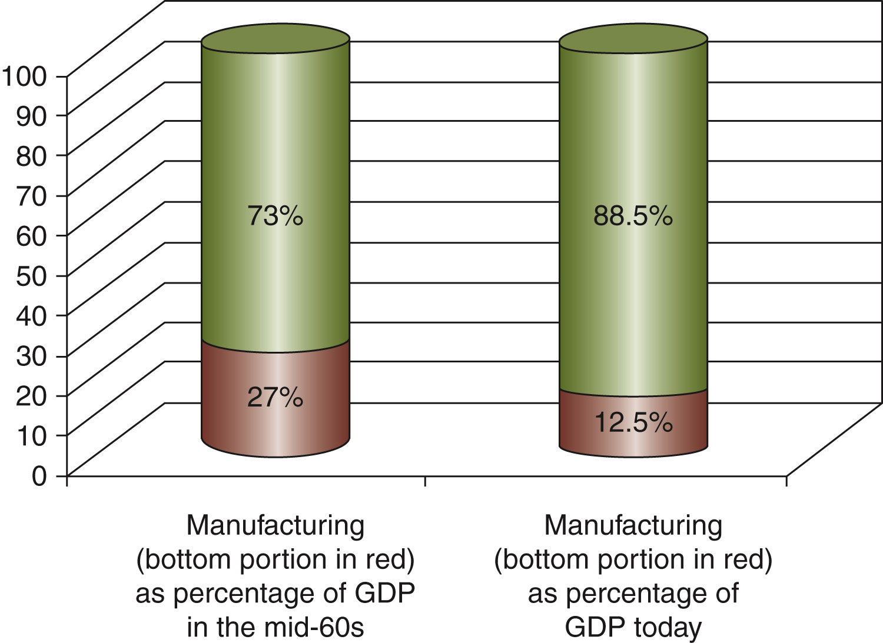
“As a percentage of gross domestic product, manufacturing in the United States has declined by more than 50 percent since the 1960s.”
Notes:
‹#›

Slide 20
Today’s Economic Challenges
Outsourcing jobs: Since the 1980s, many U.S. manufacturers have closed or curtailed their operations and becoming marketing organizations for other producers, usually foreign.
The result is the evolution into a new kind of company, one that does little or no manufacturing.
The firm may perform a host of profit-making functions, but lacks its own production base.
Instead, it outsources, buying parts or whole products from other producers, both at home and abroad.
Moral Issues in Business
Chapter 4
Notes:
‹#›

Slide 21
Today’s Economic Challenges
Outsourcing jobs: Over 1.3 million manufacturing jobs have moved abroad since 1992.
Outsourcing has affects white-collar jobs.
  About 54 percent of the 1,000 largest U.S. companies outsourcing or planning to outsource white-collar jobs.
  At least 300,000 white-collar jobs may flow overseas every year through 2015.
  This would mean a total loss of 3.4 million jobs.
Moral Issues in Business
Chapter 4
Notes:
‹#›

Slide 22
Today’s Economic Challenges
Economists disagree about whether outsourcing benefits America overall.
Some economists argue that the economy is hurt by the massive job losses that result.
Some economists argue that a country should produce for the world market those goods in which it has a competitive advantage.
Moral Issues in Business
Chapter 4
Notes:
‹#›

Slide 23
Today’s Economic Challenges
The U.S. trade deficit: America today imports twice as much merchandise as it exports.
Our relentlessly growing trade deficit is now over $700 billion annually, equivalent to almost 6 percent of GDP.
With this deficit the country’s reliance on foreign borrowing has increased, and foreign creditors now provide two-thirds of America’s net domestic investment.
Today we owe the rest of the world about $3 trillion—twice what we owed in 2000.
Moral Issues in Business
Chapter 4
Notes:
‹#›

Slide 24
Today’s Economic Challenges
Changing attitudes toward work: Americans now work 20 percent more than in 1970.
But the American work ethic is disappearing:
Only one in three persons believes that hard work pays off in the end.
People are less interested in work than in looking out for themselves.
With increased education, we are rearranging our ideas about what we want from life.
People want meaningful and challenging work that offers us autonomy and self-development.
Moral Issues in Business
Chapter 4
Notes:
‹#›

