Slide 1
Slavery, Empires, and American Identity

Slide 2
The Origins of American Slavery

Slide 3
Unfree Labor in England
Serfdom had existed in the Middle Ages, but had largely died out
That said, English society was extremely hierarchical
Many English men and women were in a legal status of servitude

Slide 4
Religion and Slavery in 16th and 17th Century English Thought
Sixteenth century Christian thought prohibited the enslavement of Christians
It did not prohibit slavery, under Just War theory
Christian theology, Protestant and Catholic, preached a hierarchical order of existance

Slide 5
Native Americans and Africans in 16th Century English Thought
Native Americans
Africans
Noble Savages
Religious Interpretation: Lost Tribe of Israel
Not Christian only because they were denied knowledge of Christ
Blackness seen as sign of evil
Religious interpretation: Ham’s Curse
Irredeemable
Animals

Slide 6
Unfree Labor in Virginia In the Early 16th Century
In the early days of Virginia, Indentured Servitude, Indian Slavery, and African slavery existed simultaneously
Slavery was especially an informal affair in early Virginia. Formal slave codes do not develop until the early 18th Century
The initial language of slavery was not racial, but religious. Heathen and Christian, not black and white
Religious-based slavery and Indian slavery increasingly led to problems keeping people in the institution
Indentured Servants and Slaves were often employed on the same plantations in the same jobs, which promoted connection and the development of a “class consciousness”

Slide 7
Bacon’s Rebellion
1676
Turning point in racial roles and unfree labor in Virginia
Triggering issue was refusal of long-time Governor William Berkeley to respond to Indian attacks on the frontier
Triggered uprising led by Nathaniel Bacon, a young aristocrat, leading primarily an alliance of servants and slaves pressuring for action against Native Americans to open more land for settlement
Bacon’s forces burn the capital city of Jamestown before Bacon dies of disease and English naval forces arrive allowing Berkeley to regain control ending the revolt. More than 20 leaders of the revolt were executed
The Bi-racial nature of Bacon’s revolt alarmed the Virginia gentry, leading to the increasing hardening of racial lines socially and legally in Virginia, culminating in the Slave Code of 1705
The use of Indentured Servants in favor of African slaves accelerated after the revolt as well

Slide 8
Black Population in the Colonies (Total)

Slide 9
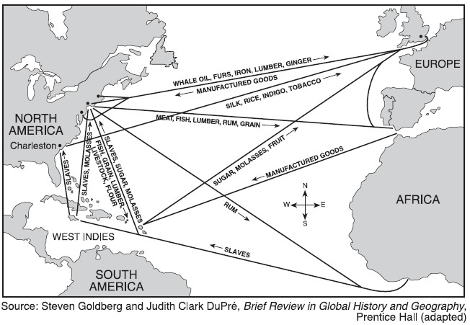
Triangular Trade

Slide 10
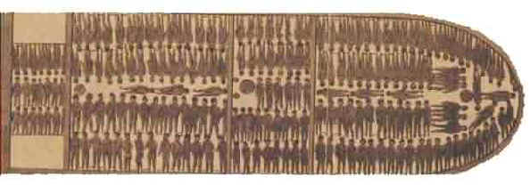
The Slave Ship

Slide 11

The Middle Passage

Slide 12

The Slave Auction

Slide 13

Plantation Life

Slide 14
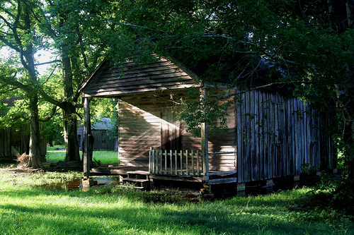
Slave Quarters

Slide 15
Slavery in the North
Slavery existed in all English Colonies (even Quaker Pennsylvania)
Slaves in the north were far fewer in number than in the South
The fear of slave uprisings was far less in the north
Northern slaves were much more likely to be in an urban setting and in a skilled trade
Free Blacks were also far more common in Northern colonies

Slide 16
Comparative Populations
Massachusetts (Including Plymouth)
Virginia

Slide 17
Comparative Populations
New York
South Carolina

Slide 18
The Anglicization of English America

Slide 19
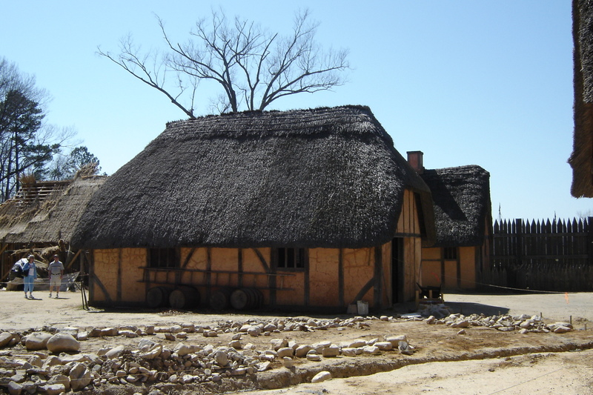
Early Colonial House

Slide 20
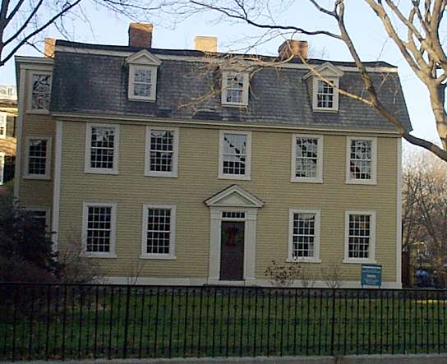
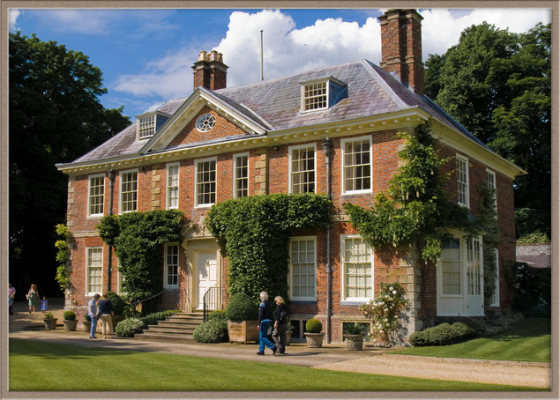
Comparative Architecture: Homes
18th Century Colonial House
18th Century English House

Slide 21
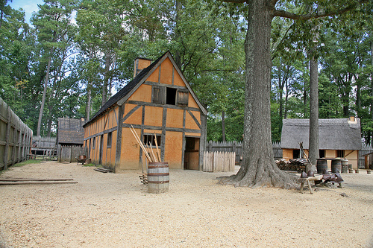
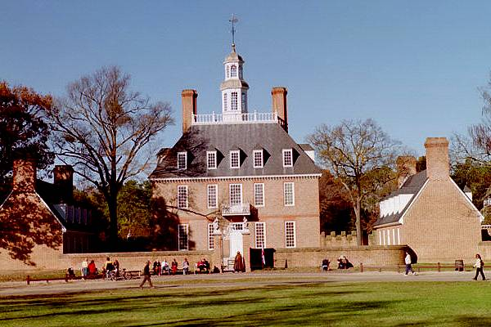
Virginia’s Governor’s Mansions
Jamestown
Williamsburg

Slide 22
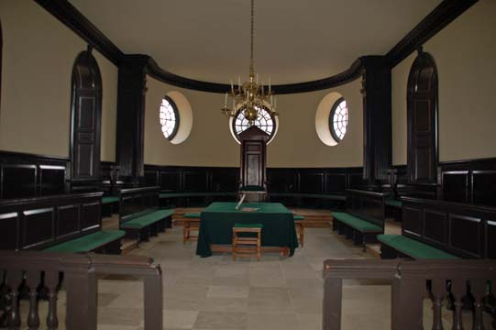
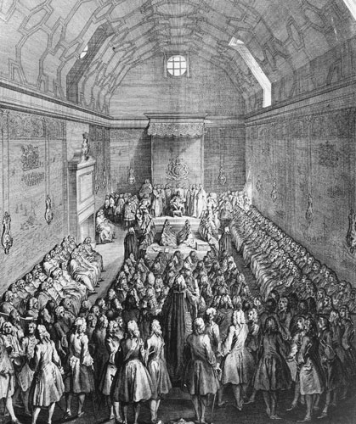
Comparative Architecture: Government
Virginia House of Burgesses
British House of Commons

Slide 23
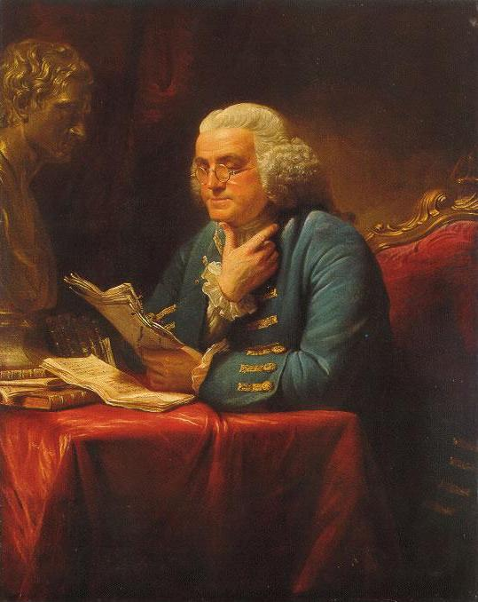
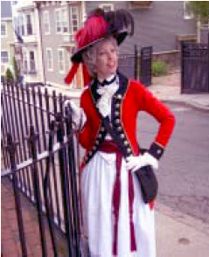
18th Century Colonial Dress

Slide 24
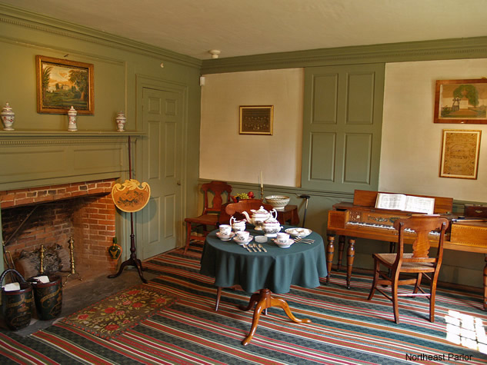
An Empire of Goods

Slide 25
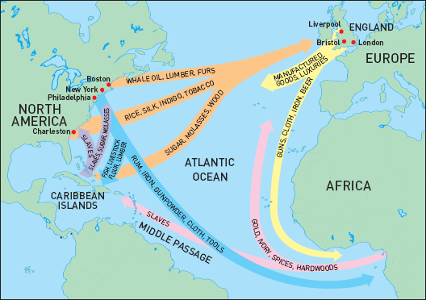
The Imperial Trade Network

Slide 26
Education and The Enlightenment in Colonial America
While the primary role of the first colleges in English America was to train clergy, they expanded quickly, and were functioning like English universities by the early 18th Century
By the mid-18th Century secular educational and intellectual institutions were founded (The Academy of Philadelphia in 1751 and King’s College in New York in 1754)
Overall, the American populace was more highly educated and literate than the English population
American’s were full Participants in the discussions and institutional development of the Enlightenment
  The works of the Philosophes and other Enlightenment thinkers were readily available in the colonies
  Institutions to promote learning and discussion were founded in the colonies’ urban centers
  The Gentry fully partook in debate and scientific experimentation
  European-style music and theater fully embraced in the colonies

Slide 27
The Colonial Class Structure
The Better Sort- Planters, Large Landowners, Wealthy Merchants, etc. These are the colonial “gentry,” and the closest to an aristocracy. They were the “men of leisure,” who did not actively work. They served at the upper levels of colonial society and government.
The Middling Sort- Also known as “the Leather-Apron Crowd,” they were the largest class in Thirteen Colonies (in general). These were the skilled tradesmen, shop-owners, and professionals of the colony. They were also the free-holding farmers of moderate wealth.
The Lower Sort- The bottom rung of the social ladder for free men

Slide 28
The First Great Awakening
Trans-Atlantic Religious Movement
Both American (Jonathan Edwards) and English leaders (George Whitfield and John Wesley)
Reaction against the rigid, top-down strictures of both Anglicanism and the Calvinist denominations of New England
Birth of the Revival
  Itinerant Preachers
  Mass crowds
  Emotive Preaching
Divided existing churches between older elites and younger congregations
Split Calvinism into two denominations (Congregationalists and Presbyterians) and the birth of the Baptists and the Methodists
Emphasized personal agency for salvation and in religion. Democratized the structure of American religion

Slide 29
Benjamin Franklin
Born January 17, 1706 in Boston
Son of a Soap and Candle Maker
Apprenticed to his brother, a printer and founder of the first independent newspaper in North America for which Franklin wrote under a pseudonym
Ran away to Philadelphia and worked for a printer their and in London
Set up own printing business in 1728 which would prove to be extremely successful
Became “Man of Leisure” in 1758
Prolific scientist and social innovator

Slide 30
The Contest of Empires

Slide 31
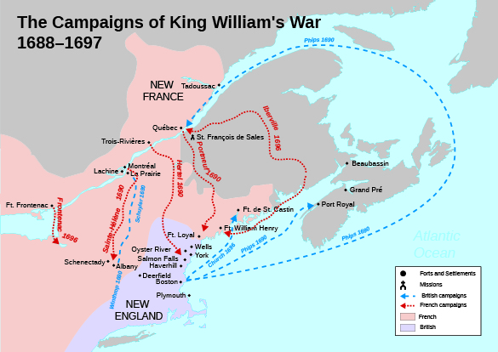
King William’s War
1688-1697
American component of the War of the League of Augsburg
Side-show to the larger European War, almost no involvement from European regular forces
French colonials and native allies fought New York and New England along with the Iroquois Confederacy
Primarily raids and occasional unsuccessful attacks on major centers
War ended with the Treaty of Ryswick in 1697, resulting in status quo ante bellum
Iroquois broke with the English, continued the war until 1701, and afterwards, adopted a policy of neutrality and playing the English and French off each other.

Slide 32
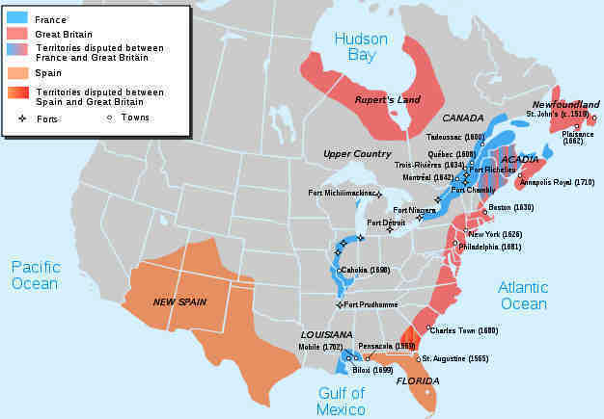
Queen Anne’s War
1702-1713
American component of the War of the Spanish Succession
Fought in the Carolinas, along the Canadian frontier, and Newfoundland
Almost no regular involvement on either side
War primarily small raids conducted by English colonists on the French and their Indian Allies, and vice versa
War ended with the Treaty of Utrecht in 1713, which awarded Newfoundland and Nova Scotia to Great Britain

Slide 33
King George’s War
1744-1748
American component of the War of the Austrian Succession
Minor regular involvement on the British side, enabling the Colonial capture of the French fortress city of Louisbourg in 1745
Heavy raids and losses took a toll on New England
Ended with the Treaty of Aix-la-Chappelle 1748- status quo ante bellum

Slide 34
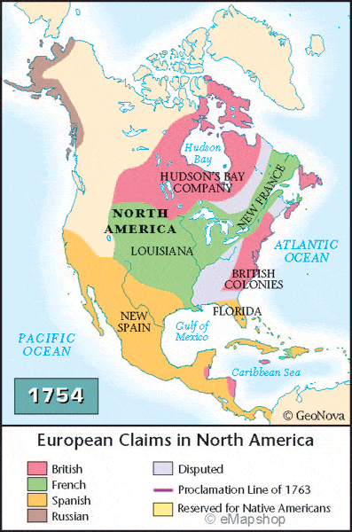
To an American, and a World, War
The Treaty of Aix-la-Chappelle left imperial friction in North America unresolved
France wanted to build connections between New France and Louisiana, via the Ohio River and began establishing forts in what is now Western Pennsylvania
Meanwhile, the Iroquois are losing control of natives in the area due to French influence
1753- Virginia sends an expedition to a French fort to demand withdrawal from the Ohio valley, refused
1754- A Virginia force under Lt. Col. George Washington enters the area to destroy the new French Fort at the Ohio Forks (modern Pittsburgh). He attacks and defeats a French expedition (May 28) and is then itself defeated at the hastily built Fort Necessity (July 3)…War is effectively begun on the American frontier, but not in Europe

Slide 35
To an American, and a World, War
1755- Major General Edward Braddock arrives in Virginia from England with two regiments of British regulars. He has command of all British military forces in North America. Plans a multipronged attack against Fort Duquesne, the Canadian Frontier in New York, and Acadia.
1755- Braddock personally led the expedition against Fort Duquesne. His force is ambushed at the Battle of the Monongahela (July 9). Braddock is killed and 2/3 of his force are killed or wounded
1755- The Canadian expedition defeats the French at the Battle of Lake George (September 8) but stop advancing, achieving none of its objectives
1755- Acadia is effectively taken by British forces (1755)
There is also raiding action at sea in the Atlantic
Meanwhile, frictions left over from the last war led to the rupture of the Anglo-Austrian Alliance and the formation of one between Austria and France. Britain allies with Austria’s enemy Prussia. Austria and Prussia go to war in 1756 drawing England and France into a European War, of which the American War is now a part

Slide 36
The Disastrous Early War
1756- Britain sends Lord Loudon to take command of British military efforts in North America, but he quickly alienates Colonial soldiers and colonial governments who increasingly refuse to cooperate with him
Loudon’s offensive plans are increasingly frustrated by this opposition, as France wins victories on the frontier
1757- France takes Fort William Henry on the New York frontier at the cost of destroying its alliances with the native Americans
In Europe, British and Hannover forces suffer repeated defeats and stalemates while Prussia fights Austria and Russia at the same time, winning at extreme cost (in lives and British money)

Slide 37
The British Regular and the American Provincial
British Regular
American Provincial
Average Height 5’4
Soldiers came from Urban poor, debtors, and criminals
Officers selected generally from Aristocracy
Brutal Discipline “Bloodybacks”
Poorly Paid
Term of Service: For the Duration (minimum)
Average Height 5’7
Soldiers raised from towns as unit, community effort
Officers elected by their men, often local leaders
Men often questioned officers, difficult to discipline, men often came and went at pleasure
Paid equal with civilian laborers
Term of Service: 1 year

Slide 38
The Reforms of William Pitt
In 1757, in the wake of repeated defeats, a new British government was formed. The central figure of which was William Pitt. He completely changed the direction of British war planning
He doubled-down on the support for Prussia
He began raids on the French coast (“decents”)
He reverses all of Loudon’s North American policies, treating the Colonists as partners, with almost immediate results. He recalls Loudon as well.
Strategy was to force stalemate in Europe while stripping France of its empire abroad. Each victory will make him more ambitious

Slide 39
Britannia Triumphant
1758- General Jeffrey Amherst takes Louisbourg. Loudon’s successor, General James Abercombie, is defeated by an inferior French force at Fort Carillon (July 6-8). He is replaced by Amherst (July 26). Fort Duquesne falls (November 24) . Britain builds a much larger post, Fort Pitt to replace it.
1759- Anno Mirablis- French naval power is effectively destroyed at the Battle of Quiberon Bay (November 29). Fort Carillon falls, becomes Fort Ticonderoga under British control. Western Pennsylvania is cleared of French influence. New France is cut off from the southwest. Quebec falls to British forces (September 13)
1760- Montreal falls, effectively ending New France.
Britain will win other victories in the Caribbean, India, and the Philippines (Spain enters the war in 1762) while holding the line in Europe. Even the rupture between Prussia and Britain and the fall of Pitt does not stop the string of sucesses.

Slide 40
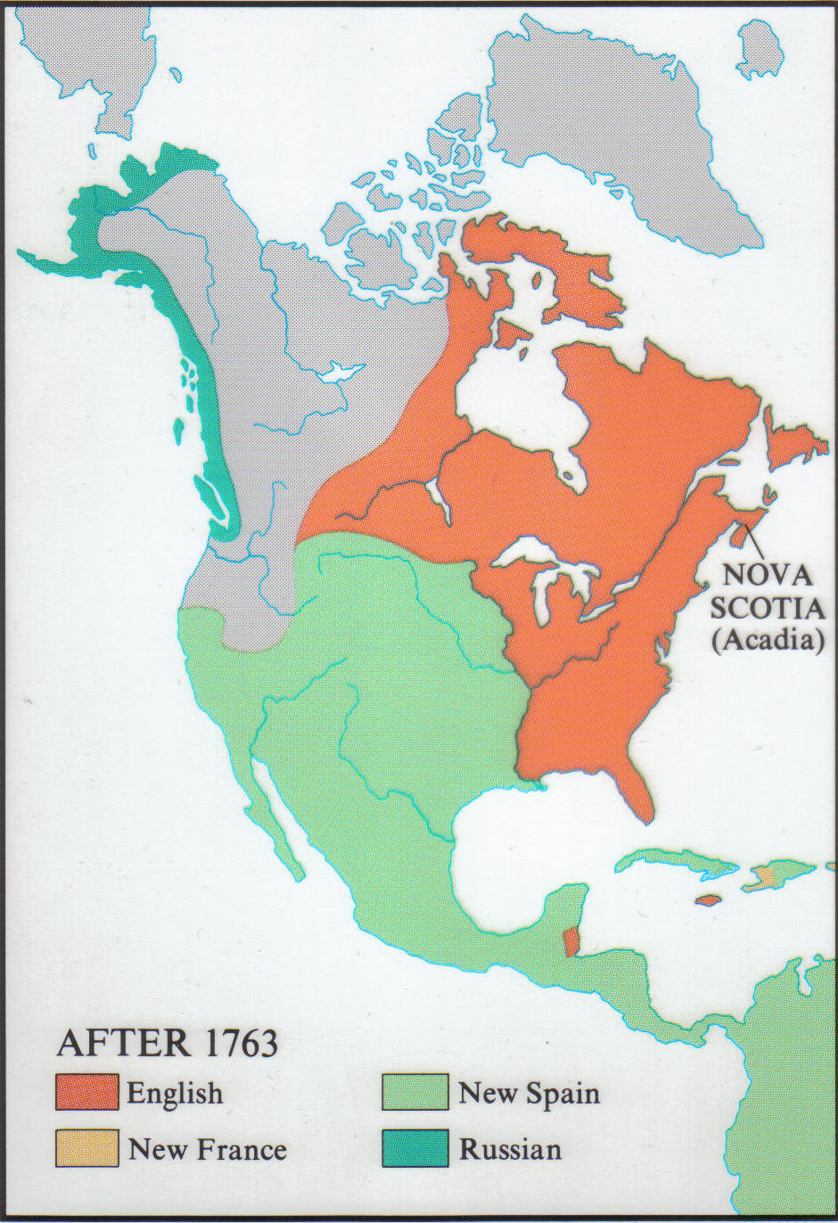
North America After the 1763 Treaty of Paris

Slide 41
Images of the Other Left By the French and Indian War
American Views of the British
British Views of Americans
Tyrannical
Arrogant
Lacking virtue
Mercenary
Uneducated
Arrogant
Disrespectful of rightful authority
Obsessed with money
Lacking virtue
Spoiled, Disobedient Children
Unwilling to sacrifice

