Slide 1
Multi-media presentation
Name:
Institution:
Date:

Slide 2
Introduction
Different pieces of media such as songs, video show, paintings focus on the theme of gender, sexuality, love among others (Lopatovska, 2016).
This is one way of passing important message to the audience and its also a means of educating them
The use of specified television shows and paintings has been discussed below on how relevant they are when it comes to message passing.

Slide 3
Definition
Painting is a specific form of art work which symbolizes things which happened long time ago in the history.
A television show is a feature length motion picture which is produced mainly with the aim of educating and entertaining people.

Slide 4
Similarities
Considering the (Vincent Van Gogh, Cafe Terrace At Night) painting and the television show namely Osama (http://www.imdb.com/title/tt0368913/plotsummary?ref_=tt_ov_pl).
We realize that the similarity is that the both reflect things which happened in the past

Slide 5
In both, we realize that people still have interest in them even though they are believed to be things of the past.
This is due to belief and also the curiosity to be informed much.

Slide 6
In both we find that there is no specification of the audience (El‐Sepelgy, 2017)
The information is useful both for men and women.

Slide 7
Differences
Vincent Van Gogh, Cafe Terrace At Night painting is a religion art which resembles the last supper (Lopatovska 2016).
Osama video is about politics where Taliban are ruling Afghanistan. It focuses much on gender inequality where women were not allowed to work.

Slide 8
Overall message
The overall message in Vincent Van Gogh, Cafe Terrace At Night painting represents the last supper which Jesus took with his disciples (Ferguson 2016).
In Osama movie, the overall message is about dictatorial leadership.
But then citizens strive to survive despite of the harsh rules in the state, especially women.

Slide 9
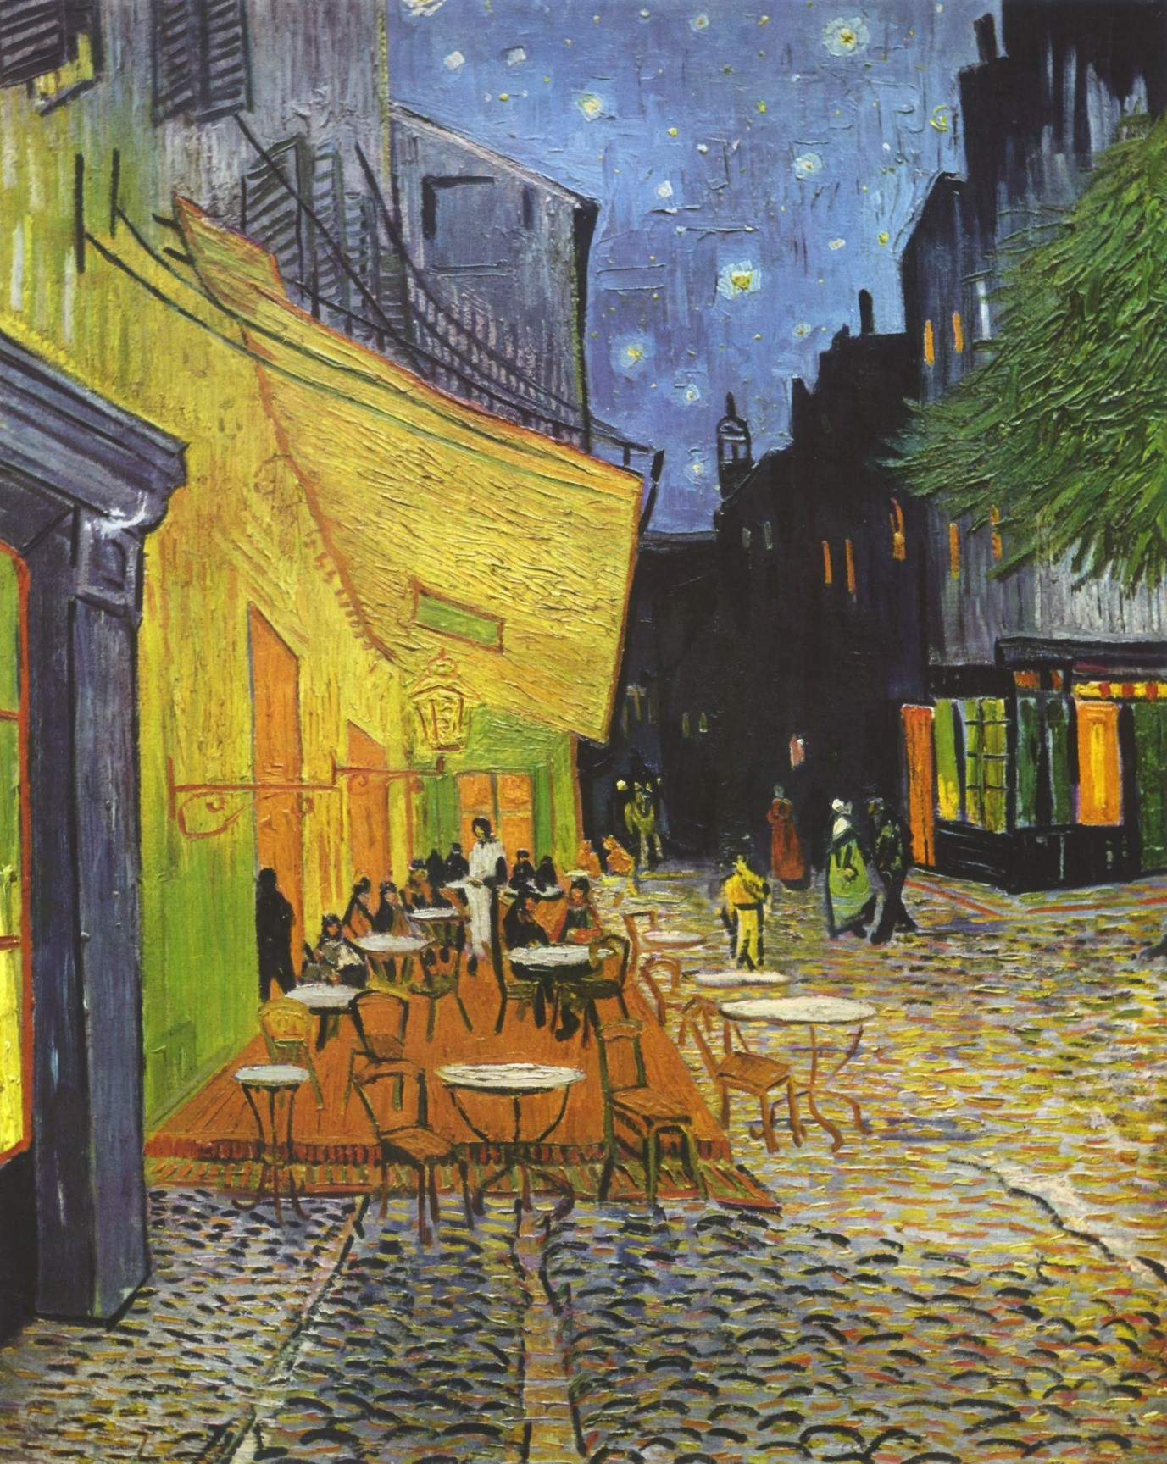
Cafe Terrace At Night

Slide 10
Historical background
Its also known as Cafe Terrace on the Place du Forum.
It is an oil painting which was executed by Vincent van Gogh in mid-September 1888 while at Arles, France.
It still exists today and it’s a “mecca” for the fans of van Gogh who visit the south of France.

Slide 11
Historical background
Osama video is a drama show which was released on 27th June 2003.
We find that the Taliban are ruling Afghanistan in their oppressive regime before women.
Afterwards women try to fight for their rights and work even though it was illegal (Lopatovska, 2016).

Slide 12
Demography
The demographic information in Cafe Terrace at Night , reveals that Jesus had twelve disciples (Ferguson 2016).
This is biblically true and it becomes easier for people to understand this fact.
Sitting together is also a symbol of unity which Jesus used in his mission.

Slide 13
In Osama movie, we find that most men were killed during the war, leaving a higher population of women.
The main message was to reflect on poor ruling system of killing citizens.
The potential of women is also evident on the way women strive to survive.

Slide 14
References
El‐Sepelgy, O., Alandini, N., & Rueping, M. (2017). Corrigendum: Merging Iron Catalysis and Biocatalysis—Iron Carbonyl Complexes as Efficient Hydrogen Autotransfer Catalysts in Dynamic Kinetic Resolutions. Angewandte Chemie International Edition, 56(12), 3129-3129.

Slide 15
Ferguson, K. (2016). Does Context Information Affect Perceptions of the Intrinsic Value of Visual Art?. Inquiry: The University of Arkansas Undergraduate Research Journal, 20(1), 4.
Lopatovska, I. (2016). Engaging young children in visual literacy instruction. Proceedings of the Association for Information Science and Technology, 53(1), 1-5.

