Slide 1
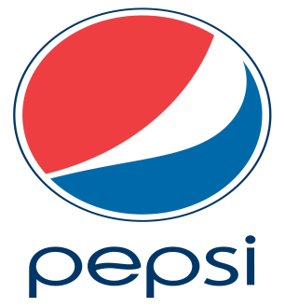
PEPSI
Strategic

Slide 2
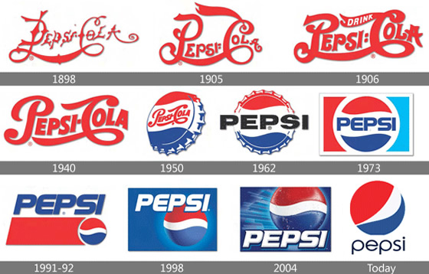
Introduction
Mission
Mission is to be the world's premier consumer products company focused on convenient foods and beverages. And in everything we do, we strive for honesty, fairness and integrity.
Vision
"PepsiCo's responsibility is to continually improve all aspects of the world in which we operate - environment, social, economic - creating a better tomorrow than today."
Our vision is put into action through programs and a focus on environmental stewardship, activities to benefit society, and a commitment to build shareholder value by making PepsiCo a truly sustainable company.

Slide 3
Environmental Scanning
External:
STEEP Analysis
In terms of Social and Cultural believe that PepsiCo impair blockbuster of consumers of all age groups in society, and in terms of Technological They are impressive of course what you need the company of cooling products and used the company also machines Self sales to sell their products, such as vending machines in public streets ,In Economic terms, the Pepsi company is very strong economically it and guide it did not significantly affected in the last economic crisis that hit some big companies, but it took advantage of the crisis well, where the acquisition of two of the largest bottling companies affected by the financial crisis, and Finally, from the political point they are certainly very impressive for the company because it is when you get the political crisis which affected markets, it is certain that the company was damaged in the demonstrations taking place in the Arab countries in terms of reduced sales or other aspects.

Slide 4
Environmental Scanning
External:
Porter's Analysis
Threat of New Entrants:
This would effect Pepsi’s business because consumers have more options to purchase than there already are. Examples of New Entrants include ALSI cola and Bcola in saudi .
Bargaining Power of Suppliers:
Pepsi is already the number two bottling company, so it can push to be number one.
Bargaining Power of Customers:
There are many, many buyers, so this does not affect Pepsi very much.

Slide 5
Environmental Scanning
External:
Porter's Analysis
Threat of Substitute Products:
This produces a small amount of threat only because Pepsi is already the second most profitable bottling company in the industry, so the only thing they need to worry about is the number one, who produces a substitute product.
Nature of Rivalry:
Coca Cola industries is the number one competitor of Pepsi.

Slide 6
Environmental Scanning
Internal:
Value – Chain Analysis
PepsiCo is downstream of it is that makes the powder, which makes them soft drinks produced by the company and send them to distributors around the world, and also that make bottles that filled their products and send them also to distributors around the world, and through owned manufacturers for the manufacture bottles, which holds the product marketing and transferred to the distributors who assume fill bottles and sell them, but without changing the name of the company because they are considered branches of PepsiCo.

Slide 7
Environmental Scanning
Internal:
Marketing Mix:
There are so many different products and brands that Pepsi sells for competitive prices. They promote sales of their products in countless different places that the product is bound to sell no matter what.

Slide 8
Environmental Scanning
Internal:
Competitive Advantage
Diversity and Inclusion.
Talented and motivated workforce.
big, brand.
The proven ability to innovate and create differentiated products.

Slide 9
Environmental Scanning
Internal:
SWOT Analysis
Strengths
Branding.
Diversity.
Company is run by experienced management team.
Weaknesses
Find alternatives to sugary, calorie.
market share in the world beverage market compared to Coca-Cola.

Slide 10
Environmental Scanning
Internal:
SWOT Analysis
Opportunities
Broadening of Product Base
International Expansion
Threats
Changes in consumer tastes
Water scarcity
Intense competition
Hostile campaigns for soft drinks

Slide 11
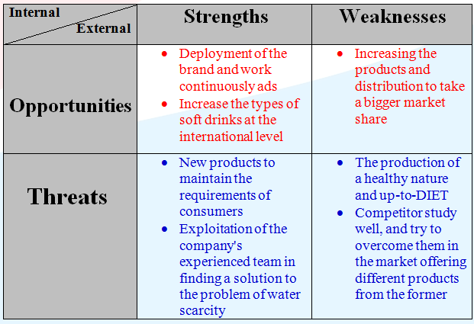
Environmental Scanning
Internal:
SWOT Analysis

Slide 12
Conclusions
All of the elements of their strategy are guided by six principles.
Is to care for their customers because their success depends on the consumer understanding of how the company cares to reach their satisfaction.
Is to only produce what the company is proud of and believe that it’s going to make them achieve their success.
Is to speak the truth of everything they do in the company not only what they achieved so they can achieve what is not been achieved.

Slide 13
Conclusions
All of the elements of their strategy are guided by six principles.
Is to have stability between short term and long-term risks and benefits, which will make them, sustain their growth and will make their solutions and results better for now and the future.
Is to accomplish their goals with diversity and inclusion which will bring them new ideas, innovation and new market opportunities.
Is to respect others so they can succeed together, respecting people in and out the company will improve their communication and collaboration so they can work together and accomplish their goals.

Slide 14
Thank you

