Slide 1
Why Reading Books is important
Leo Haung

Slide 2
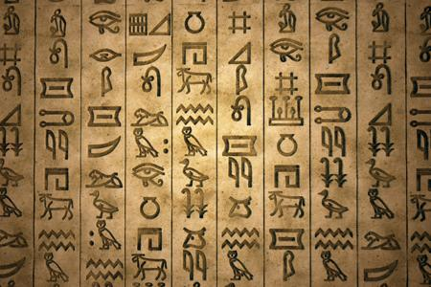
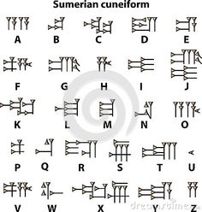
Introduction
Reading books is of great significance to people. Over time, it has been proved that people have different reasons for reading books. They have a high memory ability, they can recall things or events which took place several years ago (Pearson, p.83). One of the reasons as to why reading came into existence is the need to keep records during the Agrarian revolution. Cuneiform type of writing in Mesopotamia and Hieroglyphics Egypt in were invented.
Egyptian Hieroglyphics
Sumerian cuneiform

Slide 3
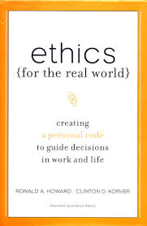
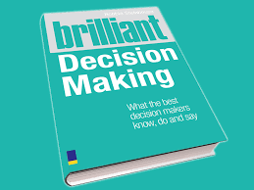
Developing Mental Ability.
The ability of the brain to function depends greatly on what we see in our lives. There is a strong relationship between reading books and the development of the mental ability. Different books present different themes. Through the analysis of how different themes are solved in the book, the mental ability of an individual grows strong. As a result, such a person is able to make sound decisions in life.
Different books have different themes

Slide 4
Improvement in creativity
Creativity is the ability of an individual to come up with new ideas or develop the existing ones.
Through reading books, an individual gets to know more about a give issue, for instance if one is reading a book based to technology, he will get more information how a given device was made, how it works and how it can be modified to give more impressive results.
It is due to reading that the field of technology is improving each day in the world. For instance, students study physics in classrooms, what is the implication of this in the universe? Increased creativity levels.

Slide 5
Improvement in creativity
Creativity is in several ways. Fro instance, a student studying engineering may decide to read novels by certain authors. What does such a student get from it? Subjects relate in schools. Reading novels does help one to be creative in writing proposals for projects, developing plans and so many other things.
The way a person who has been reading novels will present a project is more creative than the one who does not read will present.

Slide 6
Vocabulary enhancement and entertainment value
Different authors have different dictions (choice of words). Through reading these books, an individual gets to understand a wide range of vocabularies. For students, good diction can earn them marks in their projects. Nevertheless, they can end up becoming good writers. Good writers are often identified by their theme selection, choice of words, among several other books.
Most novels have entertainment values despite their moral lessons. For instance, when we were kids, we read stories like Cinderella, Snow White and the Forty Dwarfs and several others. We got entertained and to some extent, our parents would narrate the same stories to us during story times.

Slide 7
Memory Improvement
The memory of a child is like a blank slate. Any information fed to it, some is retained. This proves that additional information can be added to an individual’s brain.
Additional information improves the memory of a person.
Those people who are fond of reading, often have a good ability to recall things.
For students, reading over and over on a given subject creates a good understanding of the theme. As a result, the student can remember things read during a certain exercise. Developing a habit of reading immediately after the teacher leaves helps to improve memory.

Slide 8
Critical and Analytical Skills.
Reading entails engaging your mind in a specific thing with a specific objective. Through reading the way situations are analyzed in given books, one develops the ability to critically analyze situations in life.
Reading involves, getting the message, understand it, then present it or use it to attain a certain goal.
Students who engage in reading books are widely knowledgeable. They can present their information on assigned tasks through a wide use of real life examples and situations.

Slide 9
Mental stimulation.
The Brain requires exercise just like any muscle in the body for it to remain strong.
Keeping the brain active through reading helps it to maintain its power.
Through reading puzzles in books, magazines, newspapers or any other print material, lead to cognitive stimulation.
Nevertheless, the mind is relieved from stress (Doren, Mortimer & Charles, p.33).

Slide 10
How one can get motivated to read books.
Self motivation is the most important tool when it comes to reading books. What do you want in life? Life is full of challenges. These challenges are not new, they were there in the past and methods to solve them arrived at. How did they arrive at the solution? Through asking yourself these questions, you will find out that the books are the best sources for your decision (Mais, p.17).
Most people will find reading books boring. The reason behind this is the lack of focus. Know what you want from a certain peace of reading and you will never get bored.

Slide 11
Conclusion
Having informed you on the importance and fun in reading books, I believe it is time to start making use of the existing books in the library. The library will not come to you, it is for you to go and find it. Decide on the main reason as to why you decide to read a certain book, for instance, is it for entertainment, fun or improving your writing skills?

Slide 12
Works Cited
Mais, S. P. B. Why We Should Read (Classic Reprint). London: Fb & C Limited, 2015.Print.
Link:https://books.google.co.ke/books?id=1ogFswEACAAJ&dq=importance+of+reading+books&hl=en&sa=X&redir_esc=y
Pearson, D. Books as History: The importance of books beyond their texts. London: Oak Knoll Press 2012. Print
http://www.worldcat.org/title/books-as-history-the-importance-of-books-beyond-their-texts/oclc/815043559

Slide 13
Doren, Mortimer J. Adler & Charles Van. How to Read a Book
New York: Simon $ Schuster, 2011. Web.
https://books.google.co.ke/books?id=Z5PpkQadm5EC&dq=importance+of+reading+books&source=gbs_navlinks_s

