Slide 1
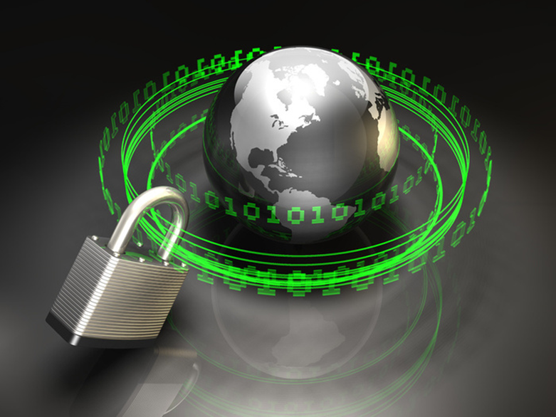
Information Systems & Internet Security
Dr. Albert Huang
Notes:
Welcome back! This is Dr. Albert Huang.
Today, we are going to discuss the security issues for information systems and the internet. We put special emphasis on the internet, because it has become such an important part for doing business. Consequently, the security issues about the internet have become a critical part of the overall information systems security.

Slide 2

Security Report
Latest Video & Report:
http://www.symantec.com/security_response/publications/threatreport.jsp
Notes:
Firs, I would like you to watch a brief video about the 2013 Security Report issued by the Symantec corporation. The second link takes you the full report.

Slide 3
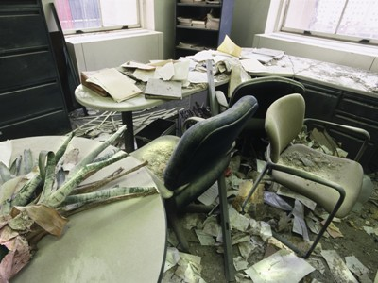
Types of Threats
Physical security threats:
Damages to computer hardware and buildings
e.g., war, vandalism, theft, fires, floods, earthquakes, hurricanes, etc.
Logical security threats:
Loss of control over data and software.
Notes:
To understand information systems security, we need to look at the types of threats faced by the modern information systems. We can classify the threats into two categories: physical and logical.
Physical threats mainly refer to damages to the tangible objects, such as the computer hardware and other facilities such as the buildings. These threats can be done intentionally by people; or they could be nature disasters. For example, events like: war, vandalism, theft, fires, floods, earthquakes, hurricanes, and so on could cause serious damages to information systems equipment.
The second category is the logical threats. Logical threats mainly refers to loss of control to your data and software. This category is more common and requires constant attention. We will discuss this category in the next few slides.

Slide 4
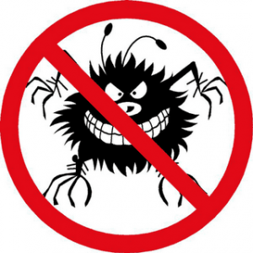
Types of Logical Threats
Behavioral
Malware
Phishing
Denial of Service
Identity theft
Interception during transmission
Notes:
There are many types of logical threats. The 6 main categories are: Behavioral
Malware
Phishing
Denial of Service
Identity theft
Interception during transmission

Slide 5
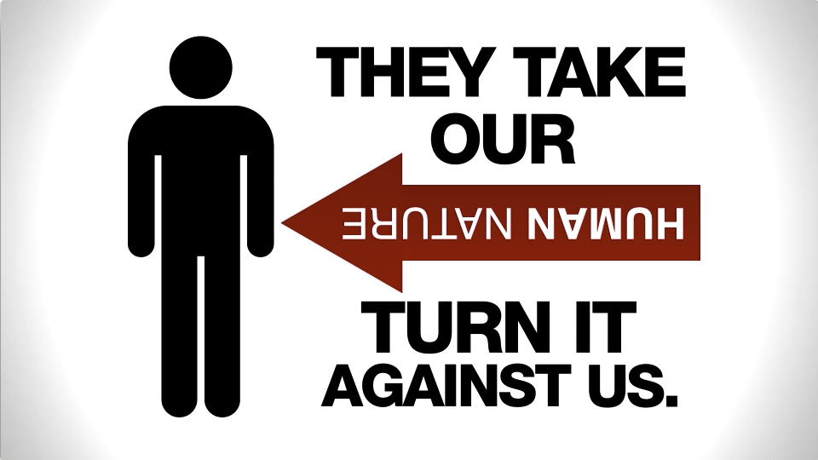
Behavioral Threat
Definition: threats caused by human behavioral weakness and bad habits
For example, users write passwords on sticky notes; give out private information over the phone; fail to check the identify of persons who request for information, etc.
Social engineering example:
A hacker calls up a victim (you), claims to be your network admin, and ask for your password
Read more about social engineering:
http://www.pcworld.com/article/182180/top_5_social_engineering_exploit_techniques.html
Notes:
What are behavioral threat? These are threats caused by human behavioral weakness and bad habits. For example, many users write passwords on a sticky note then stick it on the monitor or keyboard;
Many people give out private information over the phone to strangers; Employees sometimes fail to check the identify of persons who request for confidential information.
Social engineering is the process hackers use to obtain private information from unaware users. For example, they can call up a victim (you), claims to be your network admin, and ask for your passwords and other information. There is really no technology to prevent this type of hacking. User education to increase awareness is the only solution.

Slide 6
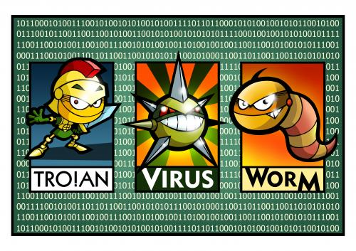
Malware
Types
Viruses
Worms (viruses that do not destroy data)
Trojan horses
Spyware
Ransomware
Malware is easy to find:
http://www.infoniac.com/offbeat-news/computervirus.html
Notes:
The next category of logical threat is malware. It includes Viruses, Worms (viruses that do not destroy data), Trojan horses, and Spyware. We will define each one in more details in the next few slides. Malware is a serious threat partially because it is so easy to obtain it and spread it.

Slide 7
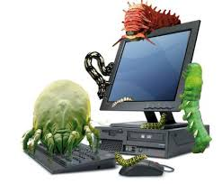
Computer Virus
Definition: a computer program that attacks your system. It might erase or modify files on your computer. It might make a computer function incorrectly, or not able to function at all.
How does a virus spread?
A virus attached to an email might send itself to everyone in your contact list using your name.
A virus might attach itself to other files. You might get a virus when you download a file from the Internet or access a file from an external media, such as a USB disk.
Virus Video: http://youtu.be/_4sFZgUWhB4
Notes:
The most common type of malware is computer virus. It is a computer program that attacks your system. It might erase or modify files on your computer. It might make a computer function incorrectly, or not able to function at all. Viruses are mainly by two methods. One is by email. A virus attached to an email might send itself to everyone in your contact list using your name. Another way is by file transfer.
A virus might attach itself to other files. You might get a virus when you download a file from the Internet or transfer a file from an external media, such as a USB disk.

Slide 8
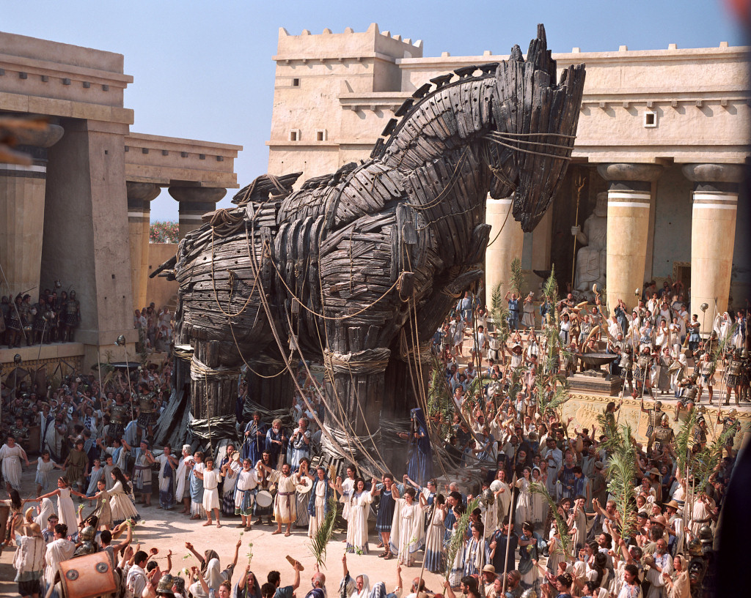
Trojan Horse & Spyware
Trojan horses: a malicious code hidden inside other programs. It might use the host to attack others; it might steal information.
Spyware: instead of destroying files, the spyware captures all of your activities, such as Web sites visited, passwords entered, and credit card numbers.
Notes:
The second type of malware is the so called “Trojan horses”. It is a malicious code hidden inside other programs. It might use the host to attack others; it might simply steal information. A similar category is the so called “spyware”. It can captures all of your activities, such as Web sites visited, passwords entered, and credit card numbers. It is a serious invasion of user privacy.

Slide 9
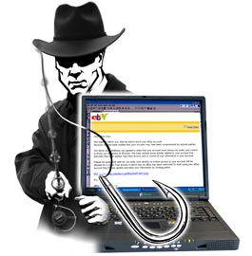
Phishing
Definition: using a fake web site or email to obtain information or money.
e.g.: an attacker copies the login page of e-Bay and e-mails millions of users with a link to the fake site, and wait for fish (you) to “bite”
Notes:
Phishing is not a computer program like viruses or spyware. It is usually done by a web site, email, or combination of the two. The purpose of phishing is to steal information or money. For example, an attacker copies the login page of e-Bay and host the fake page on their own server. They then e-mail millions of users with a link to the fake site, and wait for the fish (you) to “bite”. When you visit the web site, it looks just like the real site. As you put the ID and Password to log in, they capture the information, and use it to steal your other information or money.

Slide 10
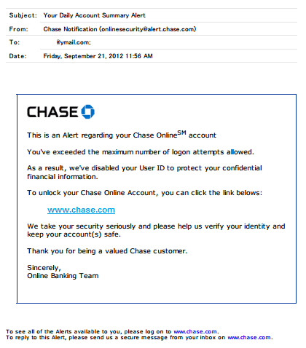
Notes:
This is an example of a phishing email. It shows that it is from Chase bank, but it is really not from the real Chase Bank. If you click on the link, you will be taken to the fake web site set up by the hacker.

Slide 11
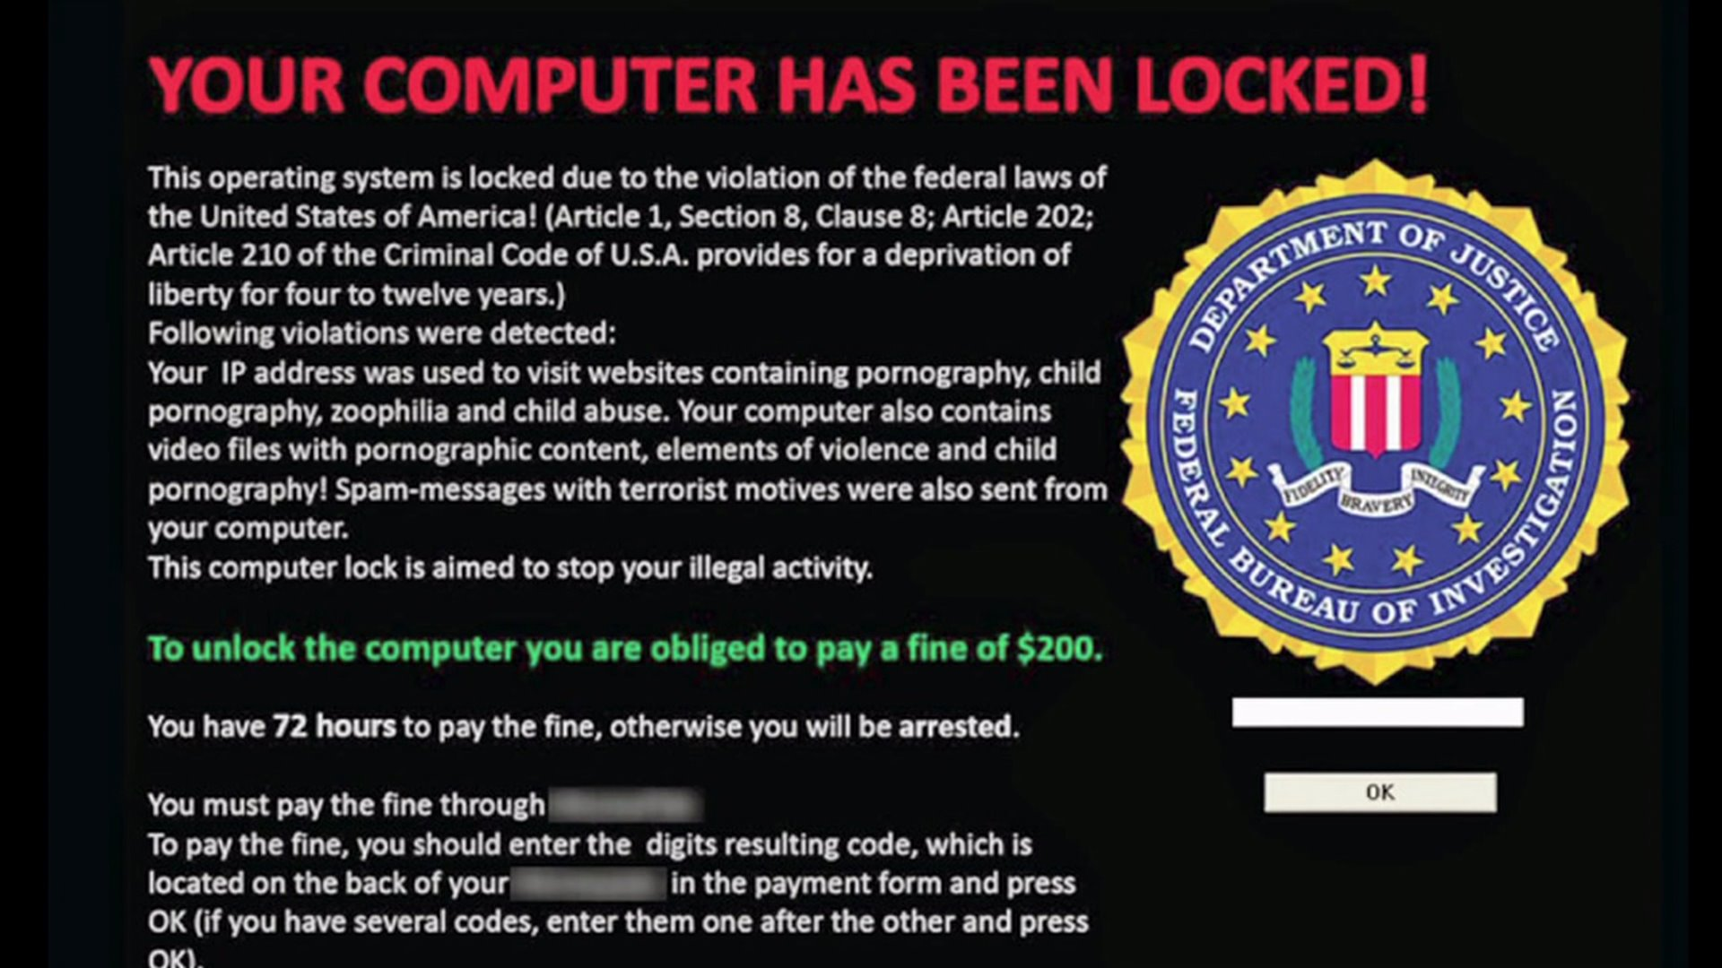

Slide 12
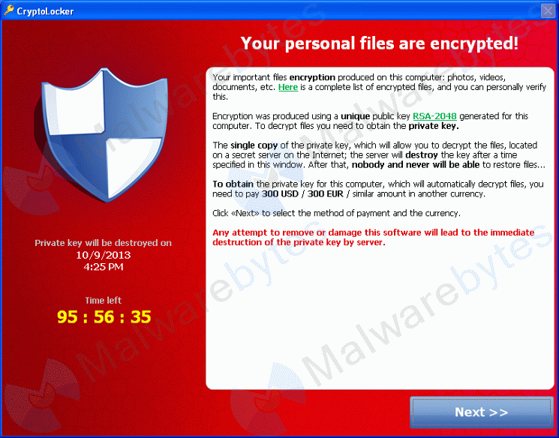

Slide 13
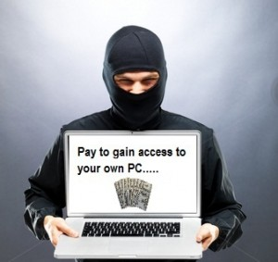
Ransomware
Restricts access to the computer system that it infects
Demands a ransom to remove the restriction
Forms
Change password
Encrypt files

Slide 14
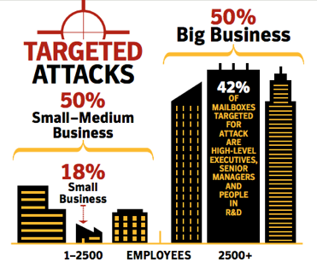
Targeted Attacks
Aimed at a specific user, company or organization.
Not widespread like a common virus or phishing, but rather are designed to attack and breech a specific target.

Slide 15
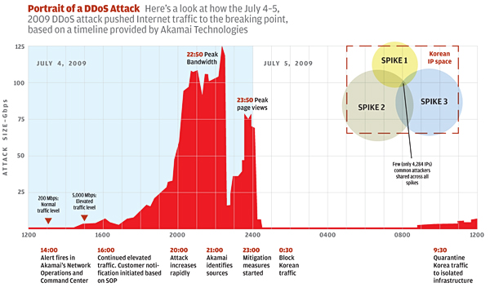
Denial of Service
Prevent legitimate users from accessing information or services.
E.g.,
"floods" a network with information, numerous requests, ect.
http://www.us-cert.gov/ncas/tips/ST04-015
Notes:
The next type of logical threat is Denial of Service attack. The purpose of DOS attack is to use a large amount of information to paralyze your system, and prevent other users from using it. For example, they can send millions of request every second to your web site. You web server will not be able to handle the request of legitimate users. They could also use a large number of spam email (thousands) to fill out the buffer or storage of you email server, so you won’t be able to handle the emails from legitimate senders.
The picture on the right shows you the traffic log of a DOS attack. You can see that the traffic suddenly increases to a very high level that might take the system down.

Slide 16
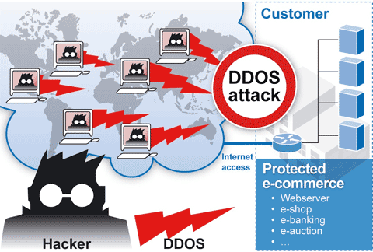
DDOS
DDOS:
an attacker could take control of your computer. He or she could then force your computer to send huge amounts of data to a website or send spam to particular email addresses. The attack is "distributed" because the attacker is using multiple computers, including yours, to launch the denial-of-service attack. “
DDOS Video:
http://youtu.be/jc-S4fa5BxQ
Notes:
Most of the DOS attack is done by using a network of computers. We call this DDOS. IN a DDOS, an attacker could take control of your computer. He or she could then force your computer to send huge amounts of data to a website or send spam to particular email addresses. The attack is "distributed" because the attacker is using multiple computers, including yours, to launch the denial-of-service attack“ on a third party. DDOS is very hard to trace, because the attack could come from thousands of computers owner by innocent users.

Slide 17
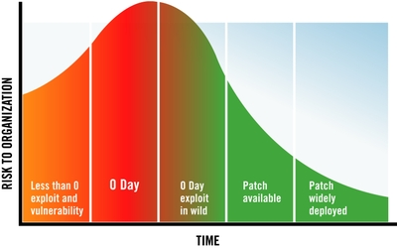
Before You Know It
Zero-Day Vulnerability
A hole in software that is unknown to the vendor.
Zero Day Attack
Exploited by hackers before the vendor becomes aware
Infiltrating malware, spyware or allowing unwanted access to user information.

Slide 18
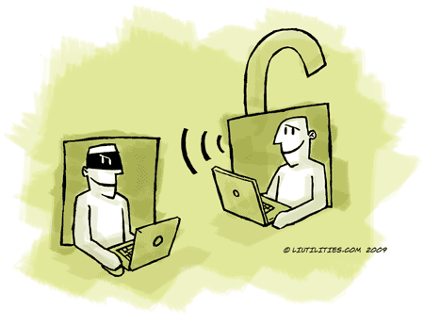
Transmission of Information
Internet is NOT natively a secure channel of communication
Protection of the physical facilities/media is not enough
Security on the Internet is achieved using encryption
Notes:
Another way for hackers to steal your information is during the transmission process, especially on the internet. Keep in mind, internet is not a secure channel of communication. This is not a secret; but most people do not realize it or simply ignore it. Anything you transmit on the internet can be easily intercepted and read, if it is not protected.
To protect your information on the internet, you need to use encryption.

Slide 19
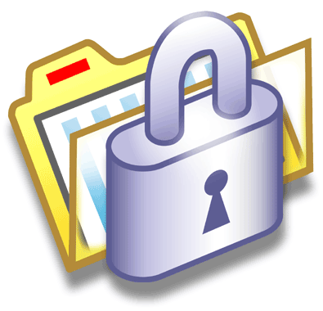
Encryption
Single key encryption:
Both the sender and receiver have the same software and key that handles the encryption and decryption
Dual key encryption:
Require two keys to encrypt and decrypt a message. Whichever key is used to encrypt the message, the other key must be used to decrypt it.
Notes:
There are two types of encryption: single key and dual key. With single key encryption, Both the sender and receiver have the same software and key that handles the encryption and decryption. Like using a lock to secure your house, you use a key to lock it, and also use the same key to unlock it.
Single key encryption does not work very well on the internet. For example, if you lock a message using a key, how do you give the key to the receiver so they can unlock it? There is not an easy way to send the key securely on the internet.
The solution is to use dual key encryption. Dual key encryption require two keys to encrypt and decrypt a message. Whichever key is used to encrypt the message, the other key must be used to decrypt it. The theories behind this method is quite complicated. We won’t get into the technical and mathematical details of dual key encryption here.

Slide 20
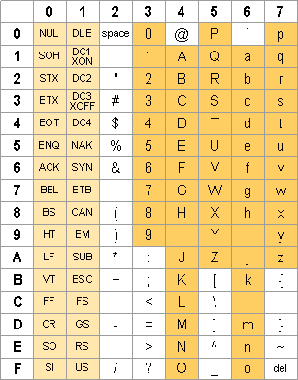
Single Key Encryption Example
Decrypt the following message:
597A837084797A7E72
4869726F7368696D61

Slide 21
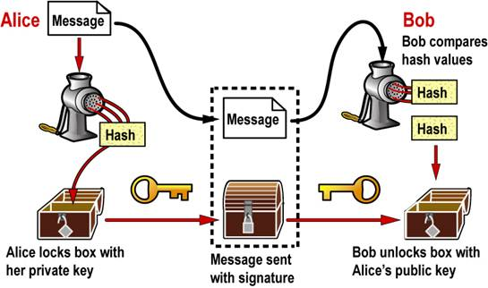
Digital Signature
Dual key encryption technology is also used to digitally sign a document and authenticate the sender of information – called digital signature.
It is a code generated using the sender’s private key
It is NOT a scanned copy of your hand written signature
Notes:
In addition to secure a message, encryption can also be used to authenticate the sender of a message or the owner of a web site. It is called digital signature. It is a code generated using a message sender’s private key.
Keep in mind that a digital signature is not a scanned copy of you handwritten signature. So do not send an image of your signature when you are asked for your digital signature.

Slide 22

Protect Your System
OS: update your OS
Antivirus software, update constantly
If you do not have antivirus software - use an online virus scan - http://housecall.trendmicro.com/
For Android phones - http://housecall.trendmicro.com/mobile/
Backup your data
Notes:
So, with all these threats that could seriously affect your system and business, what can you do? There are some simple things that can be done to lower the possibility of being attacked.
First, update you OS. It is important that you update you OS to have the latest patches.
Second, use antivirus and anti spyware programs. Keep in mind that you also need to update these software constantly to get the latest list of viruses and spyware.
If you do not have antivirus software - use an online virus scan - http://housecall.trendmicro.com/
For Android phones - http://housecall.trendmicro.com/mobile/
Unfortunately, these actions cannot prevent you from being attacked entirely. So the smartest thing to do is to backup your data.

Slide 23
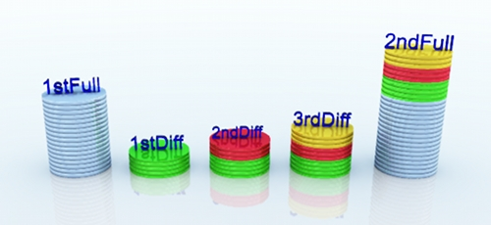
Backup Methods
Full Backup
Backup everything
Not practical to do frequently with large data
Incremental backup
A backup of all changes made since the last backup. With incremental backups, one full backup is done first and subsequent backup runs are just the changes made since the last backup.
Differential backup:
a backup of all changes made since the last full backup. With differential backups, one full backup is done first and subsequent backup runs are the changes made since the last full backup.
All 3 methods are used concurrently
Notes:
Backup sound like a simple thing to do, but it is time consuming. Many users simply don’t do it, because it is not urgent. It is always too late to think about backup when you are being attacked.
For business managers, backup your data is as important as safeguarding your money. In general, there are 3 backup methods. The first is a full backup. A full backup make a copy of the entire system; but it is the most time consuming. The second backup method is incremental backup. An incremental backup only copy the files that are changed since the last backup. That is, if you perform incremental backup daily, each incremental backup only copy the file changed in the last 24 hours. The first incremental backup should be a full backup.
The 3rd method is differential backup. A differential backup copy the file changed since the last full backup. That is, if you perform a full backup at the beginning of each month, and a differential backup once a week, each differential backup will copy the files changed since the beginning of the month. So the differential backup for the first week should contain one-week of changed files; the backup for the second week should contain 2 weeks of changed files.

Slide 24
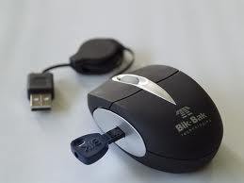
User Identification
Two-factor authentication:
use more than one identification methods, such as ID & Password; ID & card scan; ID & biometric, ID & hardware key, etc.
Kerberos server:
users log in once and the security server provides authentication to all of the authorized servers
Notes:
The second thing to do to protect your system is to make sure only the authorized users are using your system. This is called user identification. At a minimum, information systems should use 2-factor authentication. For example, you are asked for an ID to get foods from the cafeteria. This is only a 1-factor, not a 2-factor authentication. When you withdraw money from an ATM, you need to use the ATM card, and put in your PIN. On most computer systems, we need to have a user account ID and password.
These are examples of 2-factor authentication.

Slide 25
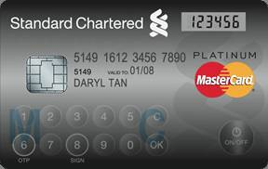
Password Generator
Small electronic cards that generate new passwords every minute. The same system is embedded on the main computer. When you want to log in, you simply enter the number on the card that you are carrying. Since the password is changed every minute, you do not have to worry about anyone guessing it or intercepting it.
Notes:
One way to enhance the security of 2-factor authentication is to change the password constantly. A device that helps you do this is a password generator. It is a Small electronic cards that generate new passwords every minute. The same system is embedded on the main computer. When you want to log in, you simply enter the number on the card that you are carrying. Since the password is changed every minute, you do not have to worry about anyone guessing it or intercepting it. Of course, you need to keep this card with you. If you lost it, you will need to report it immediately.

Slide 26
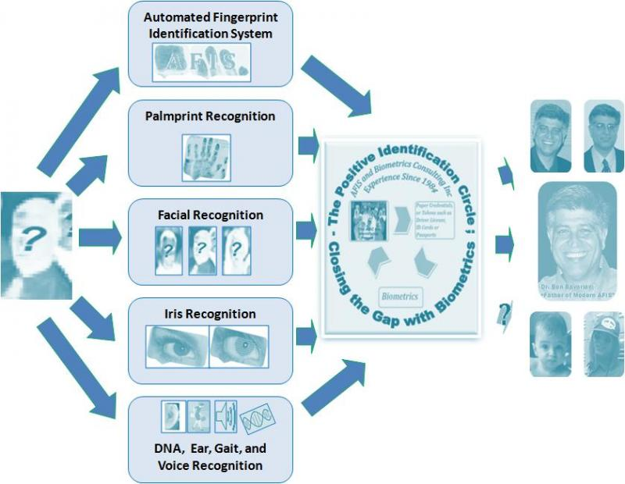
Biometric
a field of study that attempts to identify people based on biological characteristics: finger prints, palm prints, iris, facial, ear, voice, gait, DNA, etc.
Notes:
Biometric is a field of study that attempts to identify people based on biological characteristics: finger prints, palm prints, iris, facial, ear, voice, gait, DNA, etc. The technology has become more matured in recent years. Many computers now have a built-in fingerprint scanner. You can also get an external one for less than $20 dollars.

Slide 27
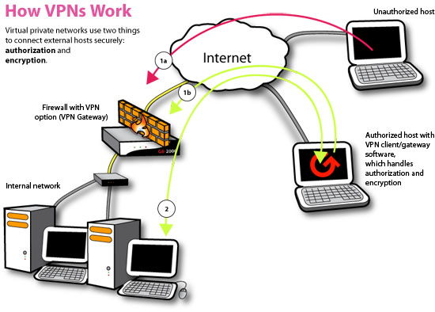
Virtual Private Network (VPN)
Encrypts all transmissions before they are sent across the Internet. Using this technology, it is safe for employees to work from home using high-speed Internet connection.
Notes:
Although the internet is an open network, it is possible to have secure communication with encryption. We can use encryption on a single file, we can also use it to secure an entire communication session. The technology is called VPN. VPN allows users to use a public network, like the internet, as if they are using a private network. When you use VPN to connect your computer from a remote location to your company, you feel like you are inside the office. All communications are secured and private between your computer and other nodes on the company network.

Slide 28
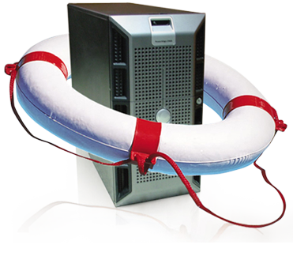
Disaster Recovery
Data loss only
Restore backup
More than data loss
Cold Site
Hot Site
Mirror Site
Notes:
Finally, disasters could still happen despite all the efforts to protect your system. When disasters occur, what do you do?
If the disaster does not destroy your facilities and equipment, you may simply try to restore your system on the sample equipment. That is, assuming you have the backup files stored in a safe location.
If the facilities are unusable due to flood, fire, or other causes, you can move you operation to either a cold site, a hot site, or a mirror site.

Slide 29
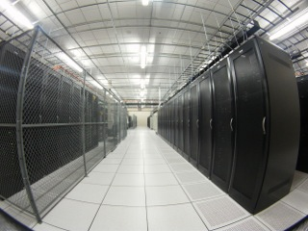
Cold Site
Fully functional computer room space, without the computer equipment.
Either the company or the disaster recovery services provider can arrange for the necessary equipment to be shipped to the cold site.
Might be a delay of several days before the new data center will be operational
A cold site is often used in conjunction with a hot-site contract.

Slide 30
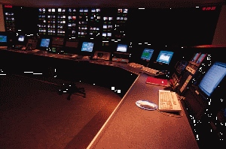
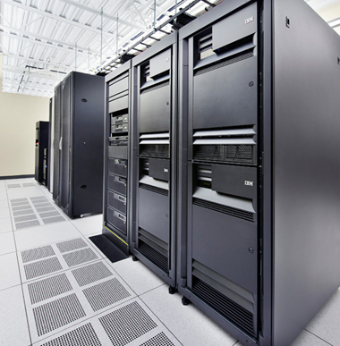
Hot Site
A fully configured computer center.
Still need to restore your backup files.

Slide 31
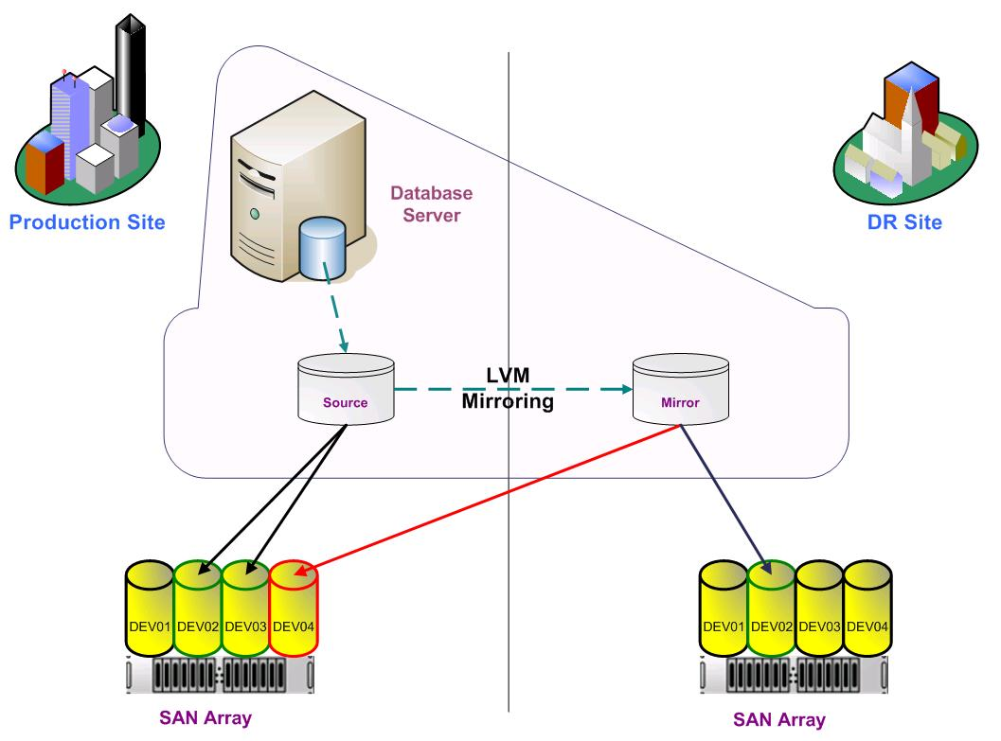
Mirror Site
A backup computer that is continuously running to maintain a complete copy of the daily operations.
All data is maintained simultaneously at both locations.
If problems arise with one machine, the second one takes over automatically.

