Slide 1
ISEM 530: Analysis and Design of Modern Information Systems

Slide 2
Team Contribution

Slide 3
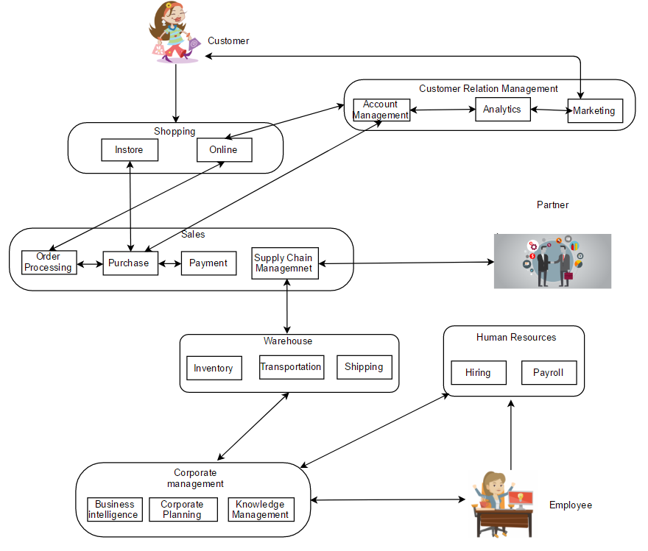

Slide 6
Enterprise Ontology
Enterprise Ontology – Understanding of a business’ operation which is totally independent of realization and implementation of enterprise.
Helps offering a structure to organize knowledge and monitor knowledge acquisition.
Assists in identification of appropriately competent professionals to discuss ideas and guide task execution.
ARTS Retail Data Model can be used a Business Reference Model.
Notes:
ARTS Retail Data Model offers two discrete perspectives across a retail business:
Enterprise context - Delivers an understanding into the retail enterprise by means of three levels within retail operations:
Home Office Level
Warehouse Business Level
Retail Store Business Level
Subject area composition - Offers awareness into the retail enterprise through subject areas that span across all three levels of retail operations.
Organized into 10 major business functions, the data model breaks them down further into different subject areas, each of which defines a process that occurs in any retail organization.

Slide 7
Business Reference Model
Using the ARTS Retail Data Model, the business pattern developed can be expanded to include following functions:
Supply side tax processing (Supply Chain Management)
Loyalty Program Management (Customer Relationship Management)
Point Of Sale processing
Inventory location maintenance (Inventory Management)

Slide 8
Reference Links
http://www.iceis.org/Documents/Previous_Invited_Speakers/2005/ICEIS2005_Dietz.pdf
https://nrf.com/resources/retail-technology-standards/data-models
https://www.emarketer.com/

