Slide 1
Darfur
INR2002

Slide 2
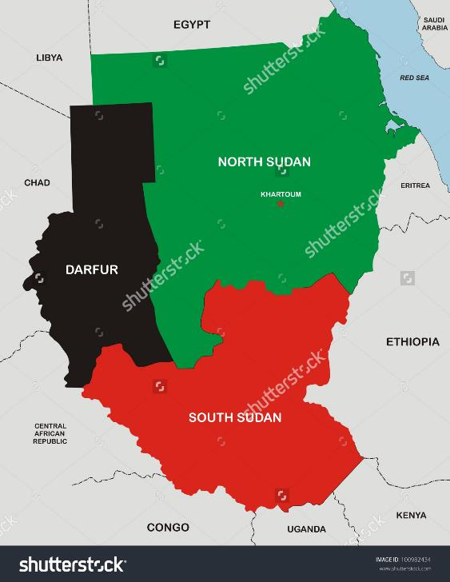

Slide 3
Darfur
0208 https://youtu.be/USLDoIiFzzg Drivers of Darfur conflict 10:00
0209 https://youtu.be/b7cZKMfjJKE UNAMID 8 years ago 1:18
0416 https://youtu.be/Hl_vR9L-xSo Bashir 4:37
0616 https://youtu.be/lJQU08ItUR0 2016 update to conflict 26:00
0616 https://youtu.be/SWqZro7voVM Update of UNAMID 14:48
https://www.hrw.org/news/2016/09/08/ngo-letter-regarding-human-rights-situation-sudan

