Slide 1
The Future of iPad in The Tablet Market Place
Proximity Stakeholder Presentation
Michael Kelly Jr.
Proximity Media Analyst
January 2017
Apple’s iPad and other of tablets have fallen in the cracks between smartphones and notebooks. Tablets are no longer seen as important in the market. Apple is looking to be more innovative with iPad to satisfy consumer needs.
Notes:
Also, because of Microsoft, even Office on iOS and many different business class applications are being made for iOS every month
and make it the coherent gadget they bring with them when joining the workforceAn iPad with a console and iOS can handle the lion's share of what they require in their occupation.
Apple's objective with the iPad is to make it the real apparatus they give to all, particularly millennials. Apple is looking to maintain relevance in the future for the millennial market.

Slide 2
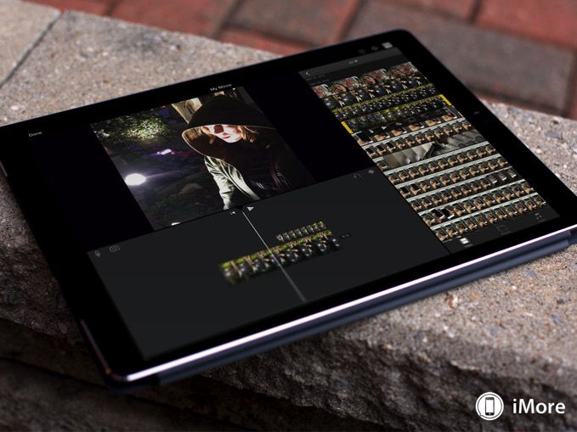
Tablet Market
Tablets are starting to fall short in the market due to innovation of Mac and smart phone.
Ipad is till leading the tablet market but it’s new rival is Windows surface detachable.
Fewer in tablet market continues due to less people buying tablets because they don’t want to upgrade existing devices.
Notes:
The teardown demonstrates how the basic structure of the iPad befits its motivation as an easy to use, media-eating up gadget
The display, the multi-touch screen and other human-PC interface parts make up about 44 percent of the aggregate bill of materials
The display, the multi-touch screen and other human-PC interface parts make up about 44 percent of the aggregate bill of materials

Slide 3
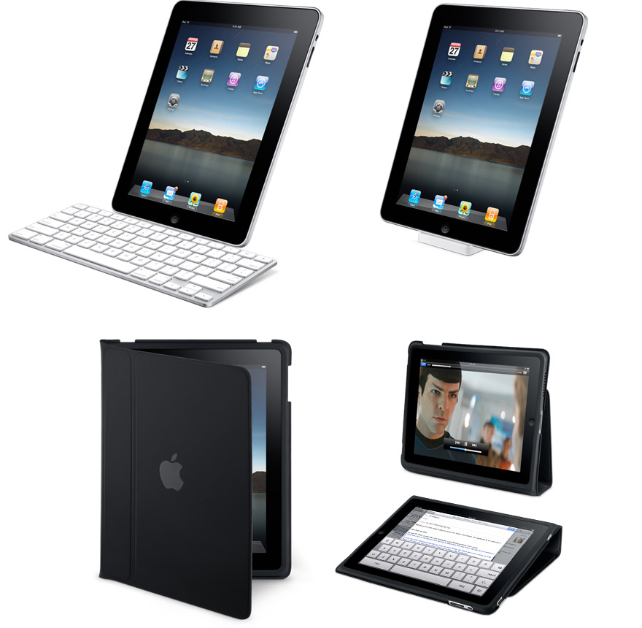
Apple’s iPad Advantages
Apple's iPad ranked highest in overall consumer satisfaction for tablets.
Buyers are progressively value sensitive while picking an iPad.
Apple’s applications serves a purpose for education.
Apple has great success in the app world
Notes:
. Less expensive iPad have not just determined down the normal tablet offering cost — which dropped from $390 in 2012 to $337 in 2014 — additionally general shopper fulfillment, which plunged to 835 focuses a year ago from 853 focuses in 2012. Fulfillment is scored on a 1,000 point scale
Buyers are progressively value delicate while picking an iPad, measuring cost more vigorously than components or brand notoriety.

Slide 4

Apple’s Response to Competitors
Apple has championed k-12 educational programs
The iPad has a tendency to be more steady and simpler to use than Android tablets.
Ipad is now able to do some of the qualities of doing things that a computer capable of.
As to the window having full windows download they are unable to compete with Apple’s app store.
Notes:
Shink to how apple is respondig

Slide 5
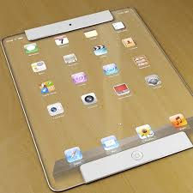
What’s Next For iPad
Because of Microsoft, even Office on iOS and many different business class applications are being made for iOS every month.
Apple is pushing iPad to be a coherent gadget to bring business applications to the work force.
Ipad creating accessories like key boards to function as a computer
Apple is adding new applications to enhance the use of iPad in K-12 education
Notes:
The iPad additionally does not have the capacity to grow its stockpiling through microSD cards. There are different alternatives, for example, Dropbox, and you can utilize some outer drives with the iPad, yet the absence of support for microSD and Flash drives is a distinct negative.

Slide 6
References
Fromm, J., & Garton, C. (2013). Marketing to millennials: reach the largest and most influential generation of consumers ever. AMACOM Div American Mgmt Assn.
Mang, C. F., & Wardley, L. J. (2012). Effective adoption of tablets in post-secondary education: Recommendations based on a trial of iPads in university classes. Journal of Information Technology Education, 11(1), 301-317.
Mangold, W. G., & Smith, K. T. (2011). Selling to Millennials with online reviews. Business Horizons, 55(2), 141-153.
Blackburn, H. (2014). Millennials and the adoption of new technologies in libraries through the diffusion of innovations process. Library Hi Tech, 29(4), 663-677.

