Slide 1
HRM 530 Assignment 5: Employee Compensation and Benefits
Antoine Brown
Dr. O
HRM 530
6/12/2017
Notes:
-Welcome-

Slide 2
Introduction
Employee compensation and benefits structure.
It includes wages and annual or hourly salaries.
Attempts to distinguish exempts and non-exempts.
Other compensation structure include benefits such as bonuses, incentives, retirement benefits, and insurance policies.
Well-structured compensation scheme key to improving performance and job retention.
Notes:
Employee compensation and benefits refers to the combination of wages, salaries and benefits that a worker receives as exchange for work done either in accordance to the formulated duties or in excesses of overtime and other viable bonuses. Compensation can be calculable hourly wages plus bonuses and incentives while benefits may include healthcare insurance policies and retirement savings.

Slide 3
Agenda
Develop a comprehensive and an elaborate compensation scheme.
Enhance HR organization and structuring.
Illustrate key benefits.
Outline overall benefits of the concept to an enterprise.
Eliminate employer-employee conflict of interest.
Notes:
The agenda of developing a comprehensive and well-structured compensation and benefits scheme helps in enhancing human resource organization and structuring in an enterprise. The reason behind re-evaluating and creating a new compensation scheme are to update the traditional concept with the emerging approaches so as to remain competitive.

Slide 4
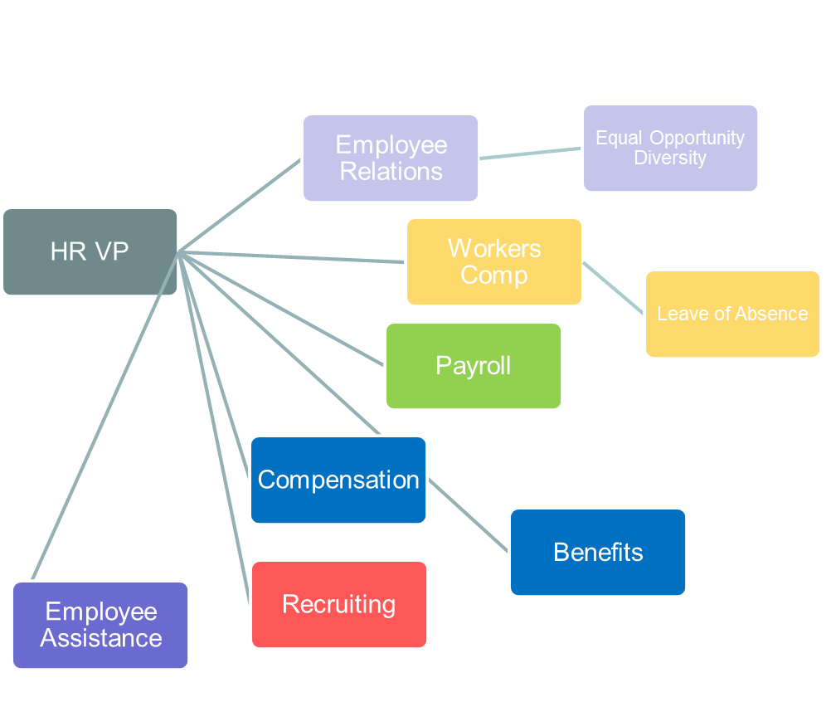
Employee compensation and benefit structure

Slide 5
Medium-enterprise employee’s compensation factors to consider
Attractive compensation and benefits.
Job retention.
Performance.
Duties and skill requirements.
Personal ability development opportunities.
Exempts and non-exempt regulations.
Fair labor compensation compliance.
Notes:
A medium-based organization need to provide an elaborate employee compensation and benefits package to attract and retain employees such as secretaries. The competitive compensation and benefits package that befit a secretary position in a medium-based organization that anticipate future growth include annual salaries, retirement savings, salary increments, bonuses, paid time-off from work plans, employee non-monetary assistance plans, and group health benefits.

Slide 6
Exempt factors
Are salaried compensation schemes.
Refers to annually-based compensation plan.
Considers educational background, professional duties, experience, and qualifications.
Does not protect against overtime pay.
Notes:
Exempted are salaried employees who are not entitled to overtime pay. The term ‘exempts’ generally refers to the annual salary that an employee receives or an approach of employee compensation that does not require overtime pay. Exempts regulations under the Fair Labor Standards Act requires an employee compensation plan to based on a salary scale and the aspects considered include educational levels, professional experience level, exempts duties, expertize credentials, qualifications, and job competency.

Slide 7
Non-exempt factors
Non-exempt employees are not paid on annual salaried payment scheme.
Non-exempt covers only hourly-based payment workers.
Earn less than $455 per week.
Does not cover for holidays and rest days.
Working on the non-exempted duties.
Notes:
Non-exempt employees are covered by the protections of the FLSA and employee who fall under this category are eligible to overtime pay due to the fact that they are paid on a hourly basis. In addition to hourly-based payment scheme, they are also fall under the non-exempt category because they earn less than $455 per week and perform non-exempted duties. Employees covered by the Act must be compensated for hours worked over 40 in a workweek at a rate not less than time and one-half their fixed rates of pay. There is no limitation of the number of hours employees aged 16 and older may work in any workweek.

Slide 8
Factors determining a secretary compensation plan
Attractive compensation and benefits.
Job retention.
Performance.
Exempts factors;
  Typically, professional and administrative position
  Not entitled to overtime
  Meet both salary test and duties test
Notes:
A medium-based enterprise should consider several factors that may be influential into developing an appropriate compensation and benefits package. They include attractive compensation and benefits, job retention and performance. In addition, other factors that should also be consider result due to the non-exempt and exempt regulations.

Slide 9
Total compensation plan for a secretary
Compensation inform of salary.
Rewards inform of bonuses, awards, promotions, equity offering, salary increment, new job assignment, and recognitions.
Benefits in terms of healthcare insurance, retirement benefits, paid leave periods, and paid training programs.
Notes:
The total compensation plan for a secretary should include the salary, rewards, and benefits that the organization deem as baseline as well as those which can enhance job retention, support to gain a competitive advantage, improve performance, and create confidence among all stakeholders.

Slide 10
Salary and reward scales
Annual salary which range between $35,000 and $41,000 for starters.
12 percent increment after every 2 years.
Monetary-based awards.
Performance-based promotions.
Notes:
The average annual salary of a secretary should range between $35,000 and $41,000, and should be backed-up with a 12 percent increment after every two years of service. Other reward should include performance-based promotions and recognitions.

Slide 11
Secretary’s benefit structure
Benefits offered | rank | priority
Healthcare insurance | 1 | high
Life insurance | 2 | medium
Retirement benefits | 3 | high
Paid leave | 4 | high
Pre-tax deductions | 5 | optional
Paid training | 6 | high
Paid sick leave | 7 | medium
Notes:
The compensation and benefits package should also establish a benefits prioritization scale in order to outline the most prioritized aspects of the benefits program.

Slide 12
Other important benefits
Supplement life insurance.
Auto-homeowners insurance.
Mortgage services and discounts.
Tuition disbursements.
On-site day-care services.
Notes:
In addition, it is appropriate to outline other non-mandatory benefits within the next few months to enhance employee performance and provide job motivation. They include supplement life insurance, auto-homeowners insurance, mortgage services and discounts, tuition disbursements, and on-site day-care services.

Slide 13
Impacts of government regulations
Baseline employment standards.
They influence employers costs on employee compensation.
Determines minimum wages and required baseline benefits.
Determines exempts and non-exempts factors.
Establishes supplemental pay.
Notes:
Government regulations on employment compensation provide baseline employment standards and also influence employers costs on employee compensation as well as determines minimum wages and the required baseline benefits.
In addition, government regulations such as the fair labor standards law determines exempts and non-exempts factors which are critical in classifying employees and determining their payment basis. They establishes basis for supplemental pay.

Slide 14
Governmental laws affecting compensation and benefits
Fair Labor Standards Act (FLSA)
Employee Income Retirement Security Act (ERISA)
Age Discrimination and Employment Act (ADEA)
Family Medical Leave Act (FMLA)
Economic Growth and Tax Relief Reconciliation Act (EGTRRA) of 2001
Health Insurance Portability and Accountability Act (HIPAA) (including amendments)
Pension Protection Act of 2006

Slide 15
Average compensation for a non-profit organization
Job description | Average annual salary
Administrative assistant | 32,632
Receptionist | 31,067
Office manager | 36,875
Secretary | 34,364
Mail manager | 30,799

Slide 16
Average compensation in State offices
Job description | Average annual salary
Secretary junior level | 30,164
Secretary intermediate level | 34,567
Secretary senior level | 40,623
Receptionist | 32,357

Slide 17
Comparison and recommendations
The Bureau of Labor Statistics survey indicate almost identical pay ranges.
The management should update compensation in order to align it with other sectors.
It will enhance the competitive advantage concept in the organization.
Notes:
According to the Bureau of Labor Statistics, most organizations base their payment level for each job category in accordance to the provisions of employment laws thus, most identical job categories are likely to have an almost similar compensation level.

Slide 18
Competitive compensation impact on HRM
Job retention.
Maintaining skills and professionalism.
Eliminating employer/employee conflict.
Sustaining HR organization and improved structures.
Management of high-risk coverages.
Notes:
Competitive compensation and benefits packages for a new secretary aspects such as progressive salary increments, bonuses, incentives, rewards for recognizable jobs, and payment plans for time-off from work duties can improve motivation levels as well as to provide job and skill retention mechanisms.

Slide 19
Conclusion
Well-structured compensation scheme key to improving performance and job retention.
It will enhance the competitive advantage concept in the organization.
Also eliminates employer/employee conflict.
Support to sustain HR organization and improved structures.
Notes:
In conclusion, a medium-based organization need to provide an elaborate employee compensation and benefits package to attract and retain employees such as secretaries.

Slide 20
References
Bloom, D. E., & Trahan, J. T. (2016). Flexible Benefits and Employee Choice: Highlights of the Literature. Saint Louis: Elsevier Science.
Dalton, J. F., Dalton, M. A., & Cangelosi, R. R. (2016). Retirement planning and employee benefits.
Wilson, J. W., Pensions Management Institute,, & JLT (Firm). (2014). Employee compensation and benefits.
Notes:
The End.

