Slide 1
Chapter 11
Segment Reporting, Transfer Pricing, and Balanced Scorecard

Slide 2
1
Define a strategic business segment, and prepare and use segment reports.

Slide 3
Strategic Business Segment
Has its own mission and set of goals to be achieved
Mission influences the decisions that top managers make in both short-run and long-run situations
Organizational structure often dictates the type of financial segment reporting used to evaluate the segment managers

Slide 4

Decentralization
The delegation of decision-making authority to successively lower management levels in an organization
The lower in the organization that authority is delegated, the greater the decentralization.

Slide 5
Segment Reports
Income statements for portions or segments of a business
Such as distinct divisions of
Product lines
Geographic territories
Organization units
Used primarily for internal purposes
Used also for disclosure of segment information for GAAP purposes

Slide 6
Steps to Prepare Segment Reports
Three steps basic to the preparation of all segment reports:
Identification of the segments
Assign direct costs to the segments
Allocate indirect costs to the segments, where appropriate
Format varies depending on the approach adopted by a company for reporting income statements internally.

Slide 7
Multilevel Segment Reports
Multiple combinations of divisions, products, and territories can be used to structure multilevel reporting
Goal is not to slice and dice the revenue and cost data, but to provide meaningful information to management

Slide 8
Costs in Multilevel Segment Reports
Each level of segment reporting categorizes costs into four categories.
Four Categories of Costs on Segment Reports
Common Segment Reporting Levels
Variable costs
Direct fixed costs
Allocated common costs
Unallocated common costs
Divisions
Products
Geographical Territories

Slide 9
Cost Descriptions
Variable Costs
Vary in proportion to the level of sales
Direct Fixed Costs
Nonvariable costs directly traceable to the segments incurred for the specific benefit of the respective segment
Allocated Common Costs
Incurred for the common benefit of all related segments; A reasonable basis for allocating to segments exists
Unallocated Common Costs
Incurred for the common benefit of all related segments; No reasonable basis for allocating to segments exists

Slide 10
Multilevel Segment Income Totals
Sales
LESS variable costs
Contribution margin
LESS direct fixed costs
Segment margin
LESS allocated segment costs
Segment income
LESS unallocated common costs
NET INCOME
Referred to as division margins, product margins, and territory margins
All revenues of the segment minus all costs directly or indirectly related to it

Slide 11
Multilevel Segment Example
Burger King has two territories in its Florida division. It provided the following data relating to its salad product line in the Florida division:
 | North Territory | South Territory
Sales | $16,000 | $18,000
Direct fixed costs | 2,000 | 1,600
Allocated segment costs | 1,200 | 1,400
Variable costs | 5,600 | 6,100
Unallocated common costs are $1,500.
Prepare a geographical territory segment report of the salad product line.
Continued

Slide 12
Multilevel Segment Example cont.
 |  | Territories |  | Salad
 |  | North Territory | South Territory | Total
Sales |  | $16,000. | $18,000. | $34,000.
Less variable costs |  | (5,600) | (6,100) | (11,700)
Contribution margin |  | 10,400. | 11,900. | 22,300.
Less direct fixed costs |  | (2,000) | (1,600) | (3,600)
Territory margin |  | 8,400. | 10,300. | 18,700.
Less allocated segment costs |  | (1,200) | (1,400) | (2,600)
Territory income |  | $ 7,200. | $ 8,900. | 16,100.
Less unallocated common costs |  |  |  | (1,500)
Net income |  |  |  | $14,600.
Segment margin is relevant for measuring short-term effects of decisions to continue or discontinue a segment.
Segment income is relevant for measuring long-term effects of decisions to continue or discontinue a segment.

Slide 13
2
Explain transfer pricing and assess alternative transfer-pricing methods.

Slide 14
Transfer Pricing
The internal value assigned a product or service that one division provides to another
Normally occurs between profit or investment centers
Objective is to transmit financial data between departments or divisions of a company
Used in decentralized operations to determine whether organizational objectives are being achieved in each division

Slide 15
Transfer Pricing Management Conflicts
Problem
Solution
Managers may take actions not in the best interest of the company due to the desire of selling and buying divisions to maximize performance
Companies should maintain a corporate profit-maximizing viewpoint coupled with divisional autonomy

Slide 16
Transfer Pricing Conflict Example
FirePete Sauce has three divisions. The West Division manufactures two products, Extreme and Volcano. Extreme is sold externally for $32 per gallon, and Volcano is transferred to the East division for $26 per gallon. Costs include:
 |  | Extreme | Volcano
Variable costs:
 | Direct materials | $ 8.00 | $ 6.50
 | Direct labor | 2.50 | 3.50
 | Variable manufacturing overhead | 2.00 | 1.50
 | Variable selling expense | 1.50 | 0
Fixed costs:
 | Fixed manufacturing overhead | 4.50 | 4.00
Total |  | $18.50 | $15.50
Continued

Slide 17
Transfer Pricing Conflict Example cont.
A proposal has been received from an external company to supply the East Division with a substitute product similar to Volcano at a price of $22. The West Division has excess capacity.
Buy |  |  | $22.00.
Make
 | Direct materials | $6.50
 | Direct labor | 3.50
 | Variable manufacturing overhead | 1.50 | (11.50)
Difference |  |  | $10.50.
Best Decision from Corporate Perspective
Transfer the product because the relevant cost is $11.50 per gallon compared to the cost to buy from an external source for $22.00.
Continued

Slide 18
Transfer Pricing Conflict Example cont.
FirePete is now operating at capacity and can sell all the Extreme it can produce. There is no external market for Volcano. The outside supplier offers to sell Volcano to FirePete for $22 per gallon.
Selling price of Extreme |  |  | $32.00.
Outlay costs of Extreme
 | Direct materials | $8.00
 | Direct labor | 2.50
 | Variable manufacturing overhead | 2.00
 | Variable selling expense | 1.50 | (14.00)
Opportunity cost of transferring Volcano to East Division |  |  | $18.00.
Make
 | Outlay cost of Volcano
 | ($6.50 + $3.50 + $1.50) | $11.50
 | Opportunity cost of Volcano | 18.00 | $29.50
Buy |  |  | $22.00
FirePete should purchase for $22 because it costs $29.50 to make.
Continued

Slide 19
Transfer Pricing Methods
Market Price
Variable Costs
Variable Costs plus Opportunity Costs
Absorption Cost plus Markup
Negotiated Prices
Dual Prices

Slide 20
Market Price as the Transfer Price
Ideal when there is an existing market with established prices for an intermediate product
Preserves divisional autonomy and leads divisions to act in a manner that maximizes corporate goal congruence
Assuming divisions are free to buy and sell outside the firm
Often specified as market price less selling costs if selling costs are avoided for internal transfers

Slide 21
Market Price as the Transfer Price Example
FirePete’s Extreme sauce can be sold competitively at $32 per gallon or transferred to the Queso Division for additional processing. FirePete will normally not sell Extreme for less than $32 externally.
Because variable selling expenses of $1.50 per gallon can be eliminated in interdepartmental transfers, the transfer price could be reduced from $32 to $30.50.
Market price transfer pricing policy may lead to a bad decision from a corporate perspective if there is excess capacity.

Slide 22

Variable Cost as the Transfer Price
Equal
Variable Cost of Selling Division
Variable Cost of Buying Division
If excess capacity exists in the supplying division, this leads to optimal actions by the purchasing division
If no excess capacity exists in the supplying division, the supplying division will have to forego other sales

Slide 23
Variable Cost Plus Opportunity Costs as the Transfer Price
Viewed by organizations as the optimal transfer price because all relevant costs are included
Two problems with this method
When the supplying division has excess capacity, causes the supplying division to report zero profits or a loss equal to fixed costs
Determining opportunity costs is difficult if the supplying division produces several products

Slide 24
Variable Costs as the Transfer Price Example
If Volcano sauce can be sold externally at $26 per gallon, West Division will not willingly sell to the East Division for a $11.50 transfer price based on the following variable costs:
Direct materials | $6.50
Direct labor | 3.50
Variable manufacturing overhead | 1.50
Total variable costs | $11.50
An external sale will generate a contribution margin of $14.50 ($26 – $11.50) to go toward covering divisional fixed costs and contribute to divisional profit.

Slide 25
Absorption Cost Plus Markup as the Transfer Price
All variable and fixed manufacturing costs are included
Eliminates the supplying division’s reported loss on each product that can occur using a variable cost transfer method
Provides the supplying division a contribution toward unallocated costs
“Cost” amount used is standard cost
Prevents the supplying division from passing on the cost of inefficient operations to other divisions
Allows the buying division to know its cost in advance of purchase

Slide 26
Negotiated Price as the Transfer Price
Used when the supplying and buying divisions independently agree on a price
Believed to preserve divisional autonomy
May lead to sub-optimal decisions
Most common use occurs when no identical-product external market exists

Slide 27
Dual Prices as the Transfer Price
Exists when a company allows a difference in the supplier’s and receiver’s transfer prices for the same product
Allegedly minimizes
Internal squabbles of division managers
Problems of conflicting divisional and corporate goals
Supplier’s transfer price normally approximates market price
Receiver’s transfer price is usually the internal cost of the product or service

Slide 28
Transfer Pricing Problems
Suboptimization
No Established Market
Exists when divisions, acting in their own best interest, set transfer prices or make decisions based on transfer prices that are not in the best interest of the organization as a whole.
If no outside market exists, profit centers may be permitted to acquire goods or services internally or provide them for themselves.

Slide 29
3
Determine and contrast return on investment and residual income.

Slide 30
Return on Investment (ROI)
A measure of the earnings per dollar of an investment
Assumes financing decisions are made at the corporate level
Investment center income
Investment center asset base
ROI =
Evaluated by comparing to previously identified performance criteria, such as
Previous ROI
Overall company ROI
ROI of a similar division

Slide 31
Disaggregated ROI
Useful in determining the source of variance in overall performance.
ROI = Investment turnover x Return-on-sales
Sales
Investment center asset base
Investment center income
Sales
=
x

Slide 32
ROI Disaggregation Example
Operations for AST Distributors’ three divisions for the current year are:
Division | Assets | Sales | Divisional Income
Florida | $3,500,000 | $7,500,000 | $1,050,000
Detroit | 6,400,000 | 9,100,000 | 650,000
Dallas | 5,500,000 | 9,500,000 | 1,200,000
The Florida Division performed the best, while the Detroit Division shows the weakest performance.
Operating unit |  |  | Investment Turnover |  | Return-on-Sales |  | = ROI
 | Florida |  | $7,500,000 ÷ $3,500,000 = | 2.14 | $1,050,000 ÷ $7,500,000 = | 0.14 | 0.30
 | Detroit |  | $9,100,000 ÷ $6,400,000 = | 1.42 | $650,000 ÷ $9,100,000 = | 0.07 | 0.10
 | Dallas |  | $9,500,000 ÷ $5,500,000 = | 1.73 | $1,200,000 ÷ $7,500,000 = | 0.13 | 0.22
Criteria
 |  | Projected minimums |  | 1.50 |  | 0.12 | 0.15

Slide 33
Investment Center Income
Division revenues
Revenues generated at the divisional level
Division expenses
Direct division expenses
Always included in division operating expenses
Corporate or unallocated expenses
Cannot be reasonably allocated to various segments
Normally includes
Corporate staff costs
Goodwill write-offs
Nonoperational gains and losses

Slide 34
Investment Center Asset Base
Included in the investment base
Each division’s operating assets
Includes assets held for productive use, such as
Accounts receivable
Inventory
Plant and equipment
Omissions
Non-productive assets
General corporate assets allocated to divisions
Divisions have no control over these

Slide 35
Other Valuation Issues
ROI can be overstated in terms of constant dollars due to
Inflation
Arbitrary inventory and depreciation procedures
LIFO inventory costing and fixed assets acquired many years in the past cause significant asset measurement concerns.
Improve ROI comparability between divisions
By valuing assets at original cost rather than book value
By valuing old assets at replacement cost

Slide 36
Residual Income
Minimum rate
of return
Investment center asset base
Division income –
×
Alternative investment center performance measure
Disadvantage
Cannot be used to compare the performance of divisions of different sizes because it measures in dollars

Slide 37
Residual Income Example
Operations for AST Distributors’ three divisions for the current year are:
Division | Assets | Sales | Divisional Income
Florida | $3,500,000 | $7,500,000 | $1,050,000
Detroit | 6,400,000 | 9,100,000 | 650,000
Dallas | 5,500,000 | 9,500,000 | 1,200,000
AST Distributors has a 15% required rate of return.
Florida | $1,050,000 – [0.15 × $3,500,000] = | $525,000.
Detroit | $650,000 – [0.15 × $6,400,000] = | ($310,000)
Dallas | $1,200,000 – [0.15 × $5,500,000] = | $375,000.
The Detroit division generated $310,000 less than the minimum return expected, while the other two divisions generated more than expected.

Slide 38
Economic Value Added (EVA®)
A variation of residual income
Used to evaluate investment center performance
Significant differences from residual income
Weighted average cost of capital used instead of required rate of return
Net assets are used as the evaluation base
After-tax income is used as investment center income
Corrects for potential distortions in economic net income caused by GAAP
An average of the after-tax cost of all long-term borrowing and the cost of equity financing
Total assets less current liabilities

Slide 39
Economic Value Added
AST Distributors has an 8% cost of capital and a 30% income tax rate. Amounts for the Florida Division for the current year are:
Assets | $3,500,000
Division income | $1,050,000
Current liabilities | $ 250,000
Division income after taxes
Cost of capital
Current Liabilities
EVA =
–
x Assets –
= [$1,050,000 × 0.70] – [0.08 × ($3,500,000 – $250,000)] = $475,000
The Florida Division added $475,000 value to AST Distributors.

Slide 40
Why EVA?
Maximizes market value added (MVA) to a firm through managerial decisions
Argued by some to be the definitive measure of wealth creation
Provides a good operational metric for assessing managers’ performance in terms of maximizing MVA over time
Can be used to guide managerial actions
Can be used to evaluate
Capital expenditure proposals
Add or drop a product line
Acquiring another company

Slide 41
Evaluating Managers Using ROI
The manager of the Plastic Division, who is evaluated using ROI with a 15% required rate of return, is given the following investment opportunity:
Cost, $80,000
Increase in current liabilities, $10,000
Anticipated return, 16% × $80,000 = $12,800
Effect of Investment on ROI:
 | Current | + | Proposed | = | Total
Plastic Division
Investment center income | $180,000 | + | $12,800 | = | $192,800
Asset base | $900,000 |  | $80,000 |  | $980,000
ROI | 20.0% |  | 16.0% |  | 19.7%
The investment should be undertaken as it exceeds the 15% minimum return.
The manager may not want the investment as it will lower the division’s ROI to 19.7%.

Slide 42
Evaluating Managers Using Residual Income
The manager of the Plastic Division, who is evaluated using residual income with a 15% required rate of return, is given the following investment opportunity:
Cost, $80,000
Increase in current liabilities, $10,000
Anticipated return, 16% × $80,000 = $12,800
Effect of Investment on residual income:
 | Current | + | Proposed | = | Total
Silicon Division
Asset base | $900,000 |  | $80,000 |  | $980,000
.
Investment center income | $180,000 | + | $12,800 | = | $192,800
Minimum return (0.15 × base) | (135,000) |  | (12,000) |  | (147,000)
Residual income | $ 45,000 |  | $ 800 |  | $ 45,800
Residual income increases the likelihood that managers will accept investments that exceed the minimum return compared to using ROI to evaluate performance.
The manager will likely accept the investment. It increases residual income by $800.

Slide 43
Evaluating Managers Using EVA
The manager of the Plastic Division, who is evaluated using EVA has an 8% cost of capital and is given the following investment opportunity:
Cost, $80,000
Increase in current liabilities, $10,000
Anticipated return, 16% × $80,000 = $12,800
Effect of Investment on EVA:
 | Current | + | Proposed | = | Total
Resin Division
Assets | $900,000. |  | $80,000. |  | $980,000.
Current liabilities | (10,000) |  | (10,000) |  | (10,000)
Evaluation base | $890,000. |  | $70,000. |  | $970,000.
Investment center income | $180,000. |  | $12,800. |  | $192,800.
Income taxes (30%) | (54,000) |  | (3,840) |  | (57,840)
Income after taxes | $126,000. |  | $8,960. |  | $134,960.
Cost of capital (0.08 × base) | (71,200) |  | (5,600) |  | (77,600)
Economic value added | $ 54,800. |  | $ 3,360. |  | $ 57,360.
The manager will likely accept the investment. It increases the firm’s value by $3,360.

Slide 44
4
Describe the basic balanced scorecard as a comprehensive performance measurement system.

Slide 45
Financial and Nonfinancial Measures
No single financial measure captures all performance aspects
Financial measures have reporting time lags that could hinder timely decision making
Financial measures may not accurately capture information needed for current decision making

Slide 46
What is the Balanced Scorecard?
A comprehensive performance measurement system
Includes financial and operational measures related to organizational goals and strategies
Comprises several measurement categories
Financial
Customer
Internal processes
Innovation and learning

Slide 47
Examples of Key Indicators
Key financial indicators
Cash flow
Return on investment (ROI)
Sales
Key customer indicators
Average customers per hour
Number of customer complaints per period
Number of sales returns per period
Key operating indicators
Products produced/sold per day ratio
Daily units lost
Employee turnover per period
Key growth and innovation indicators
New products introduced during period
Products discontinued during period
Number of sales promotions
Special offers, discounts, etc.
Companies using the balanced scorecard monitor previous period and standards for each indicator.

Slide 48
Balanced Scorecard as Strategy
Can be the primary vehicle for translating strategy into action and establishing accountability for performance
Identifies the areas of managerial action that are believed to be the drivers of corporate achievement

Slide 49
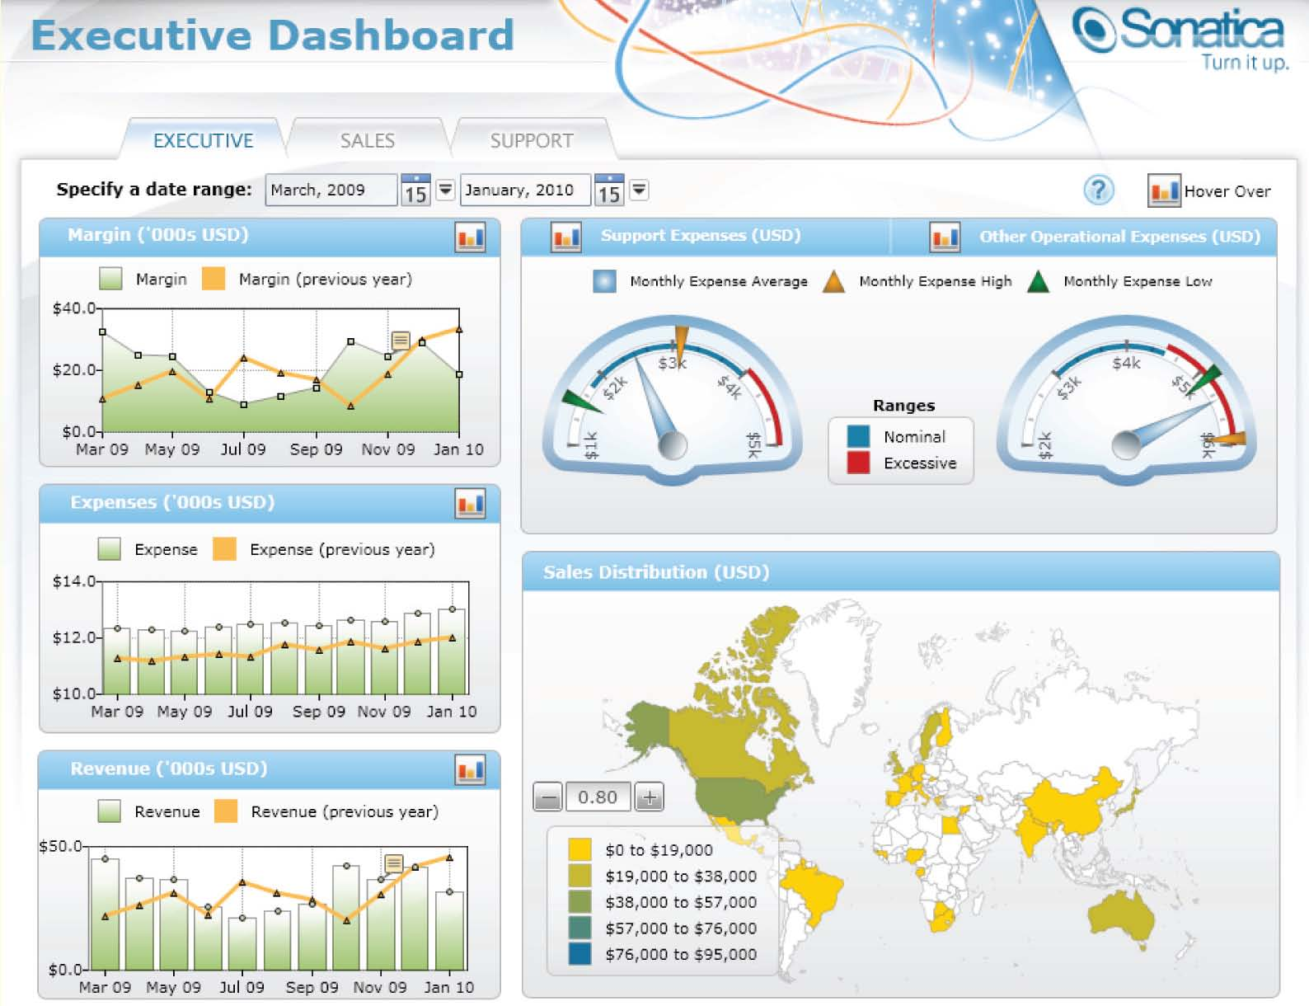
Dashboards
A Dashboard, such as this one below for utility companies, is sometimes used to tabulate and display scorecard results.
Source: http://media1.dundas.com/DashboardDemo/Viewer.aspx?view=Sonatica Performance Dashboards

