Slide 1
Reconstruction
1865-1877

Slide 2
Key Issues of Reconstruction in 1865
Physical reconstruction of the South
Constitutional status of the Southern States...did they actually leave the union?
Status of leading Confederates
Status of the Freedmen

Slide 3
Differing Ideas of Black Freedom in the South
Perspective of the White South
Perspective of Black South
Blacks are now free because they are no longer slaves, but still need to be controlled
Former Slaves Free, but not independent
Mississippi planter Samuel Agnew, “A man may be free and not yet be independent”
Kentucky newspaper, African Americans “free, but only free to labor.”
Freedom more than simply not being owned by Whites
Means ability to do what White Southerners can do: travel, own dogs and guns, meet in groups
Restored and Victorian family life
Independent Churches
Education
Vote
Land
Henry Adams, freed slave from Louisiana, “If I cannot do like a white man, I am not free.”

Slide 4
Emancipation and the Freedman’s Family
Emancipation both legitimized and transformed the families of former slaves.
New laws, and the Civil War pension system brought legal validation to slave families.
The freedom to travel allowed families to reunite after having been split-up by slavery.
African American families in the South began to try to emulate the Victorian era white families: Man head out household, men and women occupying “separate spheres.”
Men saw it as a badge of honor for their wives not needing to work, though poverty would undo this.

Slide 5
Growing Institutions in African American Communities
Churches
Schools
Emancipation brought an end to biracial churches in the South: African American attendance fell from 42,000 before the Civil War to 600 in 1876.
African American churches, in addition to places of worship, served as community centers, social centers, and political gathering sites.
African American pastors became political actors; 250 would hold office during Reconstruction.
According to a Mississippi Freedman: education was “the next best thing to liberty.”
In addition to its being denied under slavery and the desire to read the Bible, Freedmen saw education as the road to economic and political opportunity
Schools grew by the hundreds across the South after emancipation founded by Northern Missionary Societies, The Freedman’s Bureau, and by themselves.
The first “Historically Black Colleges” were also founded.

Slide 6
Freedmen and Land
More than anything Freedmen wanted land.
Land was the road to economic independence.
It also provided an opportunity to establish communities free of white control.
Many Freedmen felt they had the right the land they had worked as slaves due to their enslavement.

Slide 7
Free Labor Ideology-The Northern Ideal of Freedom
Industrialization
Wage Worker is noble
Public schools
Small towns
Independent farmers

Slide 8
The Freedman’s Bureau
Created by Congress in 1865 over the veto of President Andrew Johnson
Led by Civil War Major General O. O. Howard
1,100 agents at peak
First “Social Welfare” program in American history
Had 4 primary functions
First, ensure equal treatments for blacks and whites in Southern Courts
Second, Take over war hospitals from army and open to black and white civilians in the South
Third, fund education initiatives in South
Fourth, Land Reform- attempted to turn confiscated land over to former slaves
Disbanded in 1872

Slide 9
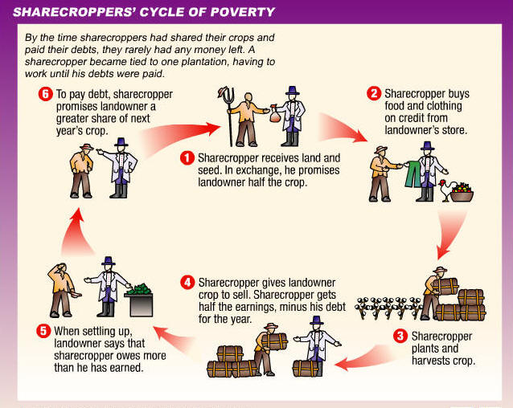
The Results of the Failure of Land Reform: The Cycle of Sharecropping

Slide 10
Two Perspectives on Reconstruction
Moderate/Lincolnite
Radical Republicans
Restoration, not Reconstruction
Secession illegal, South never left the union, Southern states must be restored to proper relationship to the rest of the Union
Primary goal restoring the Union as quickly as possible, but preserving reforms
Wholesale reform of all Southern society not a primary objective
Southern states left the Union and must be readmitted
White Southerners must be punished for war/treason
Full Black Equality and complete reform of Southern Society on Northern lines primary goal

Slide 11
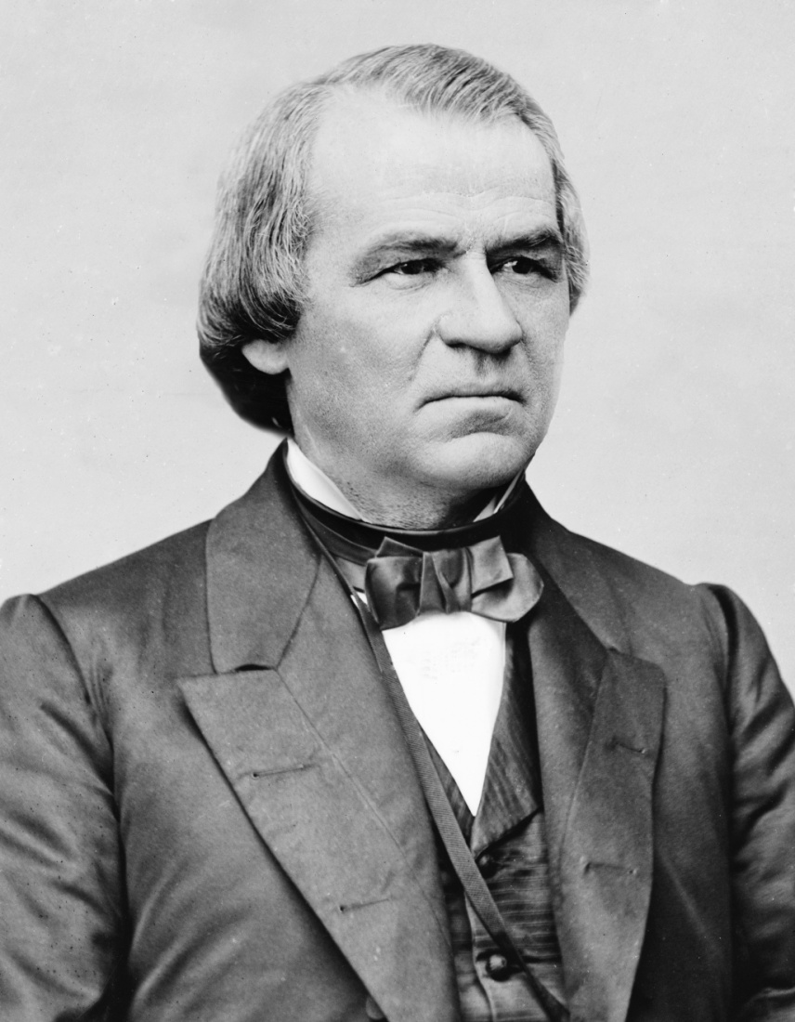
Andrew Johnson
17th President of the United States
Born December 29, 1808 in Raleigh, North Carolina
Raised poor and illiterate
Tailor
Moved to Greenville, Tennessee in 1820s, married, learned to read
Served in the House of Representatives and as Governor of Tennessee before becoming Senator in 1857
Democrat, but opponent of Planter class
Only Southern Senator to remain with the Union when his state seceded, made military Governor of Tennessee as a reward
Named as Lincoln’s VP on Union Ticket of Republicans and War Democrats in 1864
Endorsed emancipation as war aim, but virulently racist
Stubborn and Quick-tempered

Slide 12
Presidential Reconstruction
Quick Process
Offered Pardon (restoring all rights and property, except slaves) to all Southerners who took an oath of allegiance worth less than $200,000
Granted individual pardons to most of the rest over the coming months
Appointed provisional governors tasked with forming all-white state conventions to draft new Constitutions, required to abolish slavery, repudiate secession ,and refuse to pay rebel debt.
All completed before Congress sits in December, 1865

Slide 13
Presidential Reconstruction and Race: Black Codes
Rights Protected
Restrictions on Black Life
Marriage
Ownership of Property
Limited Access to the Courts
Could not testify against Whites
Could not serve on juries
Could not serve in state militias
No votes.
Blacks must sign yearly labor contracts with planters or face arrest and be hired out to whites
Some states limited the occupations Blacks could engage in
Some states barred them from owning land
Some states granted judges the power to order black children to work for former owners without parental consent.

Slide 14
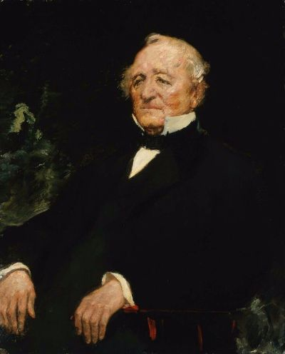
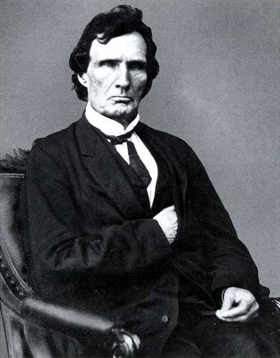
Leading Congressional Radical Republicans
Senator Charles Sumner of Massachusetts
Representative Thaddeus Stevens of Pennsylvania

Slide 15
Radical Republicans and the South
Embrace of National Power to remake the South in the vision of the North and end racial inequality
Senator Charles Sumner: The same national authority that destroyed slavery must see that this other pretension is not permitted to survive.”
Representative Thaddeus Stevens: “The whole fabric of southern society must be changed. Without this, this Government can never be, as it has never been, a true republic.”
Radical Republicans were powerful, but most Republicans were moderates, not Radicals

Slide 16
The Moderate Moment:
Civil Rights Act of 1866
All persons born in the United States as citizens
Equal protection of persons and property
Right to Make Contracts Protected
Right to Bring Lawsuits
Full Access to Courts
Voting Rights not included
Parallel legislation attempted to extend the Freedman’s Bureau
Johnson vetoed both bills arguing it interfered with state sovereignty and that African-Americas did not deserve citizenship
Civil Rights bill veto overridden and the Freedman’s Bureau extended later in the year

Slide 17
The Fourteenth Amendment
Section 1. All persons born or naturalized in the United States, and subject to the jurisdiction thereof, are citizens of the United States and of the State wherein they reside. No State shall make or enforce any law which shall abridge the privileges or immunities of citizens of the United States; nor shall any State deprive any person of life, liberty, or property, without due process of law; nor deny to any person within its jurisdiction the equal protection of the laws.
Section 2. Representatives shall be apportioned among the several States according to their respective numbers, counting the whole number of persons in each State, excluding Indians not taxed. But when the right to vote at any election for the choice of electors for President and Vice President of the United States, Representatives in Congress, the Executive and Judicial officers of a State, or the members of the Legislature thereof, is denied to any of the male inhabitants of such State, being twenty-one years of age, and citizens of the United States, or in any way abridged, except for participation in rebellion, or other crime, the basis of representation therein shall be reduced in the proportion which the number of such male citizens shall bear to the whole number of male citizens twenty-one years of age in such State.
Section 3. No person shall be a Senator or Representative in Congress, or elector of President and Vice President, or hold any office, civil or military, under the United States, or under any State, who, having previously taken an oath, as a member of Congress, or as an officer of the United States, or as a member of any State legislature, or as an executive or judicial officer of any State, to support the Constitution of the United States, shall have engaged in insurrection or rebellion against the same, or given aid or comfort to the enemies thereof. But Congress may, by a vote of two-thirds of each House, remove such disability.
Section 4. The validity of the public debt of the United States, authorized by law, including debts incurred for payment of pensions and bounties for services in suppressing insurrection or rebellion, shall not be questioned. But neither the United States nor any State shall assume or pay any debt or obligation incurred in aid of insurrection or rebellion against the United States, or any claim for the loss or emancipation of any slave; but all such debts, obligations and claims shall be held illegal and void.
Section 5. The Congress shall have power to enforce, by appropriate legislation, the provisions of this article.

Slide 18
The Reconstruction Acts of 1867-1868
State Governments formed under “Presidential Reconstruction” are abolished
South divided into 5 military districts
New state constitutions and governments formed with full Black participation
Southern States could not be readmitted until they ratify the 14th Amendment

Slide 19
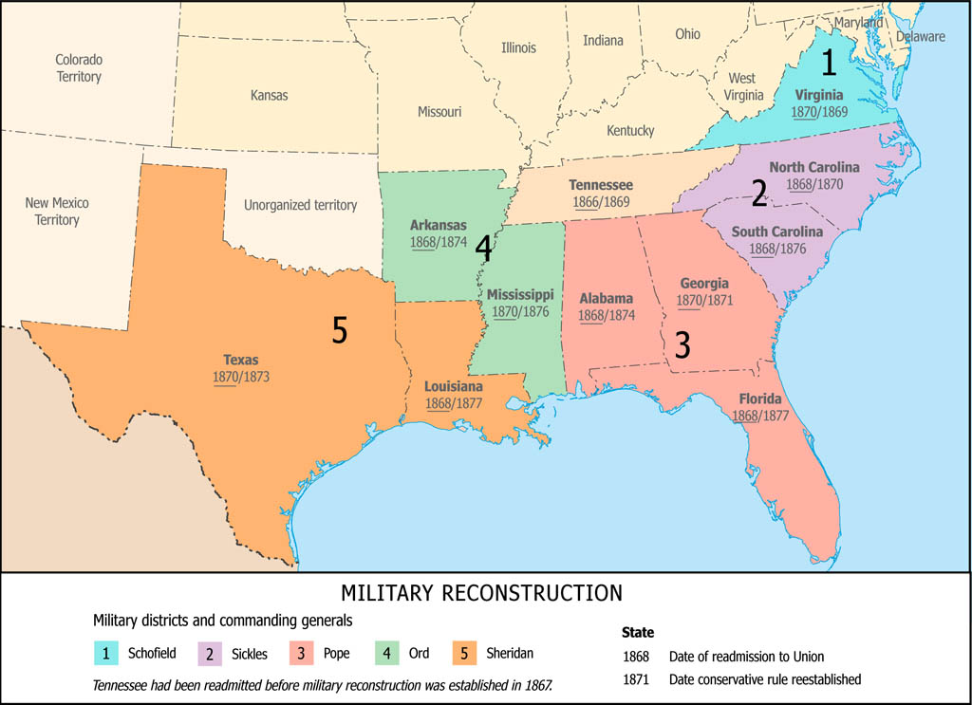
Radical Reconstruction: Military Occupation

Slide 20
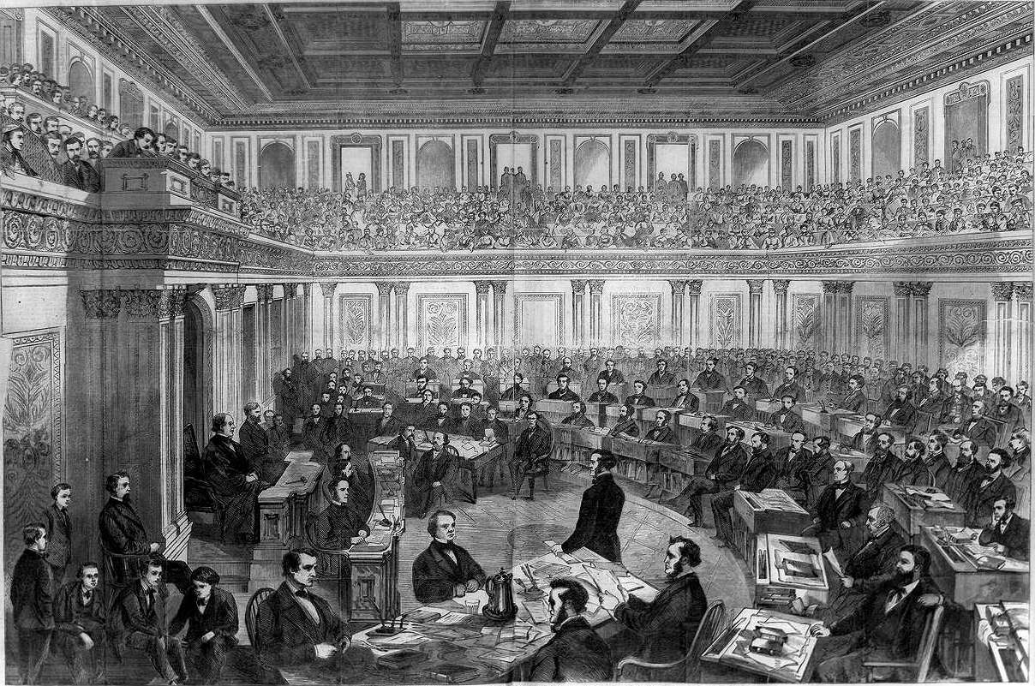
Impeachment of President Johnson
Controversy around Secretary of War Edwin Stanton
Tenure of Office Act
Congress and Stanton trying to keep President Johnson out of Reconstruction Policy
Johnson, trying to stay within Tenure of Office Act fired Stanton when Congress out of Session in August 1867
Congress refused to concur and Johnson refused to acknowledge concurrence
Led to Impeachment in February 1868 and trial in March
11 Articles of Impeachment
Vote 35-19, one short to convict, 7 Republicans voted to acquit.

Slide 21
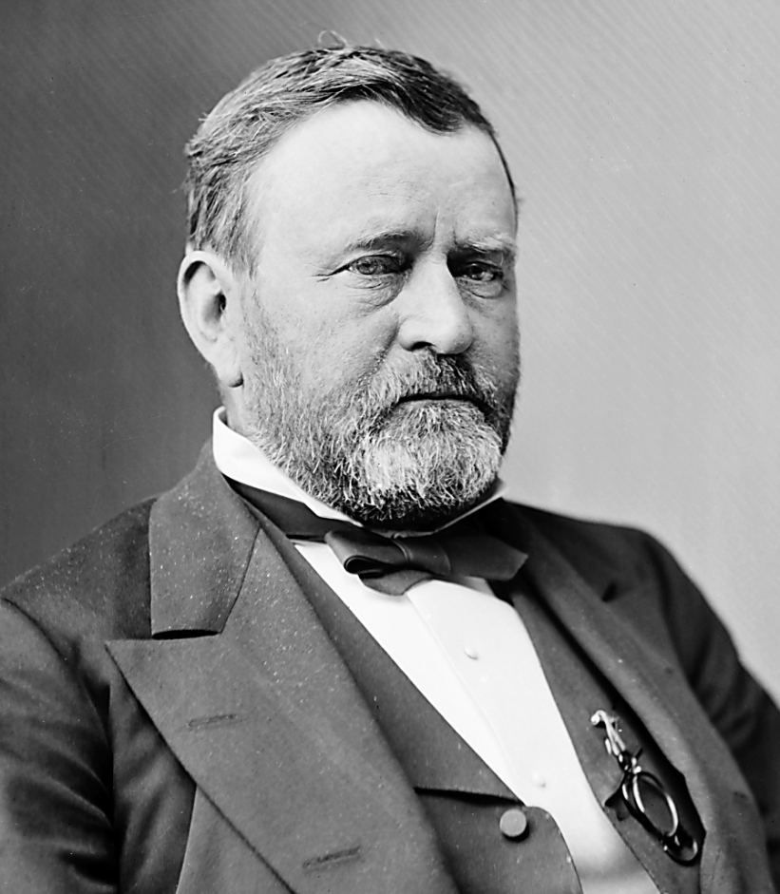
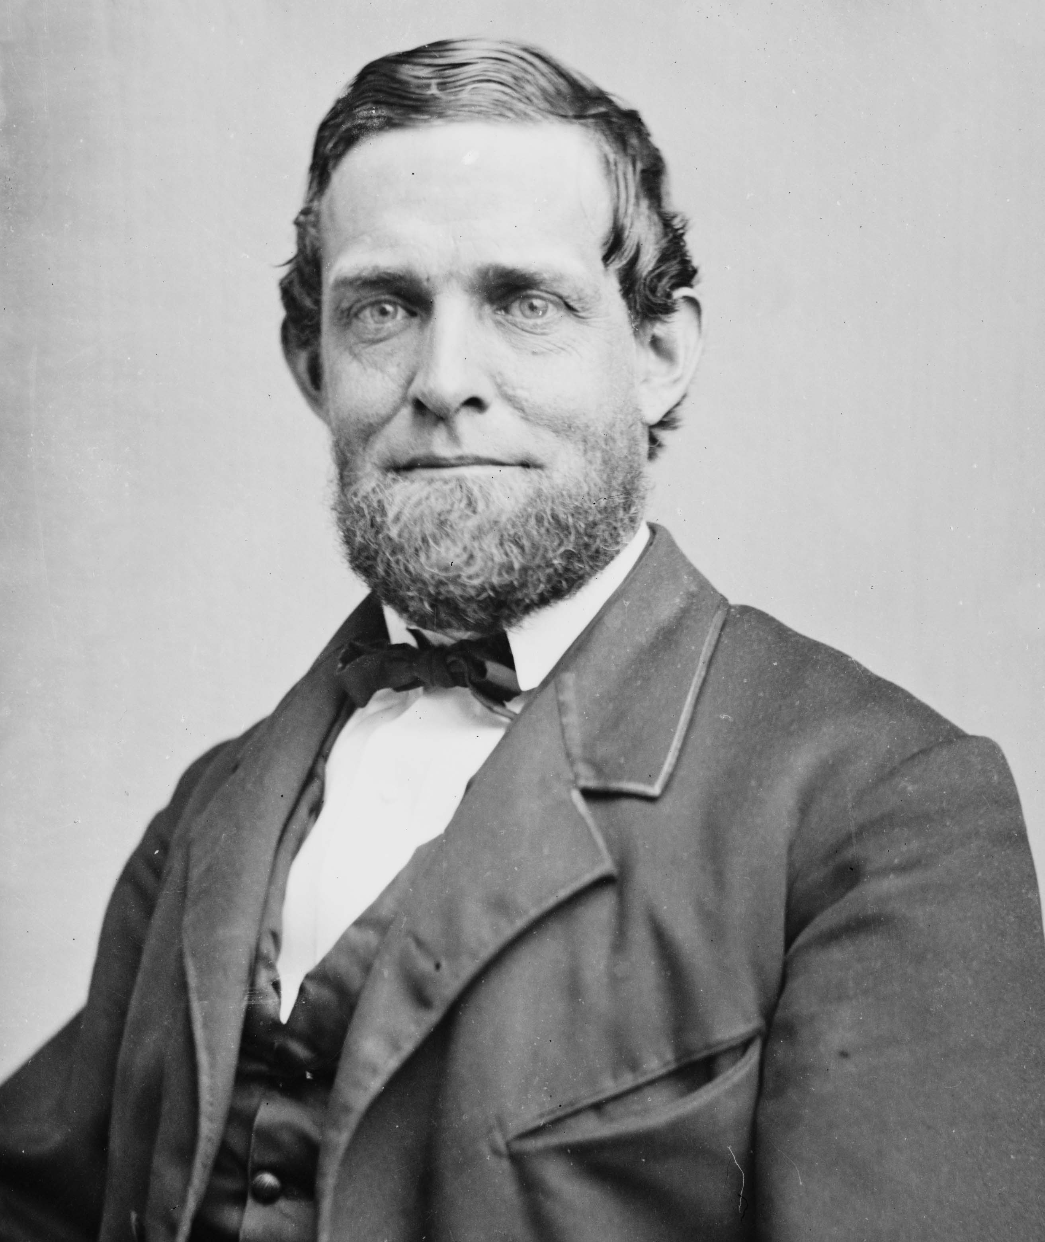
The Republican Ticket-1868
Former General Ulysses S. Grant of Illinois
Speaker of the House Schuyler Colfax of Indiana

Slide 22
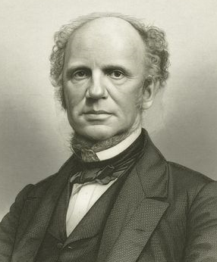
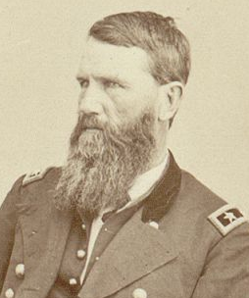
The Democratic Ticket-1868
Former Governor Horatio Seymour of New York
Former General Francis P. Blair of Missouri

Slide 23
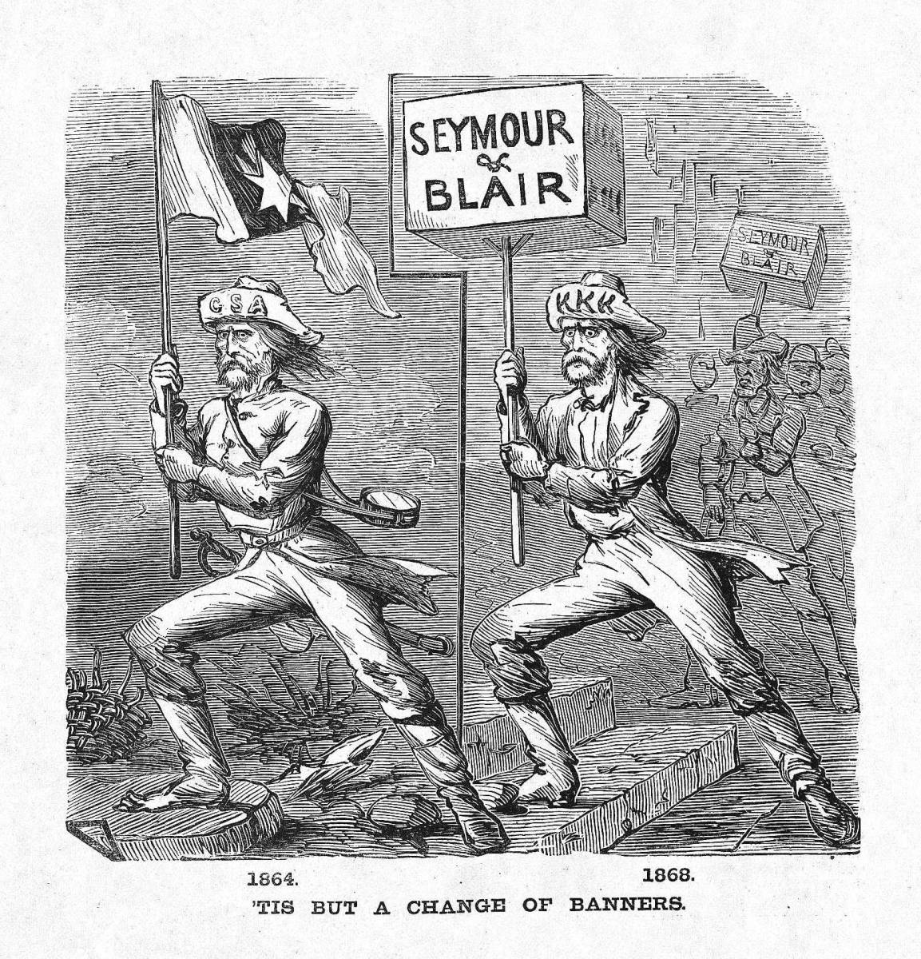
“Waving the Bloody Shirt”

Slide 24
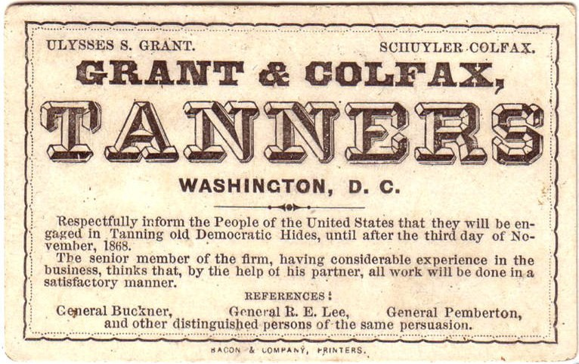
“Waving the Bloody Shirt”

Slide 25
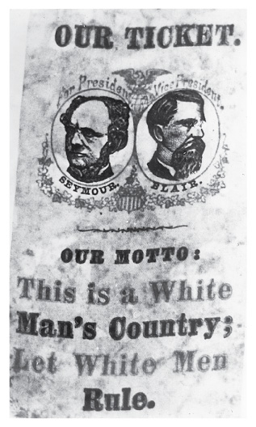
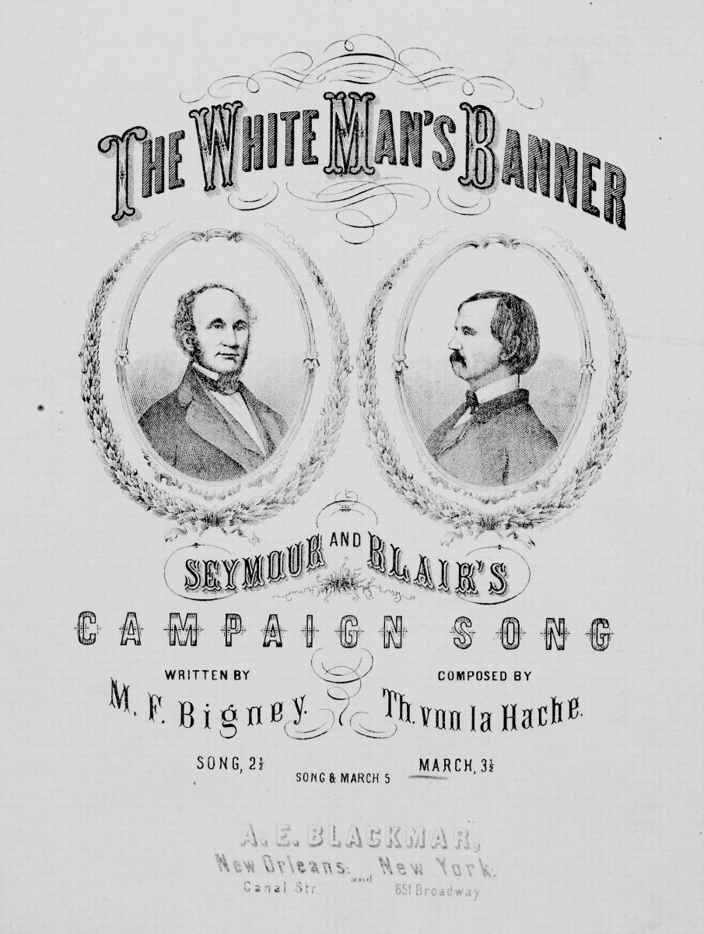
Race and the 1868 Presidential Election

Slide 26
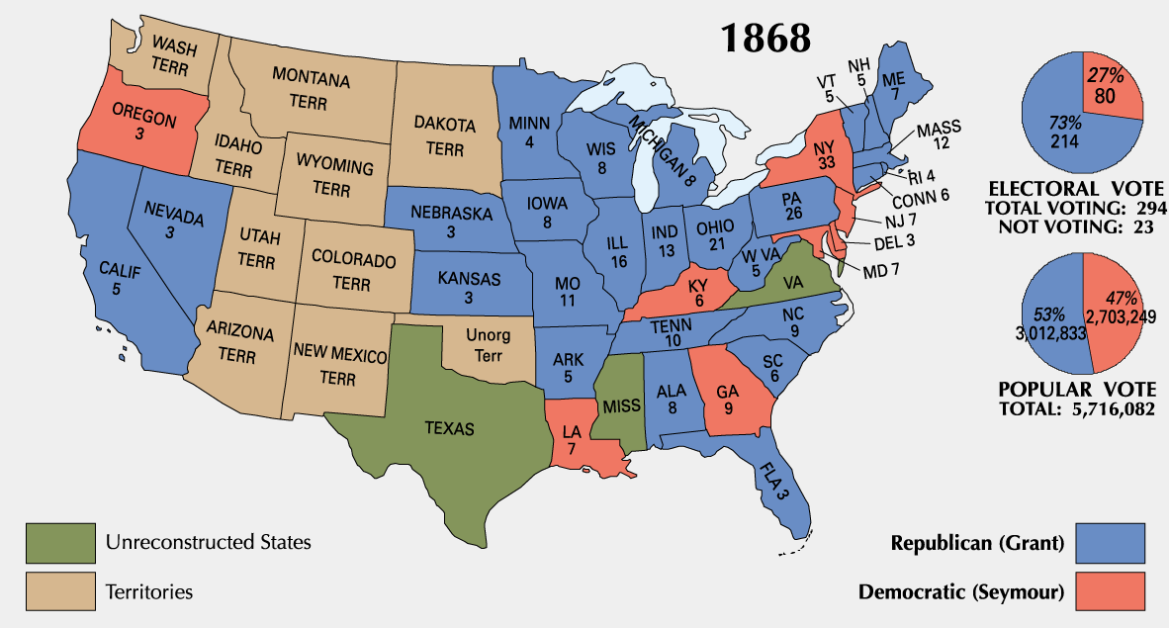
1868 Presidential Election

Slide 27
1868 Congressional Election
United States House of Representatives
United States Senate

Slide 28
The Fifteenth Amendment
Section 1. The right of citizens of the United States to vote shall not be denied or abridged by the United States or by any State on account of race, color, or previous condition of servitude.
Section 2. The Congress shall have power to enforce this article by appropriate legislation

Slide 29
Reforms in Southern Reconstruction Constitutions
Free public education funded by state
New penitentiaries
Orphan asylums
Homes for insane
Political and civil rights
Ended whipping
Ended property qualification for holding office
Ended imprisonment for debt.

Slide 30
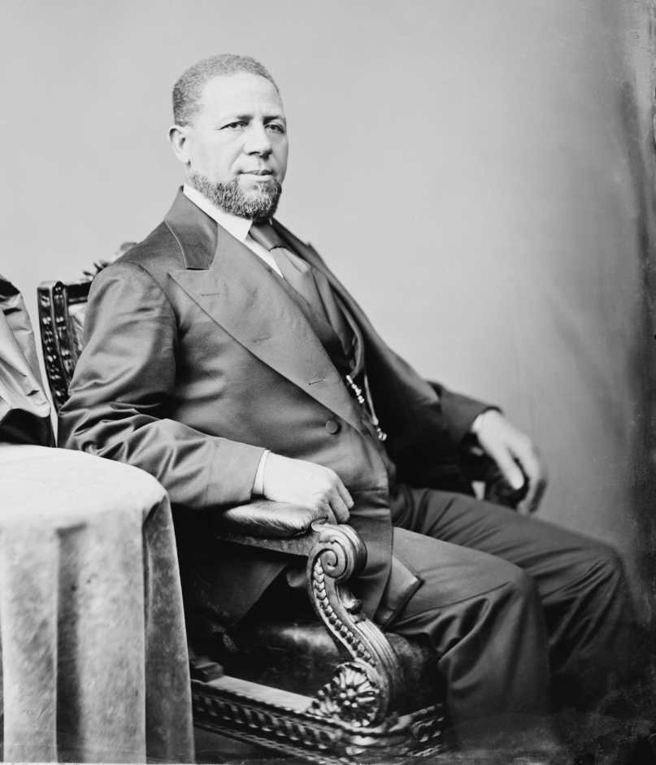
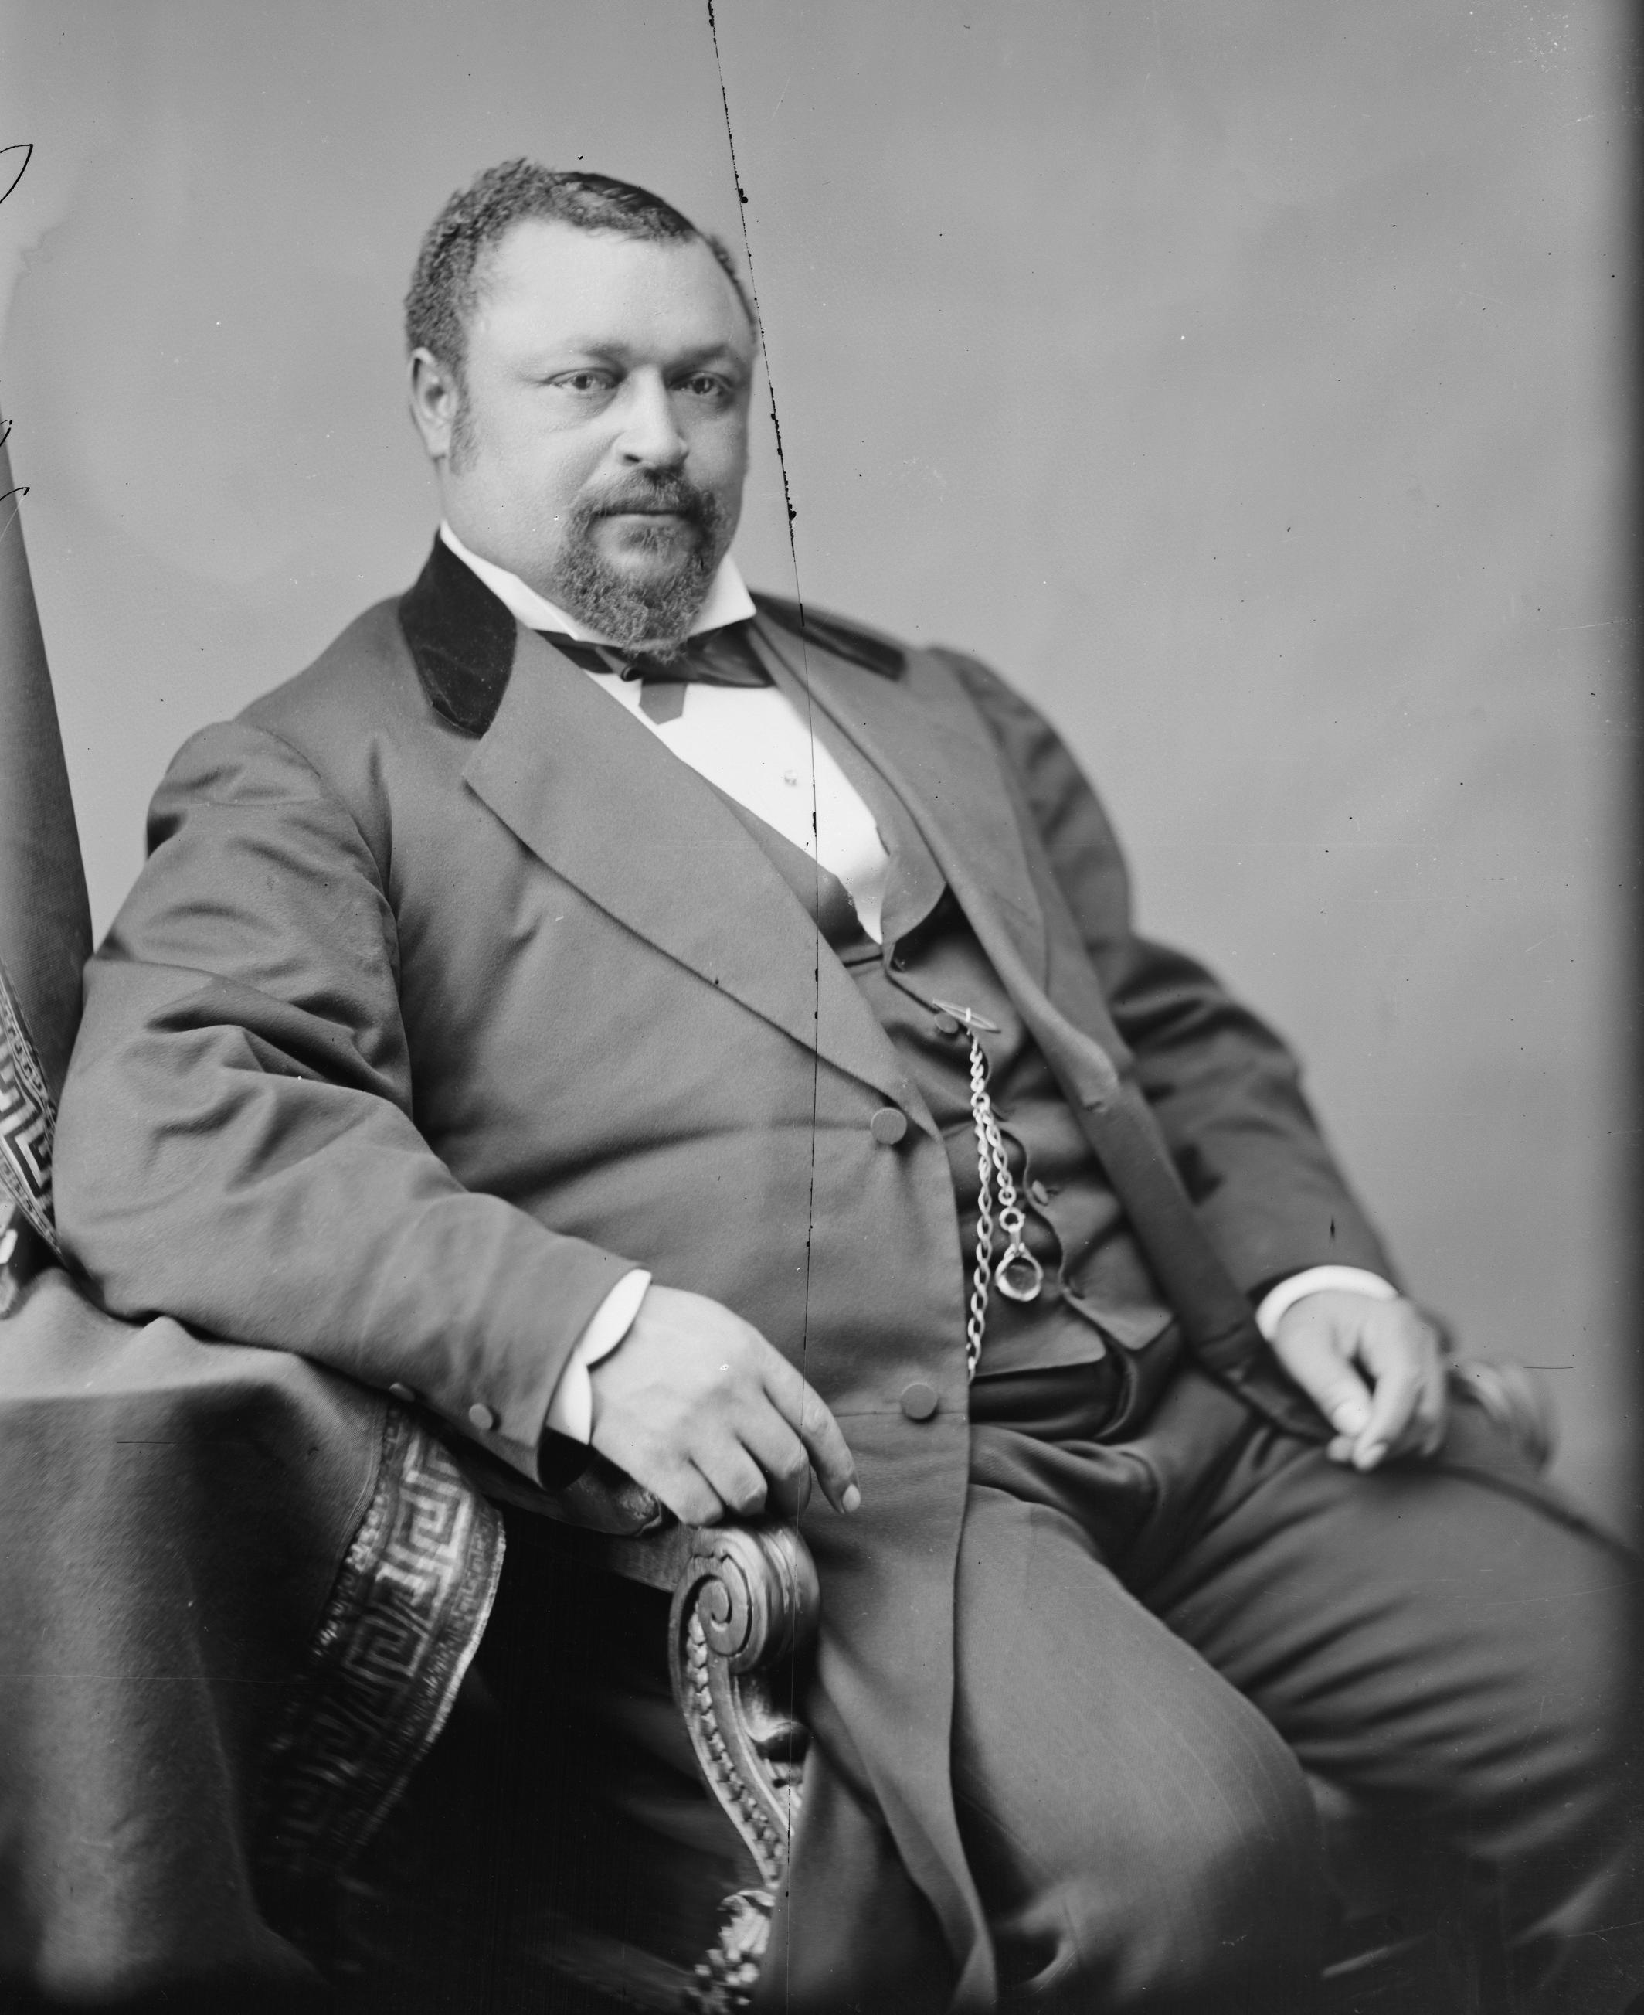
African–American Senators from Mississippi
Senator Hiram Revels (1870-1871)
Senator Blanche K. Bruce (1875-1881)

Slide 31
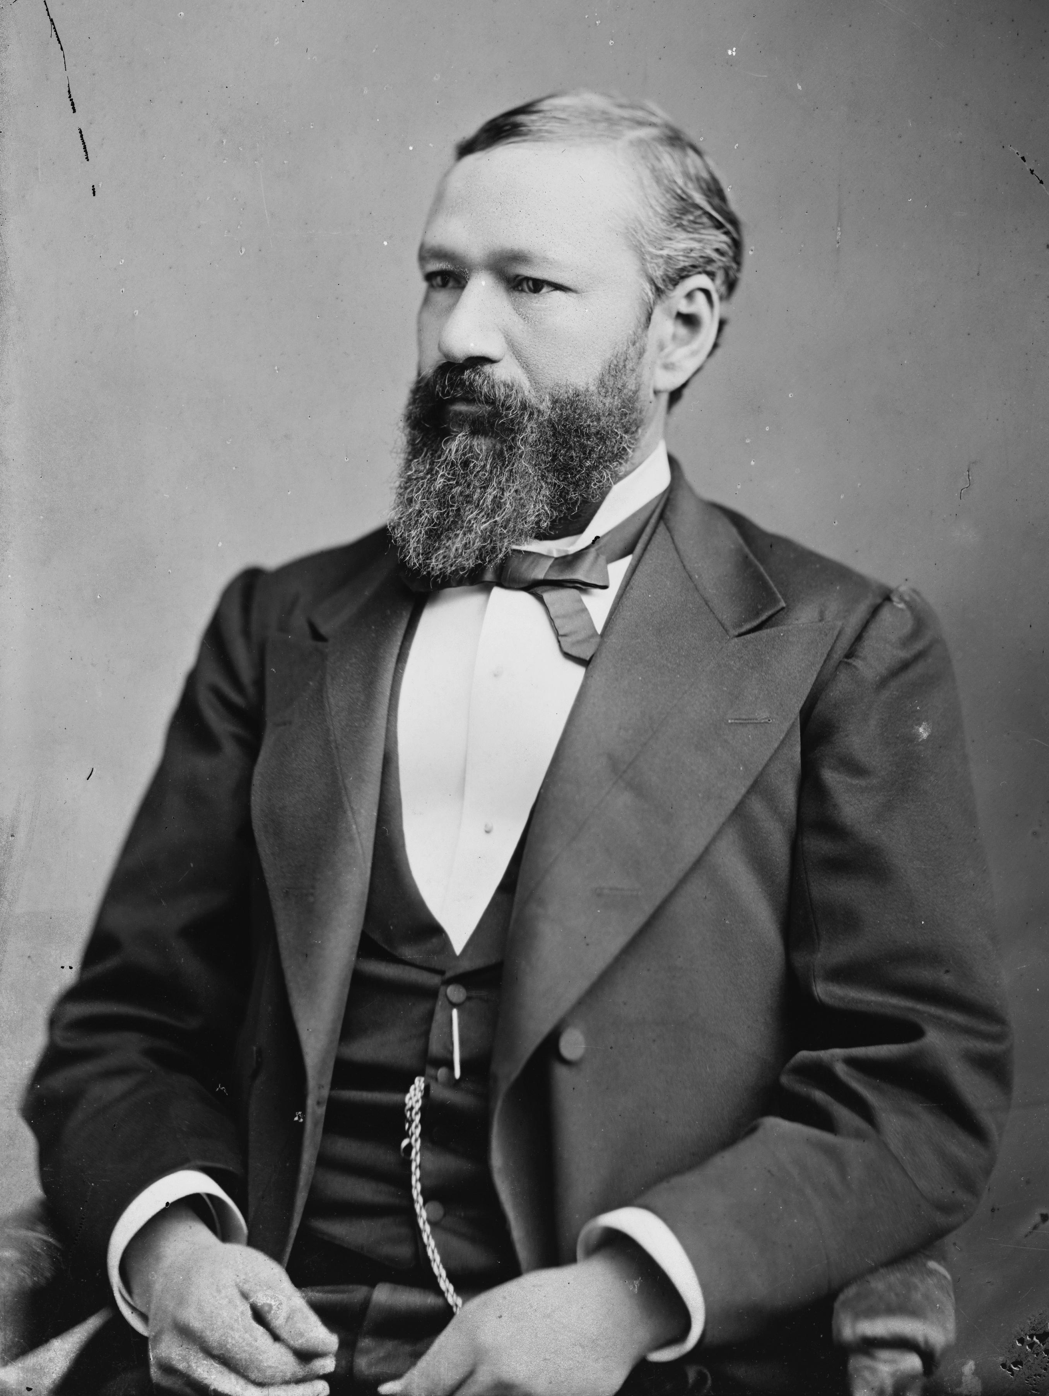
Governor Pinckney B. S. Pinchback of Louisiana (December 1872-January 1873)

Slide 32
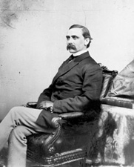
Adelbert Ames: A Carpetbagger
Born October 31, 1835 in Maine
Graduate of West Point
Served in both Regular Army and Volunteers in the Civil War
Served as Military Governor, Senator, and Elected Governor of Mississippi until 1876 when Mississippi was “redeemed”

Slide 33
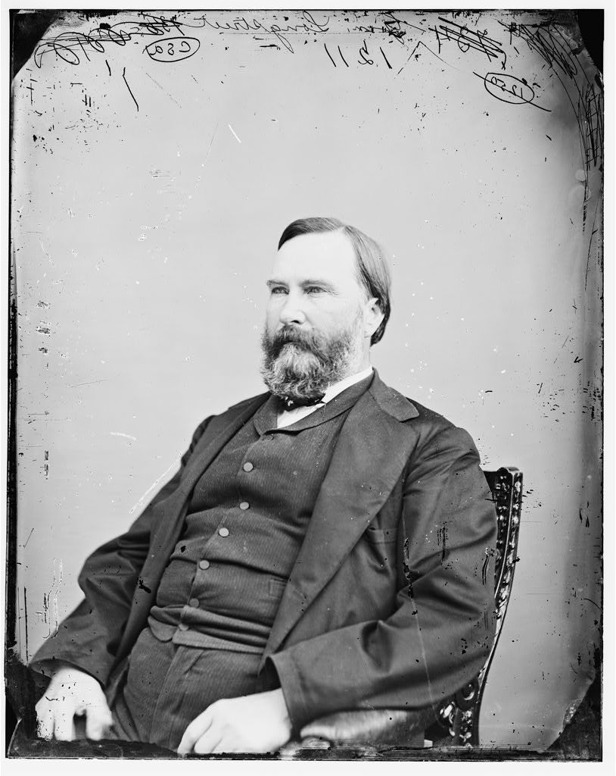
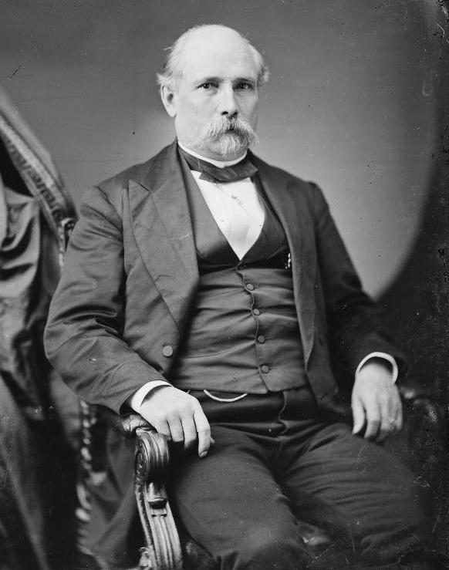
Scalawags
James Longstreet
James Lusk Alcorn

Slide 34
Accomplishments of Southern Republicans during Reconstruction
First free public school systems in the South
Civil Rights legislation preventing discrimination in “public accommodations”
Ensured sharecroppers had first right to crop, before bankers
SC Land reform
Attempted Economic Development
Attempted to purge law codes of racism

Slide 35

The Southern White View of Reconstruction Governance

Slide 36
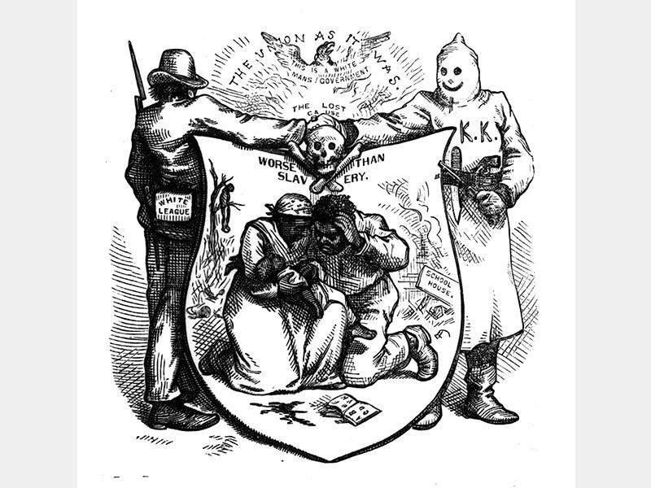
The First Ku Klux Klan
Founded in 1866
Decentralized
Run by white Southern elite
Dominated by Confederate veterans
Targeted black and white Republicans with terrorism and local uprisings
Violence out of hand by 1870 leading to the Enforcement Acts and Grant sending in troops in 1872

Slide 37
Liberal Republicans
Movement that emerged in 1872 that was critical of the corruption in the Grant administration, the increasing power of the Federal Government due to Reconstruction, and a desire to move on from the issues of Reconstruction.
Democrats, unhappily aligned with them in 1872.

Slide 38
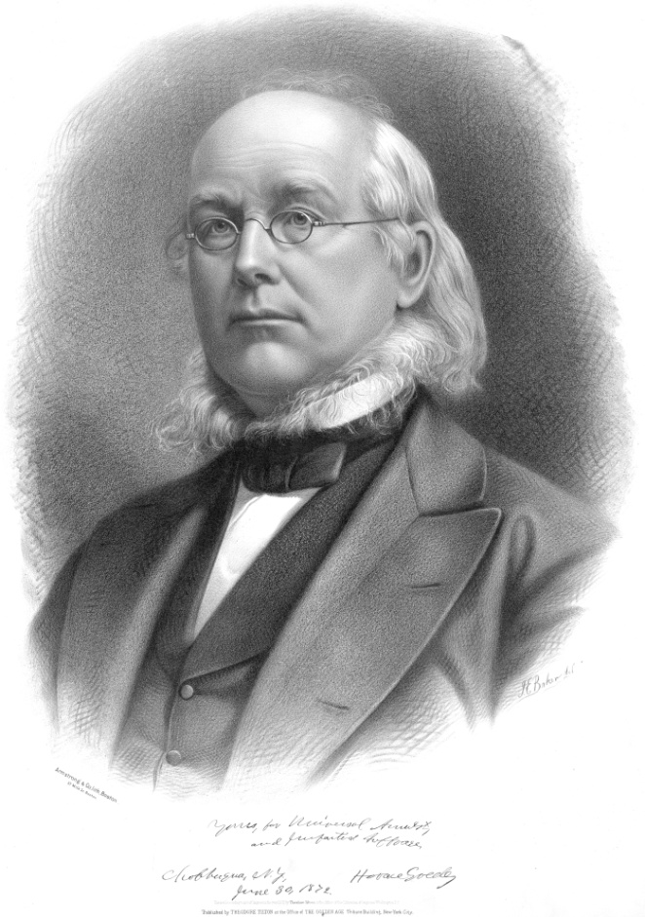
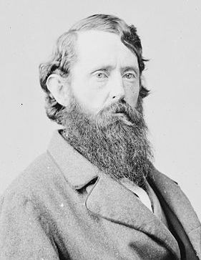
The Liberal Republican Ticket-1872
Horace Greeley
Former Senator B. Gratz Brown of Missouri

Slide 39
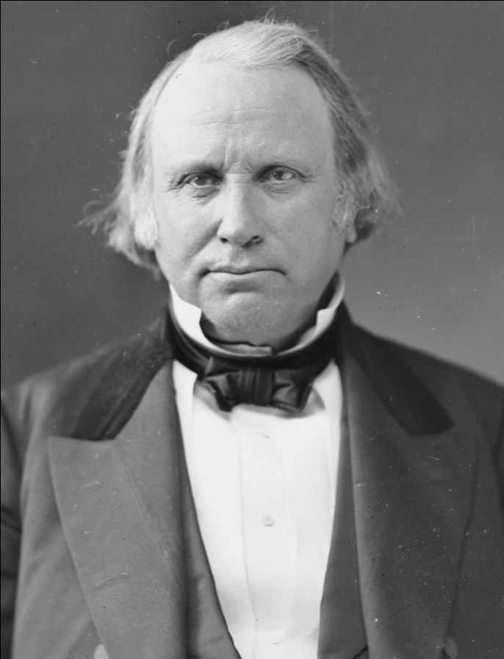
The Republican Ticket-1872
President Ulysses S. Grant of Illinois
Senator Henry Wilson of Massachusetts

Slide 40
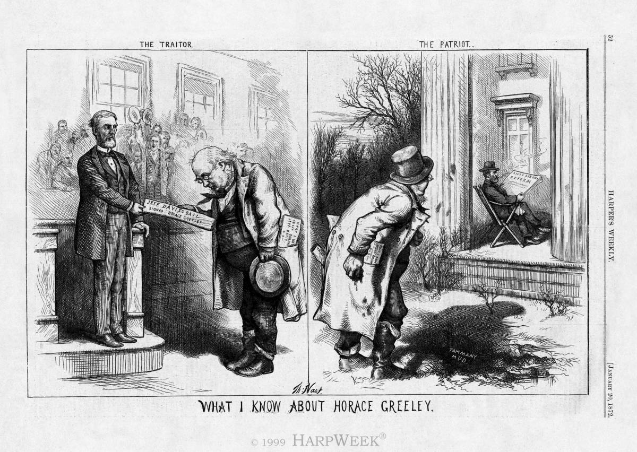
“What I Know About Horace Greeley”

Slide 41
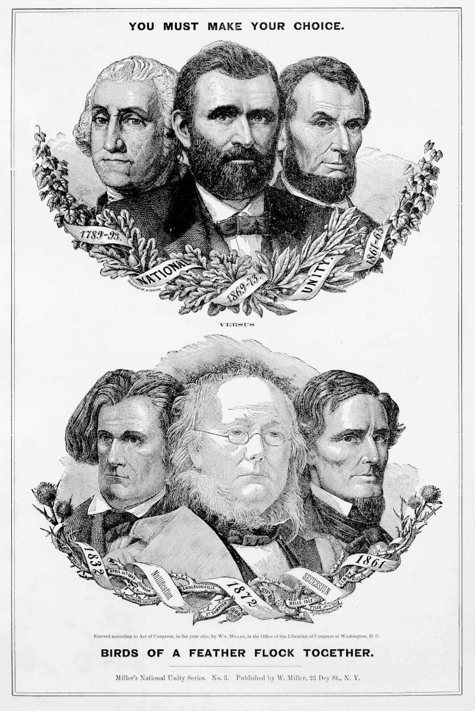
“Birds of a Feather”

Slide 42
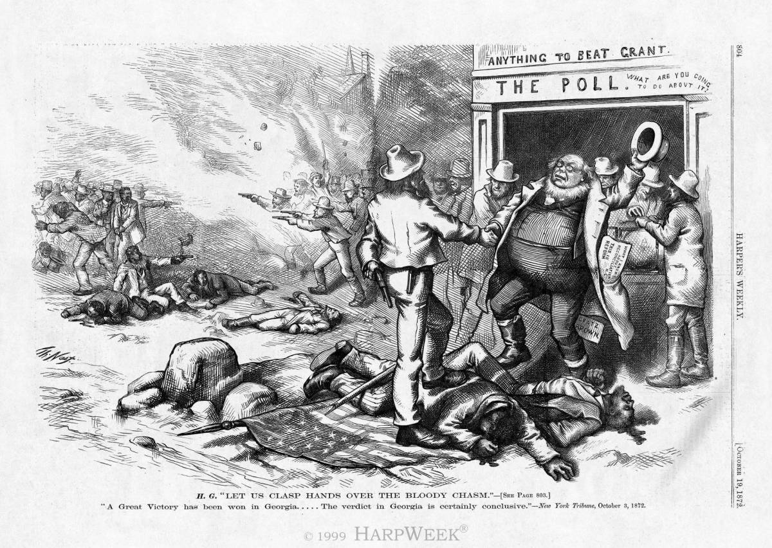
Clasping Hands over Union Dead

Slide 43
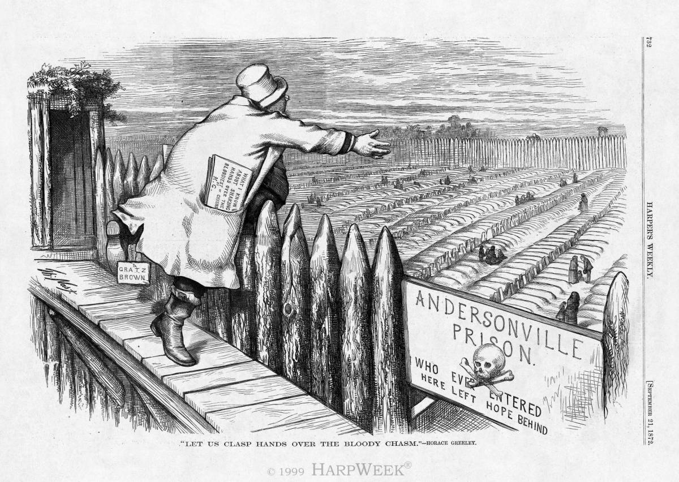
Clasp Hands Over Andersonville

Slide 44
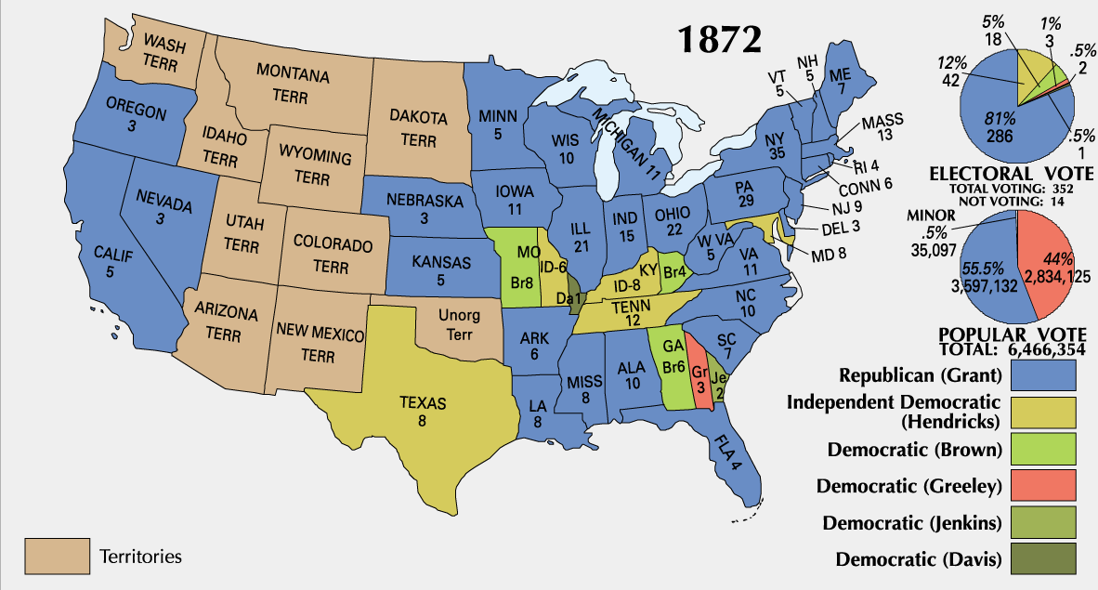
1872 Presidential Election

Slide 45
1872 Congressional Election
United States House of Representatives
United States Senate

Slide 46
The Panic of 1873
May 1873: Vienna Stock Exchange collapsed (due to a number of factors, mostly dealing with problems concerning internal issues of Austria-Hungary and the unification of Germany)
Congress also passed the Coinage Act of 1873 that Spring demonetizing silver, causing deflation in the economy and constricting the money supply and driving up interest rates
September 1873: Jay Cooke and Company, a pillar of the American banking establishment, collapsed because it couldn’t sell millions of dollars in bonds of the Northern Pacific Railroad
This caused a financial panic that forced the New York Stock Exchange to close for ten days.
What followed was the longest continued economic contraction in American history, it will not hit bottom until 1878.
The massive economic contraction shifted northern focus away from Reconstruction to economic issues and class issues and damaged Republicans electorally.

Slide 47
1874 Congressional Election
United States House of Representatives
United States Senate

Slide 48
Supreme Court Retreat from Reconstruction
Slaughterhouse Cases (1873)Butchers who were denied access to a state-sponsored monopoly in LA sued under the 14th Amendment. Court rejected their claim saying the 14th Amendment doesn’t alter traditional Federalism
US v. Cruikshank (1876)- guts the Enforcement Acts and dismisses the convictions of some involved in the Colfax Massacre of 1873
Civil Rights Act of 1875 declared Unconstitutional in 1883

Slide 49
“Redemption”

Slide 50
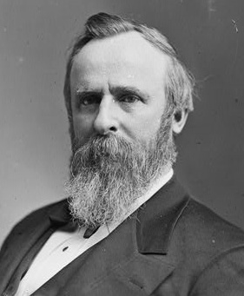
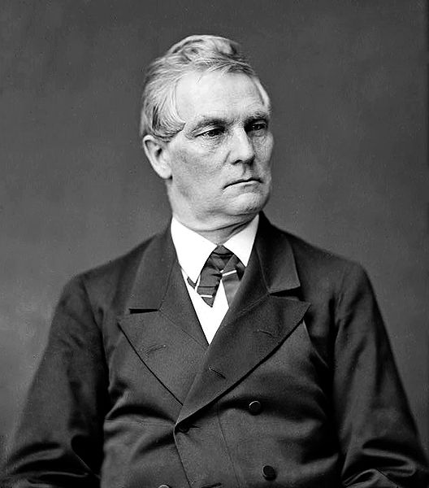
The Republican Ticket-1876
Governor Rutherford B. Hayes of Ohio
Representative William A. Wheeler of New York

Slide 51
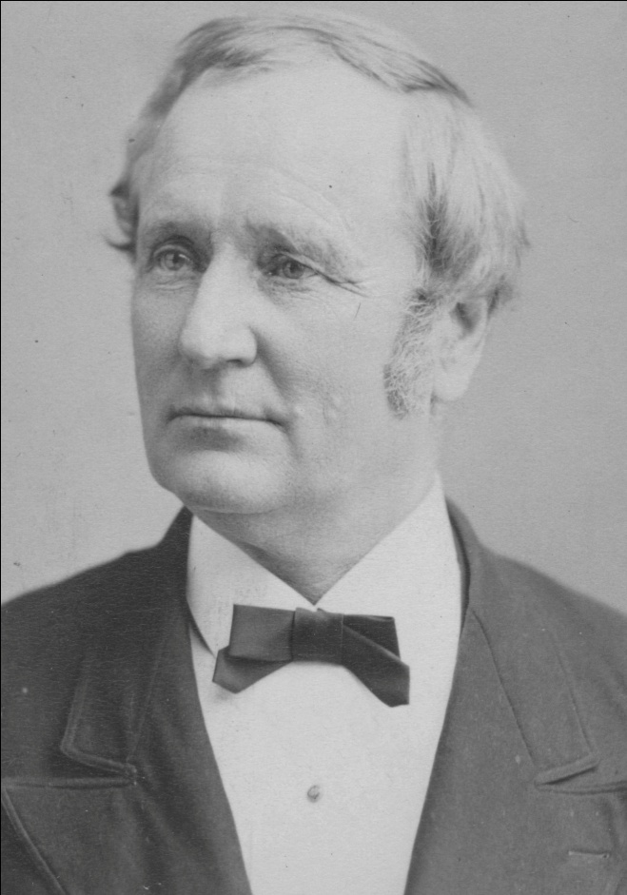
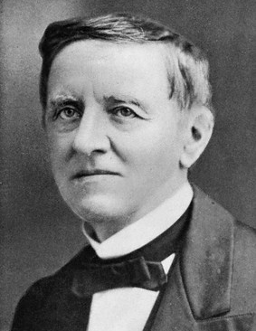
The Democratic Ticket-1876
Governor Samuel J. Tilden of New York
Governor Thomas A. Hendricks of Indiana

Slide 52
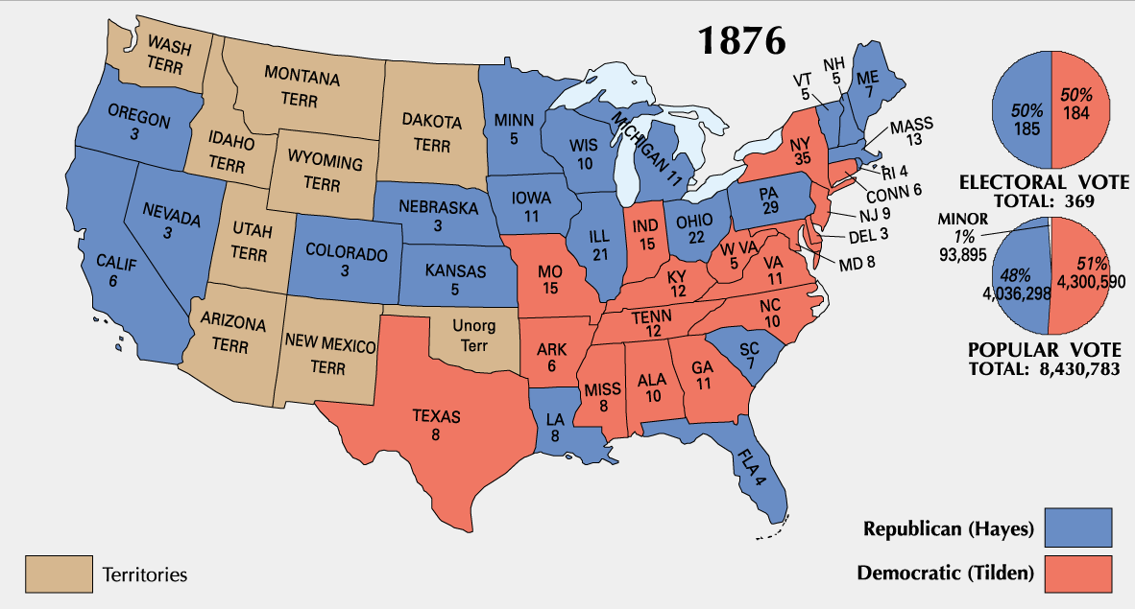
1876 Presidential Election

Slide 53
The “Compromise of 1877”
Hayes Agrees
Democrats Agree
To recognize Democratic control of entire South and not interfere in local affairs.
To appoint a Southerner as Postmaster General.
To fight for Federal Aid for Texas and Pacific Railroad (southern transcontinental route).
Not to block Hayes’s path to office.
To respect Civil and Political rights of Blacks.

