Slide 1
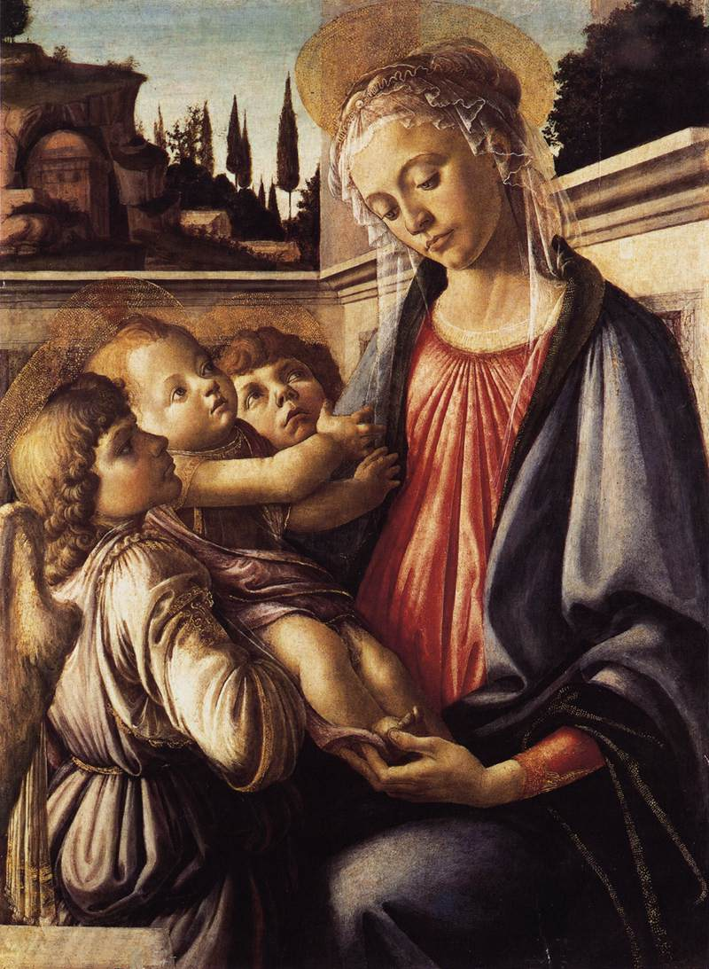
Catholic Art
The Madonna and Child and Two Angels
Sandro Botticelli, 1468
Stained glass windows were a major teaching tool.
The Virgin Mary is a major theme in Catholic art
Other themes come from biblical stories
The “Pieta” or ‘Christ being removed from the cross’ is another major theme.
Notes:
Catholic art dominates art museums since Catholicism was the only religion in Europe for nearly a millennium. The church commissioned many works and Catholic churches in the Medieval Period used art to teach the people as they were mainly illiterate. Stained glass windows were not only important to teach through the pictures, they also highlighted the importance of the church. From the outside of the church, the stained glass is dull and the pictures cannot be seen. It is only when a person comes into the church that they can learn the stories.
Pictures like this Madonna and Child abound due to the growing importance of Mary in the theology of the Catholic church. Both in the Medieval Period and in Renaissance painting, like the one shown, by Botticelli, the Virgin Mary holding the baby Jesus is depicted in thousands of poses and styles. More information could be added.
Catholic art almost always depicted biblical themes. More information could be added.
Due to the adoration of Christ in his passion, the removal of Jesus from the cross and Mary holding him is also a major theme. Michelangelo sculpture, Jean Malouel painting cir. 1400, El Greco painting cir., 1575. More notes.

Slide 2
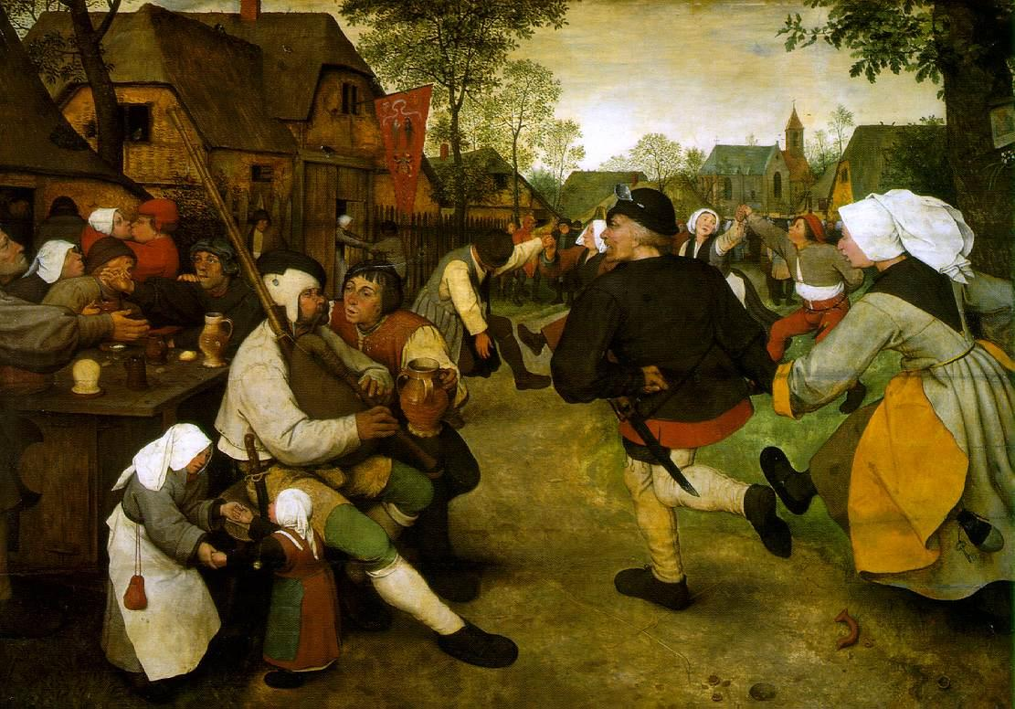
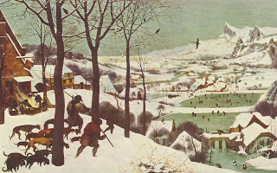
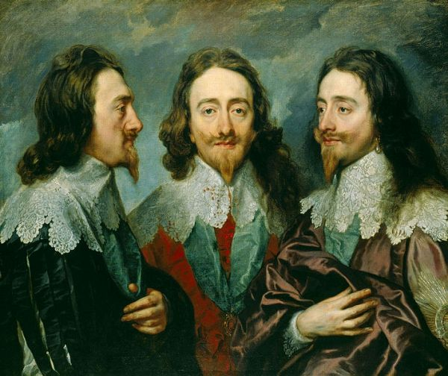
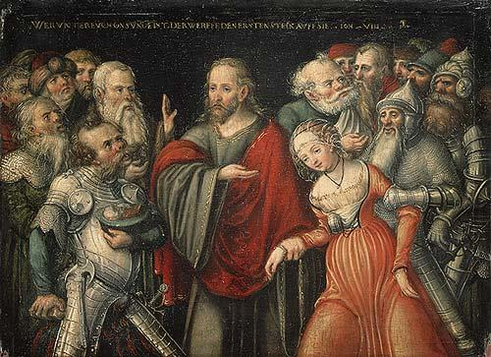
Protestant Art
Notes:
Protestant art tended to focus on themes from nature and everyday life. The two paintings at the top are from Pieter Bruegel from the mid 1500’s. On the left is “Peasant Dance” and the right is “Return of the Hunters”. More details could be given, but I am not writing the presentation.
The bottom left is a typical portrait from Van Dyke in the mid 1600’s. Protestants used this theme of painting their leaders. More information.
The bottom right shows that Protestants did paint religious themes. This is “Christ and the Adulteress” by Cranach the Elder, from the mid 1500’s. It is very typical that Protestant artists painted the Biblical scenes as if Jesus lived in Europe in the 1500’s with the disciples shown in armor and the adulteress shown as a courtier. More information.

