Slide 1
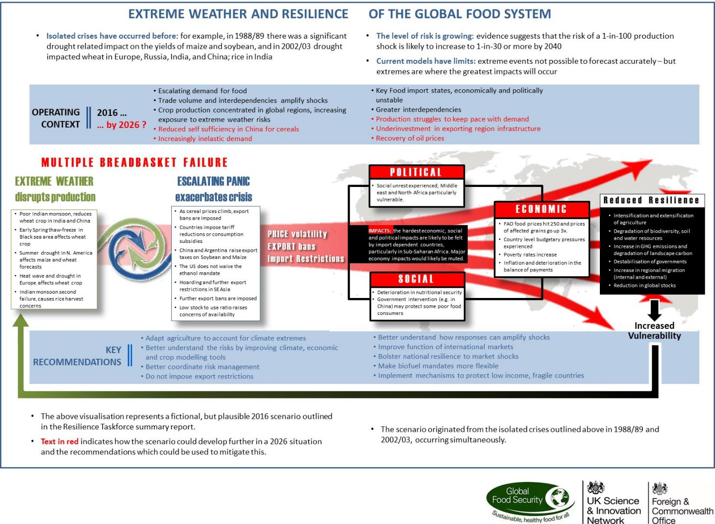
Infographic from UK/US Taskforce on Extreme Weather and Global Food System Resilience
Released on August 14

