Slide 1
Class Schedule
Grammar Workshop: Adverb Clauses
Writing Workshop
Introduction to introductions and thesis statements
Grammar Quiz #2
Outcomes addressed:
• Write coherent short essays, including creating a strong thesis, developing logical analysis and synthesis of their own ideas and others’, and organizing paragraphs with strong topic sentences and transitions;
• Demonstrate a basic understanding of the writing process by effectively prewriting, drafting, revising, and proofreading for errors;
• Develop a heightened awareness of their most common grammar errors and apply an improved understanding of the rules of grammar in order to recognize and correct them

Slide 2
Grammar Workshop: Adverbial Clauses
Reason
because, since, as
As the weather is cold, I will not go to the beach this weekend.
Contrast
Direct opposition = whereas, while
While San Francisco is cool during the summer, L.A. is generally hot.
Unexpected results = although, even though, though
Although I had studied all night, I failed the test.
Purpose
in order that, so that
I turned off the TV in order that my roommate studies in quiet.
I turned off the TV so that my roommate could study in quiet.

Slide 3
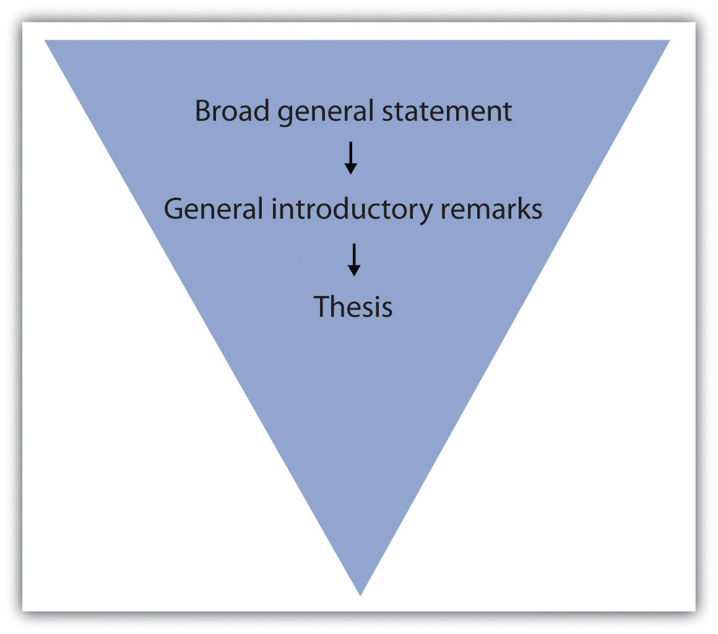
A Closer Look at the Introduction

Slide 4
A Closer Look at the Introduction
Begin with a general sentence about the topic/issue.
Introduce the author and the article. Give a little bit of information about it (overall main idea, maybe some background about the authors and/or what they say).
End with your thesis statement. This is the most important sentence in your introduction and in your essay! (Look at the rubric.)

Slide 5
A Closer Look at the Introduction
How do I write the thesis statement?
Sometimes it explains the topic of the essay and gives your opinion.
Although some parents and educators oppose same-sex classes, there is some evidence that separating boys and girls in middle school yields positive results.
Young people in my culture have less freedom than young people in the United States.
Sometimes it also explains the subtopics (what the author will say about the topic in the body paragraphs)
Although some parents and educators oppose same-sex classes, there is some evidence that separating boys and girls in middle school yields positive results, particularly in improved learner self-confidence and decreased classroom discrimination.
Young people in my culture have less freedom than young people in the United States in their choice of where they live, whom they marry, and what their job is.

Slide 6
Homework
Finish the first draft of your Summary Critique. It should include the:
Introduction
Summary
Critique #1 (analysis of one positive or negative part of the writing)
Critique #2 (analysis of one positive or negative part of the writing)
(Critique #3) (analysis of one positive or negative part of the writing)
Conclusion
Works Cited
Bring a printed copy to class with you on Tuesday. Bring your laptop and the saved copy of Draft #1 also on your laptop.

