Slide 1
Lecture Note #4: Competition

Slide 2
References
OpenStax College, Principles of Microeconomics. OpenStax College. 19 March 2014. http://cnx.org/content/col11627/latest
N.Gregory Mankiw, 2009, ``Principles of Economics'' 5th edition South-Western
Robin Bade & Michael Parkin, 2015, ``Foundations of Microeconomics'' 7th edition Pearson
R. Glenn Hubbard & Anthony Patrick O'Brien, 2013, ``Economics'' 4th edition, Pearson
McConnell & Brue, 2008, ``Economics'' 17th edition McGraw-Hill
T.Cowen & A.Tabarrok, 2015, ``Modern Principles of Economics'' 3rd edition Worth Publishers
David Besanko & Ronald R. Braeutigam, 2011, ``Microeconomics'' 4th edition Wiley

Slide 3
Competition
What we’ll cover today:
  Competitive markets
  Profit maximization for a competitive firm
  Entry and exit
  Long run competitive equilibrium

Slide 4
Competition
Perfect competition requires:
Many buyers and many sellers
Free entry and exit
Perfect information about prices and quality
Identical products

Slide 5
Competition
We assume that no single buyer or seller can exert an effect on the market price or quantity
Firms are assumed to be price takers; they take the market price as given and focus only on their quantity decision.
Good examples would be the market for corn, wheat, milk, etc. No single farmer really affects the supply.

Slide 6
Competition
By the Law of Demand market demand curves are always downsloping
Yet, we assume that each individual competitive firm faces a perfectly horizontal demand curve e.g. perfectly elastic demand:
  If the competitive firm raises its price, it sells nothing
  If the competitive firm lowers its price, it captures the entire market...but makes a loss!
And what price do we expect?

Slide 7
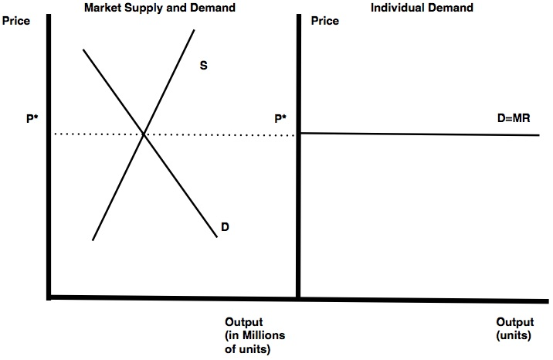
Market and Individual Demands

Slide 8
Competition
To understand how output (and price) is set by firms in a competitive market, we must first understand revenue for a competitive firm.
Revenue is defined as price times quantity or R=P x Q
Marginal revenue is the additional benefit a firm obtains by producing an additional unit of output
Marginal Revenue = Change in Total Revenue/Change in total output
MR= ΔR/ΔQ

Slide 9
Competition
What is marginal revenue in a competitive market?
In other words, what is the additional revenue a firm gains by selling another unit of output?

Slide 10
Competitive Markets
For a competitive firm, marginal revenue is just the market price!
Since the firm takes the price as given, each additional unit of output sold fetches exactly P.
In perfect competition P=MR.

Slide 11
Supply Decision of Competitive Firm
A competitive firm's pricing decision is made ahead of time by the market fundamentals
Essentially firms need only focus on their quantity (supply) decision when the market is perfectly competitive
For a given market price, p, we want to find the quantity where profits are maximized.

Slide 12
Competition: Profit Maximization
Okay, well if price equals marginal revenue, how does the firm optimize to maximize profits?
The competitive firm takes the price (and marginal revenue) as given and looks to the costs side to determine its behavior.
Recall from earlier in the course we said that optimizing requires decision makers to choose the level where marginal benefit equals marginal cost?
MB = MC
A competitive firm does the same, but now marginal benefit is just marginal revenue.

Slide 13
Competition
The competitive firm, indeed every firm, wishes to produce where MR =MC.
Recall that MC varies with output level, q.
If MR>MC, the firm should produce more output
If MR< MC, the firm should produce less output
The competitive firm looks to its cost curve and produces the output corresponding to the point where MR = P=MC

Slide 14
Competition
This has implications for the firm's supply curve
Since the firm's marginal cost curve determines the quantity the firm is willing to produce for any price, it is also the competitive firm's supply curve!
Actually, a competitive firm's supply curve is the portion of the marginal cost curve lying above the average variable cost curve.

Slide 15
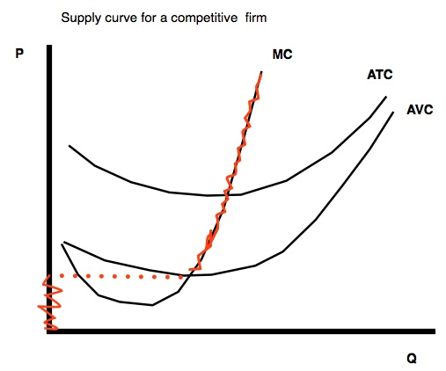
Supply Curve for Competitive Firm

Slide 16
Competition
When P > AVC, the firm will produce
When P<AVC, the firm will shut down in the short run and exit in the long-run
This is our 'shut-down' rule.
Note: the firm continues to produce when P > AVC, not just when P>AC. Why?

Slide 17
Competition
It is possible for price to lie above average variable cost but below average total cost
In other words we can get AVC < P < ATC, and since P < ATC the firm makes a loss!
But we nevertheless assume the firm remains in the market in the short run (since P<AVC is our shut-down rule).
What is going on?

Slide 18
Competition
Well, if P>AVC we know the firm is recovering variable costs.
It's not doing any worse by continuing to produce, in fact it does better!
Fixed costs are incurred either way, so those are paid regardless of the decision to produce e.g sunk cost
By continuing to produce, the firm is able to at least make back some portion of the (sunk) fixed costs and therefore 'loses less' than if it shut down.

Slide 19
A competitive firm’s profits
We can measure a competitive firm’s profits using the formula:
Profit = (Price – Average Total Cost) x Quantity
Profit = (P – ATC) x Q
Graphically this is just a rectangle!
Q is a distance on the horizontal, P-ATC is a height on the vertical

Slide 20
Competition: Numerical Example
Suppose a firm has the following cost structure:
Q | TC | FC | VC | ATC | AVC | MC
0 | 10 | 10 | 0 | 0 | 0 | 0
1 | 20 | 10 | 10 | 20 | 10 | 10
2 | 25 | 10 | 15 | 12.5 | 7.5 | 5
3 | 29 | 10 | 19 | 9.7 | 6.33 | 4
4 | 32 | 10 | 22 | 8 | 5.5 | 3
5 | 39 | 10 | 29 | 7.8 | 5.8 | 7
6 | 49 | 10 | 39 | 8.17 | 6.5 | 10
7 | 63 | 10 | 53 | 9 | 7.57 | 14
8 | 83 | 10 | 73 | 10.38 | 9.13 | 20
9 | 108 | 10 | 98 | 12 | 10.89 | 25

Slide 21
Competition: Numerical Example
Find the firm's optimal quantity and profits when P=$14
Find the firm's optimal quantity and profits when P=$7
Find the firm's optimal quantity and profits when P=$3

Slide 22
Competition: Numerical Example
When $P=14$, the firms sets P=MC=14 and produces Q=7
Profit is given by: (P-ATC) x Q which is:
Profit = (14-9) \times 7 = 35
The firm earns positive economic profits.

Slide 23
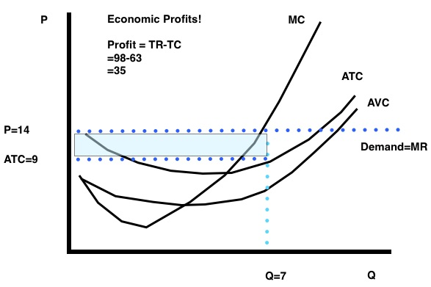
Competition: Numerical Example (Graph)

Slide 24
Competition: Numerical Example
When P=7, the firms sets P=MC=7 and produces Q=5
Profit is given by: (P-ATC x Q which is:
Profit= (7-7.8 x 5 = -4
The firm earns a loss.
But it still decides to produce Q>0 since P=7 > 5.8 = AVC.

Slide 25
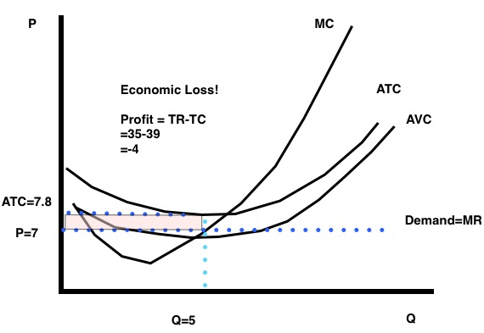
Competition: Numerical Example (Graph)

Slide 26
Competition: Numerical Example
When P=3, the firms sets P=MC=3 and produces Q=4
Profit is given by: (P-ATC) x Q which is:
Profit = (3-8) x 4 = -20
But wait! Note that P = 3 < 5.5 = AVC, so the firm shuts down, Q=0.
By shutting down the firm incurs a loss only of its fixed cost, Profit = -10.

Slide 27
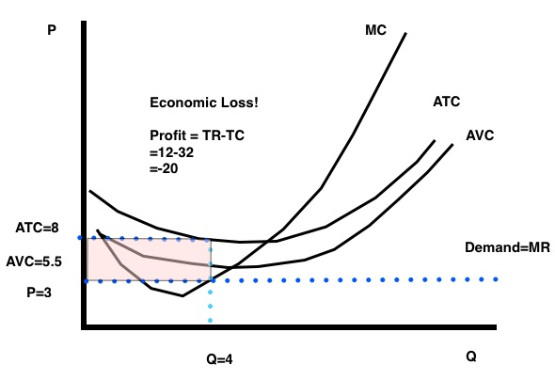
Competition: Numerical Example (Graph) BIG LOSS

Slide 28
Competition: Long Run
We assume in the long run all inefficient firms do exit the market
The long run equilibrium prediction is for price to equal the minimum average total cost of the most efficient firm remaining in the market
In this situation, all remaining firms make zero profits.
If there were profits, new entry would compete these profits away
If there were losses, exit would eliminate the inefficient firms.

Slide 29
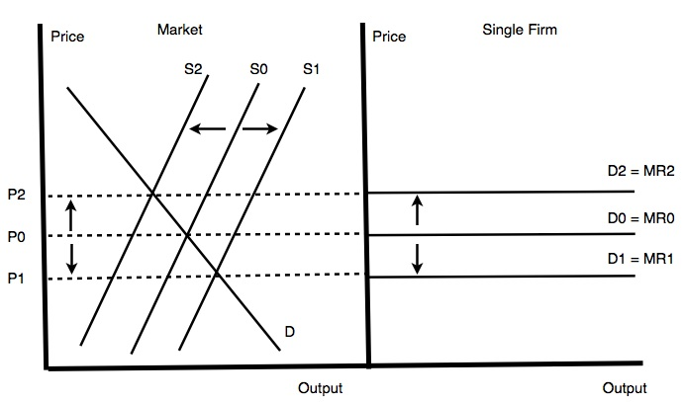
Competition: Long Run

Slide 30
Competition: Long Run
Firms continue to produce while making zero profits because we're talking about economic profits
We are assuming that in the long run all remaining firms are covering all opportunity costs
These producers are at least as well off continuing to produce as doing anything else

Slide 31
Competition: Long Run
So what happens to the market equilibrium in the long run?
We're after a point where there is going to be zero economic profit.
We have a situation where there's strong competition, firms can optimize their operating scale, and there's entry and exit.

Slide 32
Competition: Long Run
What does this fierce competition look like?
Well, each firm is going to try to undercut its rivals. To do this effectively, each firm needs to choose its operating size to exhaust economies of scale as efficient firms have lower costs.
When does entry and exit stop? At the point where there's zero economic profits: no further potential gains to induce entry, no losses to induce exit.
Here the price is going to be just high enough to cover the costs of the most efficient firms, these firms just break-even.

Slide 33
Competition: Long Run
What happened to our MR=MC assumption?? We still have it!
The market is competitive so the additional benefit from selling another unit, the marginal revenue, is just the market price. Hence: P = MR = MC
Furthermore, the firm's marginal cost curve intersects the minimum of its average total cost curve (and also, separately, the minimum of its average variable cost curve). So firms undercut rivals right down to the point where P = MC.
But this is the long run world where firms are free to vary their use of production inputs in order to minimize their costs by operating as efficiently as possible.

Slide 34
Competition: Long Run
The long run competitive equilibrium occurs at a price equal to the marginal cost of the most efficient firms which is the minimum of the average total cost curve such that firms remaining in the market are operating at the efficient scale and earning zero economic profits.
Relative to the short run pictures we had been drawing, the long run equilibrium occurs at the `short-run breakeven point'...of the most efficient firms firms in the market.
All less efficient firms have higher break-even points and therefore would be making losses if they remained in the market.

Slide 35
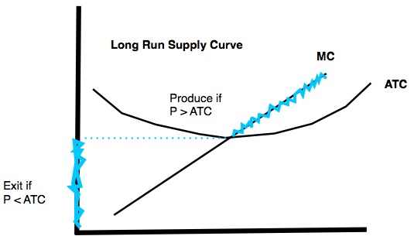
Competition: Long Run

