Slide 2
Accounting Information
Accounting provides relevant information to a variety of stakeholders
Both financial and nonfinancial information
Useful for making decisions, allocating resources, and monitoring, evaluating, and rewarding performance
Multiple purposes
Examples of accounting information:
Financial statements
MD&A
Reported expense of an operating department
Cost of producing a product or delivering a service
Cost of serving a customer

Slide 3
Management Accounting
Management accounting is a profession that involves partnering in management decision making, devising planning and performance management systems, and providing expertise in financial reporting and control to assist management in the formulation and implementation of an organization’s strategy.
- IMA 2008 Statement on Management Accounting
“We are looked upon as business advisors, more than just accountants, and that has a lot to do with the additional analysis and the forward-looking goals we are setting.”

Slide 4
Financial Accounting
Professional accountants in business work as employees, consultants, and self-employed owner-managers or advisers and support their organizations in a wide range of job functions at various levels.
Professional accountants can typically be found in four types of roles:
creating value - developing strategies for sustainable value creation
enabling value - supporting the governing body and senior management in making decisions and facilitating the understanding of performance
preserving value - asset and liability management, and managing risk
reporting value - ensuring useful internal and external business reporting
- IFAC 2013 Consultation paper on accountants in financial leadership

Slide 5
Financial and Management Accounting Differences
 | Financial Accounting | Management Accounting
Goal | Compliance | Learning
Users | External users | Internal management
Emphasis | Historical past | Future oriented
Data | Verifiable | Relevant
Rules | GAAP / IFRS | Flexible
Dynamics | Stable | Responsive
Requirement | Mandatory | Optional

Slide 6
Professional Accountants
Three legacy professional accounting bodies in Canada:
CMA – Certified Management Accountant
CGA – Certified General Accountant
CA – Chartered Accountant
Canada’s accounting profession of more than 200,000 members is now represented by a single national body:
CPA – Chartered Professional Accountant
There are numerous professional accounting bodies worldwide

Slide 7
Partial Organization Chart

Slide 9
MD&A Background
MD&A is a narrative explanation “through the eyes of management”
discussion of a company’s financial condition and future prospects – balanced discussion; bad news as well as good news
helps investors understand the financial statements
discusses trends and risks that have affected or are reasonably likely to affect the financial statements in the future
The MD&A should complement and supplement
the company’s financial statements

Slide 10
Why write a good MD&A

Slide 11
Where to start?

Slide 12
MD&A Tips
Use plain language
Provide context
Identify trends
Plan for review time
Forward-looking information
Focus on materiality
MD&A quality is not measured by its length,
but in the breadth and depth of its analysis.

Slide 18
… more from the OSC
The OSC MD&A document (109 pages) is available at:
https://www.osc.gov.on.ca/documents/en/Companies/sme_20130605_write-effective-mda.pdf

Slide 20
Performance measurement
However beautiful you think you are, you should check in the mirror from time to time. - Humphrey, 2010

Slide 21
Types of performance analysis
Financial (quantitative)
Non-financial (quantitative)
Non-financial (qualitative)

Slide 22
Financial Analysis
Includes ratio analysis
The interpretation of financial ratios computed from an organization’s financial statements
Important Financial Ratios
Liquidity ratios
Profitability ratios
Activity ratios
Leverage ratios
Other ratios

Slide 23
Non-financial performance measures
Many important strategic roles in management accounting
Driving desired results
Communication throughout the firm and with the Board
Monitoring operations
Giving feedback
Tied to measurement tools such as Balanced Scorecard

Slide 24
Performance measures - Google
Google sets impossible bodacious goals…and then achieves them. The mindset of solving the impossible problem is part of the culture.
Financial (quantitative)
advertising revenue by source (advertising is about 95% of total Google revenue)
research and development expenses as a percentage of revenues (about 15%)
Non-financial (quantitative)
number of advertisers
number of website searches initiated
advertisers’ return on investment from advertising campaigns on our websites
Non-financial (qualitative)
relevance, objectivity, and quality of Google search results
relevance and quality of ads displayed with each search results page
underlying purpose of searches

Slide 25
Performance measures - Ford Motor Company
There’s a renewed sense of energy and pride at Ford today. We’re no longer talking about survival. Our employees are focused every day on helping Ford deliver, so we never again have our backs against the wall.
Financial (quantitative)
sales, net income, earnings per share
value of portfolio of finance receivables and leases
Non-financial (quantitative)
market share for all product lines
number of vehicle recalls
Non-financial (qualitative)
adherence to governmental standards and regulations relating to safety, fuel economy, emissions control, noise control, vehicle recycling, substances of concern, vehicle damage, theft prevention, etc.
reputation of vehicle brands and industry awards
vehicle safety ratings

Slide 26
Performance measures - IWK Hospital
Our Vision: Healthy families. The best care.
Financial (quantitative)
Revenue from sources other than the Department of Health
Non-financial (quantitative)
Number of adverse events
Rate of compliance with IWK established wait-time standards
Non-financial (qualitative)
Overall employee satisfaction

Slide 27
Performance measures - SMU
Age Quod Agis – What you do, do well.
Financial (quantitative)
Unrestricted resources
Debt per student
Market value of endowed assets
Non-financial (quantitative)
Facilities condition index
Conversion rate of student applicants to actual registrations
Tuition fees compared to other universities
Non-financial (qualitative)
Student satisfaction (e.g., National Survey of Student Engagement, ICE evaluations)
University reputation (e.g., Maclean’s Magazine)
Research productivity

Slide 29
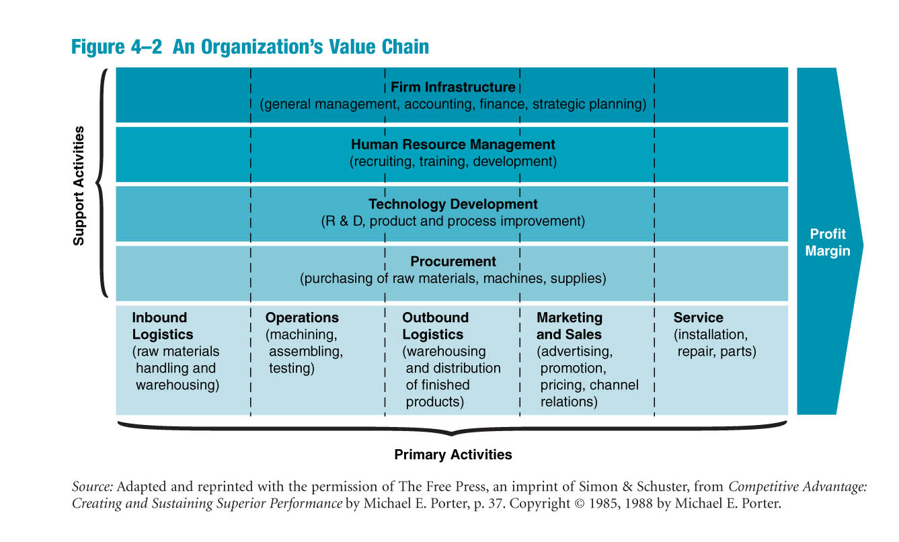

Slide 30
Value chain and TLCC
Halifax-Dartmouth Bridge Commission
Vehicle traffic on the two existing bridges no longer sustainable
Need a new harbour crossing by the year 2020
Capital budgeting decision – build a third bridge or an under-harbour tunnel?
You are the CFO:
Consider value chain of the bridge operations
Consider total life-cycle costs of the two proposed options
Consider “other factors” that may affect the decision

Slide 32
Non-profit sector in Canada
Often ignored in discussions of accounting
However, the sector is significant because of its size, and also because of its importance to society
Hospitals, Service Organizations, Arts Councils, Social and Sport Clubs, Government, Trade Associations, Religious Organizations, Educational Institutions, Charities, Clubs, Interest groups, Unions, etc.

Slide 33
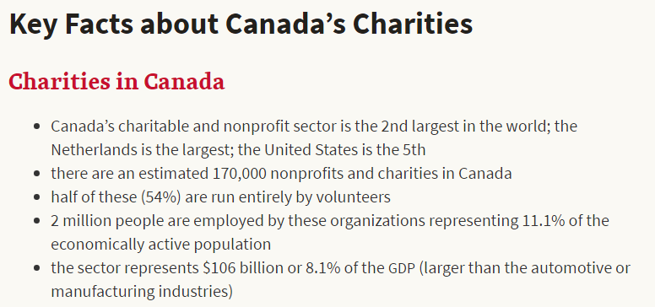


Slide 34
Key differentiator
Sources of revenue
Profit-making firm
Sale of goods and services to customers
Non-profit organization
Donations, membership dues, grants from sponsoring agency (incl. government)

Slide 35
Strategic concepts for NPOs
Vision
Mission statement
Stakeholder analysis
SWOT

Slide 36

Stakeholder analysis
And decision making

Slide 37

Vision & Mission
Vision
A world where everyone has a safe and decent place to live.
Mission
To mobilize volunteers and community partners in building affordable housing and promoting homeownership as a means to breaking the cycle of poverty.

Slide 38
Stakeholders
Board of Directors
Government
Donors
Employees
Beneficiaries
Volunteers
“Individuals or groups who can influence or be influenced by the decisions made by the organization.”

Slide 39
Differences in Financial Statements
For Profit
Not-for-Profit
Sales or Services Revenue
Income Statement
Retained Earnings/Equity
Donations and Grants
Statement of Activities
Net Assets
Statement of Expenses
Key Takeaway for NPO’s
Focus on spending efficiently and effectively, and having appropriate funds to take on projects rather than trying to maximize the “bottom line”.

Slide 40
Net Assets
Classified based on spending restrictions
Also referred to as “Funds”
Unrestricted
Internally Restricted
Externally Restricted

Slide 41
Decision Making
Relevant
Influence the decisions of financial statement users
Confirm or correct previous evaluations
Comparable
Allows users to identify similarities & differences between fiscal years
Allows users to easily compare data with industry leaders
Reliable
Faithfully represent financial information
Enhance understanding, evaluation, and decision making

Slide 42
Constraints on management
Service is often intangible and difficult to measure
Client influence may be strong or weak
Strong employee commitments
to professions and union affiliation
to “causes”
Resource Contributors
Intrusion on internal management
Fund contributors and government
Restraints on use of rewards

Slide 43

The SickKids Hospital
Users of Financial Statements

Slide 44
Internal Users of Financial Statements
Users of Financial Statements are interested parties that rely on the financial statement information of the entity in order to make relevant business decisions regarding the hospital.
CEO
CFO
Managers
Board of Directors
Employees
Pension holders
Internal auditors

Slide 45
External users of financial statements
External users: Individuals outside of the company who are interested in financial statements
Government
Investors (Donors)
Creditors
The SickKids Foundation
Research companies, e.g., drug companies
Patients
External Auditors
Other Hospitals

Slide 46
 | SickKids Board of Directors | CEO / Top-Management
Needs | Overseeing and monitoring management performance, safeguarding the interest of stakeholders, ensuring compliance with regulations | Using financial statements to accessing own performance, making business decisions
Main areas of interest | Statement of Operations Statement of Financial Position Main trends Compliance with performance standards | Financial risks Performance ratios Liquidity Solvency
Decision making | Evaluation of the CEO and company’s performance Approval of financial statements Stewardship of stakeholders’ interests | Debt financing Long-term capital acquisition Setting standards and operations

Slide 47
Important Measures of Performance (in thousands)
SickKids Account | 2014 | 2015
Construction in progress | $25,914 | $54,678
Building and services | $733,683 | $751,225
Research revenue | $171,811 | $181,466
Other expenses | $97,160 | $102,209
Clinical supplies | $69,431 | $73,605

Slide 48
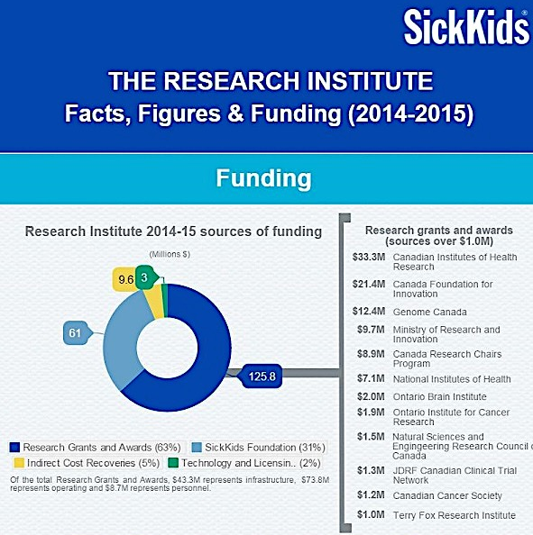
Government
A significant amount of operating revenue is from the Ontario government.
The research branch of the hospital has a quarter of its funding from the government alone.

Slide 49

Creditors
Decisions on if they will grant a loan
Assets and liabilities: Current Ratio, Quick Ratio
Cash flow statements, observe where cash moved during the year
Lines of Credit, not touched

Slide 50

YMCA - taxation
Notes:
Good morning, we would like to thank the board of directors for having us here this morning to present our analysis of the unique aspects of the YMCA as a NFP organization with relation to accounting issues and the effect on strategic management goals.
Introduce group members

Slide 51

Tax Implications - YMCA
Tax status: Registered Charitable Organization since 1967
Exempt from income taxes under the Income Tax Act
Notes:
In Canada, non-profits can be registered as charities
YMCA Canada is registered as a charitable organization and, as such, is exempt from income taxes under the Income Tax Act.

Slide 52
Tax Implications - YMCA
De-registration concerns
Must file Public Information Return T3010 no later than six months after the end of its fiscal period
85,000 CRA registered charities in Canada
Notes:
A charity may be deregistered for: failing to comply with the annual information return requirement; issuing an improper or false donation receipt; failing to continue to meet any of the requirements of registration
Most revocations stem from failure to file the information return
A registered charity must file Public Information Returns with the CRA

Slide 53
Tax Implications - Donors
Tax receipts available for donors to obtain tax credits
After factoring in provincial tax savings, donations in excess of $200 will save you anywhere from 40% to 54%, depending on your income and province of residence
The 2013 federal budget introduced a new temporary First-Time Donor’s Super Credit that permits first-time donors an additional 25% federal tax credit on up to $1,000 in donations. This one-time credit may only be claimed once in the 2013 to 2017 taxation years.
Notes:
In Canada, non-profits can be registered as charities
Because of registered charitable organization, YMCA can issue tax receipts for donations that can be used by donors to obtain tax credits. Issuing tax receipts could attract more donors

Slide 54
NPO examples
Our class groups will explore (and make a short verbal report on) strategic aspects of each of the examples in the following slides.
Who is the principal person(s) responsible for strategic thinking?
Who are the stakeholders?
What are the main strategic goals?
What corporate resources exist to achieve the goals?
What other factors affect the role of the NPO accountant?
Note – groups do not have to prepare for this exercise in advance
– we will work together on the examples

Slide 55

Group A & B: Dartmouth United Soccer Club
The Dartmouth United Soccer Club is a VOLUNTEER organization that draws its membership from the Dartmouth region of the Halifax Regional Municipality.
Club membership is over 2,000, comprising about 1,200 mini players (ages 3-10), 600 youth players (ages 11-18), 200 senior players (ages 19 and up) and over 300 Volunteers, Coaches, Managers and Executive members.
Dartmouth United Soccer Club is currently divided into Four Divisions - Mini, Youth-Boys, Youth-Girls, and Senior Men and Women, with one Executive overseeing all Club operations.

Slide 56
Group C & D: Bill and Melina Gates Foundation
From the 2006 Annual Report
None of us will soon forget the big news of 2006.On June 26, Warren Buffett announced an astonishing pledge to the foundation—10 million shares of Berkshire Hathaway Inc. stock worth more than $31 billion at the time. Most of us at the foundation had two reactions when we heard the news:
Wow—Warren has made an incredible statement. And holy cow—we have a lot of work to do.
Giving away money isn’t hard. But giving it away effectively sure is. We were already making about $1.4 billion a year in grants; thanks to Warren’s pledge, we’ll be giving away a projected $3.2 billion a year by 2009.
People frequently ask me: How can the foundation give away so much money and do it well? Believe me, we think about that tremendous responsibility every day. But as a foundation, I believe, we’re in a better position than ever to translate these immense resources into billions of people living healthier lives, getting a better education, and lifting themselves out of poverty.

Slide 57

Group E: Royal Society for the Protection of Birds
The RSPB is a British organization which promotes conservation and protection of birds and the wider environment through public awareness campaigns, petitions and through the operation of nature reserves throughout the UK.
RSPB has 1,500 employees, 12,000 volunteers and 1,000,000 members, making it the largest wildlife conservation charity in Europe. The RSPB maintains 182 reserves across the UK.
The charity was founded in 1889, as a protest group, campaigning against the use of great crested grebe skins and feathers in clothing.
Today, the RSPB works with both the civil service and the Government to advise policies on conservation and environmentalism.

Slide 59
Planning and Control
Planning
developing objectives and preparing various budgets to achieve objectives
Control
steps taken by management to ensure the objectives are attained

Slide 60
Advantages of Budgeting
Define goal
and objectives
Communicating
plans
Think about and
plan for the future
Advantages
Coordinate
activities
Means of allocating
resources
Uncover potential
bottlenecks

Slide 61
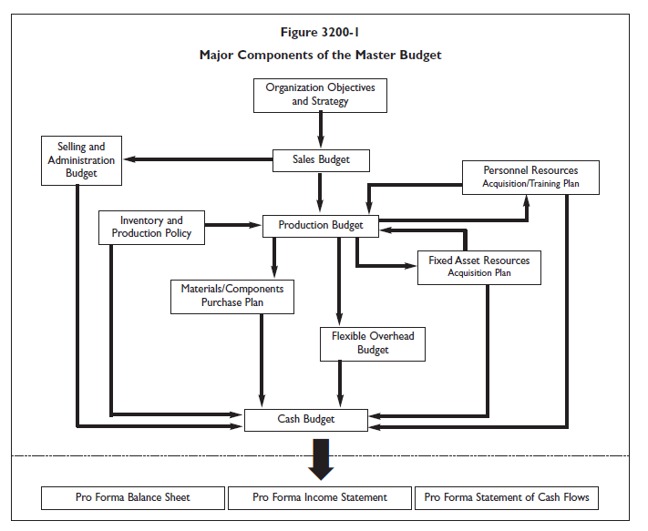
Master Budget

Slide 62
Choosing the Budget Period
Operating Budget
2013
2014
2015
2016
Annual operating budget
may be divided into quarterly
or monthly budgets

Slide 63
Zero-Base Budgeting
Zero-base budgeting - an alternate approach
Particularly used in governmental and not-for-profit sectors
Managers are required to justify all budgeted expenditures, not just changes from the previous year

Slide 64
Participative Budget System
Theoretical Flow of Budget Information

Slide 65
Responsibility Accounting
Managers should be held responsible for those items and only those items that the manager can actually control to a significant extent.

Slide 66
Budget Committee
Standing committee responsible for
overall policy matters relating to the budget
coordinating the preparation of the budget
providing advice to the CEO

Slide 68
What is Ethics?
Rules and principles that define “right” and “wrong” conduct
Involves many “shades of gray”

Slide 69
Why study ethics in accounting?
Ethical decisions
Set the standard for employee behaviour
Create a tone for an entire organization
Improve the quality of work life
Translates into increased profits for firms with a reputation for ethical behaviour

Slide 71
Are Business Ethics Suffering?
According to a Walker Information and Hudson Institute study, 62% of Canadians believe they work for an ethical company
Only 49% believe their senior leaders have high personal integrity

Slide 72
Factors Affecting Accounting Ethics
Individual Characteristics
Some employees lack a strong moral sense
Organizational Culture
A “bottom-line” mentality fosters unethical conduct
Organizational Structure
Absence of formal ethics policies and performance appraisals centred exclusively on outcomes encourages misconduct
Intensity of the issue
Usually more thought is given to “large” ethical issues that involve sums of money or great potential for harm. Should this be the case?
National Culture
What code of conduct should be used when operating in foreign countries?

Slide 75
Standards for making individual ethical choices
Front Page Test → would I be embarrassed if my decision became a headline in a news story?
Golden Rule Test → would I be willing to be treated in the same manner?
Dignity and Liberty Test → are the dignity and liberty of others preserved by this decision?
Personal Gain Test → is personal gain clouding my judgment?
Good Night’s Sleep Test → whether or not anybody else knows about my decision, will it produce a good night’s sleep?

Slide 76
Professional Ethics Rules of Professional Conduct – CPA Ontario
As professionals and pre-eminent specialists in the field of accounting, CPAs are bound by a code of professional ethics. This code stipulates and binds professional accountants to the highest level of care, duty and responsibility to their employers and clients, the public and their fellow professionals.

Slide 77
CPA Rules of Professional Conduct
Recognize and communicate professional limitations that preclude responsible judgment
Maintain professional competence
Competence
Follow applicable laws, regulations and standards
Provide accurate, clear and timely decision support

Slide 78
CPA Rules of Professional Conduct
Do not disclose confidential information unless legally obligated to do so
Do not use confidential information for unethical or illegal advantage.
Confidentiality
Ensure that subordinates do not disclose confidential information

Slide 79
CPA Rules of Professional Conduct
Mitigate conflicts of interest and declare potential conflicts
Refrain from conduct that would prejudice carrying out duties ethically
Integrity
Abstain from activities that might discredit the profession

Slide 81
Why study CSR?
Corporate social responsibility
Sets the standard for employee behaviour
Creates a tone for an entire organization
Improves the quality of work life
Translates into increased profits for firms with a reputation for ethical behaviour

Slide 82
http://www.iso.org/iso/home/standards/iso26000.htm

Slide 83
Social responsibility - 7 core subjects

Slide 84
Core CSR Issues

Slide 85
Key Elements of Highly Ethical Organizations
Role models
Corporate credos and codes of conduct
Reward and evaluation systems
Policies and procedures

Slide 86
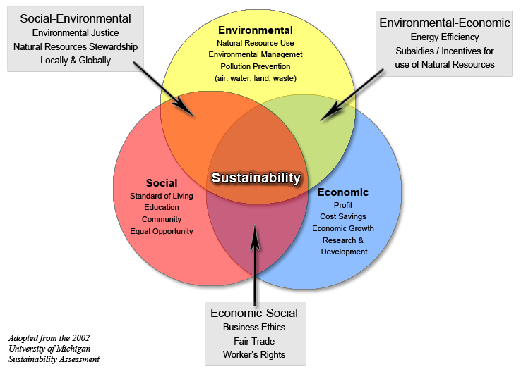
Triple bottom line

Slide 88
Management Compensation
Salary
a fixed payment
Bonus
based upon formula or agreed-upon goals
Benefits
additional items paid by the employer

Slide 89
Guelph University - President Compensation
Salary ($287,000)
Low interest loan
Pension + top-up
($100,000 x 14 yrs)
2 years salary if fired
Automobile (Buick or equivalent)
$30,000 furniture
$10,000 moving expenses
Bridge financing for old home
$15,000 annual housing allowance
Permanent paid employment for wife
All expenses paid four trips for wife (if “beneficial to university)
One year administrative leave
$7,500 annual expense account
$5,000 annual research account
Signing bonus, golf club dues, catering, snow clearing, performance bonus

Slide 90
Common benefits for employees
Pension
Bonus
Health insurance
Life insurance
Training and development
Flex hours
Home office (with equipment)
Personal time
Employee awards
Christmas party
Car allowance
Free parking
Paid professional dues
Wellness programs (incl EAP)
Tuition for university
Sick leave program
Long-term disability program
Stock purchase plans
Smart phones and laptops
Paid vacation
In-house financial consulting
Employee discounts
Mentorship
Profit sharing
Donation match
Fitness programs
Etc.!

Slide 91
Compensation strategy

Slide 92
Reading 2 – CFO as predictor
What are five things arising from the reading where the CFO’s individual performance was partly responsible for major problems at Greycor?
Who else should share in the blame, and why?

Slide 93
Reading 3 – Start with numbers
Most accounting professionals favour financial assessment over qualitative assessment
The article advocates starting and ending with numbers – but what are the factors that affect individual performance?

Slide 95
Corporate Governance
Refers to the relationship among the following players
in determining the direction and performance of the corporation:
Shareholders
Board of Directors
Management (led by the Chief Executive Officer)
Agency Issue
How corporations can succeed (or fail) in aligning managerial motives with the interests of the shareholders and the board

Slide 96
Agency theory
Goals of principals and agents may conflict
Difficult and expensive for the principal to verify what the agent is actually doing
Hard for Board of Directors to confirm that managers are acting in shareholders’ interests
Principal and agent may have different attitudes toward risk

Slide 97
Agency theory – Incenting Management
Contract-based outcomes
Performance incentives in compensation agreements
External governance mechanisms
Auditors
Banks and analysts
Regulatory bodies (Sarbanes-Oxley Act, 2002)
Media and public activists
Committed and involved Board of Directors
Active, critical participants in setting strategies
Evaluate using high performance standards
Take control of succession process
Director independence

Slide 98
Role of the Board in strategic management
Setting overall vision / mission and corporate strategy
Hiring and firing the CEO and (sometimes) the top management
Controlling, monitoring and supervising
top management
Reviewing and approving the acquisition and use of resources
Caring for shareholder interests
Board of
Directors

Slide 99
Trends in Corporate Governance
Boards are more involved in reviewing, evaluating, and shaping strategy
Institutional investors active on boards; pressure on CEO for firm performance
Shareholders demand directors own more than token amounts of the firm’s stock
Non-affiliated outside directors increasing
Boards becoming smaller
Boards taking more control of board functions
Corporations becoming more global; international experience needed
Societal expectations that boards balance profitability and social responsibility
Diversity of board members
Audit Committee taking on more responsibility for risk management

Slide 100

Making Change

Slide 101
The Future is Change!
“Only a few dozen computers will be needed in the entire world.” Charles Watson founder of IBM
“The light bulb will never catch on.” Thomas Edison

Slide 102
People in the change process
The key element in change is people
Getting people to buy into a new way of doing anything is difficult
Change inevitably involves resistance

Slide 103
Phases of Planned Change
Planned change is the result of consciously preparing for and taking actions to reach a desired goal
Three phases
unfreezing
changing
refreezing

Slide 104
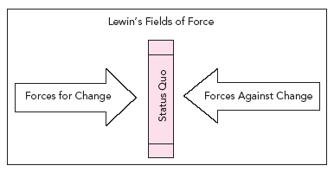
Lewin’s Forcefield Analysis

Slide 105
Roles
Leader Role
Creates a vision, goals, and influences others to share that vision and work toward the goals
Manager Role
Draws on a position of formal authority to initiate problem solving, decision making, and action
Integration of Leadership and Management Roles
One person fills the role of both leader and manager
This individual needs to be adept at both creating change as well as emphasizing internal process controls

Slide 106
Formal and Informal Leaders
Many leaders have a formal, appointed leadership role while others are informal leaders
Informal leaders do not have the advantage of formal authority, but are able to stir up new ideas, champion new causes, and inspire coworkers to pursue strategic visions

Slide 107
Targets for Change
Strategy
Product and Service
Technology
People
Culture
Management

Slide 108
Resistance to Change
Individual resistance
Selective perception
Lack of information
Fear of the unknown, personal uncertainty
Habit
Resentment towards the initiator, possible loss of face
Organizational resistance
Power maintenance – loss of control
Structural stability, loss of identity, loss of competence
Organizational culture
Team norms
Real threats

Slide 109
Strategies to Overcome Resistance to Change
Useful, positive strategies include:
negotiation and agreement
education and communication
participation and involvement
facilitation and support
Risky, short-sighted strategies include:
manipulation
co-optation
coercion (explicit and implicit)

Slide 111
Create an inventory of risks

Slide 112
Assess and present the risk inventory

Slide 115

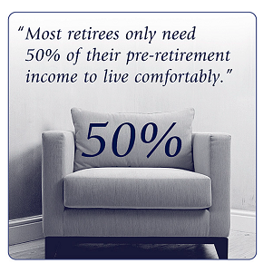

How much do employees need to retire?

Slide 116
RRSP – start now!
http://www.retirementadvisor.ca/retadv/apps/assetaccumulator/assetAccumulator.jsp?toolsSubMenu=preRet

Slide 117



Retirement challenge - your money loses value
1980
Today
Cost of
Groceries⁺
$21
$50
Cost of
a car
$6,715
$18,490*
Cost of
a house
$110,292
$303,700**

Slide 118



Will employees outlive their savings?
65
91
95
Retirement
50% chance
one spouse will
live to age 91
25% chance
one spouse will live to 95
Source: Canadian Institute of Actuaries – 1994 Uninsured Pensioner Mortality Table Projected to 2020.

Slide 119
SMU Pension Members - Equity Allocation

Slide 120
Canadian Equities Distribution of historical annual returns
 |  |  |  |  |  | 2006 | 2010
 |  |  |  |  |  | 2004 | 2005
 |  |  |  |  | 2007 | 1997 | 2003
 |  |  |  |  | 2000 | 1995 | 1996
 |  |  |  |  | 1987 | 1991 | 1989
 |  |  |  |  | 1986 | 1988 | 1985
 |  |  |  |  | 1982 | 1977 | 1978 | 2009
 |  |  | 1998 |  | 1973 | 1976 | 1972 | 1999
 |  |  | 1994 |  | 1971 | 1975 | 1968 | 1993
 |  | 2002 | 1992 |  | 1965 | 1967 | 1964 | 1983
 |  | 2001 | 1984 |  | 1960 | 1963 | 1955 | 1980
 |  | 1990 | 1970 |  | 1959 | 1956 | 1951 | 1961
 |  | 1981 | 1969 |  | 1953 | 1948 | 1949 | 1958
 |  | 1940 | 1966 |  | 1952 | 1944 | 1936 | 1954
2008 |  | 1937 | 1962 |  | 1947 | 1943 | 1934 | 1945
1931 | 1974 | 1932 | 1946 |  | 1941 | 1942 | 1926 | 1935 | 1979 | 1950
1930 | 1957 | 1929 | 1939 |  | 1938 | 1924 | 1925 | 1928 | 1927 | 1933
-40 to -30 | -30 to -20 | -20 to -10 | -10 to 0 |  | 0 to 10 | 10 to 20 | 20 to 30 | 30 to 40 | 40 to 50 | > 50

Slide 121
Accounting presentation of pension transactions
Dalhousie University → DB pension plan
Saint Mary’s University → DC pension plan
* note: discussion of Dal and SMU financial statements in class

