Slide 1

Chapter 2
Accountants as Business Analysts
Kristine Brands
MSAA/MBAA 617 Accounting Information Systems
May 17, 2017

Slide 2

Agenda
Learning Objectives
Terms
Changing Role of Accountants
Documentation
Business Models
BPMN
BPM
DFD
Homework
Questions

Slide 3
Learning Objectives
Describe the roles of the accounting/finance function in business and why those roles require knowledge of technology and business processes
Understand the importance of business process documentation
Recognize the value of business models
Articulate the characteristics of activity models
Understand and apply the building blocks for BPMN (activity) diagrams
Use pools and lanes to identify process participants
Apply message flows to show interactions between pools
Understand and apply flow object types
Recognize and model repeating activities
Understand and apply data objects and stores to model data created, updated, transferred and deleted in a process

Slide 4
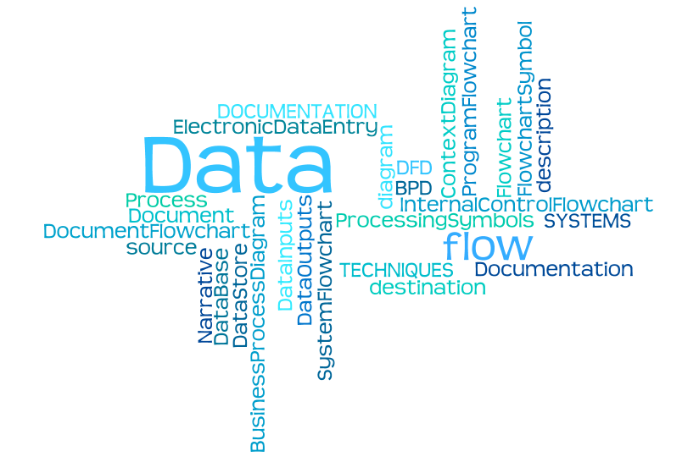

Slide 5

Changing Roles of Accountants in Business
LO# 1
In the past accountants focused on
  Stewardship and reporting functions
  Preparing financial reports
  Auditing
Now accountants also take active role in
  Helping enterprises optimize processes
  Achieving competitive advantage
  Maximizing shareholder value

Slide 6

Changing Roles of Accountants in Business
LO# 1
Rapid changes in technology increase availability of data
  Business intelligence systems
  ERP systems
Information produced by systems must support the information requirements of the enterprise’s decision makers
Accountants involved in supporting evidence-based decision making
  Strategic planning
  Process improvement
  Compliance management

Slide 7
Roles of Accountants in Business
LO# 1
Stewardship and Reporting | Accounting/Finance Operations | Business Management Support
Regulatory compliance | Finance and accounting processes | Management information
Tax returns | Financial close | Planning budgeting and forecasting
Stakeholder assurance | Financial reporting and analysis | Performance measurement
Investor relations | Providing management information | Performance management
Raising capital and loans | People management | Risk management – from strategic to operational including fraud risk
Board reports | Using IT to make finance and accounting processes more efficient and effective | Investment appraisal
Statutory reporting |  | Cost management
 |  | Supply chain management

Slide 8
Changing Roles of Accountants in Business
LO# 1
To prepare for their changing roles accountants must:
  Understand the business and how it collects summarizes and communicates business information
  Understand how the business delivers value to its customers
  Understand the risks that the business faces and the internal controls in place to mitigate those risks
  Understand how accounting information systems collect summarize and report business process information

Slide 9

Systems Terms
Processes
  A set of actions that that transform data into other data or information.
Data Sources
  Where the data comes from
Data Destinations
  Where the data goes
Data stores
  Where and how the data is stored
Data Flow
  Data movement through a process source to destination to stores

Slide 10
Definitions
LO# 2
Business Process: a defined sequence of business activities that use resources to transform specific inputs into specific outputs to achieve a business goal.
Business Analysis: the process of defining business process requirements and evaluating potential improvements.
Business Model: a simple abstract representation of one or more business processes.
Documentation: explains how business processes and business systems work; a tool for information transmission and communication

Slide 11
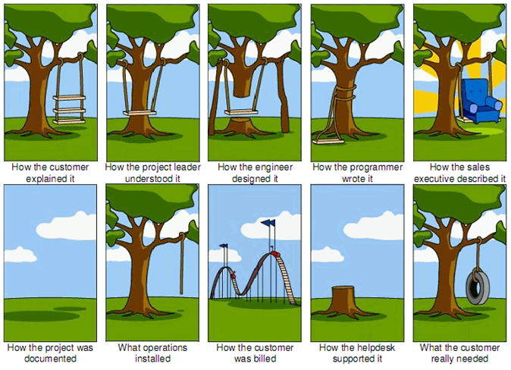
Documentation is critical

Slide 12
Importance of Business Process Documentation
LO# 2
Sarbanes-Oxley Act of 2002
  Made documentation essential for businesses
  Requires managers to assess and attest to the business’s internal control structure and procedures
  Requires external auditors to audit management’s assessment of the effectiveness of internal controls and express an opinion on the company’s internal control over financial reporting

Slide 13
Importance of Business Process Documentation
LO# 2
Documentation supports the following:
  Employee training
  Internal and external audit requirements
  Accountability
  Standardized communication within the enterprise
  Standardized communication between the enterprise and its customers, suppliers, and other stakeholders
Documentation includes:
  Business process models
  Business rules
  User manuals training manuals
  Product specifications
  Software manuals
  Schedules
  Organization charts
  Strategic plans

Slide 14
Why Document Systems?
Accountants must be able to read documentation and understand how a system works (e.g., auditors need to assess risk)
Sarbanes-Oxley Act (SOX) requires management to assess internal controls and auditors to evaluate the assessment – Accounting and IT Controls
Used for systems development and changes – Configuration Control
Notes:
It has been said that a picture is worth a thousand words, and that certainly is true when it comes to an easy way to understand an organization’s information system. Documenting an information system requires great skill; however, the ability to understand and read a documentation can be quite intuitive.
Although there are many methods used in business to document systems, the text uses the three most popular for accountants: data flow diagrams, systems flowcharts, and Business Process Modeling Notation (BPMN).

Slide 15

Importance of Business Process Documentation
LO# 2
Facilitates process improvement
  Effectiveness – are the outputs obtained as expected?
  Efficiency – can outputs be produced with fewer inputs?
  Internal control – are controls working?
  Compliance – does the process comply with constantly changing local, state, federal, and international laws and regulations

Slide 16
Systems Documentation
Explains
  How a System Works
    Who
    What
    Where
    When
    Why and How of
Explains
  System Processes
    Data Entry
    Data Processing
    Data Storage
    Information output
    System Controls

Slide 17

Documenting Processes and Systems
Pictorial Representations of processes and systems include:
  Concept diagram
  Process maps
  System flowcharts
  Document flowcharts
  Data flow diagrams

Slide 18
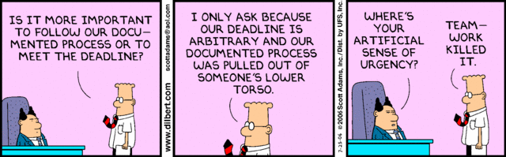
SYSTEM Documentation

Slide 19

Value of Business Models
LO# 3
How many words would it take to provide the same information as this map of San Diego?
Similarly, business processes and systems can also be difficult to describe concisely using words alone.
Business models – like this map -allow us to depict the important features of business processes and systems clearly and concisely.

Slide 20
Value of Business Models
LO# 3
Organizational changes, including mergers, acquisitions, outsourcing, offshoring, product innovation, and continuous process improvement, and other business transformations are common.
Change, however, can be expensive and risky. Careful planning is necessary to implement change in a way that minimizes those costs and risks.
Business models create value by providing communication, training, analysis and persuasion tools.
  Presenting information more concisely and clearly than a written description
  Managing complexity by incorporating only the essential elements
  Eliciting requirements when used to interview involved parties
  Reconciling viewpoints by providing an integrated view
  Simulating potential changes
  Specifying requirements for the actual business process

Slide 21
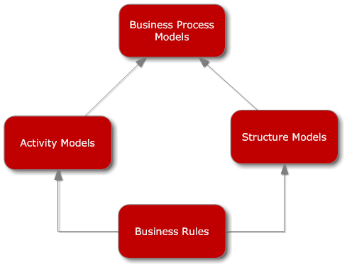
Types of Business Models
LO# 3

Slide 22



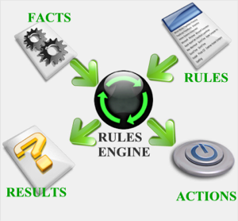
Business Rules

Slide 23
Activity Models
LO# 4
Used to analyze business processes and design changes since well before 1920
Describe the sequence of workflow in a business process
Represent the sequential flow and control logic of a set of related activities
Tools for planning, documenting, discussing, and implementing systems

Slide 24
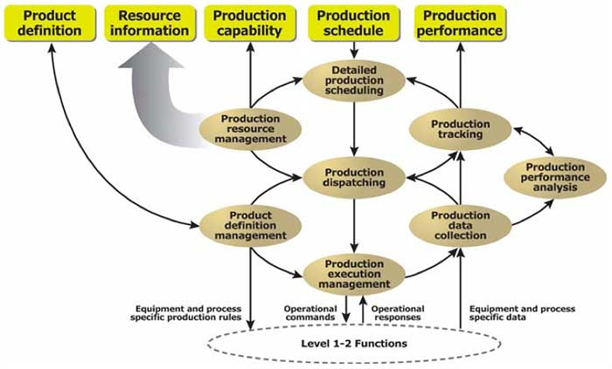
Activity Models
LO# 4
Variety of activity models – changing as technology changes
  Flowcharts
  Data flow diagrams
  Business process maps
  IDEF0 functional models

Slide 25
Activity Models - Must be Able to Describe
LO# 4
Events that start, change, or stop flow in the process
Activities and tasks within the process
The sequence of flow between tasks
Decision points that affect the flow
Division of activity depending on organizational roles

Slide 26

Flowchart

Slide 27
Flowcharts
Describe an information system showing:
Inputs and Outputs
Information activities (processing data)
Data storage
Data flows
Decision steps
Key strengths of flowcharts are that they can easily capture control via decision points, show manual vs. automated processes.

Slide 28
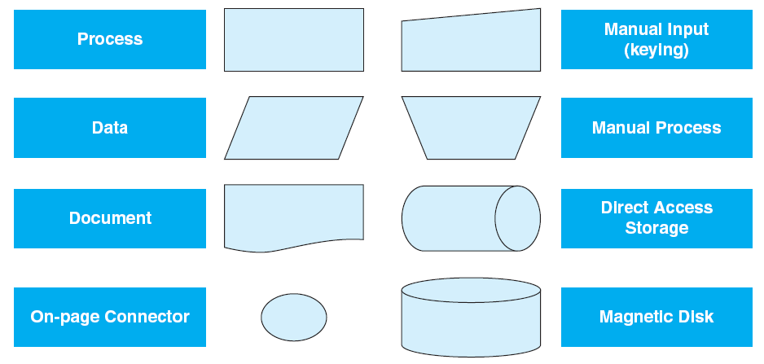
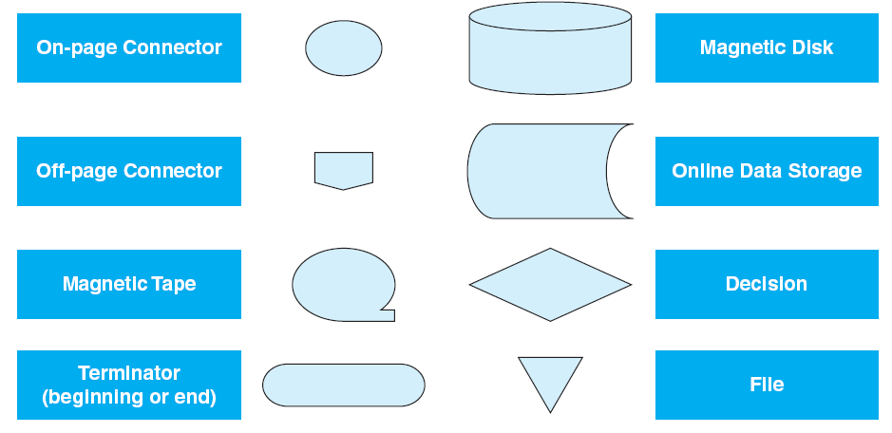
Documenting Systems
Common System Flowchart Symbols
System Flowcharts
Intended to depict the entire system, including inputs, manual and computerized processes, and outputs.

Slide 29
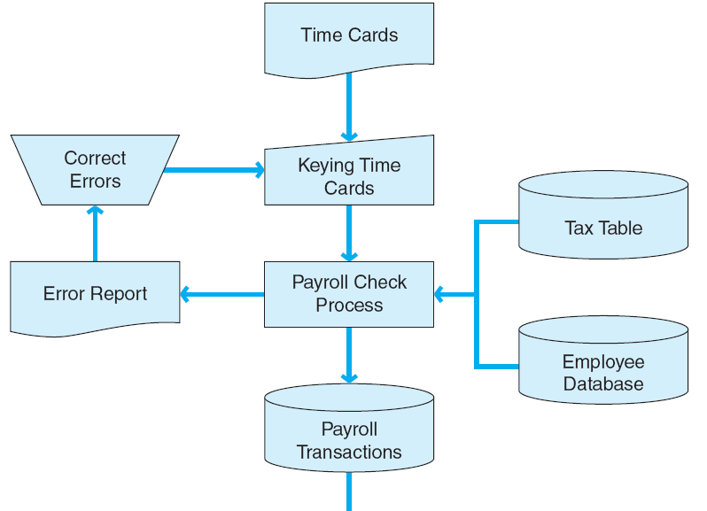
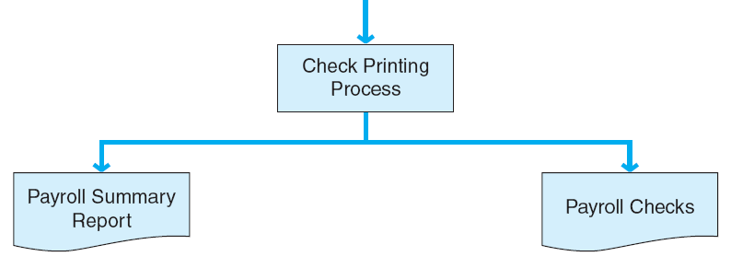
Documenting Systems
Payroll System Flowchart
Document Flowcharts
Flow of documents and information among departments or units within an organization.

Slide 30
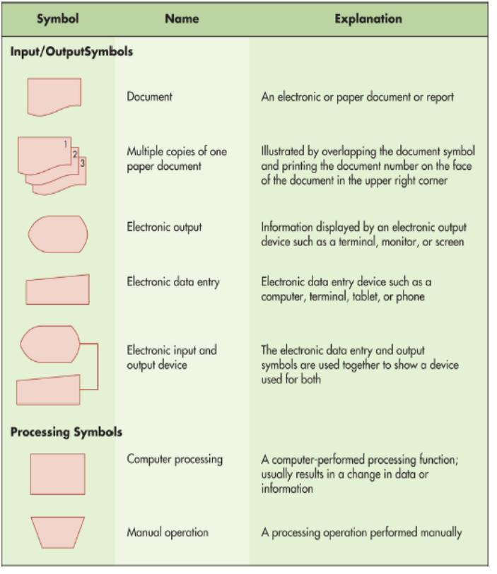
Flowcharts Symbols

Slide 31
Types of Flowcharts
Document: shows the flow of documents and data for a process, useful in evaluating internal controls
System: depicts the data processing cycle for a process
Program: illustrates the sequence of logic in the system process

Slide 32
Guidelines for Drawing Flowcharts
Understand the system you are trying to represent.
Identify business processes, documents, data flows, and data processing procedures.
Organize the flowchart so as it reads from top to bottom and left to right.
Name elements descriptively.
Edit/Review/Refine to make it easy to read and understand.

Slide 33
BPMN for Activity Diagrams
LO# 5
BPMN stands for business process modeling notation
The Object Management Group maintains the BPMN specification
First specification issued in 2004 widely adopted
Specifically designed for process modeling
Designed to be understood by business people
Software available to support modeling and subsequent process simulation

Slide 34
“Good” BPMN Models
LO# 5
They are correct; they do not violate BPMN standards.
They are clear; they describe the logic of the business process.
They are complete; they show all the important elements of the process.
They are consistent; the process logic should always result in a similar model.

Slide 35
Overview of Business Processes
Business Process - a sequence of work steps performed in order to produce a desired result.
Examples:
  Completing a sale
  Purchasing raw materials
  Paying employees
  Paying vendors

Slide 36
Business Process Diagrams
Is a visual way to represent the activities in a business process
Intent is that all business users can easily understand the process from a standard notation (BPMN: Business Process Modeling Notation)
Can show the organizational unit performing the activity

Slide 37
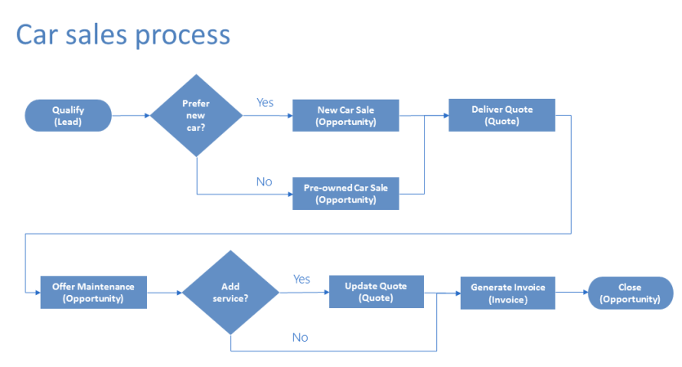

Slide 38





Process Maps
Process Maps
Pictorial representations of business processes in which the actual flow and sequence of events in the process are presented in diagram form.
Exhibit 2-6
Process Map Symbols
Start or Finish
Task or Activity
Connector
Decision
Direction of Flow

Slide 39
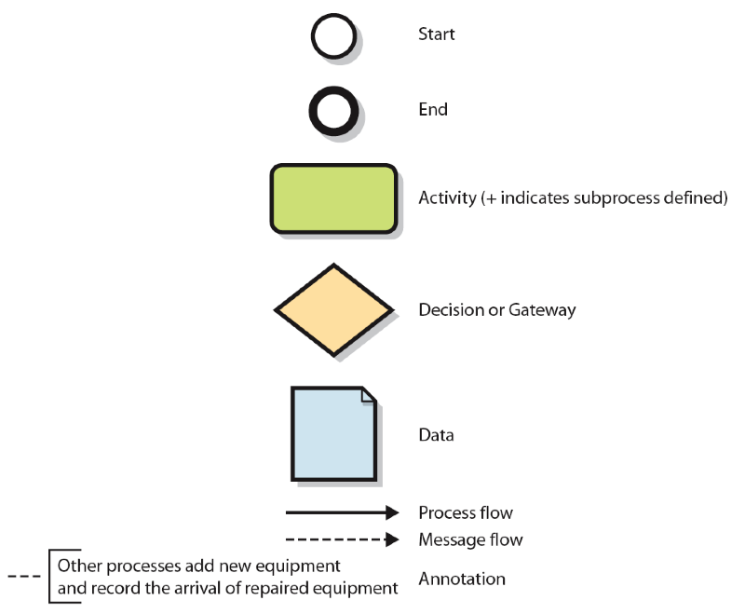
BPMN: Business Process Modeling Notation

Slide 40
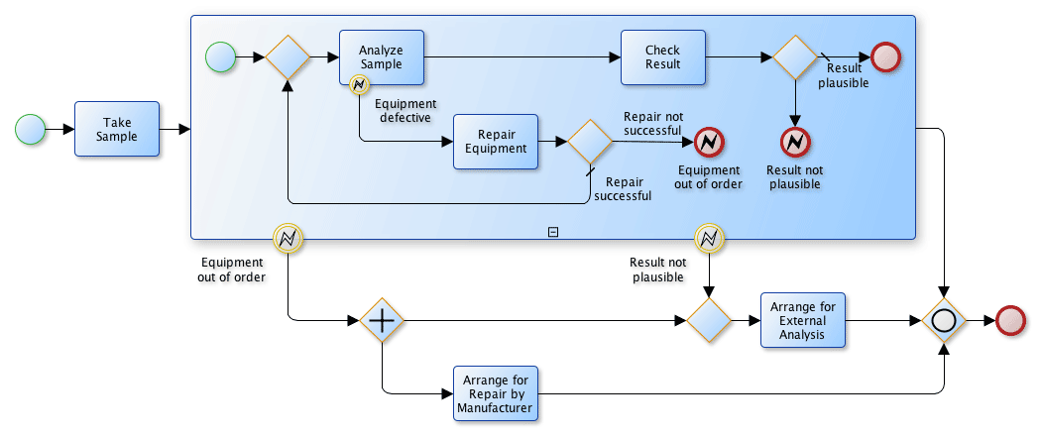
Business Process Model

Slide 41
Business Process Diagram Basic Symbols

Slide 42
Payroll Business Process Diagram Example
Notes:
Note that a major difference between the data flow diagrams and flowcharts compared to the business process diagram is that the business process diagram can distinguish the department or location that the activity takes place. These rows—such as New Employee, Human Resources, Payroll, and so on—in the above figure are called swim lanes.

Slide 43
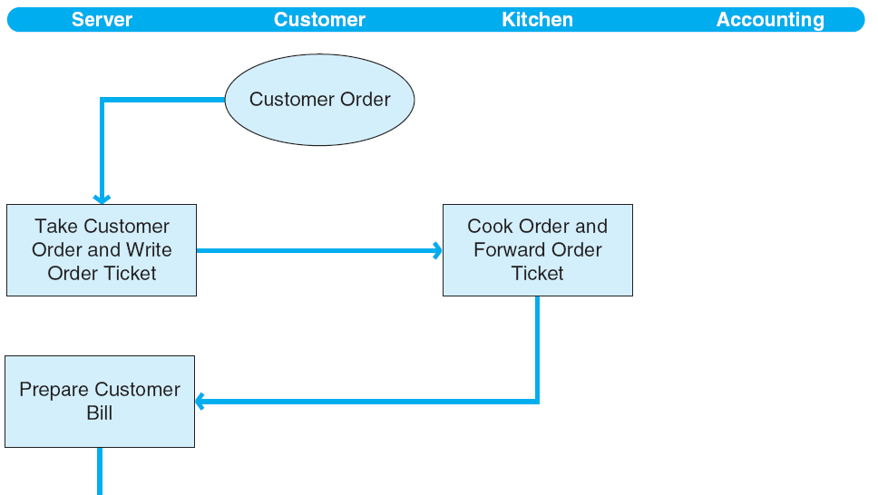
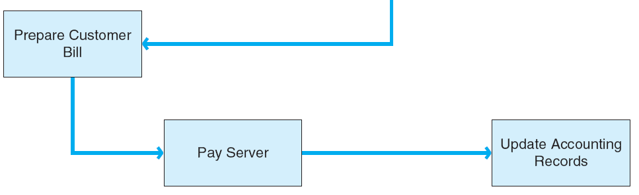
Documenting Systems
Restaurant Process Map

Slide 44
BPMN Basic Building Blocks - Events
LO# 5
Events include start, intermediate, and end events. Intermediate events affect the flow of a process, but do not start or end the process.

Slide 45
BPMN Building Blocks - Activities
LO# 5
Activities represent specific steps in the business process. Basic activities are modeled as rounded rectangles
Each activity is described with a short verb phrase

Slide 46
BPMN Building Blocks – Sequence Flows
LO# 5
Represented by arrows to indicate the progression of activity within the process

Slide 47
BPMN Building Blocks – Gateways
LO# 5
Show process branching and merging as the result of decisions
Usually gateways appear as pairs on the diagram. The first gateway shows the branching and the second gateway shows merging of the process branches.

Slide 48
BPMN Example
LO# 5

Slide 49

BPMN Pools and Swimlanes
LO# 5
Identify participants in a business process
Pools identify organizations
Lanes identify departments or individuals within the organizations
Tasks/activities are assigned to one participant to show responsibility
Each pool must include one start and at least one end
The sequence flow must not break between the start and end

Slide 50
BPMN Pools and Swimlanes - Example
LO# 5

Slide 51
BPMN Pools and Message Flows
LO# 5
Exchanges between two participants (pools) in the same process are represented as message flows
Message flows are shown as dashed lines with an arrow on the destination end and a small circle on the source end
Message flow content should be described with text

Slide 52
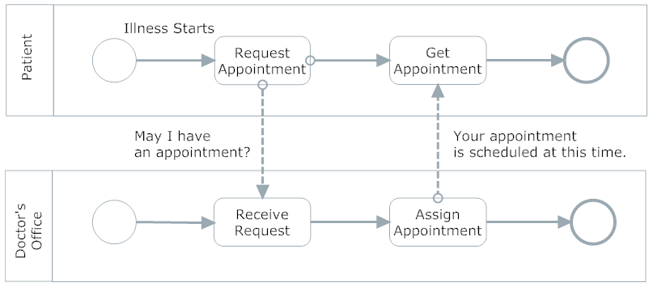
BPMN Pools and Message Flows - Example
LO# 5

Slide 53
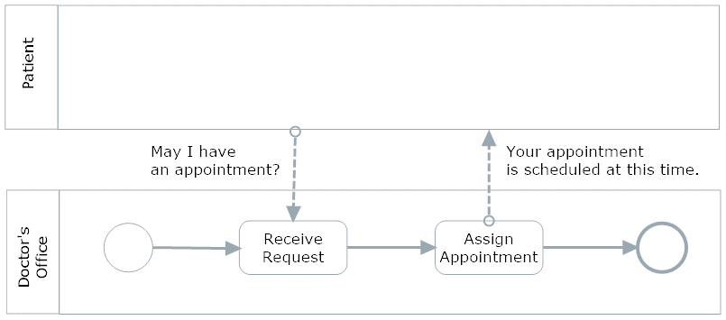
BPMN Pools and Message Flows - Example
LO# 6, 7
Usually, modelers are not very interested in activities in the external pool. Yet, we remain concerned about the message flows between the pools. So, we can make the patient’s pool opaque, hiding the activities, but still showing the message flows. Note that the message flows now attach to the edge of the patient pool.

Slide 54

The Token Concept
LO# 8
A start event generates a token.
That theoretical token must be able to flow through the process – along every potential path - until it reaches an end event.
Tokens only travel along sequence flows and pass through process flow objects.
Tokens do not traverse message flows.

Slide 55
Flow Object Types
LO# 8
Flow objects include events, activities, and gateways.
Sequence flows only connect to flow objects.
Each flow object can be further characterized by type by adding a type icon to the specific flow object symbol.
For example, a “timer” event would show the event with a clock face icon inside, and a “message” event would show the event with an envelope icon inside.

Slide 56
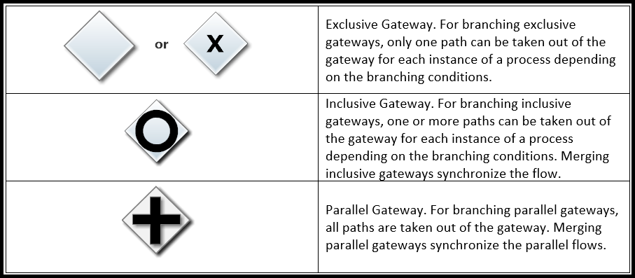
Gateway Types
LO# 8

Slide 57
Exclusive Gateway
LO# 8
The Trip Involves Air Travel or Car Travel but not Both

Slide 58
Inclusive Gateway
LO# 8
The Trip may involve either Air Travel, Car Travel, or Both

Slide 59
Parallel Gateway
The Trip involves Air Travel, Car Travel, and Hotel Stays

Slide 60
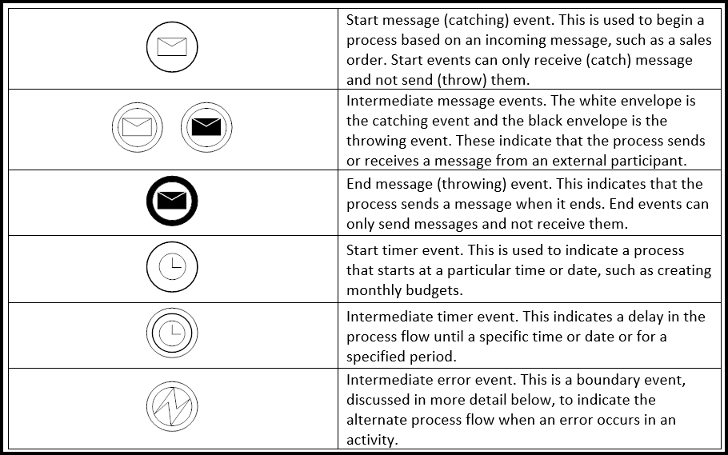
Event Types
LO# 8

Slide 61
Message Events Example
LO# 8
The process starts with a start message events that receives (catches) the “Request” message from the external participant. The process proceeds to the “Evaluate Request” task, and then the intermediate message event sends (throws) the “Evaluation” message flow to the external participant. The process flow continues to the next intermediate message event where it waits (the token stops) until the external participant responds with the “Confirm” message flow. When the event catches the message, the sequence flow continues to the “Do Something” task and then the process ends. The end message event throws a message to the external participant that the process is done.

Slide 62
Timer and Boundary Events
LO# 8
The start timer begins the process two weeks before the birthday to be celebrated. The “Plan Party” task has an intermediate error event attached to its boundary (a boundary event). Specifically, this is an example of an interrupting boundary event that affects process flow when an error occurs in the Plan Party task. If an error occurs, then the process flows to the “Cancel Party” task and then ends. However, if the Plan Party task completes successfully, the process flows to the intermediate timer event and then waits two weeks (the token waits to proceed). After two weeks, the process continues to the “Hold Party” task and then ends.

Slide 63
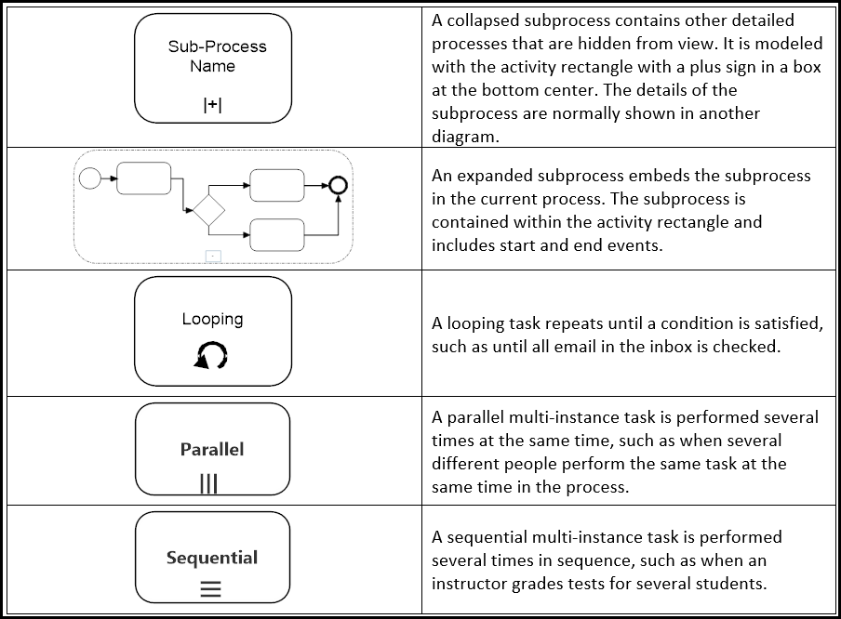
Subprocesses and Repeating Activities
LO# 9

Slide 64
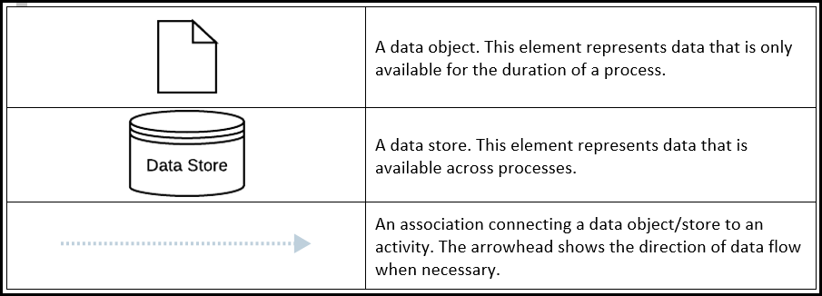
Data Objects, Data Stores, and Associations
LO# 10

Slide 65
Data Objects Example
LO# 10
The process starts and the actor buys concert tickets. The tickets data object is created. Time passes until the date of the concert and then the actor attends the concert where the tickets data object is used.

Slide 66
BPMN Modeling – Best Practices
LO# 5
Focus on one business process at a time.
Clearly identify the events that start and end the process.
Include essential elements, but avoid distracting detail.
Think about a token flowing from the start event through the process to the end event; the flow of the token should be clear for all paths through the process.
Label activities clearly with a verb and an object, e.g., pay invoice.
Model iteratively, getting feedback to improve accuracy and clarity.

Slide 67

Data Flow Diagrams (DFD)
Focuses on the data flows for:
Processes
Sources and destinations of the data
Data stores
DFD are visually simple, can be used to represent the same process at a high abstract or detailed level.

Slide 68
Basic Data Flow Diagram Elements
Notes:
There are four basic elements to the data flow diagram:
The square box symbol represents where the data is coming from (source) and where it ends up (destination). An example, from a revenue cycle perspective is that the customer would be a data source.
2. The arrows are symbols showing the directional flow of data from a source to either: a transformative process, data store, or data destination.
The circle is a symbol that shows a transformative process. This can be at a high “context” level such as “process Revenue cycle”; or it could be at a more detailed level such as “sales order entry”
4. The two horizontal lines represent data storage
In addition, you may see a triangle used in a DFD which would identify controls associated with the process.

Slide 69
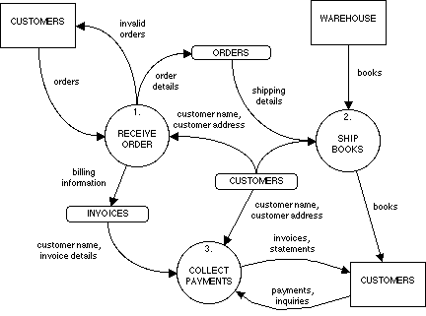
Revenue Cycle Data Flow Diagram

Slide 70
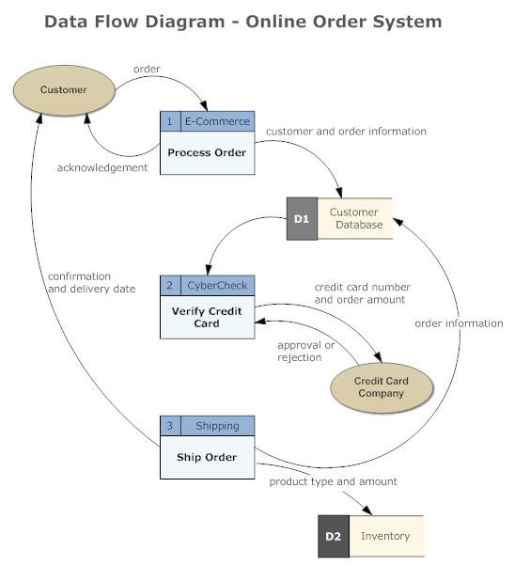
Online Order System DFD

Slide 71
Basic Element to the Data Flow Diagram
The square box symbol represents where the data is coming from (source) and where it ends up (destination). An example, from a revenue cycle perspective is that the customer would be a data source.
2. The arrows are symbols showing the directional flow of data from
a source to either: a transformative process, data store, or data
destination.
The circle is a symbol that shows a transformative process. This can be at a high “context” level such as “process Revenue cycle”; or it could be at a more detailed level such as “sales order entry”
4. The two horizontal lines represent data storage
In addition, you may see a triangle used in a DFD which would identify controls associated with the process.

Slide 72
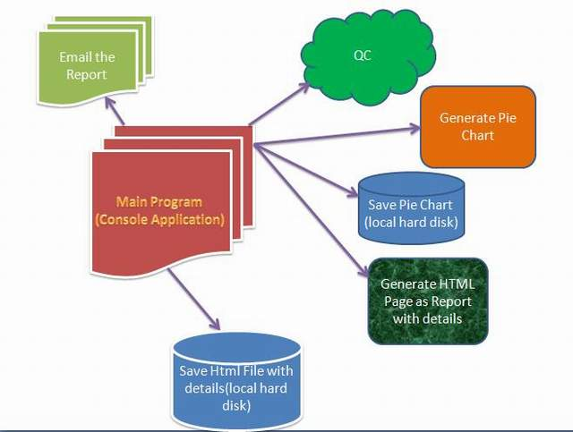
Data Flow Diagrams (DFD)
Focuses on the data flows for:
Processes
Sources and destinations of the data
Data stores
DFD are visually simple, can be used to represent the same process at a high abstract or detailed level.

Slide 73

Basic Guidelines for creating a DFD
Understand the system that you are trying to represent.
A DFD is a simple representation meaning that you need to consider what is relevant and what needs to be included.
Start with a high level (context diagram) to show how data flows between outside entities and inside the system. Use additional DFD’s at the detailed level to show how data flows within the system.
Notes:
Understand the system that you are trying to represent: if you don’t understand the system that you are trying to visually represent, no one else will understand what you created. Ways to help you understand are to actually observe the process taking place, interview and ask questions, and try to do a walkthrough of a transaction to understand how the data flows, where it generates from, what activities occur within the process, and who else uses this information. It is also good to identify the source documents used as you may have seen in the chapter. Figure 3-5, for example, identifies the source document on top of the data flow arrow.
Only relevant data elements should be included in the data flow diagram.
Starting with a level of abstraction, generally drawing a context DFD that shows the data flowing between outside entities (e.g., customer) and inside the organization allows for a simple big picture of the process. Using a hierarchy to “drill-down” into the details (e.g., sales invoice process) can show more information. By creating a hierarchy of levels of detail allows the reader of the DFD to either just get the overall big picture of a process, or really get the details of a process. It would be difficult and messy creating information overload if there was no organization of the DFD making the DFD too cluttered to read.
Identify and group the data flows. If for example, the data flows together they are in one arrow, when it separates out then use multiple arrows. An example of this would be a sales order, some orders may be approved and continue to move through the process whereas others may not be approved and would flow back to the customer. Similarly, identify and group transformation processes, data stores, data sources, and destinations.
By being descriptive it helps the reader understand the process better.
Giving a process a sequential number helps provide an information trail to the reader of the DFD as they move from abstract to detailed versions of the process.
As with anything, refining your draft and receiving feedback help provide for a clear understanding as to what you intend the reader will understand from your DFD.

Slide 74

Basic Guidelines for creating a DFD
Identify and group all the basic elements of the DFD.
Name data elements with descriptive names, use action verbs for processes (e.g., update, edit, prepare, validate, etc.).
Give each process a sequential number to help the reader navigate from the abstract to the detailed levels.
Edit/Review/Refine your DFD to make it easy to read and understand.
Notes:
Understand the system that you are trying to represent: if you don’t understand the system that you are trying to visually represent, no one else will understand what you created. Ways to help you understand are to actually observe the process taking place, interview and ask questions, and try to do a walkthrough of a transaction to understand how the data flows, where it generates from, what activities occur within the process, and who else uses this information. It is also good to identify the source documents used as you may have seen in the chapter. Figure 3-5, for example, identifies the source document on top of the data flow arrow.
Only relevant data elements should be included in the data flow diagram.
Starting with a level of abstraction, generally drawing a context DFD that shows the data flowing between outside entities (e.g., customer) and inside the organization allows for a simple big picture of the process. Using a hierarchy to “drill-down” into the details (e.g., sales invoice process) can show more information. By creating a hierarchy of levels of detail allows the reader of the DFD to either just get the overall big picture of a process, or really get the details of a process. It would be difficult and messy creating information overload if there was no organization of the DFD making the DFD too cluttered to read.
Identify and group the data flows. If for example, the data flows together they are in one arrow, when it separates out then use multiple arrows. An example of this would be a sales order, some orders may be approved and continue to move through the process whereas others may not be approved and would flow back to the customer. Similarly, identify and group transformation processes, data stores, data sources, and destinations.
By being descriptive it helps the reader understand the process better.
Giving a process a sequential number helps provide an information trail to the reader of the DFD as they move from abstract to detailed versions of the process.
As with anything, refining your draft and receiving feedback help provide for a clear understanding as to what you intend the reader will understand from your DFD.

Slide 75
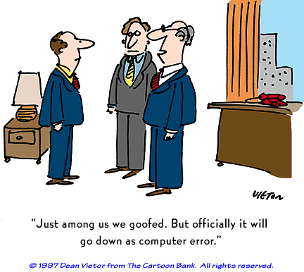

Slide 76
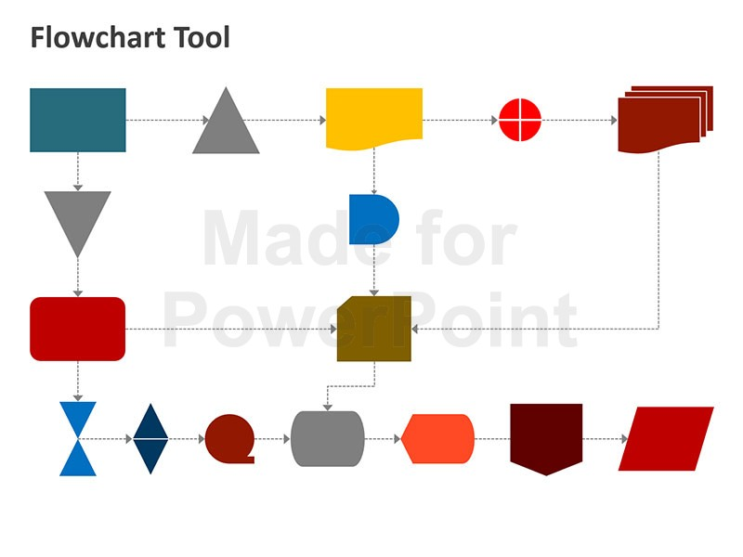
Flowchart tools and approaches
PowerPoint
Visio
Word
Excel
Paper and Pencil

Slide 77
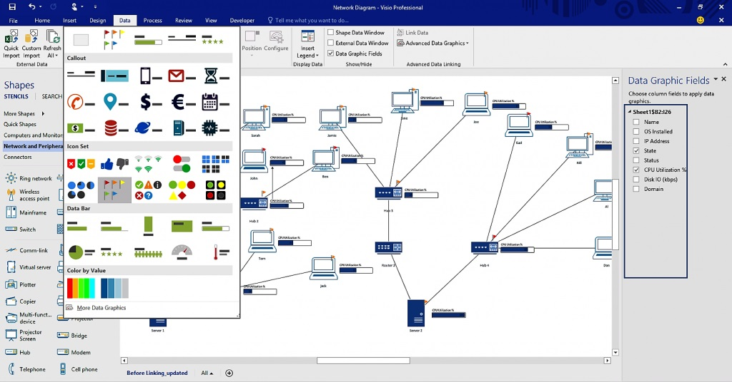
VISIO

Slide 78
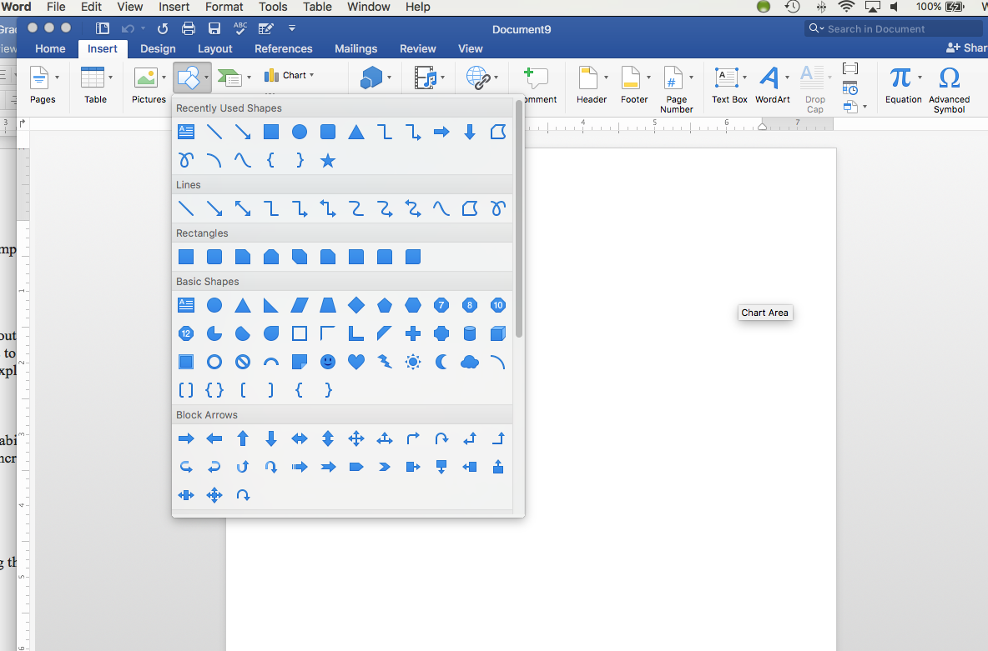

Slide 79
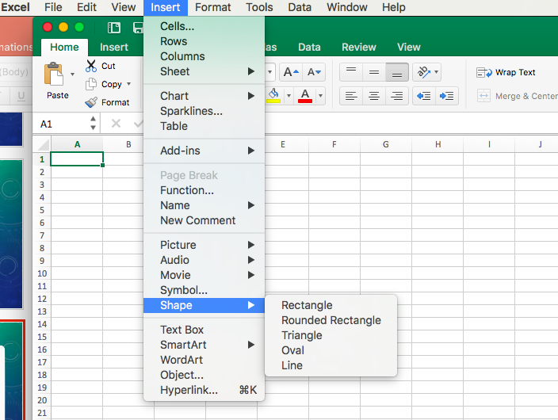

Slide 80
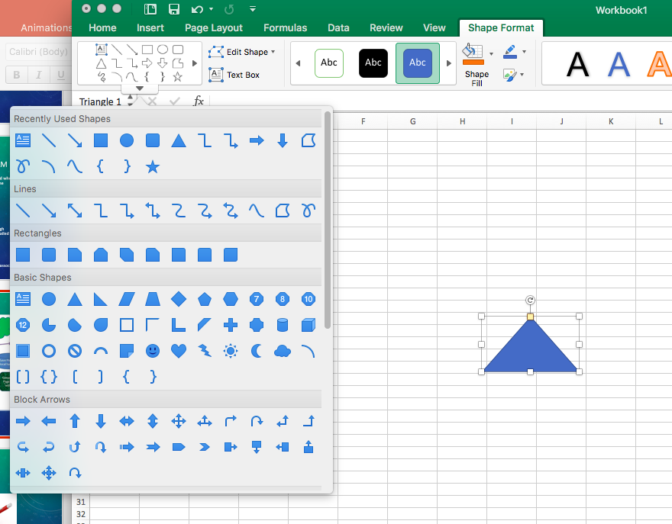

Slide 81

Low Tech

Slide 82

Week 2 assignments

Slide 83

Week 2 Readings/videos
Week 2 Assignments
Read chapter 2 in your textbook.
Week 2 Forum Discussion
Please watch the following video:
BA-Experts. (2012, October 2). What Techniques Do Business Analysts Use? [Videofile].
Retrieved from https://www.youtube.com/watch?v=dPB0lUrpeYA
Available in Closed Captioning (Elapsed time: 9:20)

Slide 84

Week 2 Forum Discussion
Summarize the video What Techniques Do Business Analysts Use? [Video file].
Retrieved from https://www.youtube.com/watch?v=dPB0lUrpeYA
in your own words in a posting of at least 250 words. Please respond to two classmate’s postings and follow APA format.
Due Date: Friday May 19th at midnight your local time.
Grading Rubric
Summarize the BA-Experts video in your own words in a forum posting 70
with a minimum 250 word posting. Be sure to cite your references in APA
format and also respond to at least one classmates’ postings in substantive post.
Respond to two classmates’ postings 10
Grammar and usage 10
APA Format 10
Total 100

Slide 85
Week 2 Assignments

Slide 86

Week 2 Assignment 1
Please complete the homework in McGraw-Hill connect for Week 2.
Due Date: Sunday May 21st at midnight your local time.

Slide 87
Week 2 Assignment 2
The employees at the Telluride Construction Company enter the work they perform on electronic time sheets using the Oracle ERP payroll module. They can do this at computer terminals at the resort using a smart phone app, or their personal computers. They enter the start and stop times on projects that they are working on and the project code for the project. Everyday at 11:59:59 PM the project data is sent electronically to their Cloud computer provider where it is stored until the next payroll processed. Here are the assumptions for payroll process:
1. Payroll is processed weekly.
2. The electronic project time data updates the payroll database.
3. All net pay payments are made to an employees bank account using direct deposit.
4. No paper checks are processed.
5. Payments are made to:
Government payroll tax accounts for the IRS and the State of Colorado.
The 401K provider for the pension plan.
An electronic payroll register is generated summarizing the payroll disbursement for each pay period.
An electronic payroll report for each employee is generated that summarizes the week’s payroll. The link to view this report is emailed on the day that the payroll is posted to an employee’s bank account. Employees can view this report on their computer.
A summary payroll report for the week is generated electronically and the link is emailed to the payroll supervisor.
Requirements:
Using using Excel, Visio, or Word, please:
A. Prepare a system flowchart showing Telluride Construction Company’s payroll processing.
B. Prepare a Business Process Diagram (BPD) for Telluride Construction Company’s payroll processing.

Slide 88
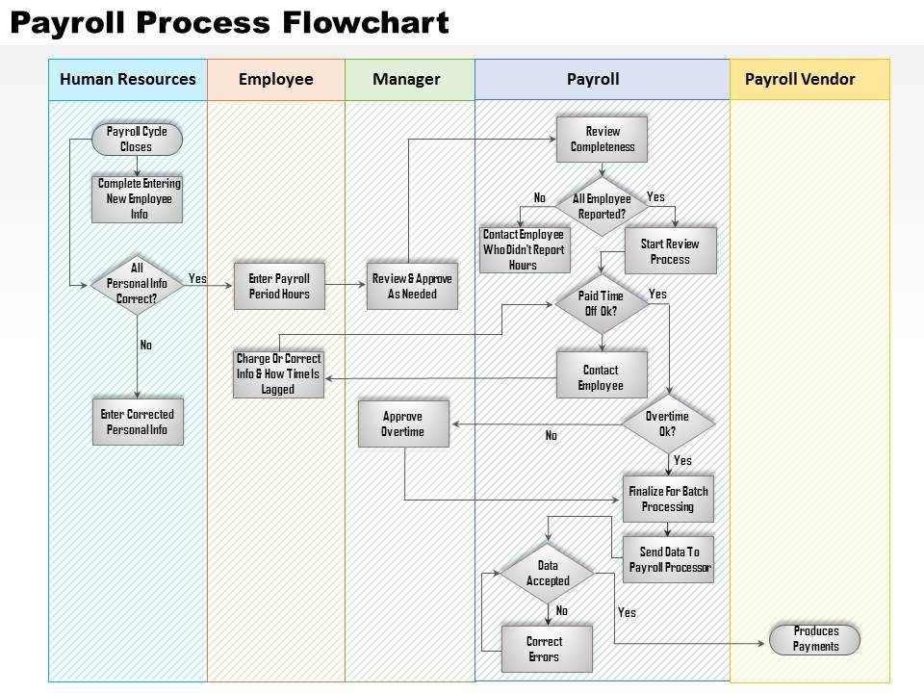

Slide 89
Payroll Business Process Diagram Example
Notes:
Note that a major difference between the data flow diagrams and flowcharts compared to the business process diagram is that the business process diagram can distinguish the department or location that the activity takes place. These rows—such as New Employee, Human Resources, Payroll, and so on—in the above figure are called swim lanes.

Slide 90
Week 2 Assignment 2 Rubric
Grading Rubric
1. The system flowchart accurately depicts Telluride 45
Construction Company’s payroll processing.
2. The BPD accurately depicts Telluride 45
Construction Company’s payroll processing.
3. Flowcharting and Business Process Notation is 10 used for A and B above.
Total 100
Due Date: Sunday May 21st at midnight your local time.

Slide 91
Questions

