Slide 1
Jennifer Spencer HN377: Studies in Child and Adolescent Development Prof: Sara Trovatore 02/26/20017

Slide 2
Growth and Development from birth through adolescence

Slide 3
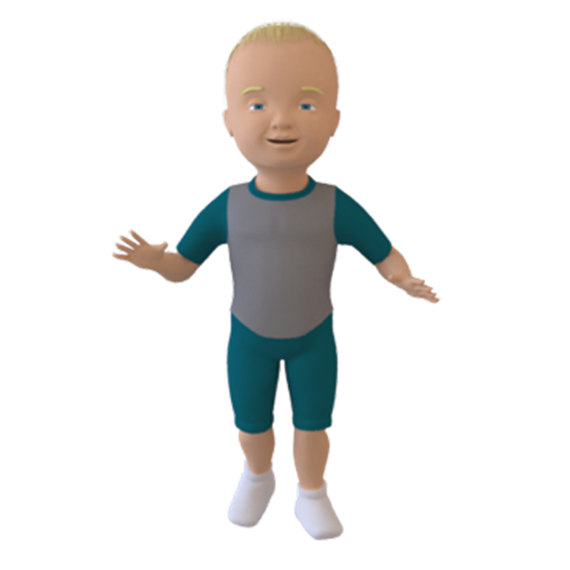
I would like to interduce my son Dylan to everyone.
I’m very smart
I love to take things apart
Play with friends

