Slide 1
The Economic Dimension of Globalization
Steger, Globalization, chap. 3

Slide 2
Wed. Mar. 2 recitation
Chap. 3: Is the Chinese economy in sync with the Global Economic Order?

Slide 3
Chap 3 japanfocus.org essays/PDF
Feb. 25 Thurs. lecture: China’s workforce in the global economy.
Reading: Jenny Chan, Ngai Pun, and Mark Selden “The politics of global production: Apple, Foxconn and China’s new working class.” japanfocus.org #3981 (2013) 13 pp.
Feb. 29 Mon. lecture: China’s energy revolution.
Reading: John Mathews and Hao Tan, "China's Continuing Renewable Energy Revolution: Global Implications." japanfocus.org #4098 (2013) 5 pp. & Clifford Krauss, “China’s Hunger for Commodities Wanes, and Pain Spreads Among Producers.” (New York Times Jan. 9, 2016) 4 pp. PDF

Slide 4

Electronic devices OFF

Slide 5
Steger: Economic Globalization
Dramatic changes have occurred in economic production and in exchange of commodities, due in part to new technologies related to the Internet

Slide 6
Economic Globalization
These technologies have transformed social interactions centered on the marketplace

Slide 7
Economic Globalization
Gigantic flows of capital mediated by digital technology have increased trade in goods and services

Slide 8
Economic Globalization
Global markets have migrated to cyberspace and created new linkages among national and regional economies

Slide 9
Question 1
i-clickers ON

Slide 10
Question 1
True or False: Steger identifies economic activity as the engine that drives forces of globalization.
True
False

Slide 11
Engine driving globalization?
The Global Economic Order’s interconnections are set in motion by political decisions
Globalization is multi-dimensional; based on interaction between politics and the economy

Slide 12
Three building blocks of 21st c. Global Economic Order:
1. Huge transnational corporations (TNCs) or multinationals
2. Powerful international economic institutions
3. Large regional trading systems
APEC Asian Pacific Economic Cooperation
EU European Union
[TPP TransPacific Partnership]

Slide 13
FYI: Multinationals vs. TNCs
We tend to read the following terms and think they refer to any company doing business in another country. Each term is distinct and has a specific meaning which define the scope and degree of interaction with their operations outside of their “home” country.
International companies are importers and exporters, they have no investment outside of their home country.
Multinational companies have investment in other countries, but do not have coordinated product offerings in each country. More focused on adapting their products and service to each individual local market.
Global companies have invested and are present in many countries. They market their products through the use of the same coordinated image/brand in all markets. Generally one corporate office that is responsible for global strategy. Emphasis on volume, cost management and efficiency.
Transnational companies are much more complex organizations. They have invested in foreign operations, have a central corporate facility but give decision-making, R&D and marketing powers to each individual foreign market.
https://leeiwan.wordpress.com/2007/06/18/difference-between-a-global-transnational-international-and-multinational-company/

Slide 14
Origins of Global Economic Order
Bretton Woods, New Hampshire, July 1-22, 1944

Slide 15
Bretton Woods system
Based on idea of British economist John Maynard Keynes (1883-1946) that a healthy economy requires regulation
Removed trade barriers of interwar years (1918-39)
Established binding rules on international economic activities

Slide 16
Bretton Woods: gold standard
Pegged national currencies to fixed gold value of US dollar, creating a stable money exchange system

Slide 17
Bretton Woods system
In operation for approx. 30 years (1945-75).
Established basis for ‘golden age of controlled capitalism’.
Allowed national gov’ts to control flow of money within their borders.
Expanded welfare state through taxes on profitable businesses and wealthy individuals.
Workers in global North were able to join the ‘middle class’ due to rising wages.

Slide 18
Why did Bretton Woods collapse?
Steger: “In response to profound political changes in the world what were undermining the economic competitiveness of US-based industries, President Richard Nixon abandoned the gold-based fixed rate system in 1971.” (pp. 39-40)

Slide 19
U.S. industries targeted by Japan
Targeted for export “overproduction”
Steel
Ship building
Watches
TVs
Automobile
Textiles

Slide 20
1971: Nixon abandoned gold standard
Currency exchange rates floated freely

Slide 21
Free-floating interest rates
Up to 1970s: USD-Yen fixed exchange rate $1.00=¥368
Current: USD-Yen floating exchange rate $1.00=¥113

Slide 22
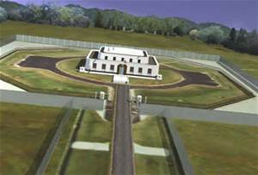
Fort Knox, Kentucky

Slide 23
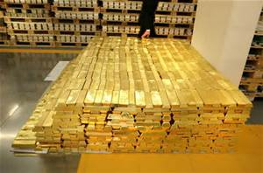
Gold reserves: 147.3 million oz.

Slide 24
CBS News Jan. 10, 2010
“Fort Knox began losing its luster when the United States went off the gold standard in 1971. Before that, gold bars packed into a secure vault gave people faith in the country’s currency.
Today, however, Fort Knox’s gold is now an asset on the Federal Reserve’s balance sheet, not a key part of our monetary system.”

Slide 25
US gold bullion holdings
The gold in Fort Knox and at U.S. Mint facilities adds up to one of the world’s largest bullion holdings.
Still, it’s a tiny part of the nation’s total assets. In a $13.8 trillion GDP economy, 147.3 million troy ounces of gold barely registers.

Slide 26
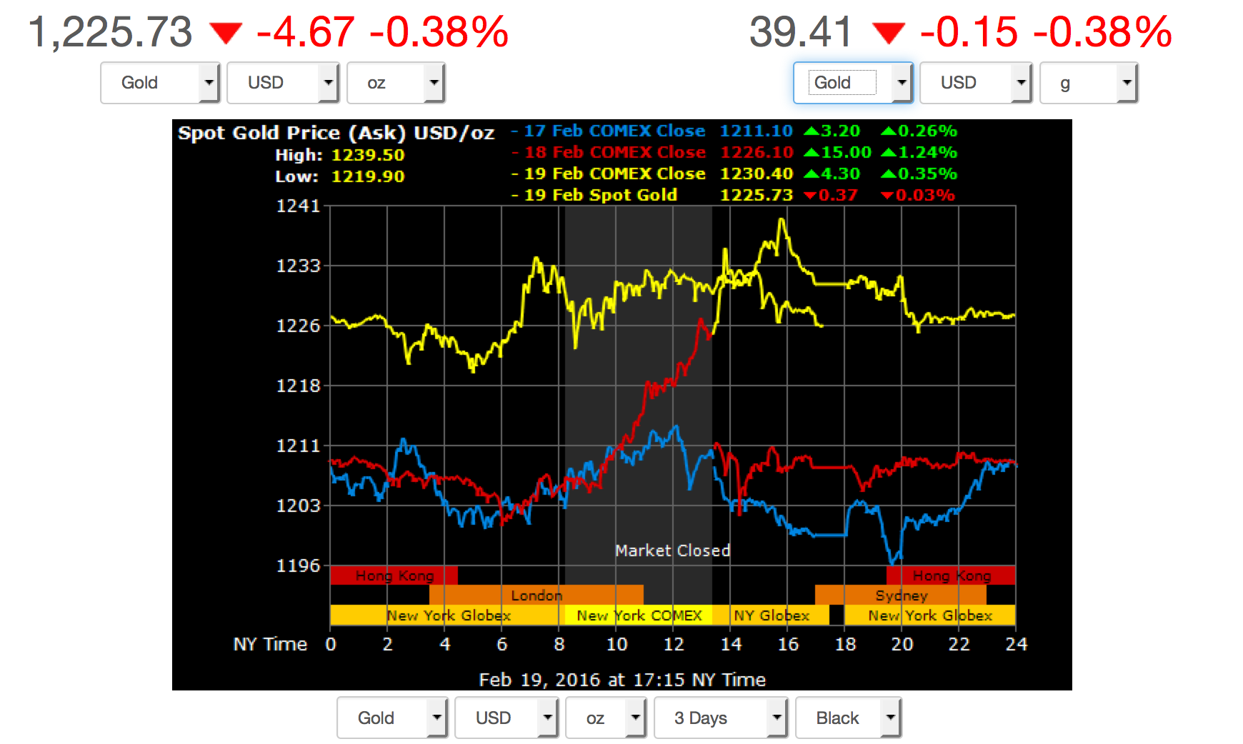
goldprice.org

Slide 27
Globex
An electronic trading platform, established by Reuters in 1992, used for derivative, futures, and commodity contracts.
Globex runs continuously, so it is not restricted by borders or time zones.

Slide 28
Comex
COMEX is the primary market for trading metals such as gold, silver, copper and aluminum.
Formerly known as the Commodity Exchange Inc., the COMEX merged with the New York Mercantile Exchange in 1994 and became the division responsible for metals trading.

Slide 29
Globex
The popularity of this platform has declined as exchanges such as the CBOT have moved towards different vehicles for matching and executing trades.

Slide 30
e-CBOT (CMEX, Chicago Mercantile Exchange)
An electronic trading platform that gives traders the ability to trade future contracts listed on the Chicago Board of Trade.
The CBOT has primarily been regarded as an open outcry market, but the incorporation of electronic trading platforms is changing the standard way in which futures trading is done.

Slide 31
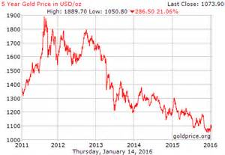
Gold price trends—5 yrs.

Slide 32
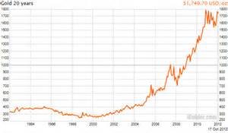
Gold price trends—20 yrs.

Slide 33
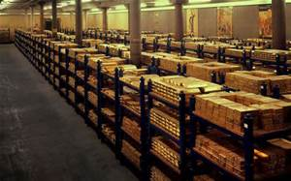
Fed Reserve Bank: “just in case”

Slide 34
1971: Nixon abandoned gold standard
Result was global economic instability
High inflation, high interest rates
Low economic growth
High unemployment
High public sector deficits
High energy costs

Slide 35
Bretton Woods: new international economic institutions
International Monetary Fund (IMF)
Administered the international monetary system
International Bank for Reconstruction and Development (now, World Bank)
Provided loans for Europe’s post-war reconstruction
Funded industrial projects in developing countries worldwide
General Agreement on Tariffs and Trade (GATT); changed 1995 to World Trade Organization (WTO)
Created and enforced multilateral trade agreements

Slide 36
Neoliberal vs. Keynesian Economics
Neoliberalism is based on idea of British philosophers Adam Smith (1723-90) and David Ricardo (1772-1823) that unregulated markets are most efficient, because of the principle of supply and demand
Keynesianism is based on idea of British economist John Maynard Keynes (1883-1946) that a healthy economy requires regulation

Slide 37
Neoliberalism
Advocates elimination of all barriers to trade and capital flows between nations
Includes idea of British sociologist Herbert Spencer (1820-1903) that free market economies naturally survive because they are the fittest
Economic Darwinism

Slide 38
1980s
Political conservatives British Prime Minister Margaret Thatcher and US President Ronald Reagan led the neoliberal revolution against Keynes-based regulation of the economy

Slide 39
1980s
The concept of globalization became linked to the deregulation of economies around the world

Slide 40
1980s
The collapse of communism in USSR and Eastern Europe 1989-1991 seemed to be a victory for the new neoliberal economic order

Slide 41
21st c. Global Economic Order
The contemporary Global Economic Order is the neoliberal economic order working in competition with restriction on trade and flows of capital motivated by national, regional, or justice concerns

Slide 42
Global Economic Order
Deregulated Neoliberal economic order
Regulation based on National, Regional, & Justice concerns

Slide 43
Economic globalization since 1989
1. Greater internationalization of trade and finance
2. Increasing power of transnational corporations TNCs and large investment banks
3. Enhanced role of international economic institutions (seems to contradict neoliberal free market ideology)
International Monetary Fund (IMF)
World Bank
World Trade Organization (WTO)

Slide 44
1. Internationalization of trade and finance
Proponents of FREE TRADE:
Seek to eliminate trade barriers worldwide.
Goals are to:
Enhance consumer choice
Increase global wealth and productivity
Achieve global security and peace
Encourage spread of new technologies
Some of the goals of FREE TRADE are being met, but at what price?

Slide 45
Downside of ‘Free Trade’
Gap between rich and poor citizens in a country is widening.
Gap between rich and poor countries is widening.
Global labor standards are deteriorating.
Severe ecological degradation is occurring.
The global South is increasingly in debt to the North.

Slide 46
Liberalization of financial markets
Deregulation of trade goes hand in hand with deregulation of financial markets.
Interest rates are allowed to fluctuate.
Credit controls are removed.
Government-owned banks are privatized.
Mobility among different segments of financial services is increased.
Investment opportunities increase.

Slide 47
Deregulation & infrastructure
Deregulation (liberalization) of financial markets required new hardware infrastructure to support ‘virtual’ internet technologies that linked the globe
“Nervous system” of internet-based technologies
Fiber-optic cable
Satellite systems

Slide 48
Financial Markets in Cyberspace
London, New York, India, and Tokyo Stock Exchanges became linked in early 2000s
In April, 2007, NYSE merged with Euronext NV, representing Brussels, Paris, Amsterdam, and Lisbon Stock Exchanges
Almost instantaneous sales and purchases of stocks are now a reality worldwide

Slide 49
Problems in Global Financial Markets
A large part of new global financial exchange has nothing to do with real production.
Investing in machinery or workers to produce saleable items

Slide 50
Problems in Global Financial Markets
Most of the financial growth has occurred in money-dealing markets that trade claims (“bets”) on future commodity prices or currency exchange rates.
Hedge funds

Slide 51
Problems in Global Financial Markets
Global speculators have exploited weak banking regulations to make huge profits that have nothing to do with real production

Slide 52
The result: financial instability and social upheaval
World’s financial systems are volatile, overly competitive, insecure
Artificial boom-and-bust cycles have endangered the social welfare of whole regions of the globe
South-East Asia 1997-98
Argentina 1999-2002
Global Financial Crisis (GFC) 2008-09 “Lehman Shock”
Greece, Spain 2011-12

Slide 53
Question 2
i-clickers ON

Slide 54
Question 2
In Steger’s analysis, what does he identify as the main causes of the Global Financial Crisis?
Criminal corporate theft and greed
Neoliberal deregulation and investor complacency
Irresponsible homeowners who took out large mortgage loans
None of the above

Slide 55
Global Financial Crisis (2008)
Steger blames: Neoliberal deregulation of banks
led to “financial services conglomerates” that dealt in bad assets

Slide 56
Global Financial Crisis (2008)
Steger blames: Investors
for failing to understand the complexity of assets they were buying
for relying on the excellent reputation of financial services conglomerates such as Bank of America or Citicorp
for trusting positive credit ratings issued by Standard & Poor or Moody

Slide 57
GFC fallout
Credit dried up
Businesses cut production, laid off workers
Stock markets fell dramatically

Slide 58
GFC costs (by 2009)
33% of the value of world’s companies was wiped out (14.3 trillion dollars)
million, billion, trillion are radically different orders of magnitude (p. 51)

Slide 59
GFC (2008) →GEC (ongoing)
GFC: Global Financial Crisis (or Lehman Shock)
GEC: Global Economic Crisis (or Great Recession)

Slide 60
Economic globalization since 1989
1. Greater internationalization of trade and finance
2. Increasing power of transnational corporations
3. Enhanced role of international economic institutions
International Monetary Fund (IMF)
World Bank
World Trade Organization (WTO)

Slide 61
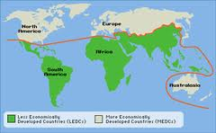
Global North-Global South

Slide 62

Global South-South Cooperation

Slide 63
Beijing Consensus?
Steger’s prediction: US dominated IMF/World Bank may give way to China dominated equivalent as the Chinese economy grows.
Asian Infrastructure Investment Bank, AIIB, international financial institution for Asia-Pacific development (US, Canada, Japan did not join)
Proposed by China 2013
Launched in Beijing 2014
Articles of Agreement went into effect Dec. 2015
Opened for business 16 Jan. 2016 (capital: $100 billion)

