Slide 1
Unemployment rate and High school graduation rate
Jiali Li
Qiang Cui

Slide 2
Background
In the U.S., the unemployment rate has a significant effect on American economy. So, we want to find out what might affect the unemployment rate, which could help to reduce the unemployment rate, and create a stable environment for the development of economy.

Slide 3
Hypothesis
We believe the unemployment rate may be related to the public high school graduation rate
Ho: The high school graduation rate not affect the unemployment rate
Ha: The high school graduation rate affects the unemployment rate.

Slide 4
Variables
Dependent Variable
-Unemployment rate (Y)
Independent Variable
-High school graduation rate (X)

Slide 5
Data Collect
Our analysis will cover 50 states of the U.S.
We collect the data of 1990 and 2015.
The unemployment rate by state will be collected from the Bureau of Labor Statistics.
The public high school graduation rate by state will be obtained from the National Center of Education Statistics.

Slide 6
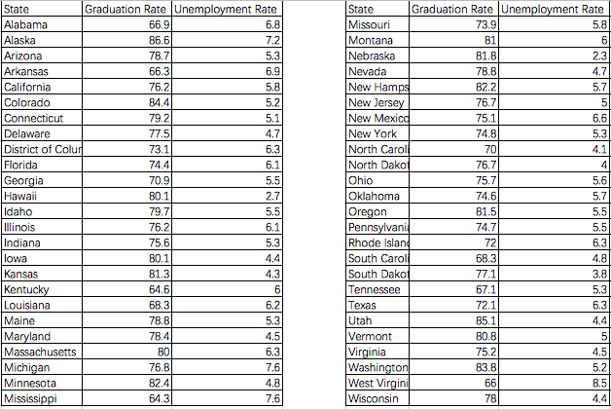
1990 data

Slide 7
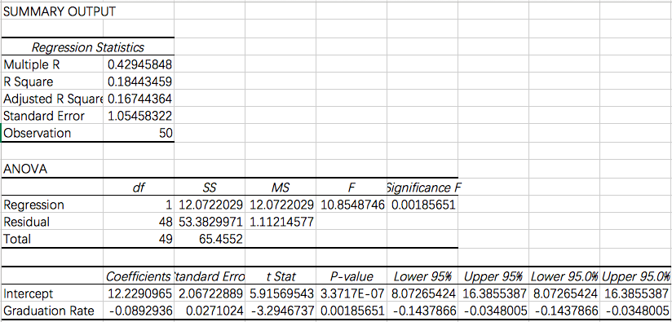
Regression

Slide 8
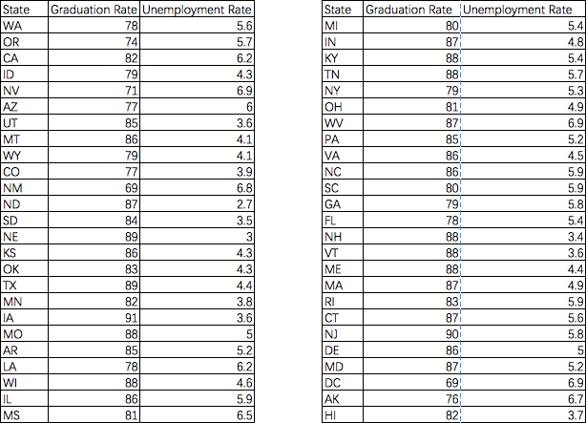
2015 Data

Slide 9
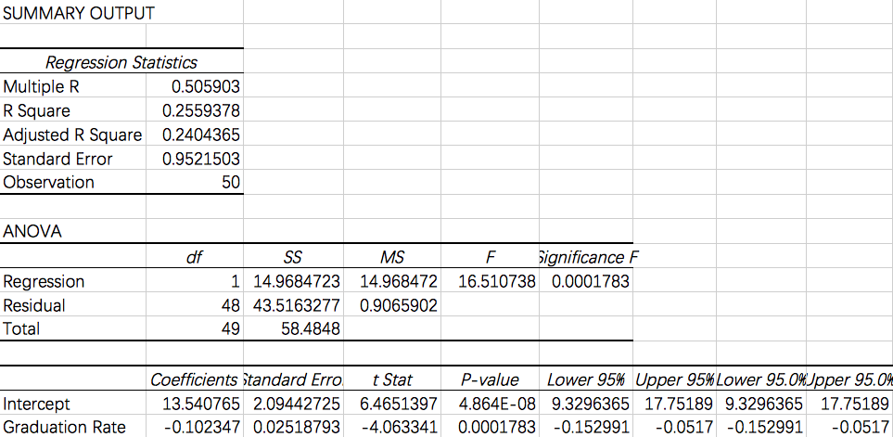
Regression

Slide 10
Analysis
Degree of Freedom: 50-1-1=48
Level of significance: Two sides 95%
T-critical: 2.011
T-cal in 1990: 3.295
T-cal in 2015: 4.063

Slide 11
Regression Equation
1990: Unemployment rate = 12.23 - 0.089(Graduation rate)
2015: Unemployment rate = 13.54 - 0.102 (Graduation rate)

Slide 12
Conclusion
From the data analysis of 1990 and 2015, we can see the high school rate is significant, and we can reject the null hypothesis.
Then, we get result is the public high school graduation rate can affect the unemployment rate, and the states with lower high school graduation rate have high unemployment rate.

Slide 13
Thank You.

