Slide 1
Chapter 4
Planning to conduct research

Slide 2
Learning Objectives
Describe different types of research participants and samples
Explain differences between laboratory and field research
Differentiate the varied research approaches
Describe benefits of animal research

Slide 3
Steps in the Research Process
Step 1: Choosing a research question
Step 2: Conducting a literature review
Step 3: Developing a hypothesis
Step 4: Designing the study
Step 5: Conducting the study
Step 6: Analyzing the data
Step 7: Reporting the results

Slide 4
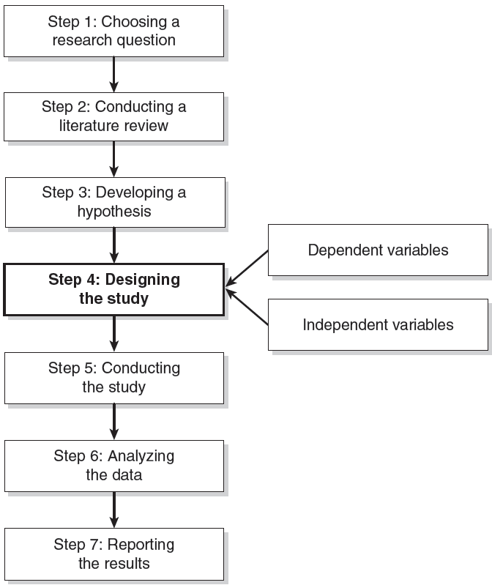

Slide 5
Designing the Study (Step 4): Important considerations
Feasibility/manageability
Operational definitions and constructs
Appropriate measurements
Sampling techniques

Slide 6
Designing the Study (Step 4): Operational Definitions and Measurement
Measuring complex constructs
Example: The Social Readjustment Rating Scale to measure stress
Items causing stress: Death of a spouse, change in work, Christmas, change in recreation

Slide 7
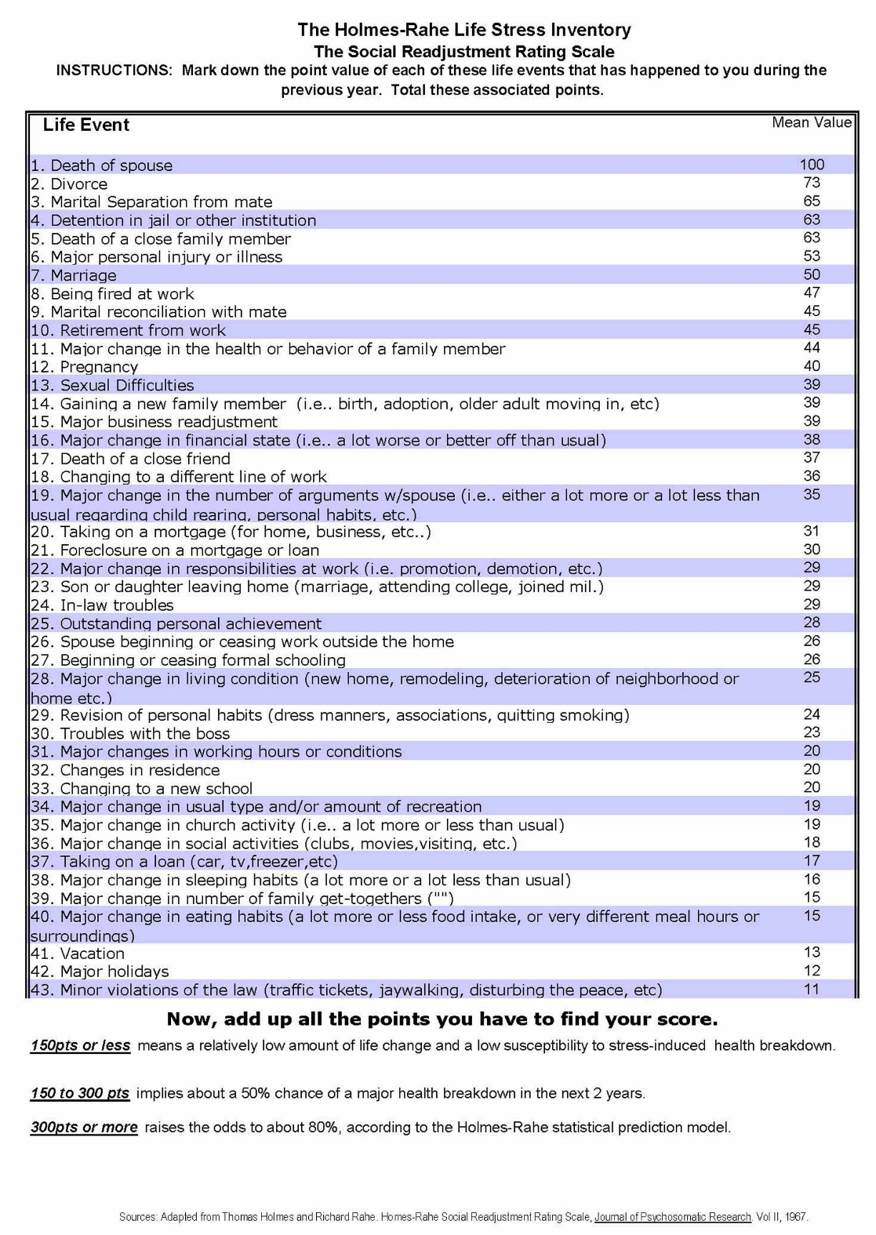

Slide 8
Designing the Study (Step 4): Operational Definitions and Measurement
Depression
Score on Beck Depression Inventory (BDI) as measurement of level of depression
After reading negative statements, participants are categorized as being in depressed state

Slide 9
Designing the Study (Step 4): Operational Definitions and Measurement
Validity Considerations
Populations and samples

Slide 10
Sampling
Sample
Population

Slide 11
Probability Samples: Determining your population
Simple Random
Cluster
Stratified Random
Every member of population has equal chance of selection.
Groups within population chosen at random
Proportion of individuals with a particular characteristic is equivalent in the population and sample.

Slide 12
Simple Random Sample
⓪①⓪⓪⓪①①⓪
①⓪①①①①⓪⓪⓪⓪
①①⓪⓪⓪①①⓪⓪①⓪⓪
①①①⓪⓪①①①⓪①①①
⓪①①①⓪⓪⓪①⓪⓪⓪⓪
①⓪⓪①①①⓪⓪①⓪①⓪
⓪①①⓪①⓪⓪⓪①⓪①⓪
⓪①⓪⓪①①①①⓪⓪
⓪⓪①①①⓪⓪①⓪⓪⓪⓪①⓪⓪⓪⓪①⓪⓪⓪⓪
Sample of 1000 students
chosen randomly from population
Population: all students at your university/college
5% chance of being chosen
20,000 students

Slide 13
Cluster Sample
⓪①⓪⓪⓪①①⓪
①⓪①①①①⓪⓪⓪⓪
①①⓪⓪⓪①①⓪⓪①⓪⓪
①①①⓪⓪①①①⓪①①①
⓪①①①⓪⓪⓪①⓪⓪⓪⓪
①⓪⓪①①①⓪⓪①⓪①⓪
⓪①①⓪①⓪⓪⓪①⓪①⓪
⓪①⓪⓪①①①①⓪⓪
Clusters chosen at random
1 cluster = 1 school
⓪⓪①①①⓪⓪①⓪⓪⓪⓪①⓪⓪⓪⓪①⓪⓪⓪⓪
Sample of students
chosen randomly from each cluster
Population: all university/college students
Each grouping represents a different university/college

Slide 14
Stratified Random Sample
Males
Females
Males
⓪⓪⓪①①①①①
⓪⓪⓪⓪①①①①①
⓪⓪⓪⓪⓪①①①①①①
⓪⓪⓪⓪⓪①①①①①①①
⓪⓪⓪⓪⓪①①①①①①①⓪⓪⓪⓪⓪①①①①①①①
⓪⓪⓪⓪⓪①①①①①①
⓪⓪⓪①①①①①
⓪⓪⓪⓪⓪⓪⓪⓪①①①①①①①①①①①①
Females
Sample of 20 students
chosen randomly from subsets
40% males, 60% females
Population: all students at your university/college
40% males, 60% females

Slide 15
Convenience Samples: Probability unknown
Haphazard/Volunteer
Quota
Sample of available individuals
Essentially a stratified convenience sample

Slide 16
Haphazard/Volunteer Samples
“I volunteer”
“I volunteer”
Sample
College students in psychology classes
representing population of college students

Slide 17
Recruiting Participants
Techniques
Threats to validity
Response bias
Participant Pools
Typically introduction to Psychology and other naïve students
Levels
Classroom level
Individual level
Internet sampling
Advantages?
www.qualtrics.com
www.surveymonkey.com

Slide 18
Common Pitfalls
Problem: Confusion of “volunteer” sample and consent—the use of the term volunteer sample can be inaccurately interpreted as a sample that consents to participate.
Problem: Devaluation of volunteer samples—students often believe that if a study uses a volunteer sample, it is flawed.

Slide 19
Learning Objectives: Revisited
Describe different types of research participants and samples
Explain differences between laboratory and field research
Differentiate the varied research approaches
Describe benefits of animal research

